Slide 1
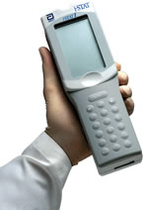
i-STAT 1 TESTING
NE GA Medical Center
July 2015

Slide 2
Overview of i-STAT 1
IR PORT
BATTERIES
LASER

Slide 3
Analyzer Components
Laser scanner
screen
Infrared screen
On top
“scan” key
keypad
Menu key
Enter key
“print” key
Cartridge goes
here
ON/OFF button

Slide 4
i-STAT 1 Test Menu

Slide 5
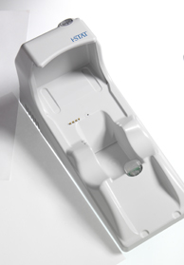
Downloader
Download results ASAP
Charges the battery
Downloads results to LIS and HIS
Screen states:
“Communication in Progress”

Slide 6
NEW SHIPMENT OF CARTRIDGES
When a new shipment of cartridges is received the temperature of the shipment card is recorded on the log sheet for new shipments.
An ORANGE “NOT QC’d” sticker is attached to each box in the new shipment.
Once the Liquid QC is ran on the new shipment, a GREEN “THIS LOT IS READY FOR USE” sticker is put on each box of QC’d Cartridges. The date and initial of staff doing the QC is put on the green label.
If the box does not have the GREEN label on it, the cartridges cannot be used for patient testing.

Slide 7
i-STAT 1 Quality Control
Internal Simulator – Is automatically activated when a new cartridge is inserted in to the instrument.. If it gives a “Electron ic Simulator Failed”, remove the cartridge and re-insert it immediately. If this fails, use another instrument. Run the External simulator. If the External Simulator fails, take the instrument out of use and notify POCC.
External Simulator – Re-sets the analyzer if dropped or for general trouble shooting (ex. Internal simulator fails).
Must be run every 28 days (will give you a notice when it’s due)
Liquid QC– Must be done every 30 days or with Lot # change or with each new shipment of supplies.
Testing CANNOT be done until this is complete.
Must be rotated amongst all staff that uses the i-STAT!
Notes:
Internal Simulator
Runs every 8 hours of patient testing
External Simulator
Run as needed
Liquid QC
Required once per month on every lot number on every analyte with 2 levels
CLIA required liquid QC once per month
Both requirements can be satisfied concurrently
Proficiency
Run under Administrative Menu and Quality Tests

Slide 8
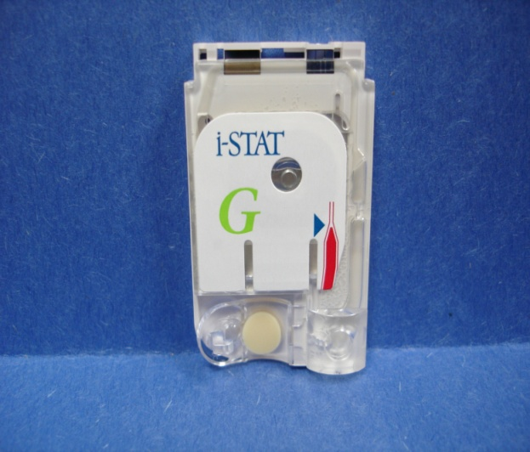
Troponin and Creatinine Cartridges
-This is what the current creatinine cartridge looks like.
-Once we receive the new shipment, the cartridge will look similar to the NEW troponin cartridge (blue).
-The New troponin cartridge will now have the snap cover and a “thumb well” to assist with holding the cartridge in place when applying sample. (old cartridges had a slide closure).
CALIBRANT
POUCH
FILL LINE
SNAP
COVER
SAMPLE WELL
Notes:
Operating Tips
Cartridge should be at room temperature
Open the cartridge pouch when ready to perform
Hold cartridge on the sides while it is flat on the table surface.
Do not touch the sensors or exert pressure on the calibrant pack
Fill the blood to the blue arrow
Close the edge of the snap cover until it snaps in place for CG4 and
Chem 8 or slide closure for cardiac cartridges

Slide 9
Cartridge-Storage
The main supply of cartridges are stored between 2-8 degrees centrigrade
Cartridges that will be used for patient testing must be at room temperature
- A single cartridge taken from a refrigerator will take 5 minutes to reach room temperature.
-An entire box of cartridges taken from a refrigerator will take 60 minutes to reach room temperature.
Cartridges brought to room temperature CANNOT be returned to the refrigerator
All cartridges brought to room temperature must be dated with the date and time taken out of the refrigerator and a 14 day expiration date.
The cartridge cannot be used past the 14 day expiration date or the printed manufacturer date. Which ever comes first.
If an entire box of cartridges is brought to room temperature, the 14 day expiration date will be written on the side of the box in the space provided.
The temperature of the refrigerator that stores the cartridges must be monitored and recorded on a daily basis using a certified thermometer.

Slide 10
i-STAT 1 Sample Requirements
ER Sample Types
Arterial, Venous
Troponin/Creatinine
Light green top tube (Li Heparin) -labeled with patient name, hospital visit number, date and time drawn.
Mix sample well after draw AND before dosing cartridge, waste 1-2 drops
Green top tube sample is good for 30 minutes post draw, the tube must be a full tube, labeled with the name, hospital visit number, date and time collected.
Syringe sample must be used immediately, mix well, waste 1-2 drops before dosing cartridge.
Notes:
CG4
pH, pCO2, pO2, Lactate
Test immediately
2 minute test
If heparinized syringe, mix 5 times 3 ways
Chem 8
Sodium, Potassium, Chloride, Ionized Calcium, BUN, Creatinine, Glucose, TCO2, Hematocrit
2 minute test
Mix tube 10x
Troponin
Troponin only
10 minute test
Mix tube 10x
Reference cutoff of ≥ 0.08 ng/mL
BNP
BNP only
Mix tube 10x
10 minute test

Slide 11
Unacceptable Samples
Unlabeled Specimen tube
Any evidence of clotting
Partially drawn vacutainer (light green top) tubes
Specimens collected in any other vacutainer tubes other than Li Heparin (light green tubes)
-The following circumstances can lead to erroneous results
Drawing a specimen above the I.V.
Inadequate flushing of indwelling catheters
Stasis (tourniquet left on longer than 1 minute before venipuncture
Hemolysis
Time delays before filling the cartridge
Air bubbles trapped in the sample chamber
Icing of the tube before filling cartridge
Extra muscle activity (fist pumping)

Slide 12
i-STAT 1 Testing
Choose “2” from Test Menu
Scan operator barcode
Scan patient’s barcode (hold the scan button down on the instrument until you have confirmed that the number on the tube or armband is the same as the number on the face of the meter. If the wrong number is entered the results will not cross the interface.
Check expiration date, scan cartridge barcode, mix specimen 7-8 times, discard 1-2 drops
Apply sample to cartridge before inserting into instrument.
After inserting cartridge into instrument, testing will begin (troponin takes 10 minutes, creatinine takes 2 minutes)
DO NOT MOVE THE INSTRUMENT AFTER CARTRIDGE IS INSERTED.
Do NOT remove cartridge during “Cartridge Locked” prompt
Notes:
Manual entry will require the operator to enter the information twice.

Slide 13
Results
Reference range for Creatinine 0.6-1.3 mg/dl. Reportable range is 0.2- 18.0 mg/dl. Results of 1.7 mg/dl or above will require Physician intervention and a comment code.
Results above 7.4 mg/dl on adults or above 3.8 mg/dl on children are considered critical for this method and must be confirmed by the main laboratory.
Creatinine testing must be done in the main laboratory on any patient taking medications containing hydroxyurea or using a topical solutions containing glycolic acid.
Reference range for Troponin <0.1 ng/mL is considered Negative- Repeat testing in 4-6 hours if clinically indicated. 0.10-1.49 ng/mL is suspicious for Myocardial injury. Serial measurements may be necessary to confirm or exclude the diagnosis of acute coronary syndrome. Results >1.50 ng/ml is considered consistent with Myocardial injury. Clinical and Laboratory correlation is recommended.
The reportable range for Troponin is 0.00-50.0 ng/mL. Any result above 50.0 ng/mL must be sent to the main laboratory for testing.
Critical results will require a comment code and will not let you bypass the comment code.
Enter comment code “7”- Doctor notified, notify doctor.

Slide 14
Unreportable Results
“***”
Sensor error
Repeat test on same sample with new cartridge
If repeat test does not result, send new sample to lab
“<“ or “>”
Result outside of instrument’s reportable range; send sample to laboratory
Quality Check Codes
Operator or instrument failure
Repeat test with same sample and new cartridge
If repeat test does not result, inform POC if Check Code error ( NOT operator related – over fill, under fill…etc)

Slide 15
Reasons you may see a cartridge failure
Insufficient sample
Overfilled Cartridge
Underfilled Cartridge
Failure to adequately mix specimen before testing
Specimen clotted
Air bubble trapped in the sample chamber
Pre-burst calibrant on the cartridge
Touching the sensors on the cartridge
Cartridge sample lid not closed

Slide 16
Tips
Should the i-STAT System become inoperable for any reason, or the result does not agree with the patient’s clinical condition, specimens should be collected and sent to the main laboratory.
Never share your operator ID. Remember your name is the only name associated with the result which becomes part of a legal document.
DO NOT move the instrument once the cartridge has been inserted.
DO NOT remove the cartridge from the analyzer until the instrument says “test options” at the very bottom on the screen.
Don’t forget-Clean instrument between each patient use with a hospital approved wipe.

Slide 17
Troubleshooting
Cathy Minish, POCC: 770-219-1520
MiHui Scales, POC: 770-219-1520
Abbott Technical Support: 1-877-529-7185

