Slide 1

Provider Performed Microscopy Procedure
(PPMP) Requirements
TPMG Roseville and Sacramento
2020

Slide 2

What is a Certificate of PPMP?
  Is a CLIA certificate for laboratory testing.
  Permits an organization to perform a limited list of moderate complexity tests, as well as any waived tests.
  PPMP procedures must be performed on a specimen obtained during the patient’s visit. Specimens deteriorate quickly, are not easily transportable.
  Testing must be performed by a physician, a mid-level practitioner, or a dentist.
  The instrument for PPMP is a microscope, limited to bright-field or phase-contrast microscopy.
  No survey is required but may be conducted and compliance with CLIA regulations is required.

Slide 3
PPMP Structure
PPM Certified Sites
Patient Visit
Specimen collected
Microsocpic test performed
Must meet CLIA Quality Standards

Slide 4

NVLY CLIA Directors
Dr. Robert Azevedo
Morse Ave MOB
Dr. Mark Ho
DAV MOB
Dr. Nguyen Quang
RCO MOB
Dr. Paul
Reynolds
FAO MOB
Dr. Eduardo Bermudez
DOCO MOB
PTW MOB
Dr. Sarah Fergerson
FOL MOB
Dr. Richard Florio
SG MOB
Dr. Terry Raposa
LNC MOB
Eureka MOB1
Eureka MOB2
RRV MOB

Slide 5
Who Can Perform PPMP
Physicians
MD
DO
Midlevel Practitioners
Nurse Practitioners
Nurse Midwife
Dentists
DDM
DDS
DPM
Physician Assistant

Slide 6
Physician Orders for Lab Testing
HCP
Lab-based testing
POCT
HCP
PPMP
HCP

Slide 7
PPMP Testing List
Direct wet prep for bacteria, fungi, parasites, or cellular elements
KOH preps
Pinworm examinations
Fern tests
Post-coital direct exam of vaginal or cervical mucous
Urine sediment examination
Fecal leukocyte examination
Qualitative semen analysis - presence/absence of sperm and motility
Nasal smears for granulocytes
May also perform any waived testing
All other testing MUST be performed by the lab…

Slide 8
Patient Identification, Specimen Collection, Handling, & Testing
Collection
Handling
Requires limited specimen handling or processing.
Testing
Primary instrument is a microscope, limited to bright field or phase-contrast microscopy.
Specimens are liable. A delay in testing could compromise the accuracy of the test result.
Improperly collected specimens should not be tested.
Document results as a permanent record.
Perform two levels of controls.
Patient identification must be done using two patient identifiers.
Follow testing steps per procedure.
Dispose of slide in sharps container.

Slide 9

Quality Requirements
Quality Control
  Two levels of controls are performed:
      Each day of testing
      Each new shipment of reagents (KOH, saline) or stains
      A change in lot numbers
      Each new operator
  Use photomicrograph as POS control and saline as NEG control
  Record QC on PPMP Quality Control Log
Maintenance
  Weekly cleaning of microscope is documented on Microscope Maintenance Log
  6 month preventive maintenance (performed via contracted vendor)
Proficiency Testing
  Need to verify accuracy of testing at least twice per year
  Participation in University of Washington MTS Program will satisfy the alternative performance assessment

Slide 10
PPMP Documents in PolicyTech
  PPMP Training Checklist
  PPMP Competency Assessment
  PPMP Quality Control Log
  PPMP Microscope Maintenance Log
  PPMP Quality Assurance Policy
  Fern Testing: Provider Performed Microscopy Point of Care Testing
  Wet Mount: Provider Performed Microscopy Point of Care Testing
  KOH Preparation: Provider Performed Microscopy Point of Care Testing

Slide 11

Training
PPMP testing personnel should have knowledge of:
Microscope use & maintenance
Quality control
Accurate performance of tests
Good laboratory practices
Safety practices
Documentation:
Procedure “read & sign”
PPMP Training Checklist
Initial competency assessment

Slide 12
Competency Assessment
Demonstration of skills, knowledge and ability to perform test correctly
Assessment of all 6 elements are required initially, at 6-months, and annually thereafter
Initial
Follows training
6 Months
6 months from initial assessment
Annual
Assessed annually thereafter
Before patient testing begins
Reassessed when problems are identified with performance

Slide 13
6 Elements of Competency Assessment
Direct observation of specimen collection and routine patient test performance
Monitoring the recording and reporting of test results in a timely manner
Review of QC performance
Direct observations of microscope maintenance performance
Test performance assessment – blind sample testing or participation in MTS on-line
Problem solving skill assessment

Slide 14
PPMP Inspections
Not subject to routine biennial inspections.
CLIA certificate is required and testing site must meet the CLIA quality standards.
Onsite inspections by CMS could be announced or unannounced.

Slide 15

CMS Inspections
1. If complaint is made.
2. To determine if the site is performing tests not permitted with a certificate for PPM.
3. If there is a harm to a patient due to inaccurate testing.
4. To collect information about PPM procedures.

Slide 16
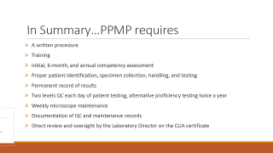
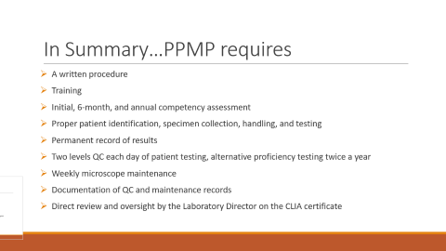
In Summary…PPMP requires
A written procedure
Training
Initial, 6-month, and annual competency assessment
Proper patient identification, specimen collection, handling, and testing
Permanent record of results
Two levels QC each day of patient testing, alternative proficiency testing twice a year
Weekly microscope maintenance
Documentation of QC and maintenance records
Direct review and oversight by the Laboratory Director on the CLIA certificate

