Slide 1
Variance – VOICE – System Changes
End User and Reviewer Instructions
SOP and Form Changes
Complete Post Test
September, 2015

Slide 2
Tips for this Training Session
Look for the Key
It means something is important
It may be a key factor that:
Has changed
Is new
Or is being highlighted as a reminder
"VOICE" is an acronym for Variance/Occurrence – Identification, Classification, and Evaluation

Slide 3
Associated SOPs/Forms
VOICE Reporting Process
VOICE Downtime Form
Variance Management Program
Process Improvement
Process Improvement Process Form
Quality Assessments Reporting
External Assessments Site Visits
Quality Indicators
Proficiency Testing (External)
Evaluation of Effectiveness
Evaluation of Effectiveness Template

Slide 4
Not a Minor Change
8 guiding documents revised
2 forms revised
Voice Downtime Form
Process Improvement Project Form
3 forms archived and now documented in VOICE system
Action Plan Development Guide
Quality Indicator Data Report
Proficiency Testing Investigation Form
1 new process
Evaluation of Effectiveness
1 new form
Evaluation of Effectiveness Template

Slide 5
What to enter into the VOICE System
Anything that varies from standard operating procedure.
Anything that interferes with job performance.
When other services did not follow established policy and affected the laboratory's ability to meet its customer's expectations.
All occasions of verbal and written customer complaints.
Intra-laboratory and inter-laboratory communication failures.
Problems with technical operations.
Supplier and Delivery related issues.

Slide 6
New Items to Enter into the VOICE system
Equipment Issues or Missed PMs
Proficiency Testing Investigations
Quality Indicator Outlier Data
Internal and External Audit findings
Internal Assessment findings

Slide 7
Product Notifications and Recalls
For all notifications, the Laboratory must review the notification and perform an impact assessment of the notification.
Documentation of the notification and its impact will be documented in the VOICE reporting system.
Notifications from vendors may take the form of product recalls, market withdrawals, or software patches and upgrades.
Notifications that have a negative impact on patient safety or care will also be reported in the EERS system for review by Risk Management.

Slide 8
Submitting a Variance or VOICE
All clinical pathology personnel can enter and submit a VOICE

Slide 9
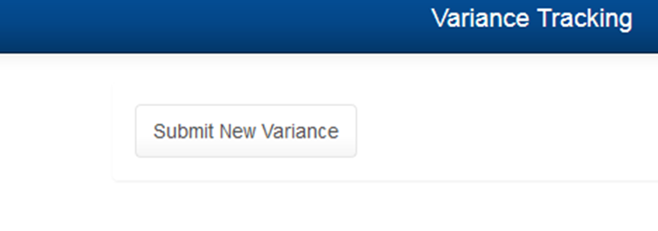
Submitting A Variance
Link located on SharePoint Site and Clinpathlink
Select VOICE
Select Submit New Variance

Slide 10
Submitting A Variance
User Name is displayed at the top
All areas with * must be completed
Enter information indicated
Occurrence – place, date, time variance most likely occurred
Discovery – place, date, time variance identified

Slide 11
Submitting A Variance
Select Variance Category.
Where in the process the error or event occurred?
Select a subcategory if applicable or enter information

Slide 12
Submitting A Variance
Select Variance Type
How was this discovered?
Enter information as indicated on the form
Proficiency Testing investigations are entered at the analyte level under the Category Testing (examination).
For example: CHEM CAP survey had incorrect potassium result and incorrect bilirubin result. Enter 2 VOICE reports and perform the investigation within 30 days of receipt of the proficiency testing survey results.

Slide 13
Submitting A Variance
Enter a clear description of the error or event
Enter immediate actions taken after discovery of the event
Enter Variance within 3 days of discovery

Slide 14
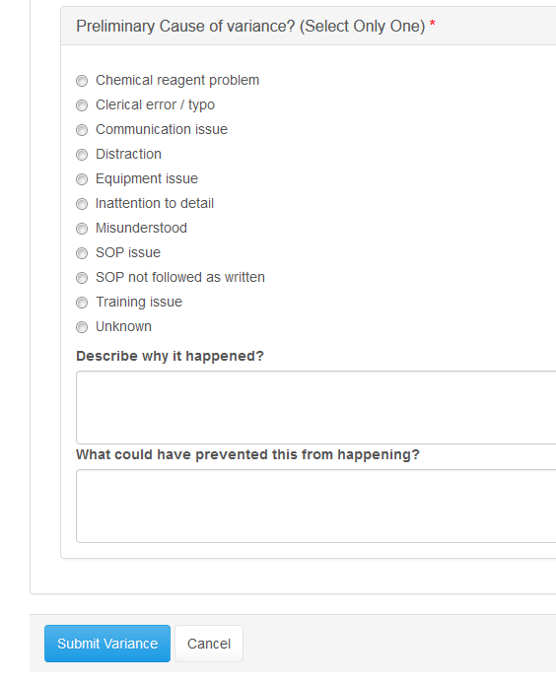
Submitting A Variance
Select a Preliminary Cause to assist the section leadership in correction of the process
Select Submit Variance when complete

Slide 15
Submitting A Variance
After you click Submit New Variance, it is routed automatically to the manager or supervisor for follow up.
Record the variance number on any supporting documentation
Variance number will be displayed in the green bar
Forward supporting documentation to section manager

Slide 16
Variance Review
Users with “Reviewer” security can access and enter follow up on a VOICE
Reviewers include managers, supervisors, and directors

Slide 17
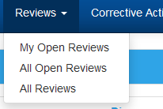
Variance Reviews
Select Review Tab
Select My Open Reviews
You can sort by clicking on any blue column header

Slide 18
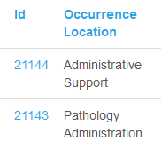
Variance Reviews
Click on Variance ID to open a variance
To Check Out Variance – click here

Slide 19
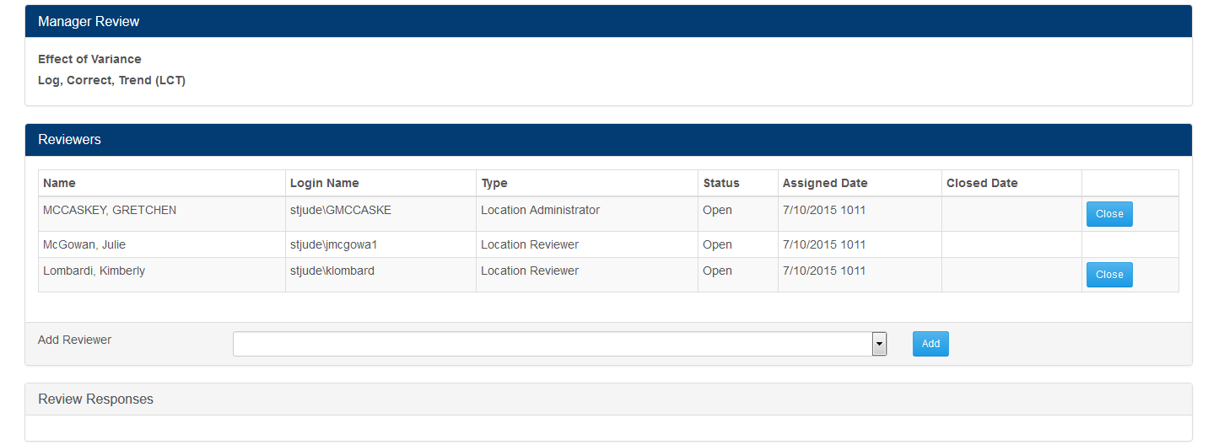
Variance Reviews
Scroll down to the dark blue Manager review bar

Slide 20
Variance Reviews
Under Manager Review select Effect of Variance from the dropdown list
(This function in the old system was performed by Quality. Now it is a manager/reviewer responsibility .)
Enter associated Lucidoc SOP or document number.

Slide 21
Variance Reviews
Is this variance a Log, Correct, Trend or does it require investigation?
If it’s an LCT – Select Yes
Save and Close. No further action required
If it’s not an LCT – Select No
Select a Variance Root Cause from the dropdown list.

Slide 22
Variance Reviews
Reviewers will be displayed as indicated below based on variance location(s) selected.
To add a reviewer, click on the drop down list, select name, and click Add.

Slide 23
Variance Reviews
Under Review Responses enter follow-up under My Comment
Attach file - Select browse and locate file to be attached

Slide 24
Variance Reviews
Comments for Evaluation of the VOICE report should contain the following information as applicable:
Who is responsible to evaluate the nonconformity
Was the immediate action sufficient or are more actions required
Do examinations need to be halted until further review is performed
What was the medical significance of the nonconforming event – did it affect patient care
Do the results of any nonconforming event need to be recalled or appropriately identified as necessary
If activities are halted, who determines activities can be resumed and the name and title of who made the determination
Include rationale for all decisions made

Slide 25
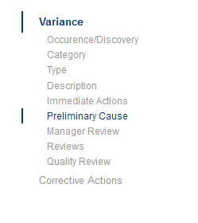
Variance Reviews
At this point add a Corrective Action Request (if known) or Save the Variance
If the reviewer is finished, using the side bar on the right, select Variance. This takes you to the top of the page for Saving the variance.

Slide 26
Variance Reviews
Save & Close Variance will save added information and complete the review process and the VOICE will be removed from the managers "open" reviews.
Save Variance without Closing will save information that was added, but the VOICE will remain in the managers "open" reviews.
Check in Variance will not save anything entered, and the VOICE will remain in the managers "open" reviews.

Slide 27
Quality Review

Slide 28
Variance Reviews
Quality Manager / Specialist will review all variances.
When the description of error/event is not clear, additional information may be needed for clarification.
When it does not appear the root cause has been determined, additional questions may be asked and the variance reassigned to the reviewer a second time.
Once the variance is complete, Quality will close it.
Quality can see in a glance who has not performed their reviews. Reviewers will be notified of pending variances to investigate/review.

Slide 29
Variance Reviews
Quality will select the phase of the laboratory operations where the event occurred.
Quality will select the risk level, when feasible.
Quality may request a manager to select the risk level, when it is not clear in the report.
When, after investigation, the manager states this is not a variance, Quality will mark the variance Not a Variance and it will not be counted.

Slide 30
Corrective Action
Reviewers will enter corrective action in the system to document and track

Slide 31
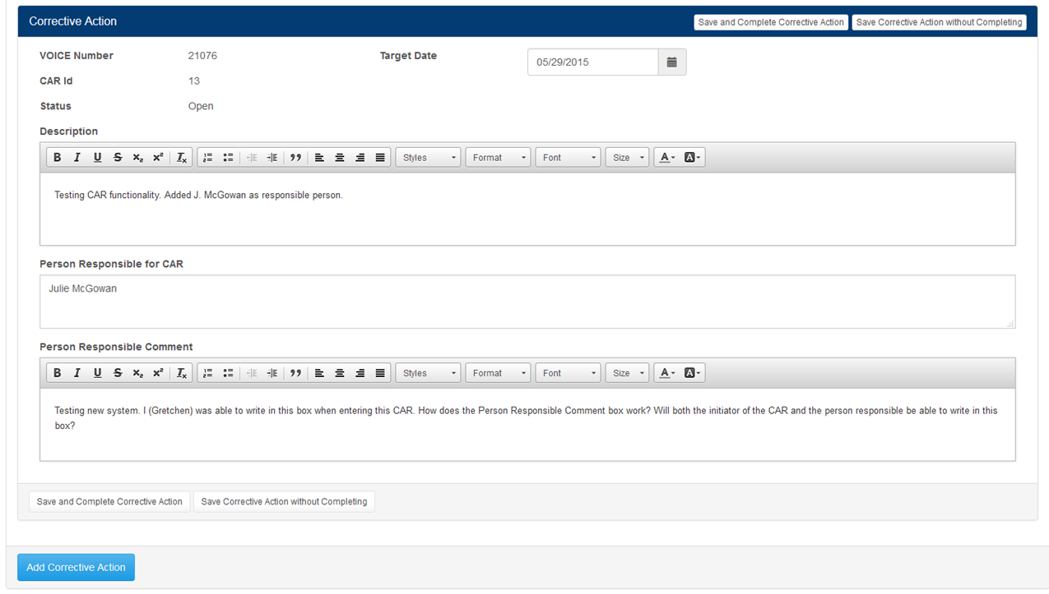
Corrective Action Requests
To make an entry, open the associated Variance
Go to the Corrective Action section and enter information

Slide 32
Corrective Action
Managers are responsible for all Corrective action items – even though it may be assigned to another individual for completion.
Select a target completion date.
Enter as much detail as possible.
Save Corrective Action without Completing – allows the CA to remain open until it is finished.
Save and Complete Corrective Action – will forward to
Quality as closed and completed.

Slide 33
Corrective Action
Variances can have multiple Corrective Actions items.
Variances may not need Corrective Action items.
Depends on the severity of the Variance and the potential consequences of the error/event.

Slide 34
Questions????
Test Time!

