Slide 1
ISO 15189 Corrective Action
Document Review and Training

Slide 2
Agenda
Root Cause Analysis (RCA) process
ISO 4.3 Document Control Standard
Non-conformance 4.3/5.5.3 Document Control
Corrective Action Plan
Test understanding of document revisions

Slide 3
RCA Process
Step 1:
Define the Problem
Assemble the team
Interview the individuals who have insight into the problem
Review the data
Develop the problem definition

Slide 4
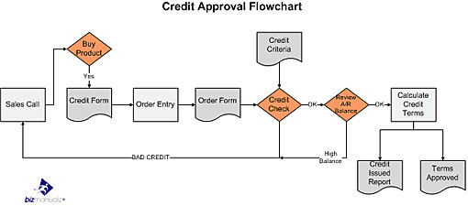
RCA Process
Step 2:
Map Current Process
Interview individuals doing the work
Review lab documents
Create and/or expand flowcharts

Slide 5
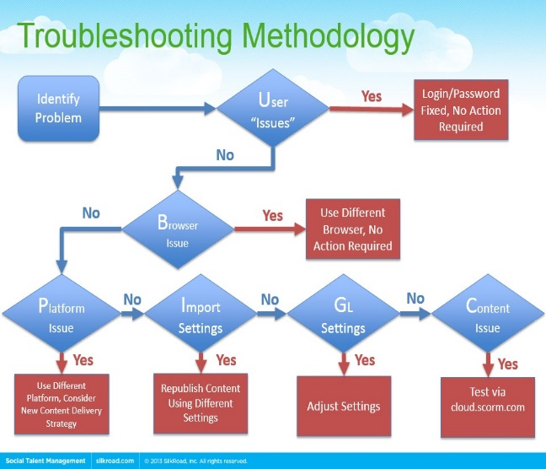
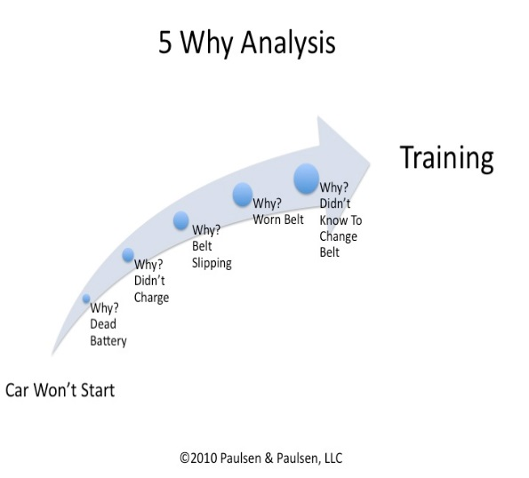
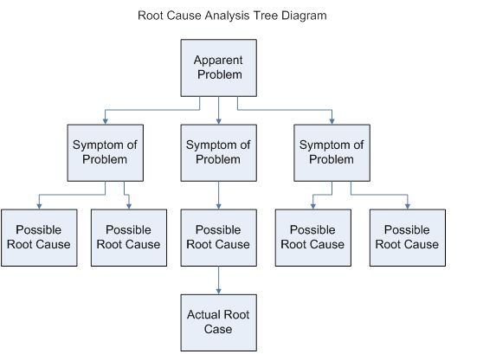
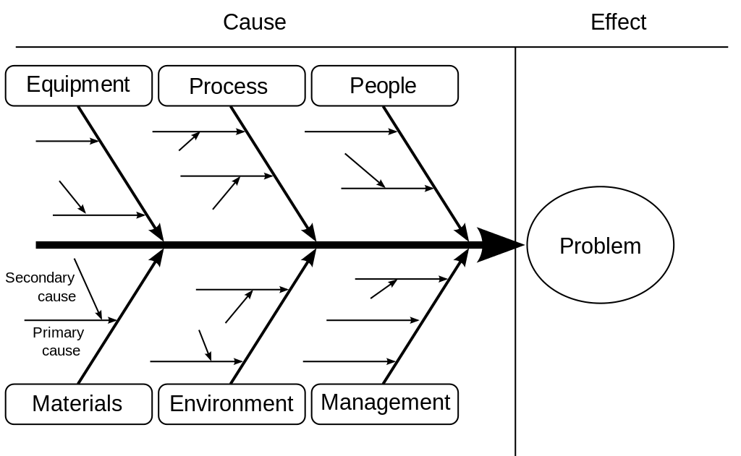
RCA Process
Step 3:
Find Root Cause
Choose appropriate tool to use
Flowcharting
Five whys
Fault tree
Fish Bone Diagram

Slide 6
RCA Process
Step 4:
Develop Corrective Actions
Consider solution types:
Weak – Provide training, warnings, and/or additional checks or reviews
Intermediate – Provide information at point of need (derivative documents)
Strong – Make physical changes to environment or redesign the process

Slide 7
RCA Process
Step 5:
Implement Corrective Action
Identify possible sources of resistance/roadblock
Develop a “Change Management” approach
Develop a plan and schedule for implementation
Implement the actions

Slide 8
Example of Change Mgmt Approach

Slide 9
Example 2: Project Timeline

Slide 10
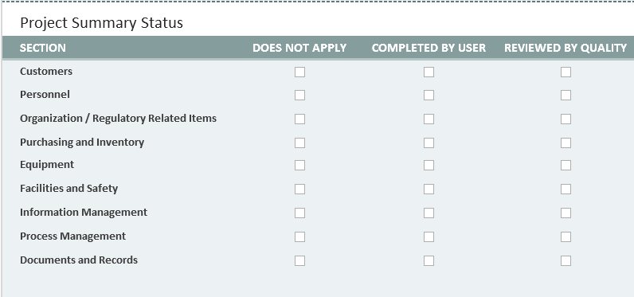
Our Change Mgmt Site (SharePoint)

Slide 11
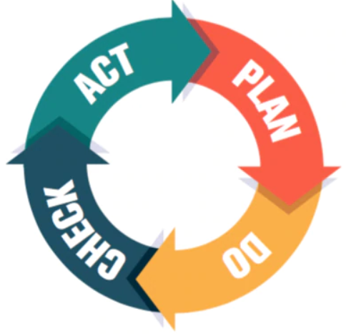
RCA Process
Step 6:
Assess Effectiveness
Choose an Assessment Approach
Monitor established metric (e.g. Quality Indicator)
Perform a focused internal assessment or audit
Set up a simulation/experiment (e.g. mock events)
Make changes if needed after evaluation.

Slide 12
Standards cited for nonconformance
4.3 Document Control
The laboratory shall control documents required by the quality management system and shall ensure that unintended use of any obsolete document is prevented.
4.3.d Only current, authorized editions of applicable documents are available at points of use.
4.3.i Obsolete controlled documents are dated and marked as obsolete.
4.3.h At least one copy of an obsolete controlled document is retained for a specified time period or in accordance with applicable specified requirements.
5.5.3 Any condensed document format must correspond to the documented procedure

Slide 13
Our Response: Performed RCA
Assembled a Team
Defined the Problem
Mapped the Current Process
Determined the Root Cause
Developed Corrective Actions
Implemented Actions
Will Assess Effectiveness

Slide 14
Assembled a Team
Team Members:
Person/Role | Contribution
Julie McGowan, Quality Program Manager | Experience with root cause analysis
Eddie Hutchison, Quality & Compliance Coordinator | Experience with root cause analysis and risk assessment
Gretchen McCaskey, Quality & Compliance Specialist | Experience with root cause analysis
Cindy Stewart, Quality & Compliance Specialist | Experience with root cause analysis
Raven Holcomb, Manager | Stakeholder
Nikki Koehler, AP Specialist I | Bench staff
Christy Embrey, Manager | Stakeholder
Sabina Sniezek, HLA Technologist | Bench Staff
Susan Starnes, Med Tech III | Bench Staff – Derivative Document Oversight Core Lab
Victoria Henderson, Supervisor | Stakeholder
Crystal Melloh, Manager | Stakeholder
Geneva Martin, Compliance Manager | Experience with root cause analysis
Richard Warren, Administrative Director | Authority for Authorizing Changes
Randall Hayden, MD | Approver of Changes
Brent Orr, MD, PhD | Approver of Changes

Slide 15
Defined the Problem
Incorrect or incomplete information is available to bench techs leading to the risk for performing incorrect actions/procedures in the laboratory.

Slide 16
Mapped Current Process

Slide 17
Determined the Root Cause
Summary: The Document Management policy and the Vendor Selection, Equipment Acquisition, and Inventory Management policy are incomplete, unclear and ambiguous regarding management of derivative documents.
The Document Management Policy outlines the process to control documents outside of Lucidoc, including derivative documents; however, there is no process for tracking these documents and their locations so that when the source document is updated, the posted documents are also updated.
Lack of clear instructions to section managers outlining the requirements for the annual review of derivative documents.
Lack of a clear requirement to have a Master List of Derivative Documents or indicator to remind managers to update the posted version when a revision occurs.
The Document Management Policy does not instruct authors to give source documentation to collaborators to ensure required changes have been made to the revised document.
Vendor Selection, Equipment Acquisition, and Inventory Management Policy does not address the management of Technical Bulletins.

Slide 18
Developed Corrective Actions
Document Management Policy was revised to address the missing requirements and clarify the process for handling derivative documents to include a Derivative Document and Form Location List, and to ensure that associated derivative documents are updated when the source document changes.
Creating and Managing Documents in Lucidoc was revised to address the Reviewer’s Impact Assessment and that the document owner must provide the source or reference document for the change – so that the reviewer can provide accurate feedback to the author.
A new policy Handling Communication from Vendors and Suppliers was developed to include all communication types received from vendors and suppliers and how to evaluate the impact on laboratory operations.

Slide 19
Implement Corrective Actions & Evaluate Effectiveness
Procedures were revised
Training required

Slide 20
Knowledge Check
Updated the following documents
Document Management
Creating and Managing Documents in Lucidoc
Derivative Documents/Forms Location List
Handling Communication from Vendors and Suppliers
Vendor Selection, Equipment Acquisition and Inventory Management
Open each document in Lucidoc and click on info
See changes in red/green. Red is deletions/Green is additions
Use above documents and the PowerPoint as a reference for the test
Must make at least 80% to pass
Test Time

