Slide 1
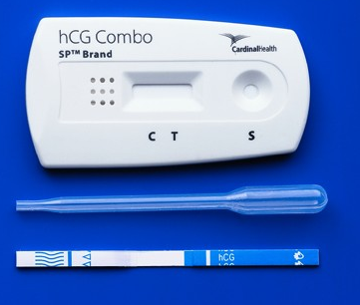
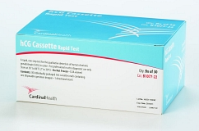
hCG Combo Rapid Test
Serum Pregnancy Training

Slide 2
Specimen Storage
Serum specimen may be stored at 2°- 8°C for up to 48 hours prior to testing. For prolonged storage, specimens may be frozen and stored below -20°C. Frozen specimens should be thawed and mixed before testing. Allow stored specimens to reach room temperature prior to testing. Do not refreeze.

Slide 3
Reagents/Equipment
hCG Combo Rapid Test Cassettes including provided Disposable Specimen Droppers (Cardinal Health CAT# B1077-23)
Package Insert (One per Kit)
Phlebotomy Supplies
Timer
Liquid Controls (StanBio CAT# 1235-305)

Slide 4
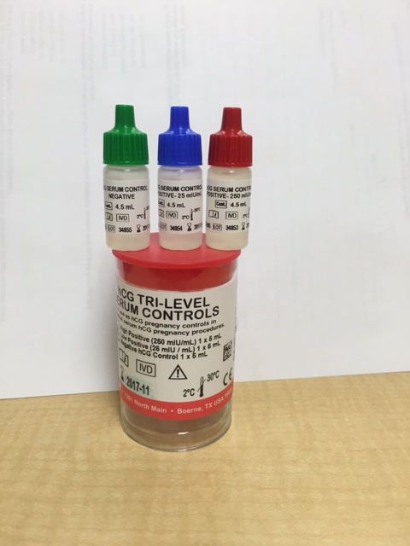
Reagent Storage and Handling
hCG Combo Rapid Test Cassettes
Store as packaged in the sealed pouch at 2°- 30°C.
Do not freeze.
Do not use after the expiration date.
Test cassette should remain in sealed pouch until use.
The test cassette should be discarded in a proper biohazard container after testing.
The test cassette should not be reused.
Discard test cassette if package is torn, ripped or if cassette itself is damaged.
Quality Control – StanBio hCG Serum Controls
Serum hCG Negative Control: Contains human serum, negative for hCG with preservative.
Serum hCG Low Positive Control: Contains human serum with approximately 25 mIU/mL hCG with preservative.
Controls are received ready to use.
Controls are stable until the expiration date on bottle when stored at 2°- 8°C (refrigerated).
Once opened, controls are stable for 90 days at 2-30˚ C, refrigerated or room temperature.
Indicate date opened and new expiration date on the bottles.

Slide 5
Quality Control
Internal Quality Control
  Internal procedural controls are included in the test. A red line appearing in the control region (C) is the internal procedural control. It confirms sufficient specimen volume and correct procedural technique. A clear background is an internal negative background control. If the test is working properly, the background in the result area should be white to light pink and not interfere with the ability to read the test result.
External Quality Control
  External Controls are performed under the following circumstances:
  With each new lot number
  With each new shipment of product
  With each new operator
  Monthly (if none of the above apply)
Each testing location must have a completed Individualized Quality Control Plan (IQCP) in place to support the Quality Control schedule above. If no IQCP is in place, two levels of external control must be run each day of patient testing.

Slide 6
New Reagent Lot Confirmation of Acceptability
The purpose of this check is to confirm that the use of new reagent lots do not affect patient results. One of the following suitable reference materials should be used:
Positive and negative patient samples tested on a previous lot
Previously tested proficiency testing materials
External QC materials tested on the previous lot
Record results on appropriate Log.

Slide 7
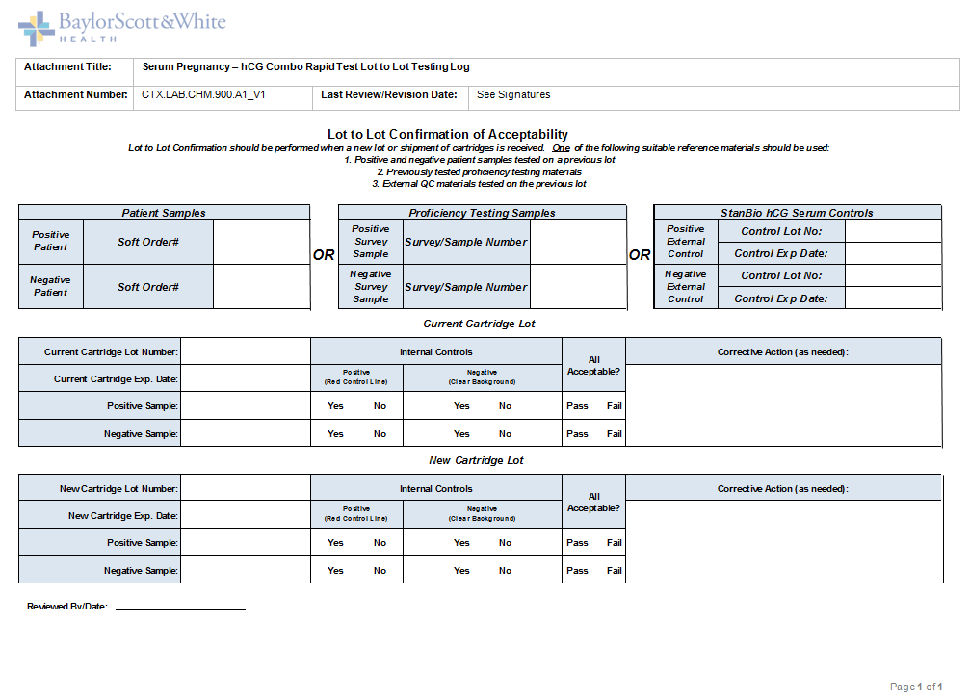

Slide 8
External QC Testing Procedure
Locate liquid controls. Allow to come to room temperature if stored in refrigerator.
Remove test cassette from the foil pouch and place on a level surface. Allow to come to room temperature if stored in refrigerator.
Label test cassette with appropriate QC level.
Hold the dropper vertically and transfer 3 full drops of QC material (approximately 100μl) to the sample well of the test cassette. Avoid trapping air bubbles in the sample well.
Do not mix caps from different vials.
Ensure QC has absorbed into specimen well and migration has begun before setting timer.
Read the result at 5-6 minutes.
Do not interpret results after the appropriate read time.
It is important that the background is clear before the results are read.
Record QC results on appropriate Quality Control Log.
Locate next level and repeat steps 1-8.
Note: If control results are not acceptable, repeat the control before proceeding with patient samples. DO NOT perform patient samples if controls are not acceptable.
Troubleshooting Failed Quality Control
Repeat testing with same QC bottle and new test cassette. If still out-of-range, repeat with new bottle of QC.
Document all corrective actions. If not resolved, do not report patient results. Contact appropriate supervisory staff.

Slide 9
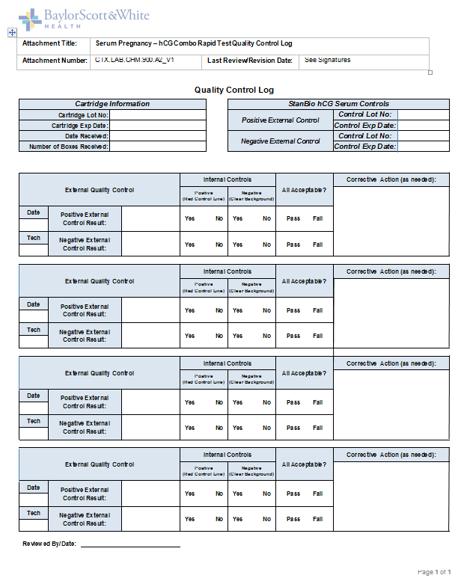

Slide 10
Patient Testing Procedure
Remove test cassette from the foil pouch and place on a level surface. Allow to come to room temperature if stored in refrigerator.
Label test cassette with patient identification.
Hold the dropper vertically and transfer 3 full drops of serum (approximately 100μl) to the sample well of the test cassette. Avoid trapping air bubbles in the sample well.
Ensure sample has absorbed into specimen well and migration has begun before setting timer.
Read the result at 5-6 minutes.
Do not interpret results after the appropriate read time.
It is important that the background is clear before the results are read.

Slide 11
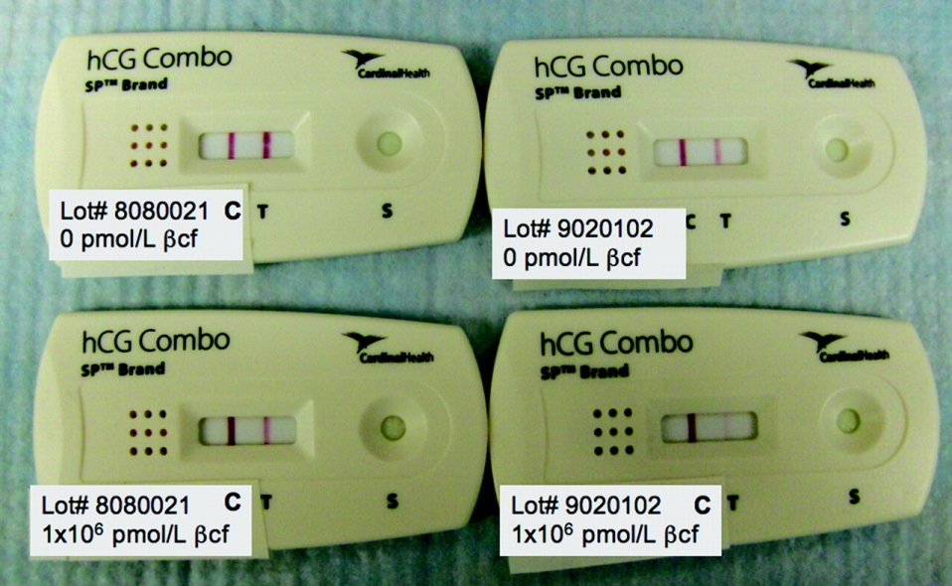
Interpretation of Results
Positive
Two distinct red lines appear. One line should be in the control region (C) and another line should be in the test region (T).
Note: A sample hCG concentration below the cut-off level of this test might result in a weak line appearing in the test region (T) after an extended period of time. A line in the test region (T) seen after the read time could be indicative of a low hCG level in the sample. If such results are seen, it is recommended that the test be repeated with a new sample in 48-72 hours or that an alternate confirmation method is used.

Slide 12
Interpretation of Results
Negative
Negative: One red line appears in the control region (C).No apparent red or pink line appears in the test region (T).

Slide 13
Interpretation of Results
Invalid
Invalid: Control line fails to appear. Insufficient specimen volume or incorrect procedural techniques are the most likely reasons for control line failure. Review the procedure and repeat the test with a new test cassette. If problem persists, discontinue using the test kit immediately and call Technical Services at 1-(866) 211-7853.
Note: The intensity of the red color in the test line region (T) will vary depending on the concentration of hCG present in the specimen. However, neither the quantitative value nor the rate of increase in hCG can be determined by this qualitative test.

Slide 14
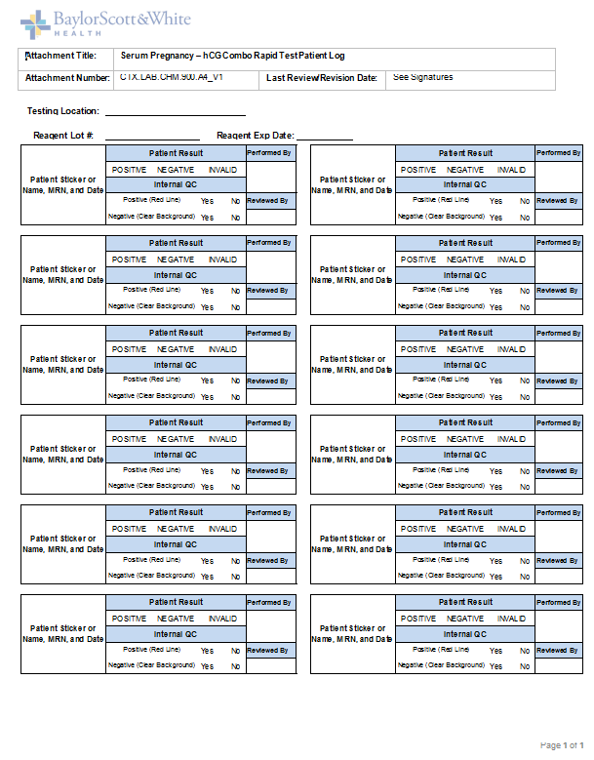

Slide 15
Limitations
False negative results may occur when the levels of hCG are below the sensitivity level of the test. When pregnancy is still suspected, serum sample should be collected 48 hours later and tested.
Very low levels of hCG (less than 50 mIU/ml) are present in serum samples shortly after implantation. However, because a significant number of first trimester pregnancies terminate for natural reasons, a test result that is weakly positive should be confirmed by retesting with a serum sample collected 48 hours later.
This test reliably detects intact hCG up to 500,000 mIU/mL. It does not reliably detect hCG degradation products, including free-beta hCG and beta core fragments. Quantitative assays used to detect hCG may detect hCG degradation products and therefore may disagree with the results of this rapid test.
A number of conditions other than pregnancy, including trophoblastic disease and certain non-trophoblastic neoplasms including testicular tumors, prostate cancer, breast cancer, and lung cancer, cause elevated levels of HCG. Therefore the presence of HCG in serum samples should not be used to diagnose pregnancy unless these conditions have been ruled out.
As with any assay employing mouse antibodies, the possibility exists for interference by human anti-mouse antibodies (HAMA) in the specimen. Specimens from patients who have received preparations of monoclonal antibodies for diagnosis or therapy may contain HAMA. Such specimens may cause false positive or false negative results.
This test provides a presumptive diagnosis for pregnancy. A confirmed pregnancy diagnosis should only be made by a physician after all clinical and laboratory findings have been evaluated.

