Slide 1
Acute Myeloid & Chronic Myelogenous LEUKEMIA
Classification
with
Images
By: Michell McAdams
&
Emily Gehring
05/16/2012

Slide 2
Acute Myeloid LEUKEMIA
FAB Classification
with
Images

Slide 3
Background
Acute Leukemia is characterized by proliferation of immature cells or blasts in the bone marrow, and commonly involves the peripheral blood and other organs.
Acute Leukemia can be classified using the French, American, and British (FAB) classification (1975-1985 revision) in which acute nonlymphoid leukemias are subdivided into 7 types, and lymphoid luekemias are subdivided into 3 types. This classifiacation system is very helpful for the student first learning about acute leukemias.
The current standard for classifying the acute leukemias is the World Health Organization (WHO) classification system. The WHO system takes into account morphology, cytogenetics, molecular genetics, and immunologic markers to create a classification system that is universally applicable and prognostically significant

Slide 4
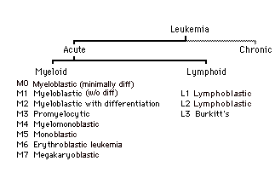
Acute Myeloid Leukemia

Slide 5
Acute Myeloid Leukemia FAB CLASSIFICATIONS
M0 – Myeloid without cytologic maturation
M1 – Myeloid with minimal Maturation
M2 – Myeloid with maturation
M3 – Promyelocytic
M3m – Promyelocytic microgranular variant
M4 – Mylomonocytic
M4Eo – Mylomonocytic with bone marrow eosinophilia
M5 – M5a and M5b
M5a – Monocytic poor differentiated
M5b – Monocytic well differentiated
M6 – Erythroid
M7 - Megakaryobalastic
***NOTE: Click on a link to go directly to that classification, Click on Fab Classification link from any page to return to this page.

Slide 6
Myeloblastic Leukemia Minimally Differentiated - M0
FAB Classification
M0 is an AML without morphological or cytochemical maturation.
5% of adult cases are the M0 form of AML.
The prognosis is poor compared to other AMLs.
Primitive leukemic blast that show no distinctive myeloid morphological features.

Slide 7
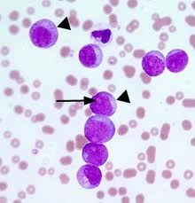
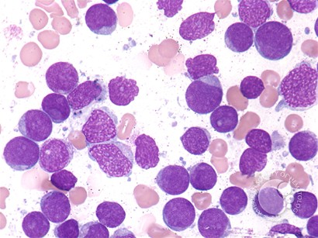
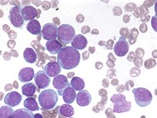
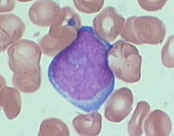
M0 Images
FAB Classification

Slide 8
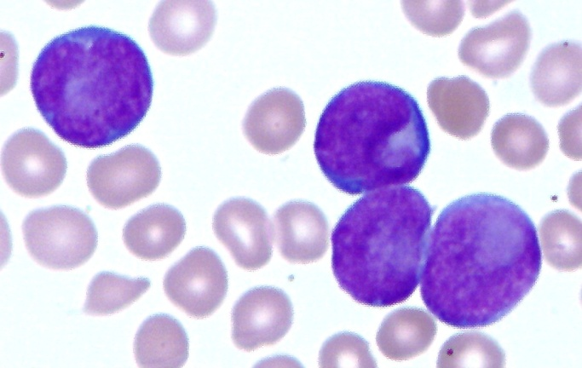
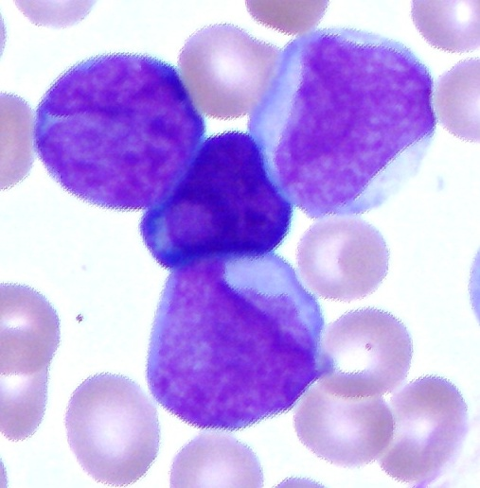
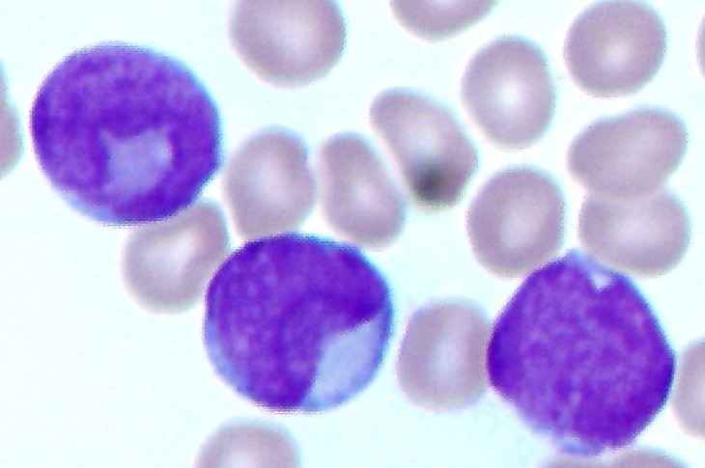
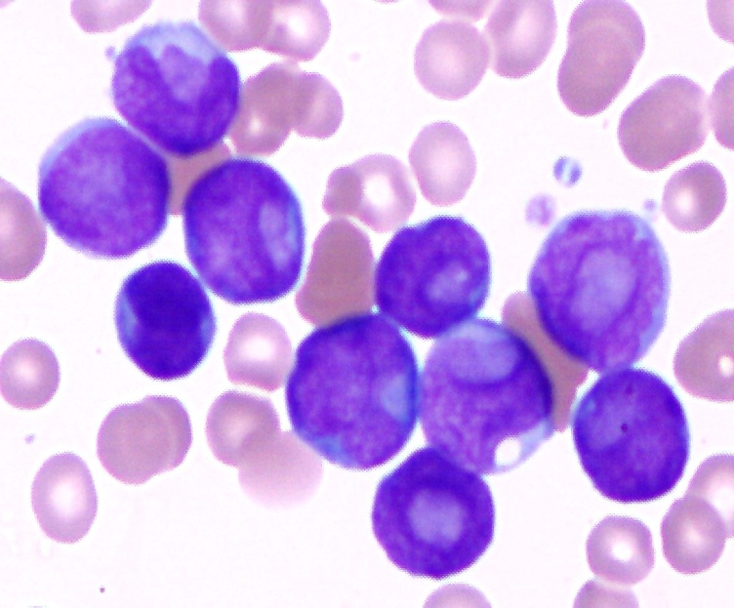
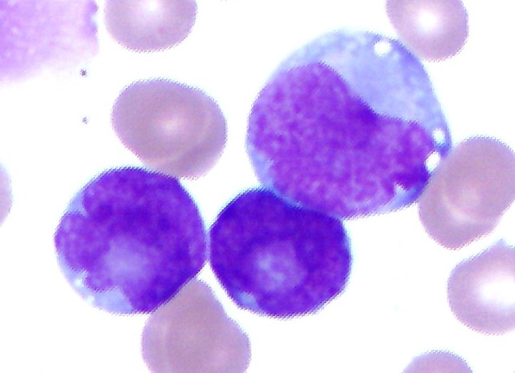
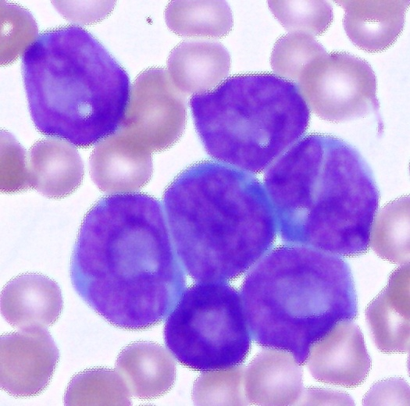
M0 Images
FAB Classification
A Scott & White Patient A 75 year Female, WBC: 228.2, HGB: 8.5, PLT: 29, 93% Blasts

Slide 9
Myeloblastic Leukemia with Minimal Maturation – M1
FAB Classification
M1 is an AML with minimal morphological and cytochemical maturation.
15% of adult cases are the M1 form of AML.
The course of this leukemia is generally described as aggressive.
M1 is characterized by poorly differentiated myeloblasts (Type 1 Blast).

Slide 10
FAB Classification
M1 Continued
The Type 1 blast represent > 90% of the nonerythroid cells.
Type 1 nucleus have loose open lacy chromatin, distinct nucleoli an immature cytoplasm without any granules.
Fewer than 10% of blast seen are Type 2.
Type 2 blast have the same morphological characteristics as Type 1, but also have < 15 azurophilic granules.
Auer rods may be present in M1 Myeloblasts.

Slide 11
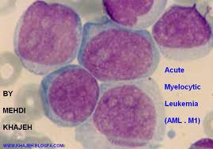
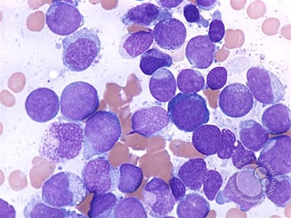
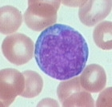
M1 Images
FAB Classification

Slide 12
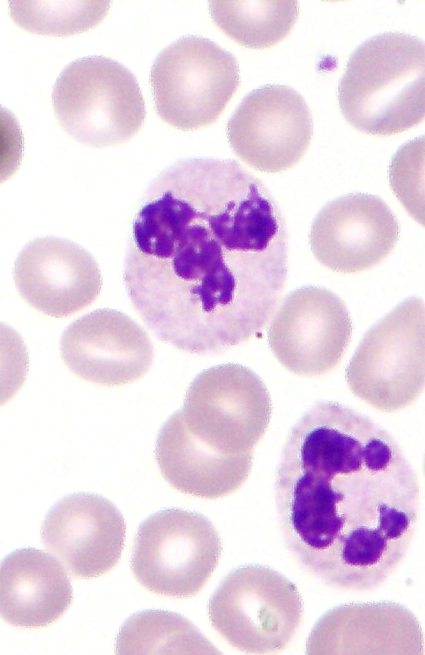
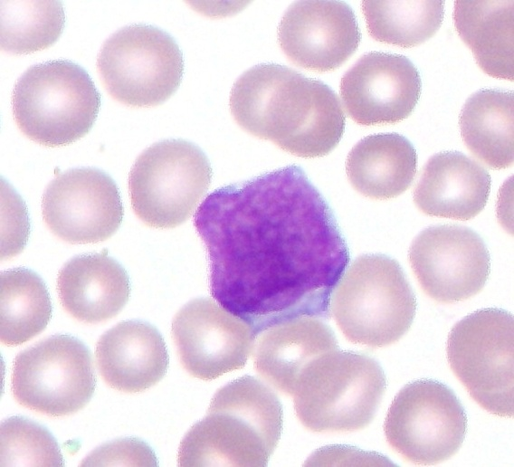
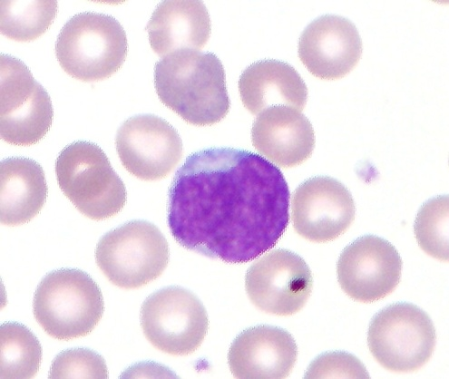
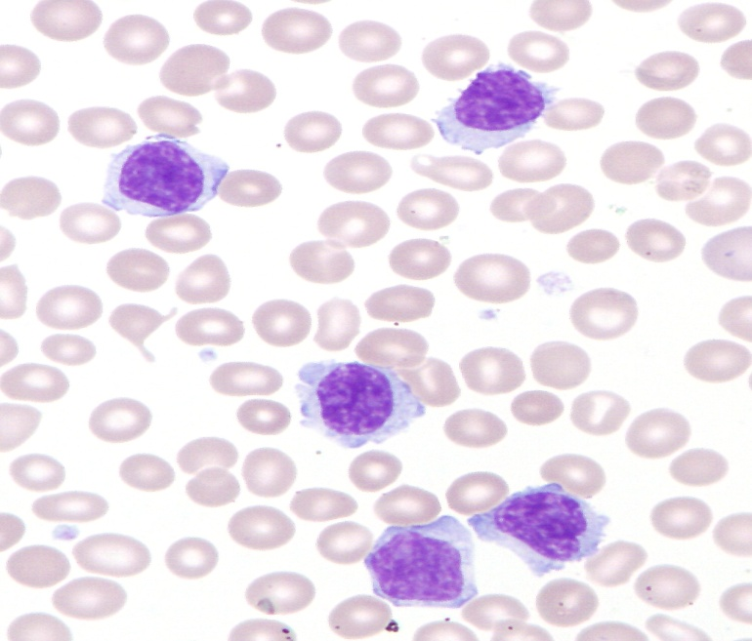
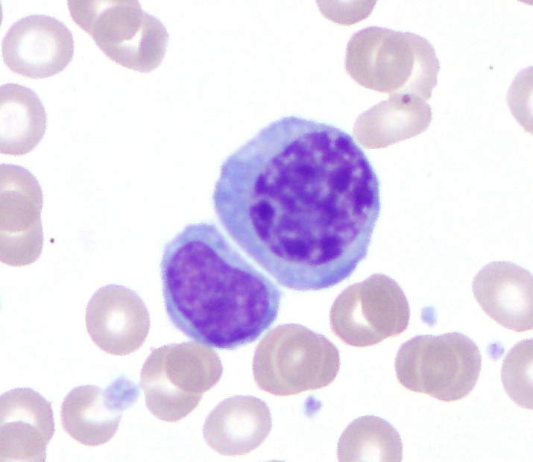
A Scott & White Patient A 72 year old Male, WBC: 22.8, HGB: 10.5, PLT: 40, 66% Blasts
FAB Classification
M1 Images
BLASTS

Slide 13
Myeloblastic Leukemia with Maturation – M2
FAB Classification
M2 is an AML with some maturation up to or beyond the promyelocyte stage.
25% of adult cases are the M2 form of AML.
This is the most common type.
M2 is characterized by myeloblasts (Type 1 and Type 2 Blast).
> 10% of the immature cells are promyelos or later stages of maturation.

Slide 14
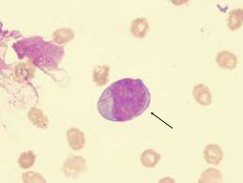
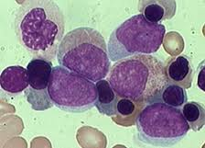
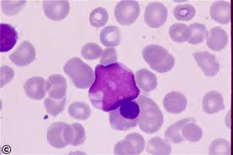
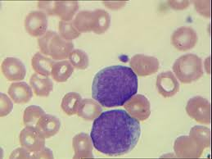
M2 Images
FAB Classification

Slide 15
ProMyelocytic Leukemia – M3
FAB Classification
M3 is an AML with abnormal promyelocytes.
10% of adult cases are the M3 form of AML.
M3 is associated with a high incidence of DIC because the promyelocyets have a large amount of thromboplastin substances.
The promyelocytes have heavy granulation that sometimes obscures the nucleus, and abundant cytoplasm.
Auer rods are frequently seen and some cells may contain bundles of Auer rods (faggot cells).

Slide 16
ProMyelocytic Leukemia – M3m
FAB Classification
M3m is the microgranular variant of M3
The promyelocytes have primary granules that are not readily visible.
The course of this leukemia is generally described as aggressive.
Patients with this variant may have a lower survival rate.
There is a high incidence of DIC with disease also
Microgranular APL can be mistaken for Myelomonocytic or Monocytic leukemia

Slide 17
FAB Classification
M3m Continued
The promyelocytes appear monocytoid with prominent nuclear folding and abundant cytoplasm
Most cells nucleus are either reniform (kidney shaped) or bilobed.
Very little granulation is present in these cells
Occasional promyelocytes with heavy granulation are almost always present.

Slide 18
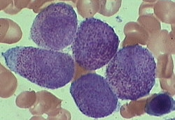
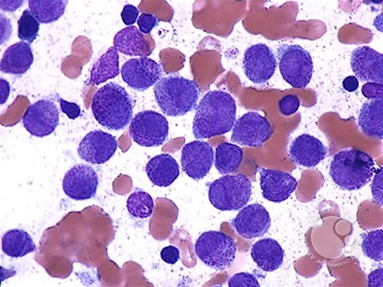
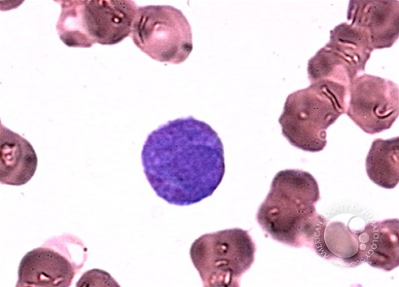
M3 Images
FAB Classification

Slide 19
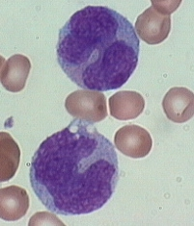
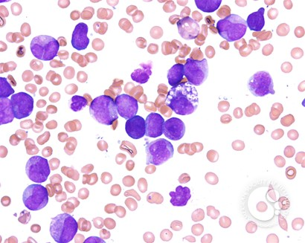
M3m Images
FAB Classification

Slide 20
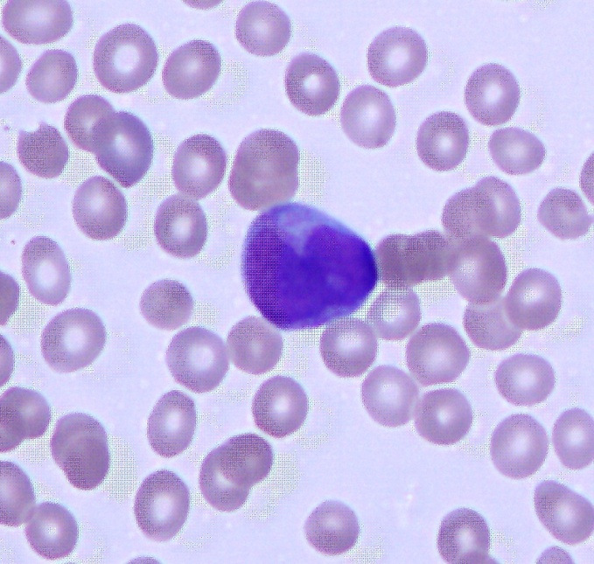
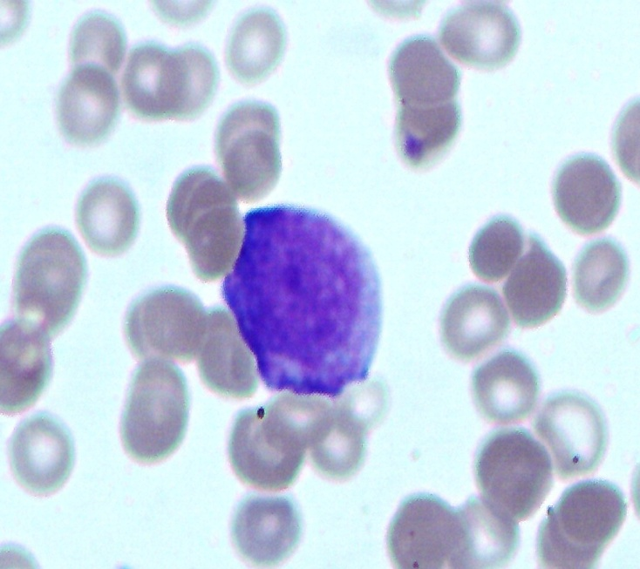
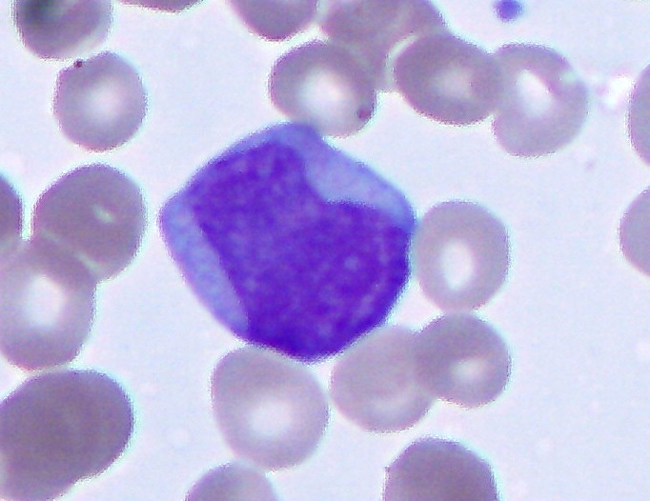
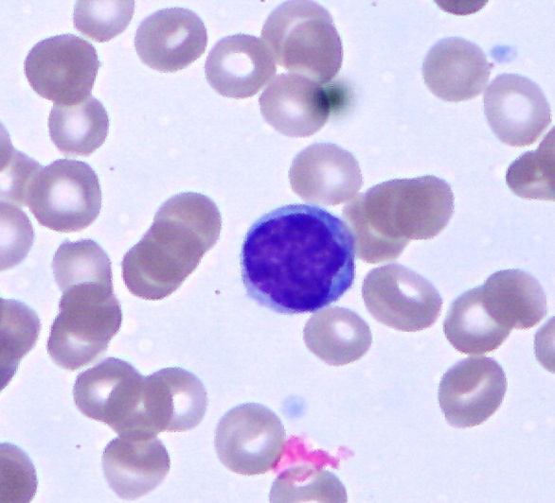
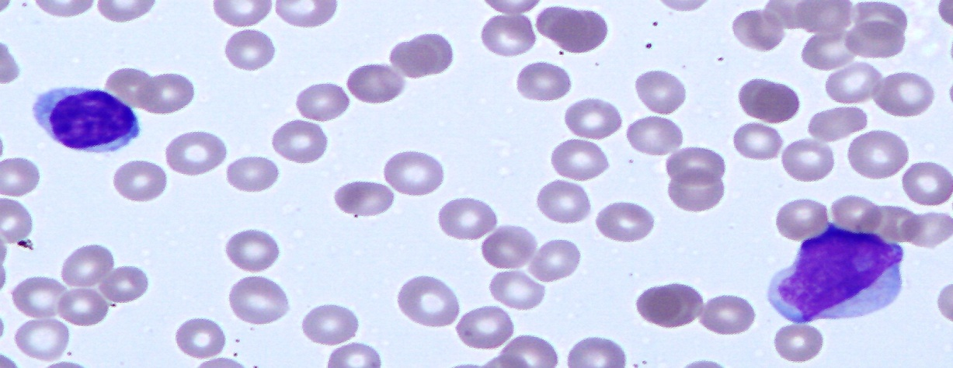
A Scott & White Patient A 13 year old Male, WBC: 0.9, HGB: 10.1, PLT: 98, 18% Blasts
FAB Classification
M3m Images
Normal Lymph
Normal Lymph
BLASTS

Slide 21
Myleomonocytic Leukemia – M4
FAB Classification
M4 is characterized by both granulocytic and monocytic differentiation.
20% of adult cases are the M4 form of AML
Monoblasts have round nucleoli and delicate chromatin, the cytoplasm is basophilic and may contain fine azurphilic granules.
Promonocytes generally have a more convoluted nucleus and a lower N:C ratio, the cytoplasm is less basophilic, more granular, and more vacuolated.

Slide 22
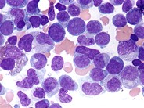
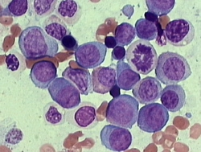
M4 Images
FAB Classification

Slide 23
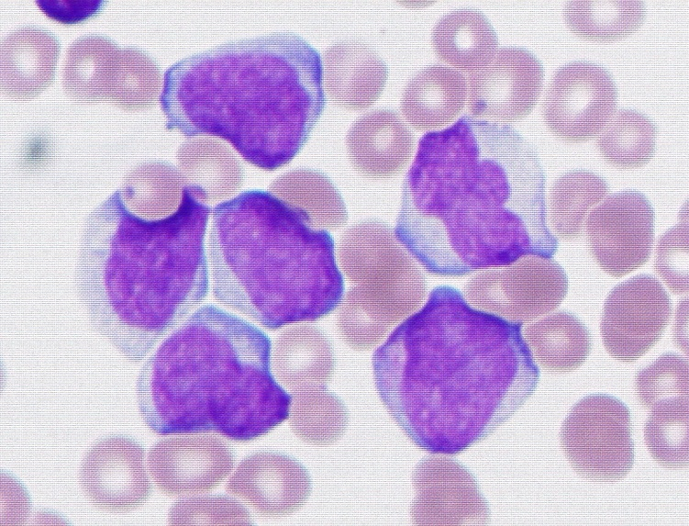
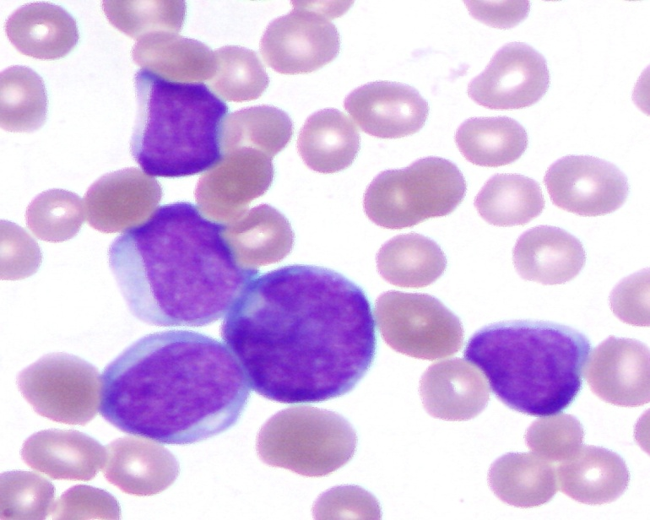
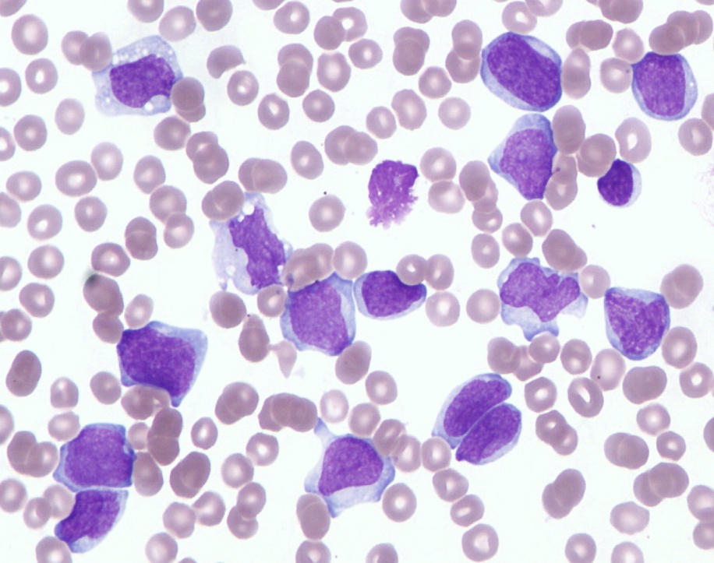
A Scott & White Patient A 30 year old Male, WBC: 122.56, HGB: 9.2, PLT: 28, 65% Blasts
M4 Images
FAB Classification
BLASTS

Slide 24
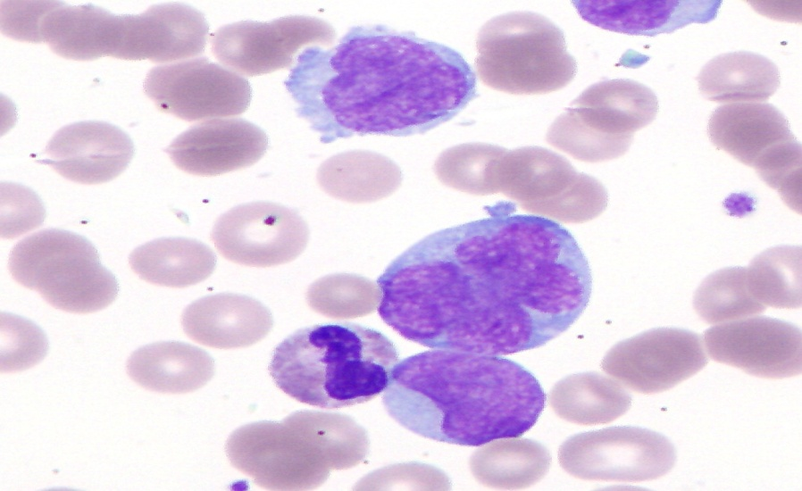
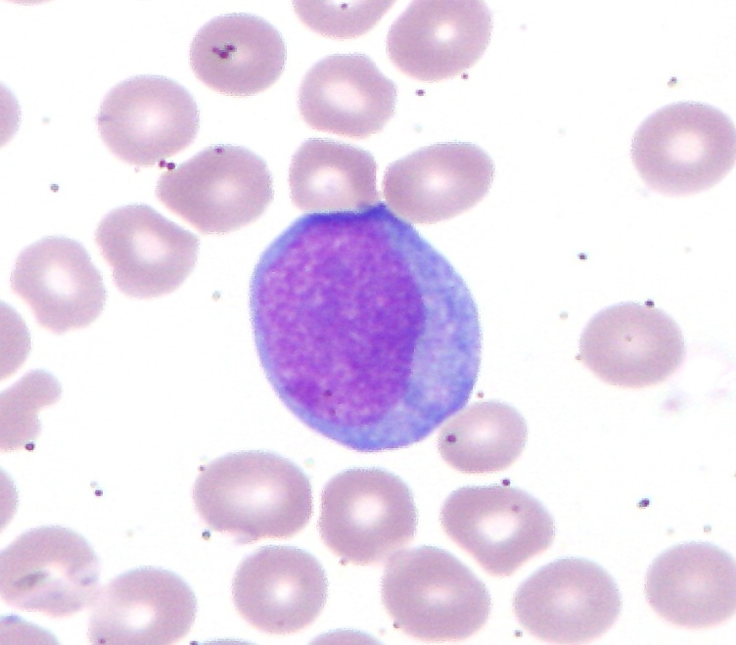
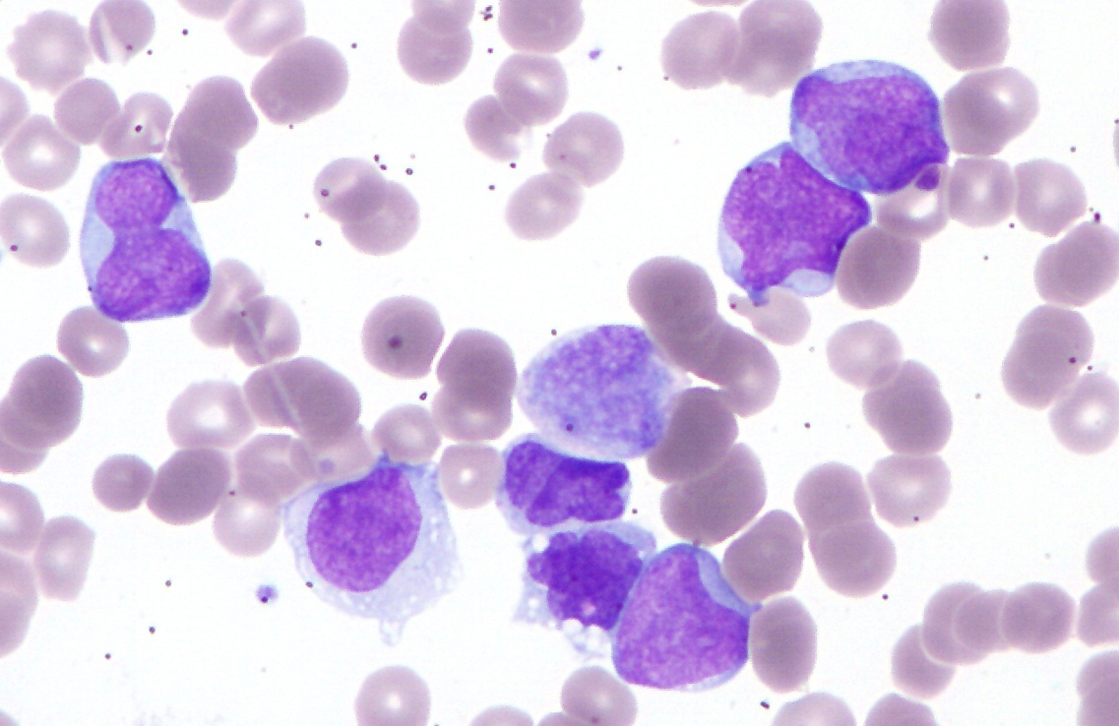
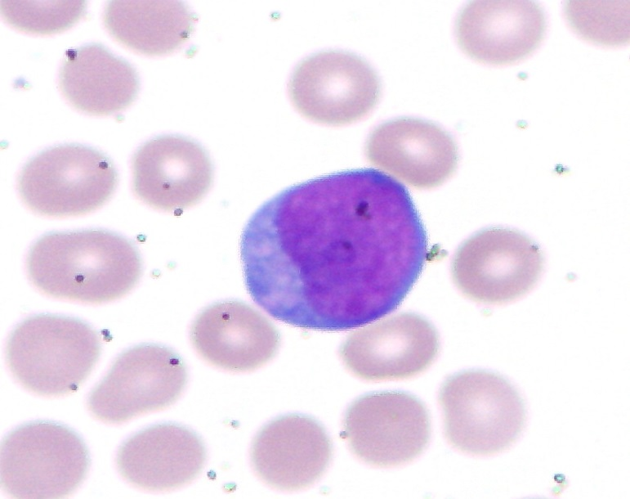
A Scott & White Patient A 79 year old Female, WBC: 81.8, HGB: 8.0, PLT: 82, 27% Blasts
FAB Classification
M4 Images
Micro- Megakaryocytes
BLASTS

Slide 25
Myleomonocytic Leukemia – M4Eo
FAB Classification
M4Eo is associated with bone marrow eosinophilia.
Both abnormal and immature eosinophils are present in the bone marrow.
M4Eo has a higher median survival then M4.

Slide 26
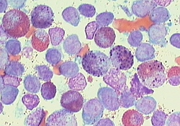
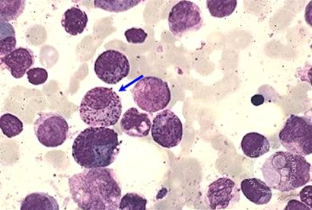
M4Eo Images
FAB Classification

Slide 27
Monocytic Leukemia (AMoL) - M5
FAB Classification
There are two subtypes:
M5a is the poorly differentiated form
M5b is the well differentiated form
How to differentiate myeloblasts from monoblasts:
Myelobasts Monoblasts
More Granules
Typically Round Nucleus
More Nucleoli
Few Granules
Occasionally Slight Nuclear Fold
Few, Large Nucleoli

Slide 28
Monocytic Leukemia- M5a Poorly Differentiated
FAB Classification
M5a – Acute Monoblastic Leukemia
M5a is characterized by an excess of monocytic cells
10% of adult cases are the M5 form of AML.
M5a cells are >80% monoblasts.
Monoblasts have round nucleoli and delicate chromatin, the cytoplasm is basophilic and may contain fine azurphilic granules.
Promonocytes generally have a more convoluted nucleus and a lower N:C ratio, the cytoplasm is less basophilic, more granular, and more vacuolated.

Slide 29
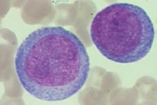
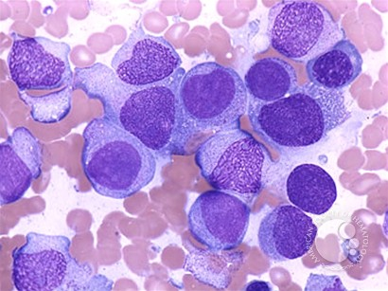
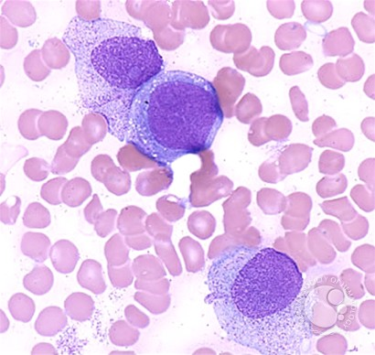
M5a Images
FAB Classification

Slide 30
Monocytic Leukemia- M5b Well Differentiated
FAB Classification
M5b – Acute Monocytic Leukemia
M5b is characterized by an excess of monocytic cells
10% of adult cases are the M5 form of AML.
M5b cells are mainly monocytes to include promonocytes which is the predominate cell in the peripheral blood.
Both M5a and M5b have distinctive clinical manifestations, to include skin and gum involvement.

Slide 31
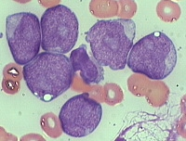
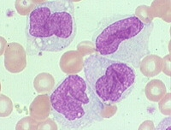
M5b Images
FAB Classification

Slide 32
Erythroleukemia – M6
FAB Classification
M6 is characterized by an abnormal proliferation of erythroid and myeloid precursors.
5% of adult cases are the M6 form of AML.
Myeloblasts comprise at least 30% of the nonerytroid cells and auer rods may be present.
Abnormal erythroid features include multinucleation of erythroblasts with vacuolated cytoplasm.
Abnormal megakaryocytes may be seen also.

Slide 33
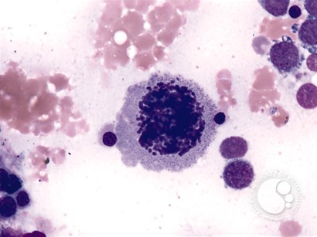
M6 Images
FAB Classification

Slide 34
Megakaryoblastic Leukemia – M7
FAB Classification
M7 is characterized by a neoplastic proliferation of megakaryoblasts and atypical megakaryocytes.
5% of adult cases are the M7 form of AML.
> 50% of the blast are of megakaryocytic lineage.
The blast display a wide range of morphological features.
Small cells with scanty cytoplasm and dense chromatin to large cells with moderate amount of cytoplasm with a fine reticulated chromatin pattern.
Cytoplasmic projections are sometimes present
Some cases azurophilic granules are present
Megakaryocytic fragments and micromegakaryoblasts may be seen in peripheral blood.
M7 blasts often clump together

Slide 35
M7 Images
FAB Classification

Slide 36
Chronic Myelogenous Leukemia
Different Phases
with
Images

Slide 37
Background
Chronic Myelogenous Leukemia also known as:
Chronic Myeloid Leukemia
Chronic Granulocytic Leukemia
Myeloproliferative disorder characterized by marked increase of granulocyte in peripheral blood, including neutrophils with immature forms, eosinophils and basophils.
CML is a clonal stem disorder in which the abnormal clone is characterized by the presence of the Philadelphia Chromosome.

Slide 38
Background (Cont.)
CML is more common in adults than in children resulting in frequent infections, bleeding problems, and anemia. Cells may collect in certain parts of the body, causing pain, swelling, and other problems.
Patient with CML maybe asymptomatic at presentation.
There are 3 phases of CML:
Chronic Phase
Accelerated Phase
Blast Phase
CML may be a triphasic disease with progression from Chronic through Accelerated to Blast Phase.
CML may be a biphasic disease with progression from Chronic to Blast Phase.

Slide 39
Chronic phase
85% of patients are diagnosed in the chronic phase.
The disease may remain stable for several years.
Usually responsive to conventional chemo.
Laboratory findings
Increased WBC count above 100,000/µL
Neutrophils will include virtually all cells in the neutrophilic series with fewer than 10% blasts.
Increased Myelocytes (myelocytic bulge) with fewer metamyocytes seen.
Increased absolute basophilic is significant.
Normocytic anemia is commonly present
Micromegakarycytes can be seen in circulation in as many as 25% of CML patients.
Decreased LAP score

Slide 40
Chronic Phase

Slide 41
Accelerated phase
The accelerated phase is significant because it signals that the disease is progressing and transformation to blast crisis is imminent.
Drug treatment often becomes less effective in the advanced stages.
Blasts are 10 – 19%
Basophilia >20%
Decreased LAP score
Platelet count <100,000, unrelated to therapy
Platelet count >1,000,000, unresponsive to therapy

Slide 42
Accelerated phase

Slide 43
Blast phase
Blast phase represents the conversion from CML to an aggressive form of Acute Leukemia
Approximately 50% of all cases will be AML, 20 – 30% will be ALL, with the remainder classified as acute undifferentiated leukemia
>20% myeloblasts or lymphoblasts in the blood or bone marrow
Large clusters of blasts in the bone marrow on biopsy
Development of a chloroma (solid focus of leukemia outside the bone marrow)
LAP score may be normal to increased.

Slide 44
Blast Phase

Slide 45
Other Chronic Leukemias
Chronic Neutrophilic Leukemia (CNL) is rare, it presents with increased absolute neutrphilia, bands are present but usually low % of other immature myeloid cells. LAP score is usually increased.
Chronic Eosinophilic Leukemia (CEL) is characterized by increased eosinophils, less than 20% blast, and tissue damage occurs as a result as infiltration by eosinophils with release of cytokines.

Slide 46
Chronic Neutrophilic Leukemia (CNL)

Slide 47
Chronic Eosinophilic Leukemia (CEL)

Slide 48
Sources
Clinical Hematology and Fundamentals of Hemostasis. Fifth Edition. Denise M Harmening. 2009
http://imagebank.hematology.org/

