Slide 1
WBC MORPHOLOGY BASICS Reference: Glassy, Eric M.D., Color Atlas of Hematology
BY: Emily Gehring & Michell McAdams
01/2013

Slide 2
Neutrophil
Neutrophil Characteristics
Size: 10 – 15 µm
N:C Ratio: 1:3
Nuclear Shape: Segmented 2-5 lobes connected by filaments
Cytoplasm: pale pink with many specific granules

Slide 3
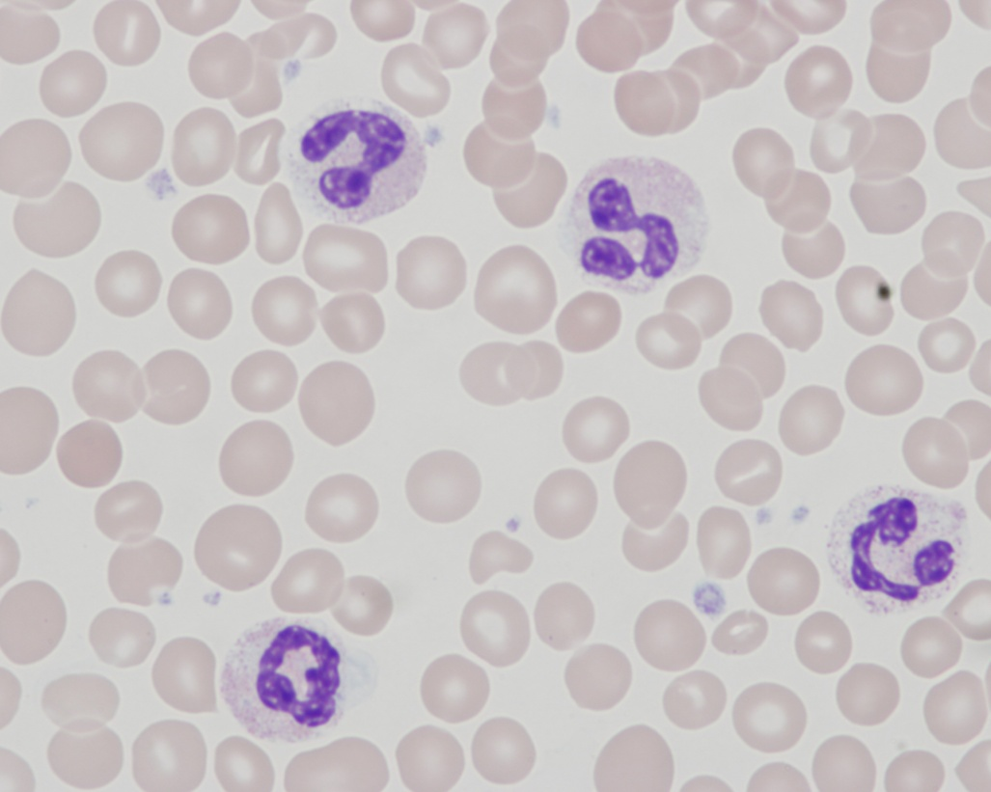
Neutrophil

Slide 4
Lymphocyte: Large and Small Varieties
Lymphocyte Characteristics
Size: 7 – 15 µm
N:C Ratio: 5:1 to 2:1
Cell Shape: round to oval
Nuclear Shape: round to oval; occasionally notched or slightly indented
Cytoplasm: pale blue to moderately basophilic
Large Lymphs (T-Lymph)
More cytoplasm then nucleus and often contain a few coarse granules
Small Lymphs (B-Lymph)
Approximately the size of a RBC
Granules are absent

Slide 5
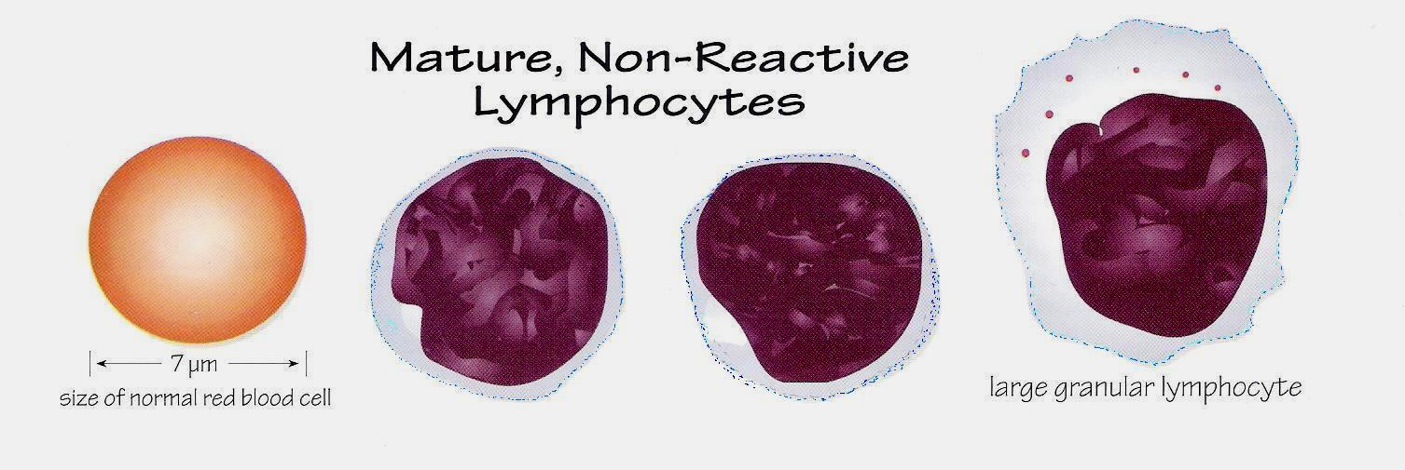
Lymphocyte: Large and Small Varieties
B-Lymph (Small)
T-Lymph (Large)
Small Lymph
Large Lymph

Slide 6
Eosinophil
Eosinophil Characteristics
Size: 10 – 15 µm for mature forms
10 – 18 µm for immature forms
N:C Ratio: 1:3 for mature forms
1:2 to 2:1 for immature forms
Nuclear Shape: Segmented with 2 – 3 lobes connected by a thin filament of chromatin
Cytoplasm: Filled by coarse, spherical, uniformed orange-red granules. Younger forms may contain a few dark purplish primary granules.

Slide 7
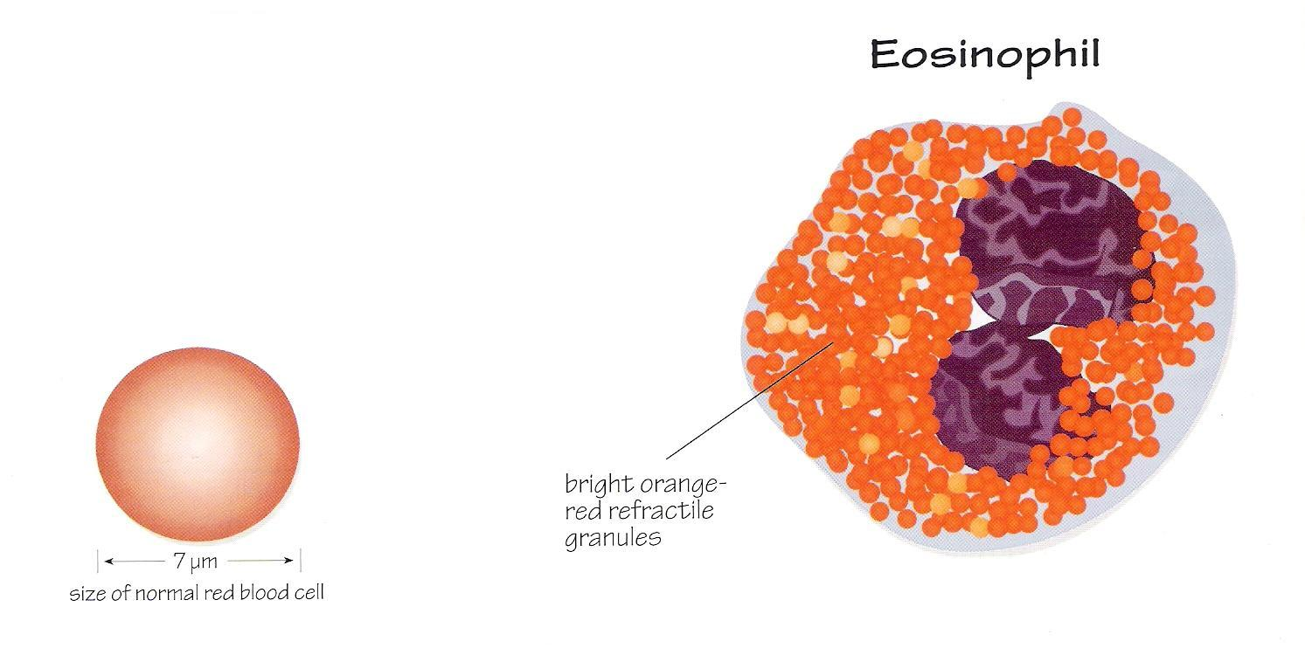
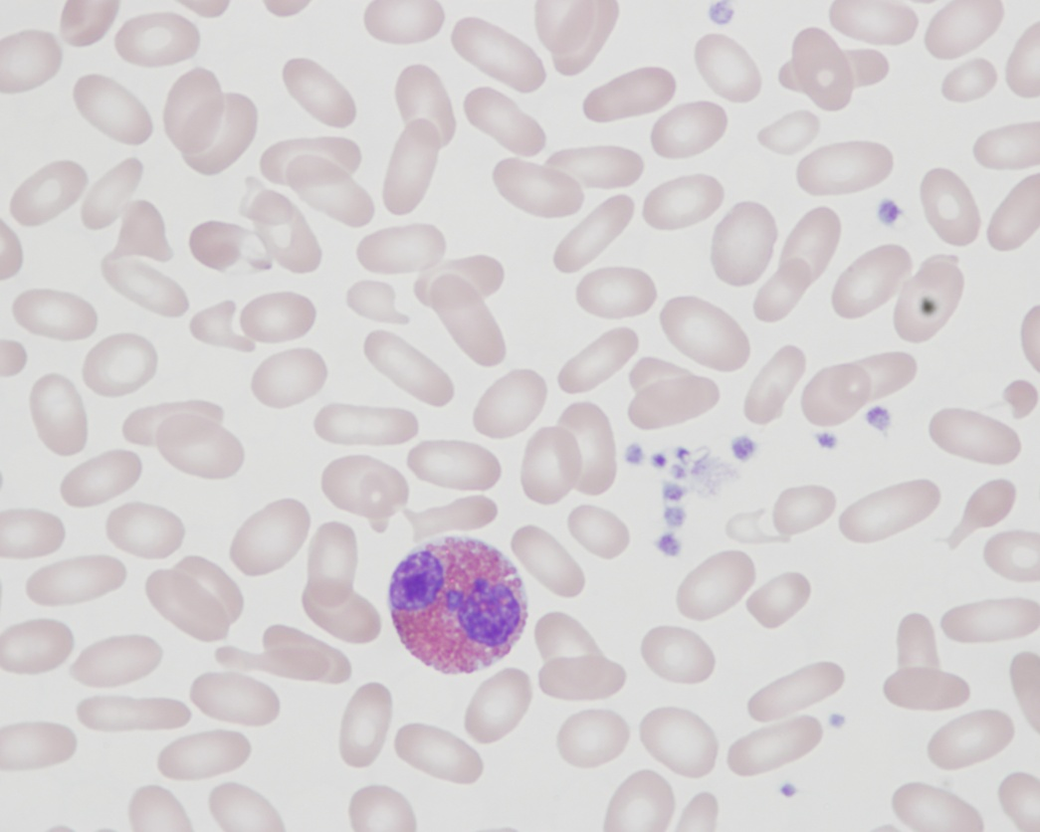
Eosinophil

Slide 8
Basophil
Basophil Characteristics
Size: 10 – 15 µm
N:C Ratio: 1:2 to 1:3
Nuclear Shape: Segmented, often obscured by granules
Cytoplasm: Coarse, dense granules. The predominant color is blue-black, but some may stain purple to red

Slide 9
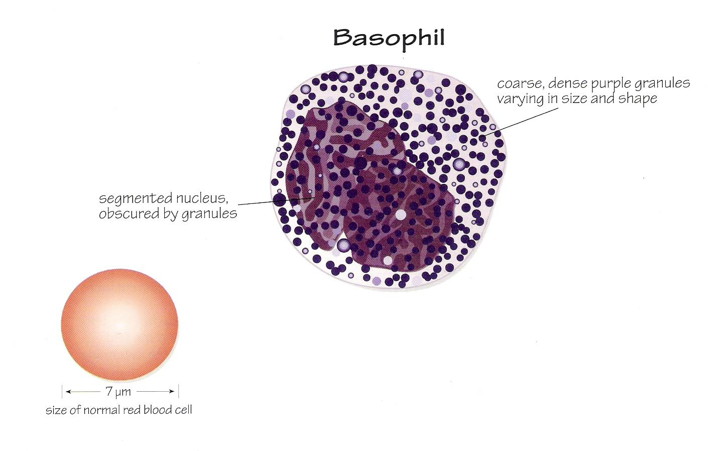
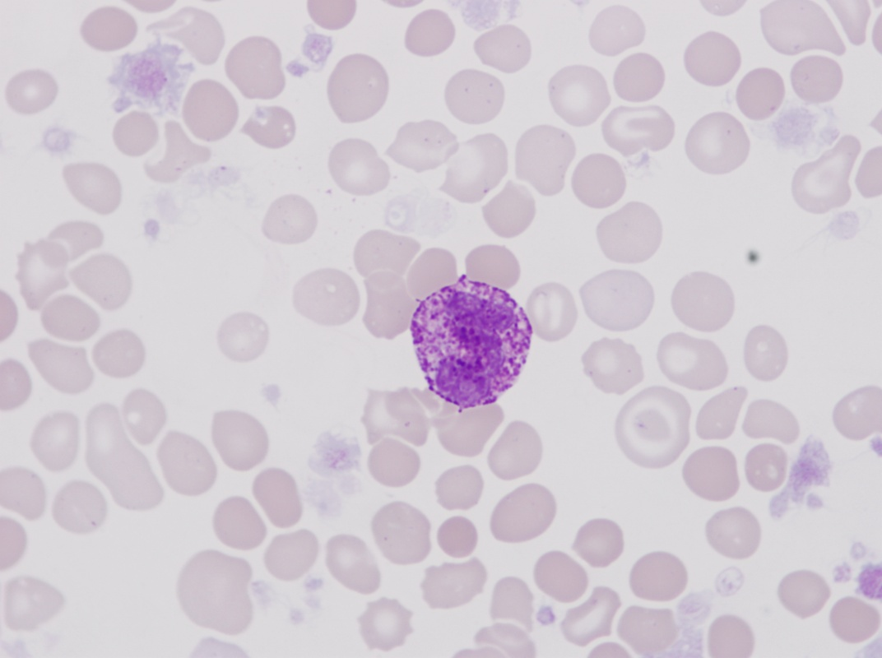
Basophil

Slide 10
Monocyte
Monocyte Characteristics
Size: 12 – 20 µm
N:C Ratio: 4:1 to 2:1
Nuclear Shape: Round to oval, indented
Cytoplasm: Abundant gray-blue (ground-glass appearance), often with scattered vacuoles, sparse lilac granules

Slide 11
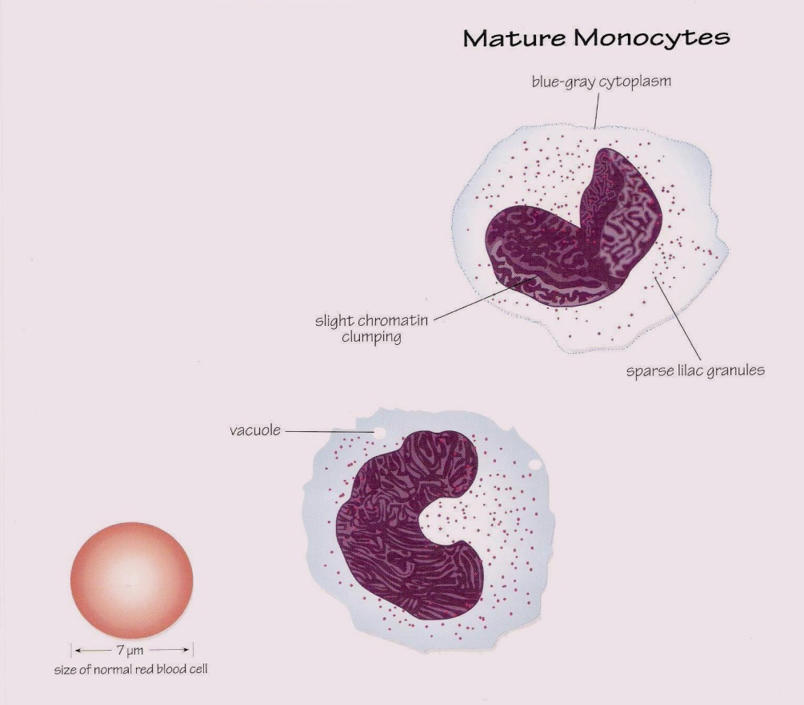
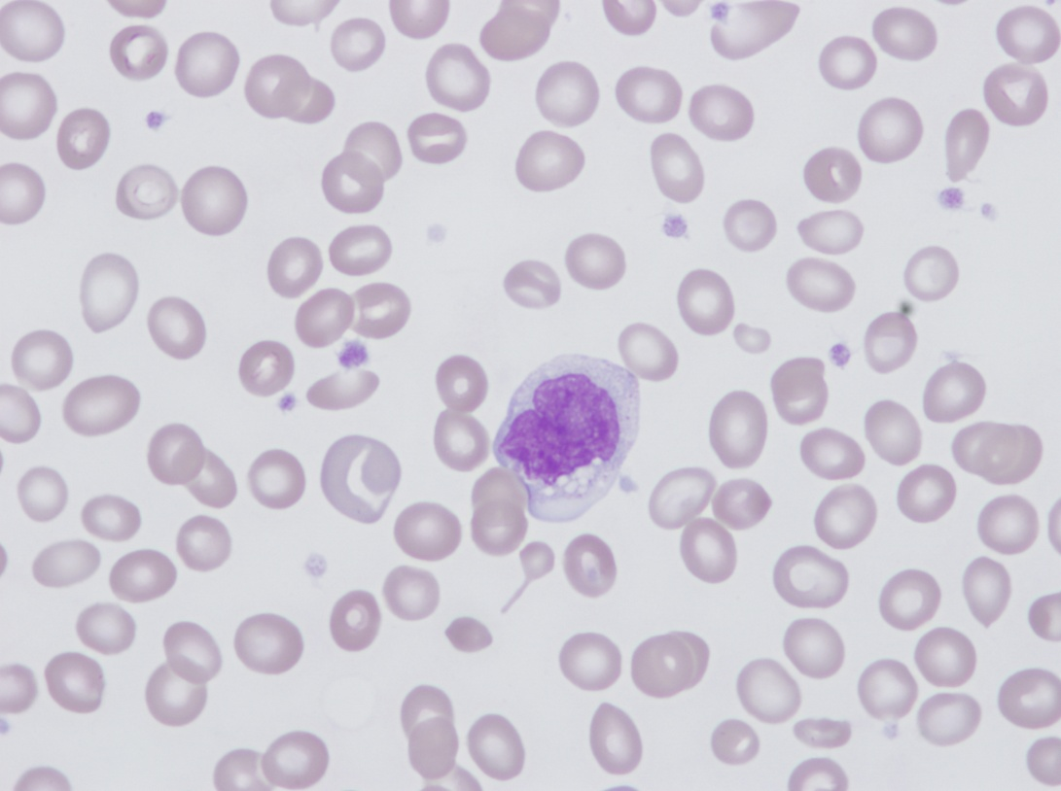
Monocyte

Slide 12
~ THE END ~ ☺

