Slide 1
Automated & mANUAL Sed Rate
By: Tina Gorup

Slide 2
Automated Sed Rate

Slide 3
Automated Sed Rate
What The Test Detects:
The ESR (erythrocyte sedimentation rate) is used to help detect conditions associated with acute and chronic inflammation. It is considered a nonspecific marker for inflammation because elevated results do not tell the doctor what is causing the inflammation or where in the body inflammation is. ESR values can also be affected by other conditions besides inflammation.

Slide 4
Automated Sed Rate
Examples of Some Conditions Associated With Elevated ESR Results:
Acute & Chronic Infections
Rheumatoid Arthritis
Myocardial Infarction
TB
Subacute Bacterial Endocarditis
Hepatitis
Menstruation
After the 3rd month of Pregnancy

Slide 5
Automated Sed Rate
ESR values may also be a useful prognostic indicator of Hodgkin’s disease.
One study showed that asymptomatic patients with an ESR of less than 10mm/h had an excellent survival rate whereas patients with an ESR of 60mm/h or greater had a survival rate as poor as those with systemic symptoms.

Slide 6
Automated Sed Rate
Low ESR results are usually not a cause for concern but can be seen in conditions like:
Polycythemia
Extreme Leukocytosis
Some Protein Abnormalities
Sickle Cell Anemia

Slide 7
Automated Sed Rate
Specimen Requirements:
Collect Specimen in Lavender Stopper Tube or Lavender Bullets
Minimum tube volume: 1.5mL
Lavender Bullets: 3 bullets filled to 500 µL mark
Specimen Stability: 4 hours if specimen is left at room temperature & 24 hours if specimen is refrigerated. Frozen samples are unacceptable.

Slide 8
Automated Sed Rate
Methodology:
ESR is the distance in millimeters that RBCs fall per unit of time, which is usually 30 minutes.
ESR is directly proportional to the RBC mass (Ex. in diseases that form rouleaux [RBCs that appear as stacks of coins] the RBCs are heavier and settle out faster increasing the ESR) and inversely proportional to plasma viscosity (the higher the viscosity, the lower the ESR). In normal whole blood specimens, the RBC mass is small and the cells don’t form rouleaux so the ESR is decreased. In abnormal conditions when the RBC mass is greater, and when RBCs form rouleaux, the cells settle out faster increasing the ESR.

Slide 9
Procedure Overview
The automated ESR is performed using the Streck Auto-Plus Analyzer. It measures the sedimentation rates of RBCs using vacuum tubes which contain sodium citrate.
Blood is transferred from an EDTA (lavender) tube into a vacuum tube
The vacuum tube is mixed on a rotator for 2 minutes to ensure sample homogeneity.
When the tube is added to the analyzer a baseline reading is stored in memory and at the end of 30 minutes the baseline reading is subtracted from the final reading with the difference converted to ESR results.

Slide 10
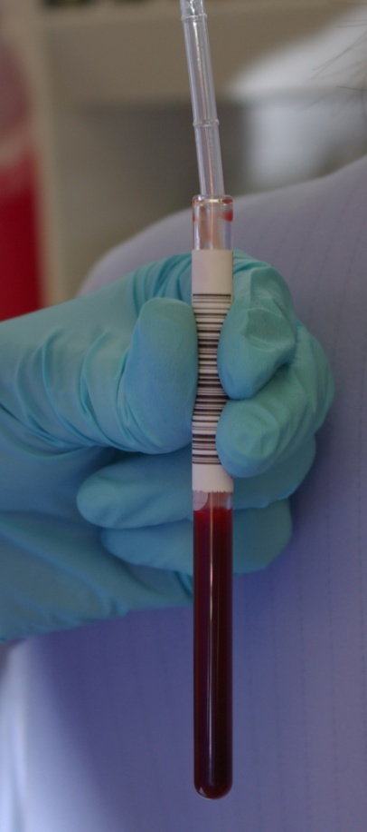
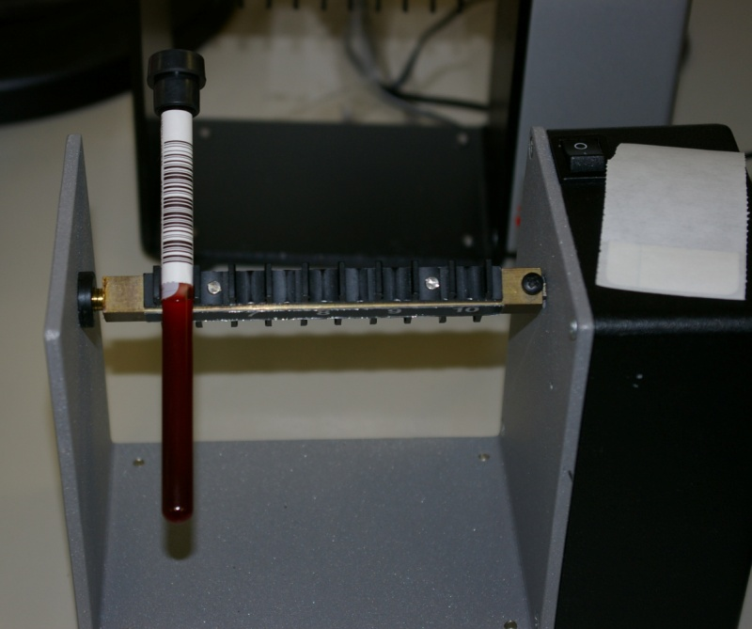
Automated Sed Rate Steps
Blood being transferred from EDTA tube into vacuum tube
Vacuum Tube Mixing on Rotator
Step 1
Step 2

Slide 11
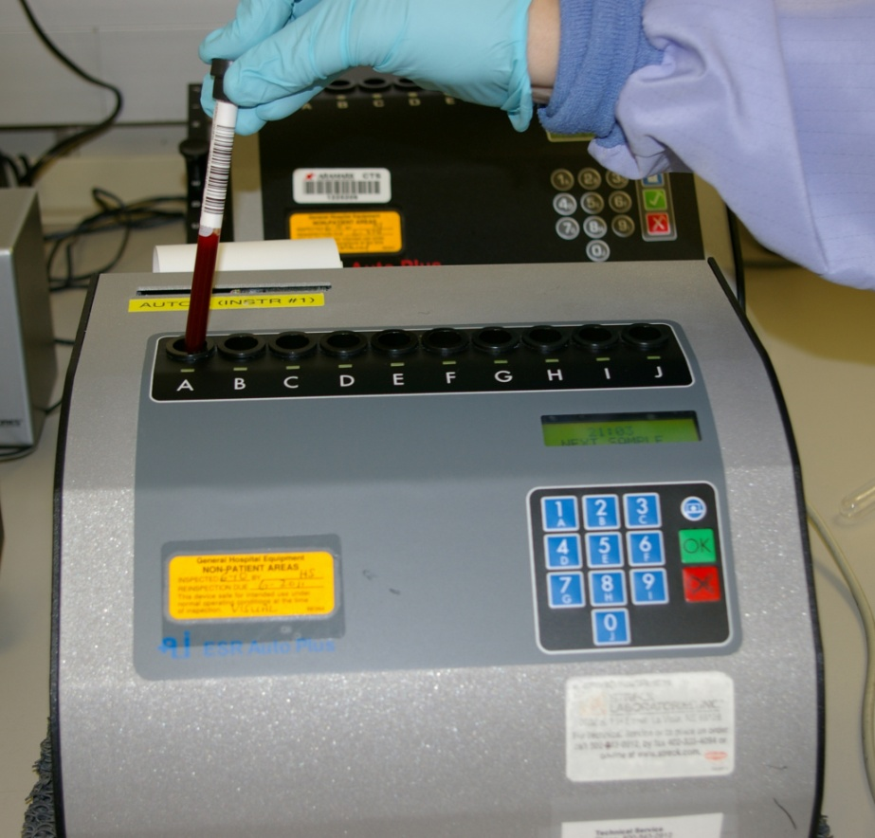
Automated Sed Rate Steps
Placing Vacuum Tube into Analyzer
Step 3

Slide 12
Procedure Overview - Continued
The results are recorded in millimeters (mm) per hour by converting the Quick mode method conversion table. This table is a scientifically developed method for measuring ESRs in only 30 minutes.
The test results are calculated and printed when the test is complete.
Two controls (Level I and Level II) are run at the beginning of each shift and are recorded both electronically and in written format in the Result and QC Log Notebook.

Slide 13
ESR Reference Ranges
Females: 0-20mm/hr.
Males: 0-15mm/hr.
Children: No specific reference range available
Linearity and Reportable Range: 0 – 120mm/hr.

Slide 14
Manual Sed Rates

Slide 15
Manual Sed Rates
This method for determining a sed rate uses the Westergren Operating Procedure and detects conditions associated with acute and chronic inflammation. Like the automated sed rate procedure, it is a nonspecific marker for inflammation.
The same conditions which cause an elevated or low auto sed rate cause an elevated manual sed rate.

Slide 16
Specimen Requirements
Collect specimen in Lavender Stopper Tube or Lavender Bullets containing EDTA
Minimum tube volume: 1.5 mL
Lavender Bullets: 3 bullets filled to 500µl mark
Specimen Stability: 4 hours if specimen is left at room temperature and 24 hours if specimen is refrigerated.
Frozen samples are unacceptable.

Slide 17
Methodology
The manual ESR is performed using the Polymedco Sediplast Diluted Westergren ESR kit.
This method measures the settling of RBCs in diluted whole blood over a 60 minute time period. The numeric value is determined in millimeters by measuring the distance from the bottom of the surface meniscus to the top of the erythrocyte sedimentation in a vertical column that has remained perpendicular to its base for 60 minutes.

Slide 18
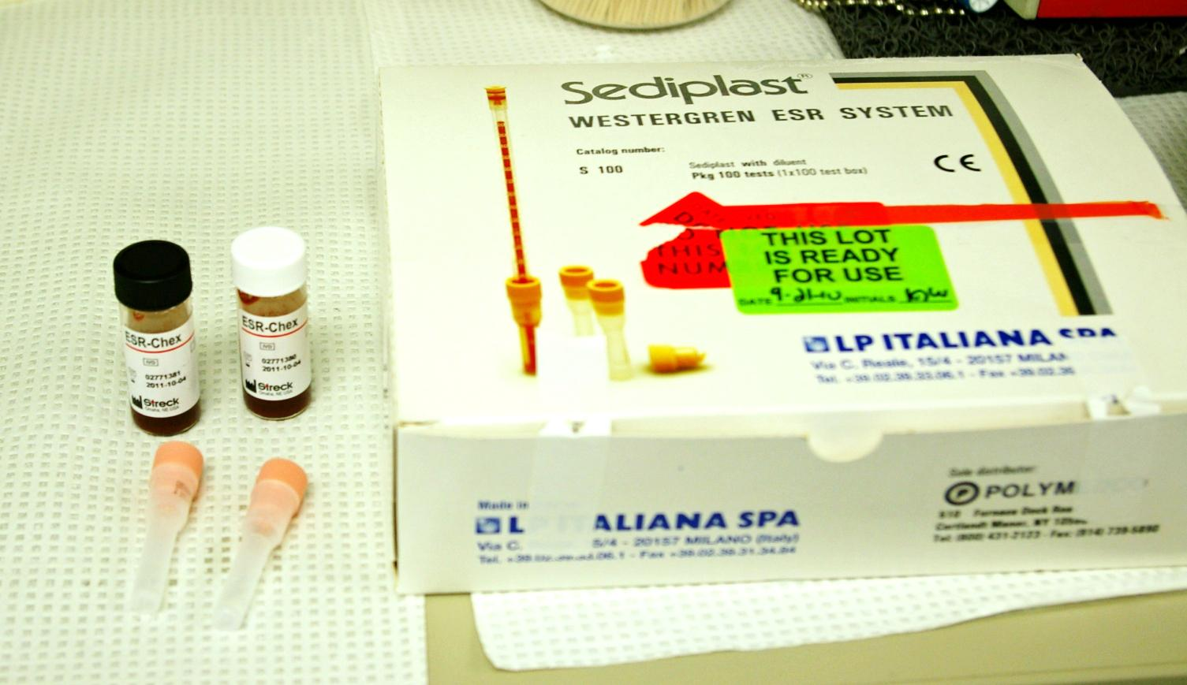
Supplies
Sediplast Westergren ESR Kit

Slide 19
Procedure Overview
Check leveling plate and adjust the level of the plate if needed.
Fill the vial with 0.8 ml of well mixed whole blood. Cap vial and invert 8-10 times until thoroughly mixed.
Carefully insert pipette through the pierceable stopper of the vial until the pipette comes into contact with the bottom.

Slide 20
Procedure Overview Continued
Place patient sample and controls into wells in leveling plate.
Set timer for 60 minutes and be careful not to bump or vibrate the ESR leveling plate until the completion of the test.
Read ESR level no longer than 5 minutes after preset time.

Slide 21
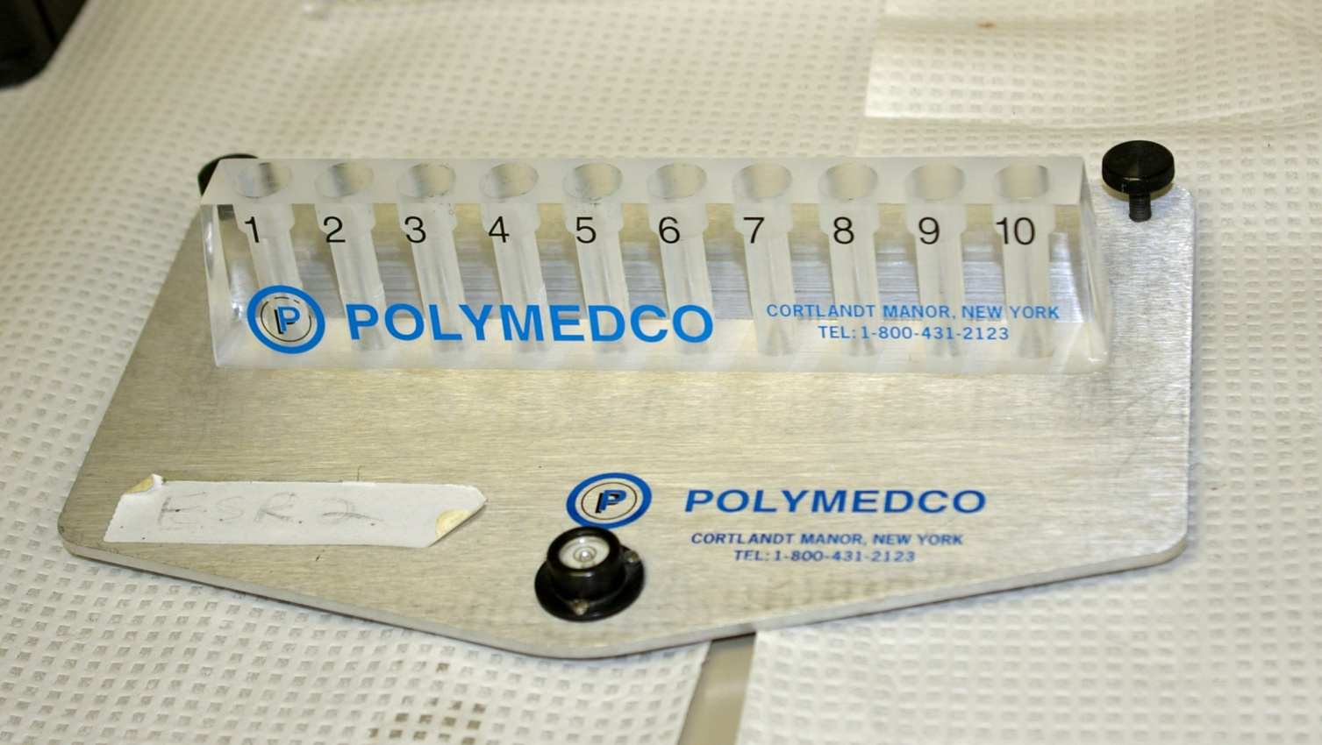
Manual Sed Rate Steps
Step 1: Check leveling plate and adjust level if needed

Slide 22
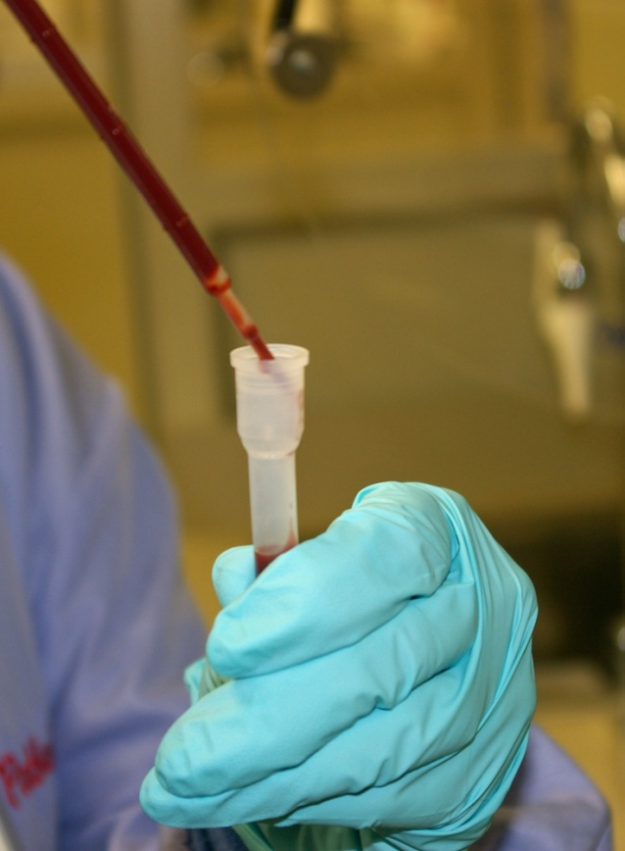
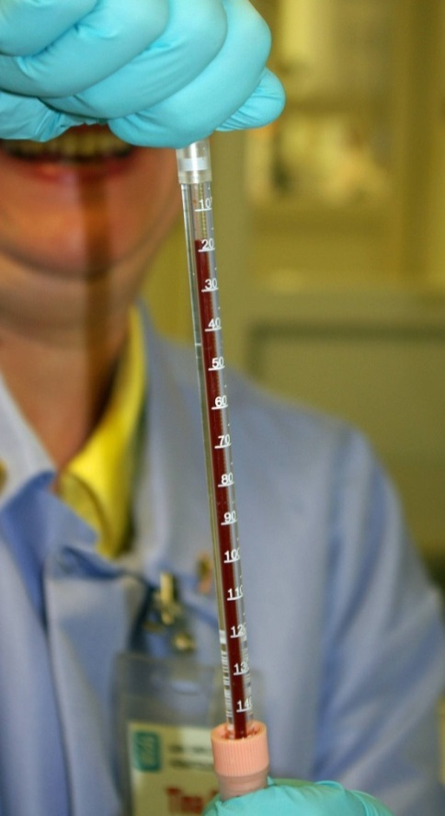
Manual Sed Rate Steps
Step 2: Fill vial with 0.8 ml of well mixed whole blood
Step 3: Insert pipette through pierceable stopper of vial

Slide 23
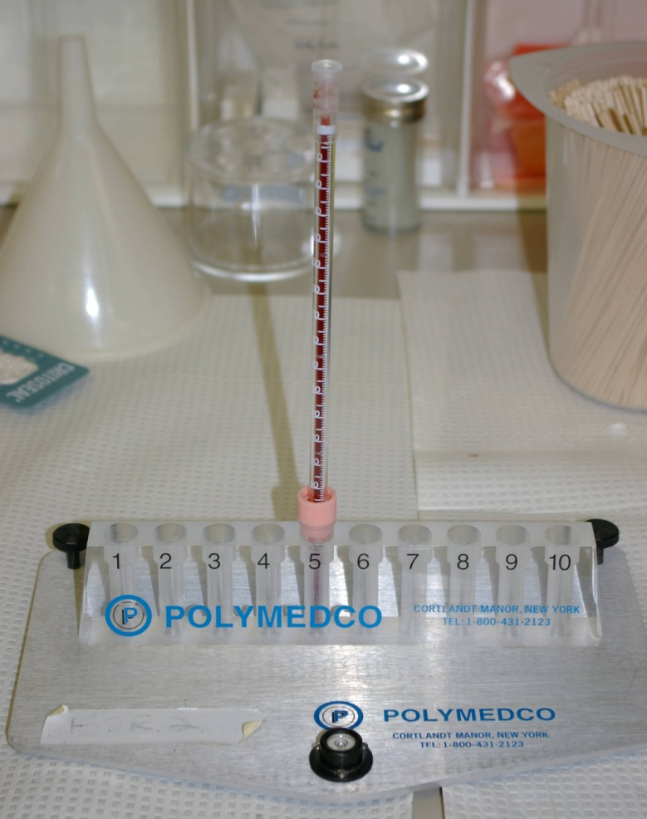
Manual Sed Rate Steps
Step 4: Place patient and control pipettes into wells in leveling plate

Slide 24
Procedure Overview Continued
At the end of the 60 minute time period read the numerical result of the ESR in millimeters
Two controls (normal and elevated) are run and are recorded both electronically and in written format in the Results and QC Log Notebook

Slide 25
~The End~ ☺

