Slide 1
TASKLIST & ESR 2
Michell Lowe – 10/2016

Slide 2
CREATING A TASKLIST

Slide 3
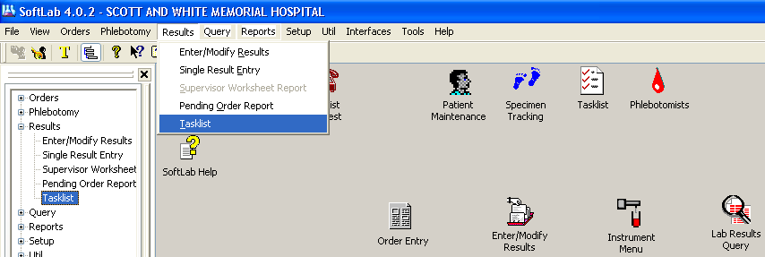
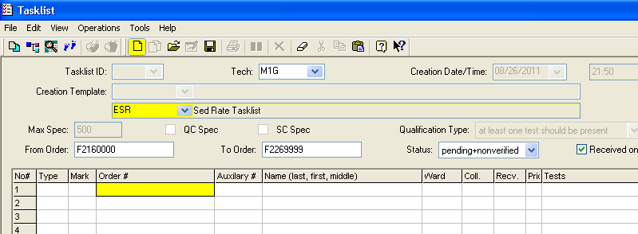
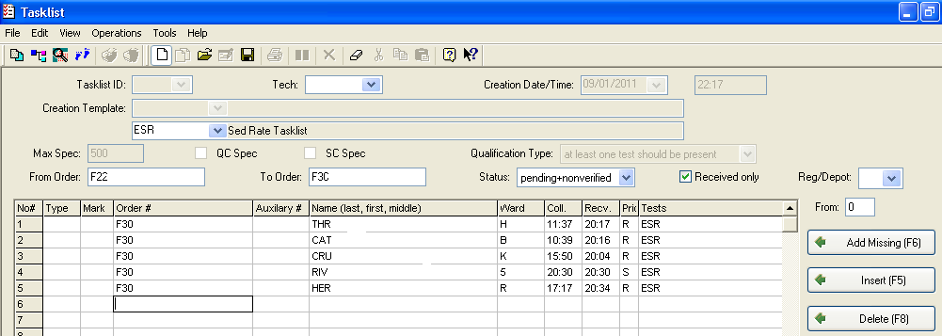
TASKLIST
To get into your Tasklist you have 3 options to use. See RED circles to the Right.
Click New
Type in ESR or AHMAN
Click in the Order # section
Type or Scan barcodes for
ESR specimens.
Click Save
when done.

Slide 4
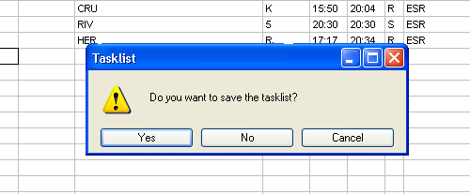
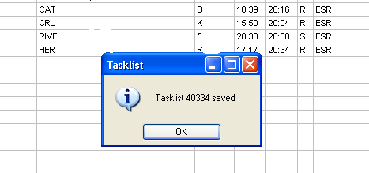
TASKLIST
Click Yes to save
Write down your tasklist
number or remember what
the number is.
You will need this again.
Go to the main screen and click on Resulting Worklist
icon

Slide 5
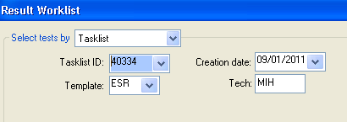
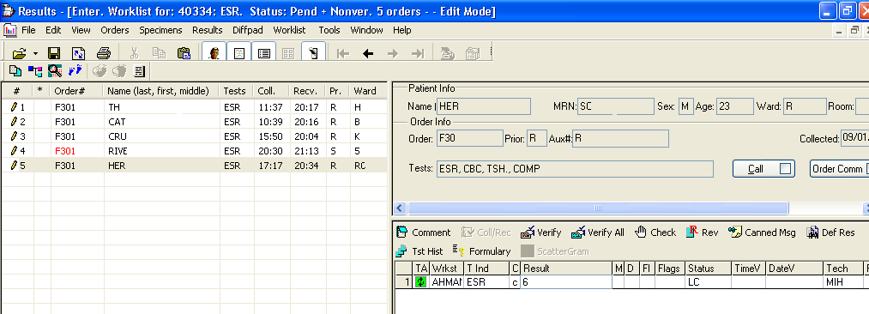
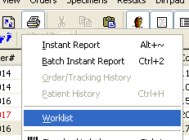
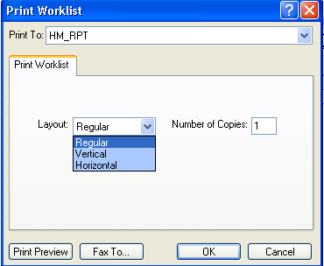
TASKLIST
Change your Template to
Tasklist, put in your Tasklist number. Click OK.
Input each patient results
and click save between each patient. Notice the pencil
next to the patient after
each save.
Click on the print icon, then click on worklist.
Change the layout to vertical or horizontial using the drop down box. Click OK.

Slide 6
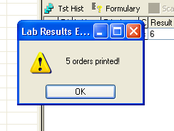
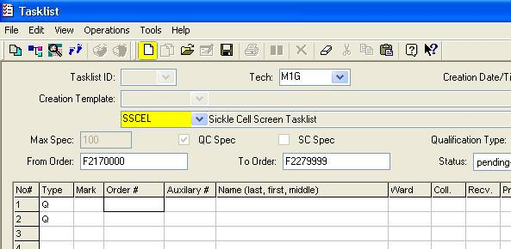
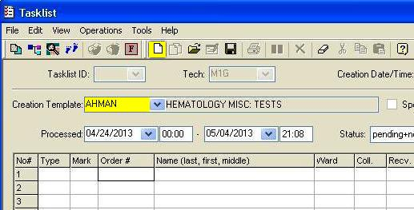
TASKLIST
Click OK on the message
box confirming ordered
printed.
For SSCELL you do the same as ESR except under Template use SSCELL. You will notice under “Type” there is a letter Q, you must use the drop
down box and put a blank in those spaces before scanning or typing
your barcodes. You may also drop
down to Line #3 and start there.
Then proceed with same steps used for the ESR.
You may also combine the
ESR and Sickle Cell together by using AHMAN for your
Template.

Slide 7
REFLEXING AN ESR 2

Slide 8
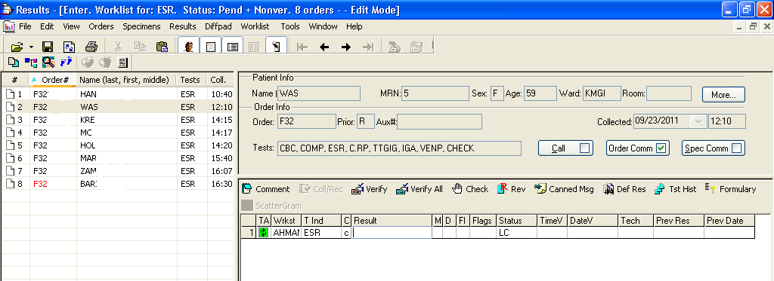
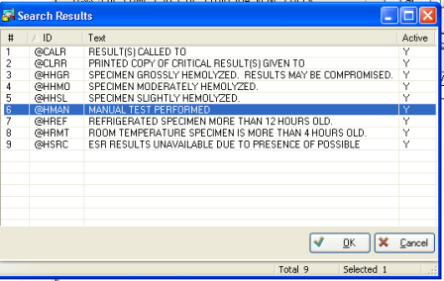
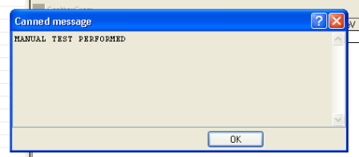
REFLEXING AN ESR 2
Go to ESR pending, find the
patient that you need. Put
your cursor on the ESR
“Result” box. Click on
“Canned Msg”.
You need the message
“MANUAL TEST PERFORMED”, click OK.
Click OK

Slide 9
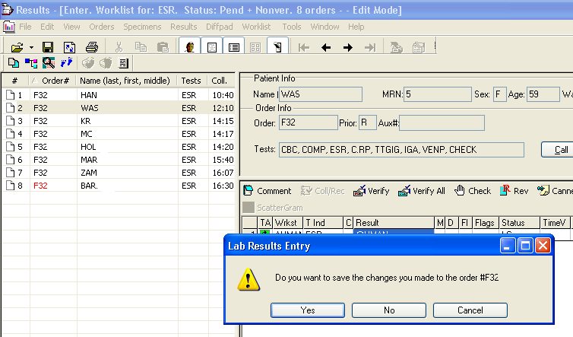
REFLEXING AN ESR 2
Bridge to Order Entry 1st,
then click Yes to save.
Once in Order Entry click
SAVE.

Slide 10
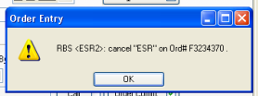
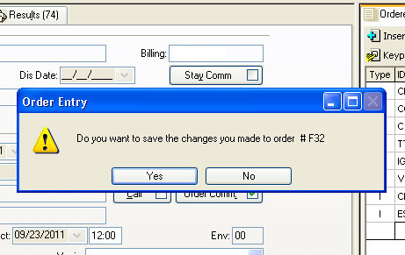
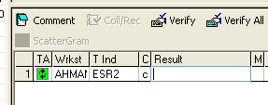
REFLEXING AN ESR 2
Click OK
Click YES to save.
Click the Big Red Box in the top right corner.
You will automatically return back to your ESR pending.
Your ESR is now an ESR2.

Slide 11
~ THE END ~

