Slide 1
SINGLE RESULTS &
Multiple records posting
By: Michell McAdams & emily gehring
08/2012

Slide 2
SINGLE RESULTS ENTRY

Slide 3
POSTING RESULTS
The Sysmex flags the results as “Negative” and “Positive”
“Positive” results will print out a graph; “Negative” results do not print.
The results are verified using either Single Results, or Multiple Records Posting (“batch” posting).
While using Multiple Records posting:
  “Negative” results will verify without stopping on the interface, unless it is un-received.
  “Positive” results will stop in the interface for the tech to review prior to releasing results.
  All positive results will begin with “FMOR+” “FDIF+” or “FCNT+”

Slide 4
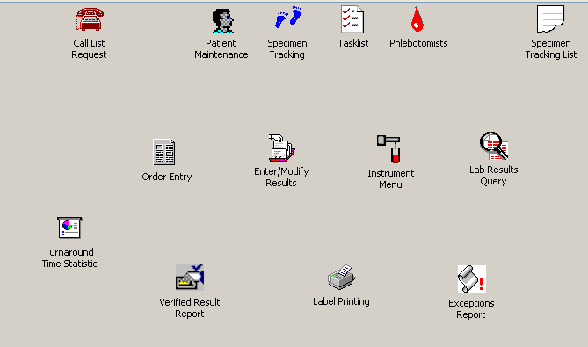
Single Results entry
From the Main Soft Screen go to Instrument Menu

Slide 5
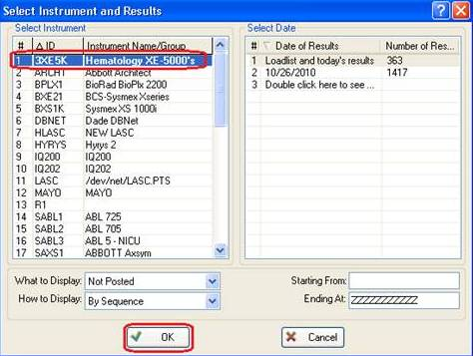
Sysmex interface
Once in the instrument menu click on Hematology XE-5000’s (3XE-5K) This is a combination of all three instruments. Then click ok (you can also double click on the instrument to open it)

Slide 6
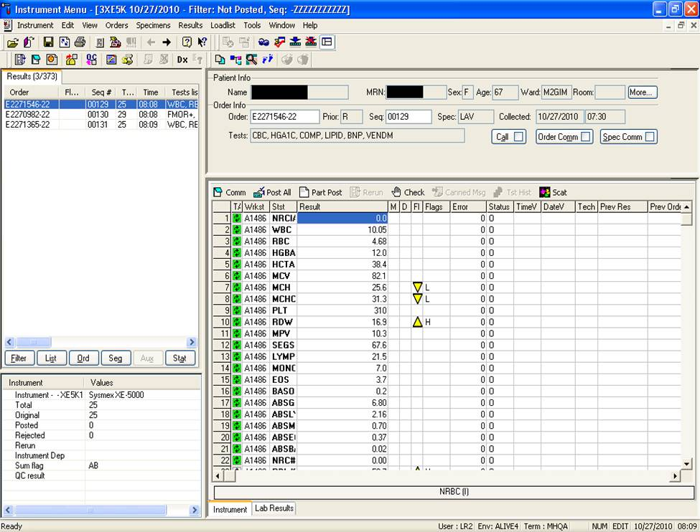
Single results entry
For Single Results Entry you will use the Post All or Part Post.
Post All will verify all your results. This includes the diff portion.
Part Post will verify only the Hemogram.

Slide 7
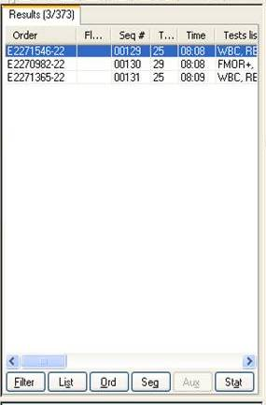
Single results entry
When looking at your instrument all Positive Results will begin with a “FMOR+”, “FDIF+” or “FCNT+”. All others will be Negative.
For all Positive results that need a diff you will
For all Negative results you will
If you have a H/H, or a Hemogram and the PLT looks good you will
For Critical, Delta, or PLTs follow the same rule as Multiple Records posting and bridge over to the Worklist. When returning to the instrument; REFRESH and continue to verify.

Slide 8

Single results entry
After going through your list you will need to refresh your menu for more pending results that need to be verified.

Slide 9
Multiple records posting

Slide 10
Sysmex Interface
From the Main Soft Screen go to Instrument Menu

Slide 11
Sysmex interface
Click on Hematology XE-5000’s (3XE-5K), Click ok (you can also double click on the instrument to open it)

Slide 12
Multiple records posting
Click on the Multiple Records Posting icon in the tool bar

Slide 13
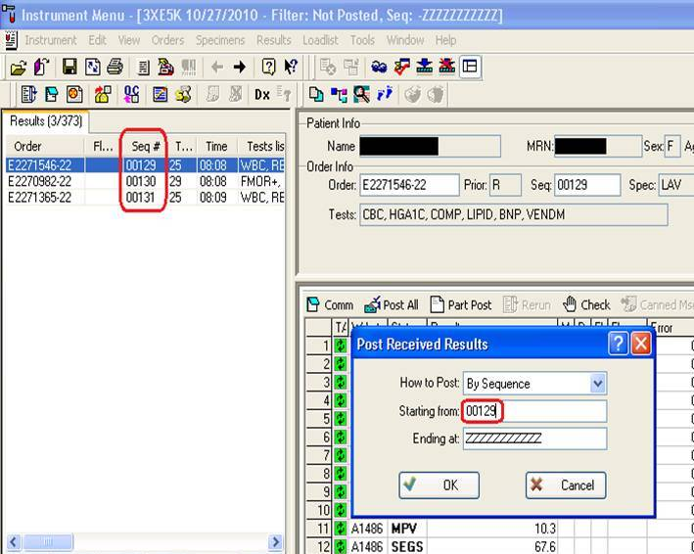
Starting a run
Click the OK button to start posting.
***NOTE: if your instrument menu seems to be running slow in the “Starting from:” box you can enter the sequence # that is at the top of the list.

Slide 14
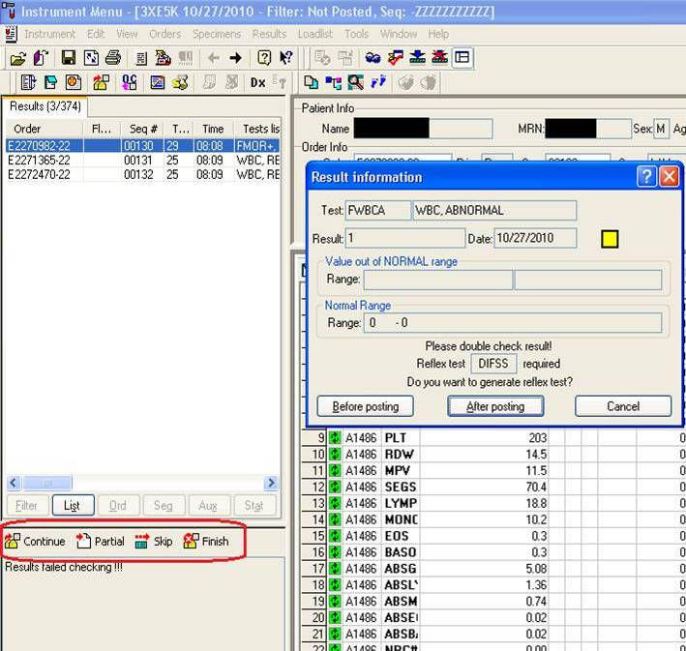
Multiple records posting
While in Multiple Records Posting a tool bar appears. These icons are used to verify results in the interface.
Verifies all test.
Verifies only the hemogram; leaving the differential pending.
Skips results temporarily.
Stops multiple records posting at any point in the batch.

Slide 15
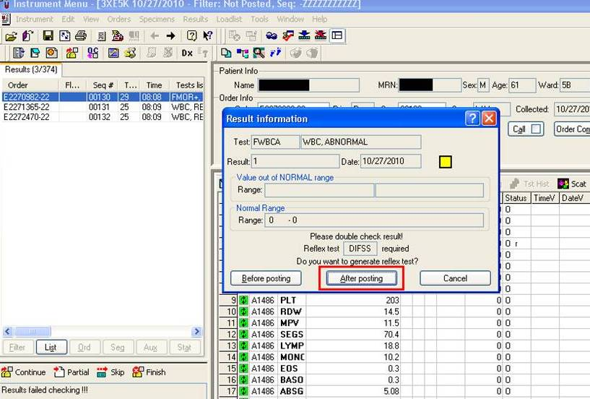
Multiple records posting
All negative results will verify without any review. A box will appear for every positive order that corresponds to the Sysmex Flags. These flags will determine how to release the results.
Click After Posting (or hit “Enter” on the keyboard) for each pop-up box.

Slide 16
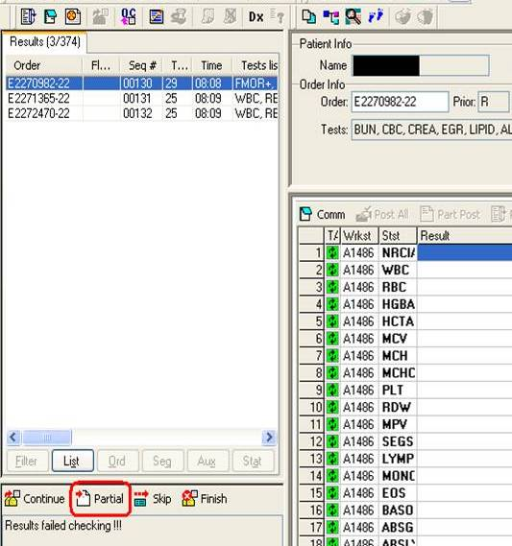
Multiple records posting
Click the “Partial” icon to verify the hemogram.
You can also use “Ctrl+B” on the keyboard.
***NOTE: If there is a critical or delta result you must follow policy for those results. If the hemogram has a low PLT, follow the Low PLT policy.
If you have a result you are not wanting to report See next slide.

Slide 17
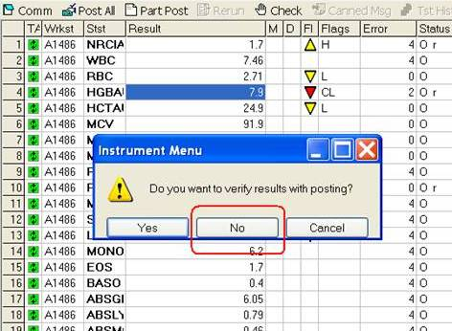
Bridging over
Critical, Delta, PLts, ect.
To bridge from the Interface to the Worklist, click on the icon
A box will appear asking to verify results with posting; always say “No”.
Results will be verified on the Worklist screen.
Use [ from the keyboard to line verify your results. Use the ↓ to skip any result.

Slide 18
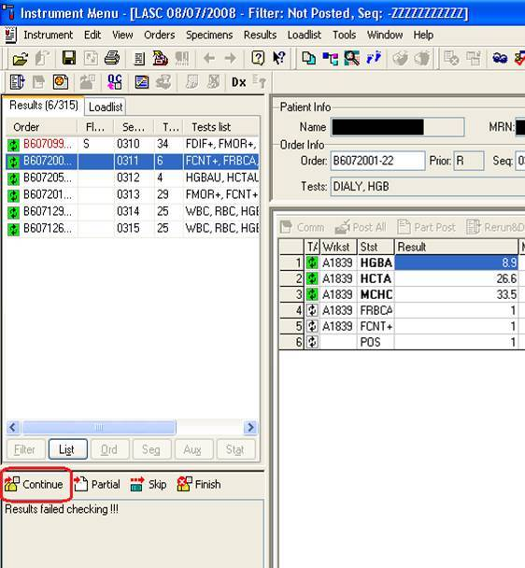
Returning to interface
Once you finish verifying, go back to the instrument interface to finish the run.
To continue hit F12 or Continue.

Slide 19
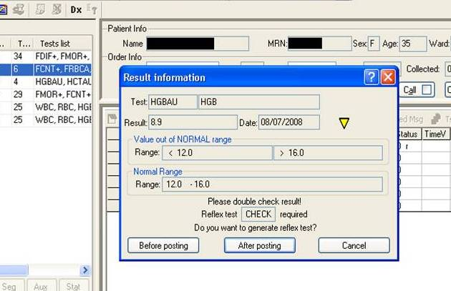
Multiple records posting
Verifying a positive H/H or Hemogram
Click “After Posting” or “Cancel” on the pop-up box.

Slide 20
Multiple records posting
Click on the “Continue” icon to verify the results.
You may also use “F12” from the keyboard.
***NOTE: If there is a critical or delta result you must follow policy for those results. If the hemogram has a low PLT, follow the Low PLT policy.

Slide 21
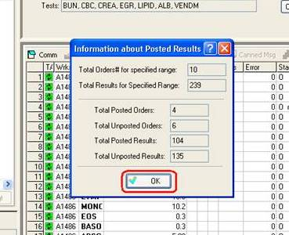
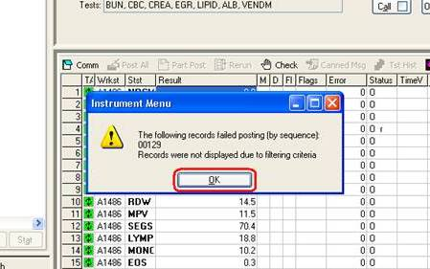
Ending a Run
At the end of each run or batch click OK on the information boxes. (These boxes contain info about the number of results released during a batch and new pending results.
If there are still results in your list start a new batch.

Slide 22
Multiple records posting
The End
☺

