Slide 1

CAP Checklist
Basics
Navigating the CAP Checklists

Slide 2
What is CAP?
The College of American Pathologists (CAP), the leading organization of board-certified pathologists, serves patients, pathologists, and the public by fostering and advocating excellence in the practice of pathology and laboratory medicine worldwide.
The CAP, founded in 1946 celebrates over 50 years as the gold standard in laboratory accreditation and advocates accountable, high-quality, and cost-effective patient care.

Slide 3
The Benefits of CAP Accreditation
Expert Inspection Teams
The CAP Laboratory Accreditation Program is the only one of its kind that utilizes multi-disciplinary teams of practicing lab professionals as inspectors. Because they deal with lab issues on a daily basis, these inspectors are uniquely qualified to provide you with a thorough inspection that is specific for each section of the lab.
Compliance with Regulations
The CAP Laboratory Accreditation Program helps you meet and exceed requirements of the Centers for Medicare and Medicaid Services (CMS) as well as those of other national and state regulatory bodies.
Unparalleled Educational Opportunities
Lab professionals are involved on both sides of the inspection process, so there is always a healthy exchange of ideas and discussion of the latest lab techniques that goes beyond regulatory requirements. There is something valuable to take away from every inspection.
Useful Inspection Tools
The inspection Checklists constantly evolve to reflect current practices and technologies and therefore serve as living documents on good laboratory practice. Adhering to the Checklists provides assurance that your lab is doing all it can to produce the highest quality test results.

Slide 4
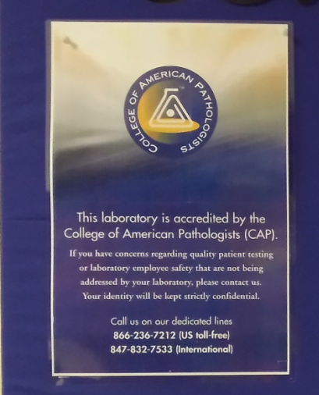
CAP has a toll free number where quality concerns can be reported confidentially.
You can find a copy posted on the wall to the right of the water fountain.

Slide 5
TRUE or FALSE
Only pathologists, managers, and supervisors need to have knowledge of the CAP checklists.
False
All laboratory personnel need to have a working knowledge of the format and content of the CAP checklists.

Slide 6
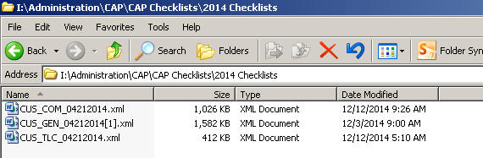
Where are the checklists located?
The most current checklists are downloaded from the CAP website and can be found on the laboratory drive:
I:\Administration\CAP\CAP Checklists\20XX Checklists

Slide 7
Format of Checklists
Cover Page
General info and disclaimers
Table of Contents
Summary of checklist changes
Explanation of checklist components
How to inspect a lab
Checklist requirements by category

Slide 8
CAP Standards
Each standard has an identifier followed by the description.
“GEN.20335 Customer Satisfaction”
The “GEN” identifies this as a General Laboratory Requirement
Each requirement has it’s own unique number
The requirements are listed in numerical order

Slide 9
Summary
Having a working knowledge of the CAP checklists
Explains why we do what we do
Improves quality
Gives the entire team, not just leadership, accountability
for satisfying the requirements.
Keeps the entire team “on the same page”

Slide 10
There is no test associated
with this module

