Slide 1
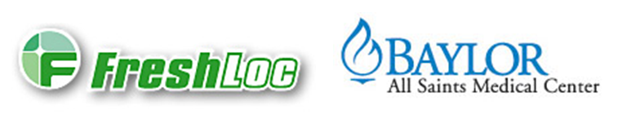

FreshLoc Training

Slide 2
What is FreshLoc
  A wireless, constant monitoring of all refrigerators, freezers, ovens, room temperature, and humidity where indicated. This is a system controlled remotely by a 3rd party vendor in which access is granted to view, change, and correct temperature readings.

Slide 3
Why FreshLoc?
  This product helps standardize Laboratory procedures with regards to refrigerator, freezer, room temperature, and oven monitoring in accordance with CAP standards. Data is also recalled faster for instances where a look-back is necessary. It is a continuous monitoring system, unlike previous methods.

Slide 4
Where is FreshLoc?
  FreshLoc is located in all refrigerators, freezers, ovens, and where applicable room temperature readings are needed.

Slide 5
Who has access to FreshLoc?
  All leadership personnel
    Managers are ultimately the Super Users
    Supervisors
    Senior Technologists
    DPIC (Designated Person In Charge)

Slide 6
Alert for Temperature Failure
FreshLoc constantly monitors the temperatures; in the event of a temperature failure, an alert will be sent. At our facility, this alert is received via pager located in the Corelab.

Slide 7
The Alert (Pager)
When the pager goes off it will display:
  Alert: #S16844091 (this is the strobe ID #)
  [BayAS-Lab] (lab location)
  BB – Cryo Frz #1 (location)
  >-20 (temp warning)

Slide 8
When an alert is received…
Immediately notify the department the alert is for.
Identify on-site staff having access to FreshLoc.
All alerts should be followed-up promptly with a appropriate documentation of resolution.

Slide 9
Competency Assessment
Please log onto MTS* and take the exam to complete this module.
(score of 100% is required)
*http://www.medtraining.org/ltac2/default.aspx

