Slide 1
BASMC Clinical Laboratory
Lean and Kanban Processes

Slide 2
What is “Lean”?
A fanatical devotion to the elimination of waste and non-value added activities
WASTE

Slide 3
Why Lean?
It’s for the good of:
  Patients
  Employees
  The organization in the long-term
  Reducing Laboratory Turn-Around- Times and errors

Slide 4
Laboratory Disciplines Where Lean Applied
  In-patient phlebotomy
  Specimen Processing
  Chemistry
  Hematology
  Coagulation
  Immunoassay
  Urinalysis
  Blood Bank
  Histology
  POC is currently in the assessment phase (2013)

Slide 5
Lean Team Observed “How we’ve always done it”
Videotaping and process observation
  Videotaping of staff performing routine daily tasks
  Staff asked “How?” and “Why?”
Process pilots and changes
  Evaluating Layout, workstation design, processes
  Emphasis on “working smarter, not harder”
Activity of the Product:
  What is actually happening?
  What steps are actually value added?
Activity of the Person:
  What % of time is value added?
  Where are people imparting variability?
Staff given opportunity to offer input and inquire about process.

Slide 6
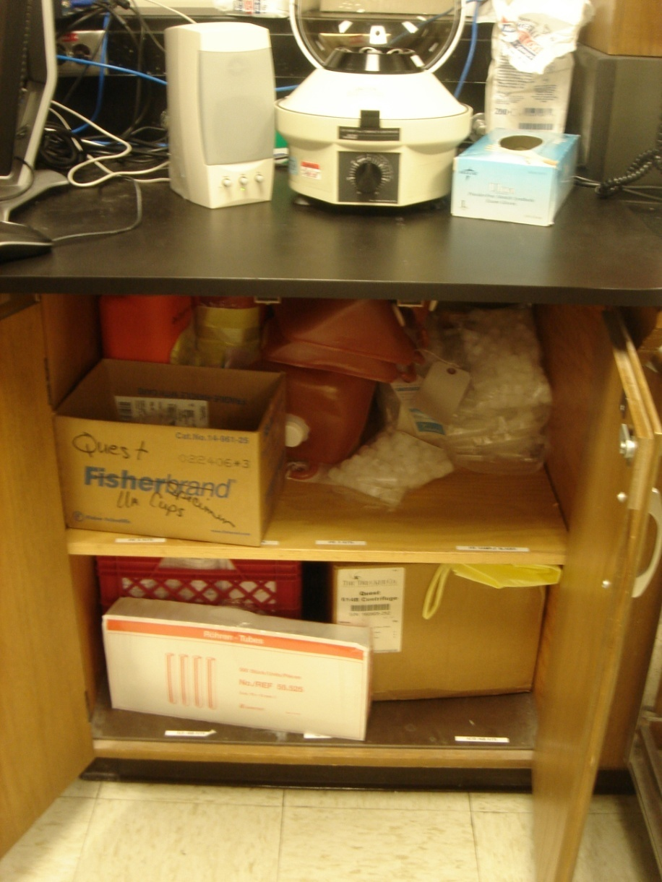
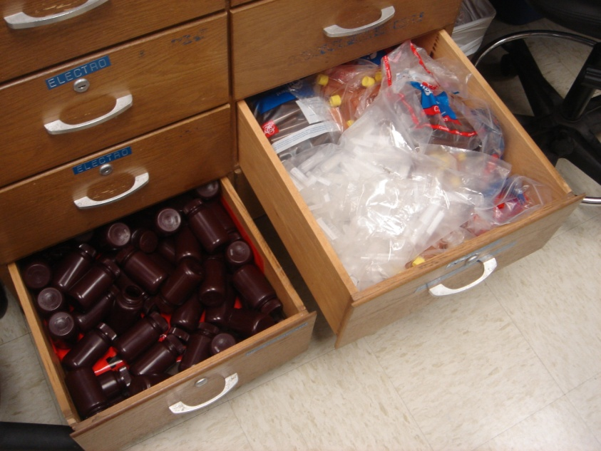
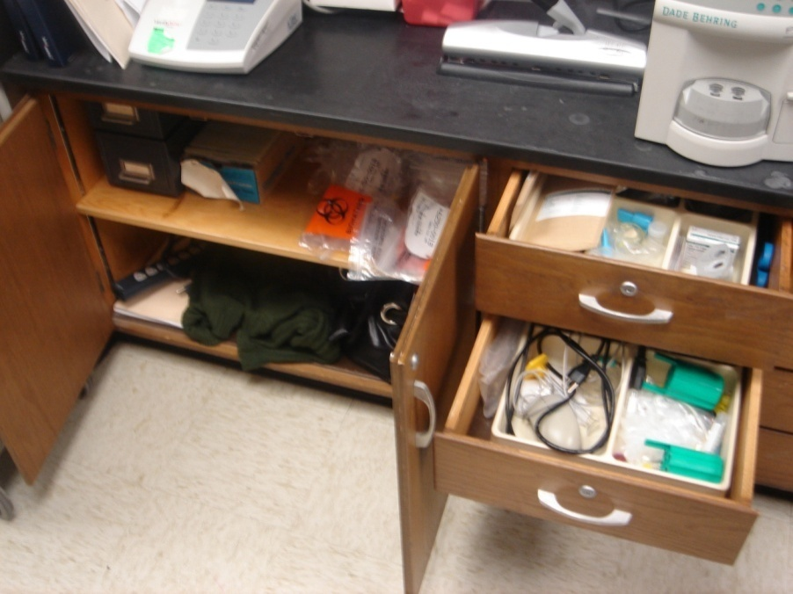
Storage the “old” way…

Slide 7
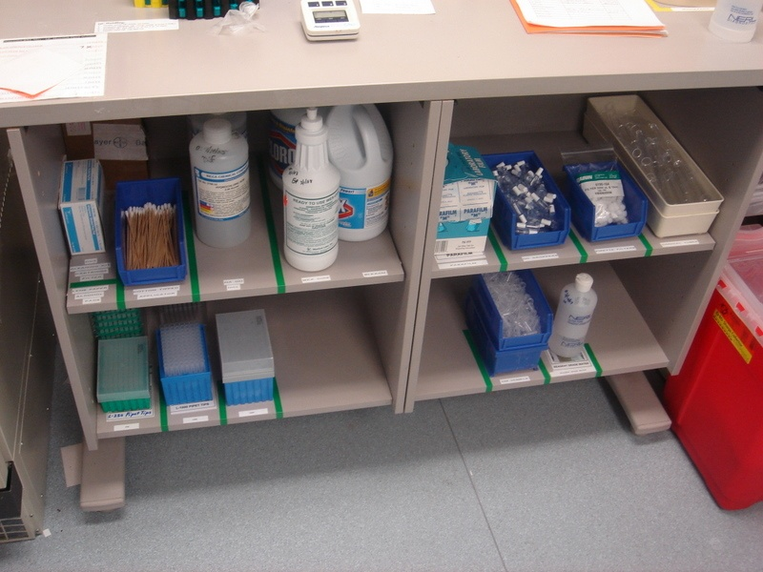
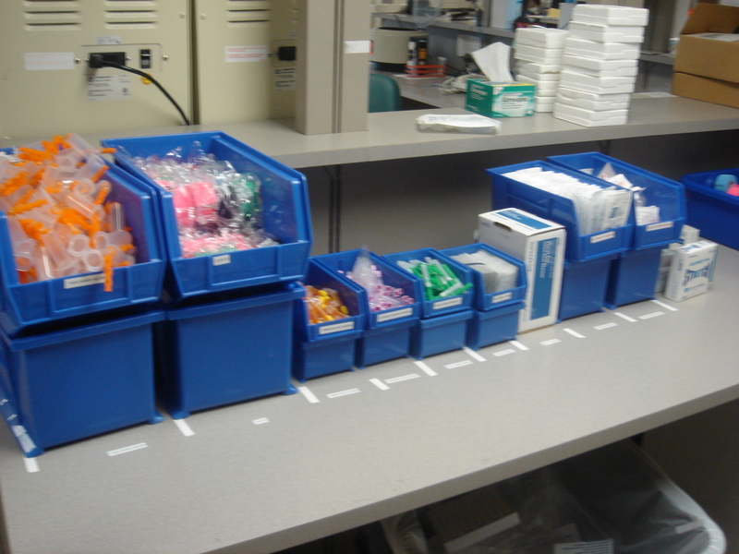
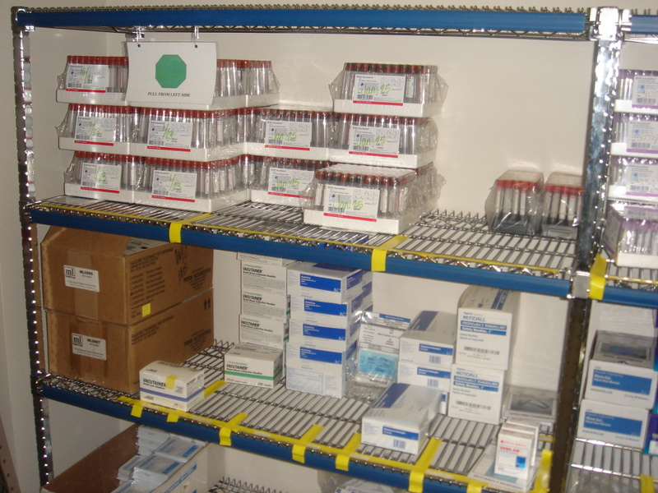
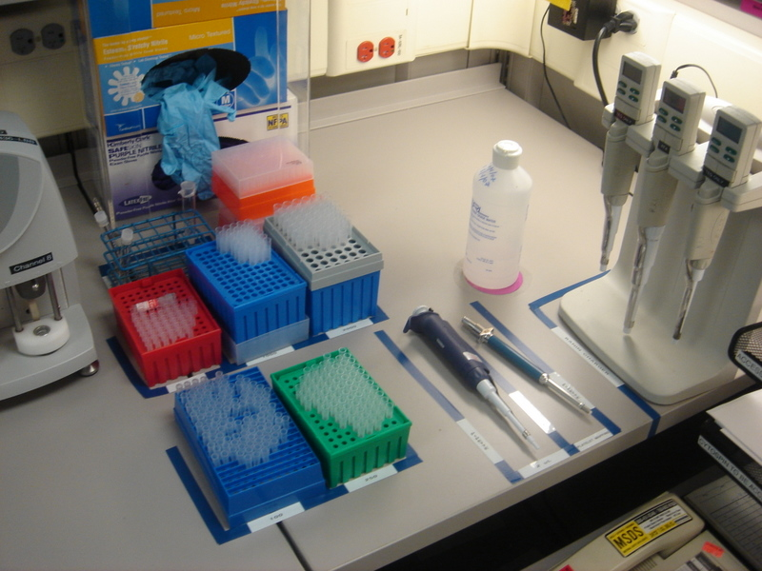
…and the Lean way

Slide 8
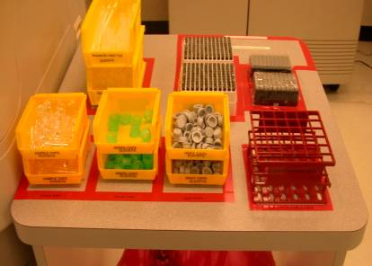
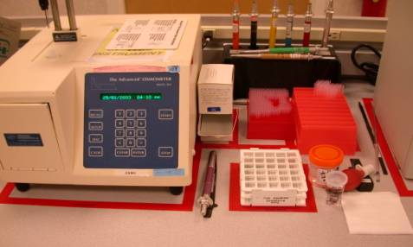
Work Areas Formatted
A taped “footprint” for all instruments and supplies ensures an orderly work area and gives user a quick visual of any items missing from bench.

Slide 9
Lean Benefits
Patients
  Better, safer care
  Reduced Turnaround Time / Length of Stay
  Reduced Cost
Employees
  Reduced waste, walking, and frustration
  More time for taking care of patients
  Reduced risk of errors
Physicians
  Improved support
  Reduced delays / cancellations
  Increased capacity for surgery
  Reduction of risk of errors
The Hospital
  Reducing costs by eliminating waste
  Driving revenue growth
  Attracting and keeping great employees

Slide 10
Lean Team Outcomes
Layout of processing and corelab areas changed for more efficient workflow.
Staff responsibilities revised to eliminate interruptions and duplication of tasks.
Kanban implemented for management of supplies.

Slide 11
What is “Kanban”?
Kanban: Japanese word meaning “signal” or card
  Kanban is a method of keeping a minimal amount of inventory and pulling items when needed
  Kanban is a systematic method of ordering materials and supplies.

Slide 12
Lean & Kanban
Implementing Kanban does not make you “Lean”
  Kanban is just a tool
The primary goal is not “zero inventories”
  Goal one: No interruptions
  Goal two: Minimum cost

Slide 13
Why Kanban?
Our previous method was not working, cycling between:
  Excess inventory
  Depleting inventory
  Expired inventory
Resulting in:
  Wasted space, cash, motion
  Disorganization
  Delayed test results
  Increased stress

Slide 14
What is“FIFO”?
FIFO = First In First Out
  Critical for avoiding expiration of supplies
Concept
  Old supplies to the front and new supplies behind.
  Always pull supplies from LEFT to RIGHT

Slide 15
Implementation of “FIFO”
A process that works
  Protects the patient
  Protects the hospital
A standard process
  Not dependent on any one individual
  A system that can work consistently
An adaptable process
  A system that works well over time
  Can react to growth and change

Slide 16
Types of Kanban
Two-bin
  Empty bin → Replenishment Trigger
Multiple-bin
  On regular cycle, # of bins used = # to order
Re-order point
  When inventory reaches a certain level, order a planned quantity

Slide 17
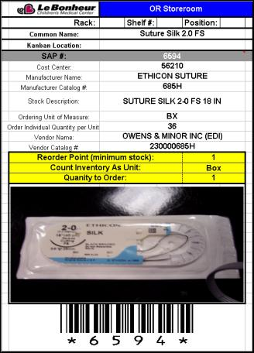
Kanban Reorder Point System
Pre-printed cards containing order information for each supply item are used to “mark” the order point for that item.
The card is placed at a predetermined point to “trigger” the user to order the item.

Slide 18
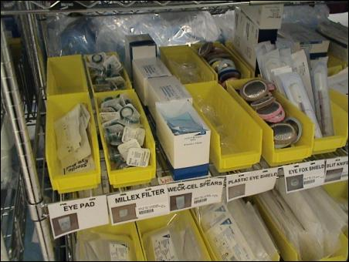
Two Bin
When one bin is empty, a second one is ready to complete the current task. Then, the empty is replenished and placed as the second bin. Placement can be stacked or one behind the other.

Slide 19
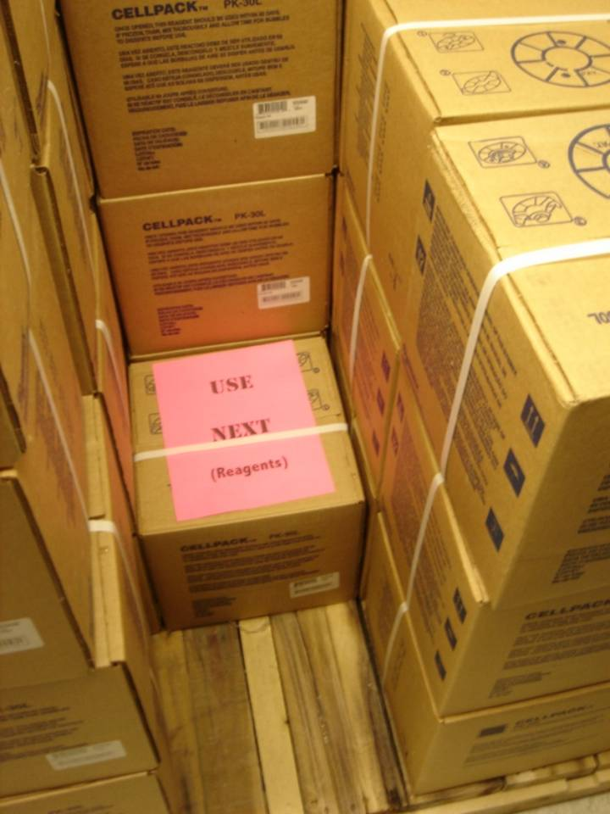
Multiple Bin
Works the same as two-bin, but not limited to just two containers

Slide 20
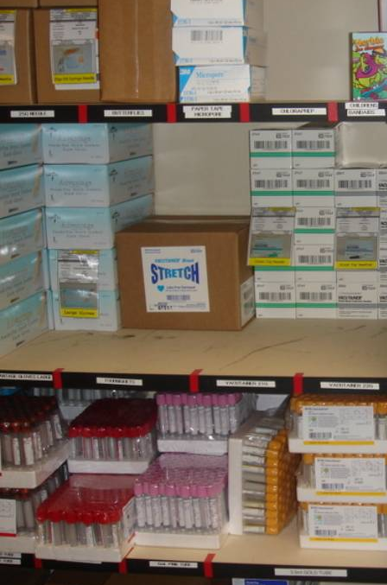
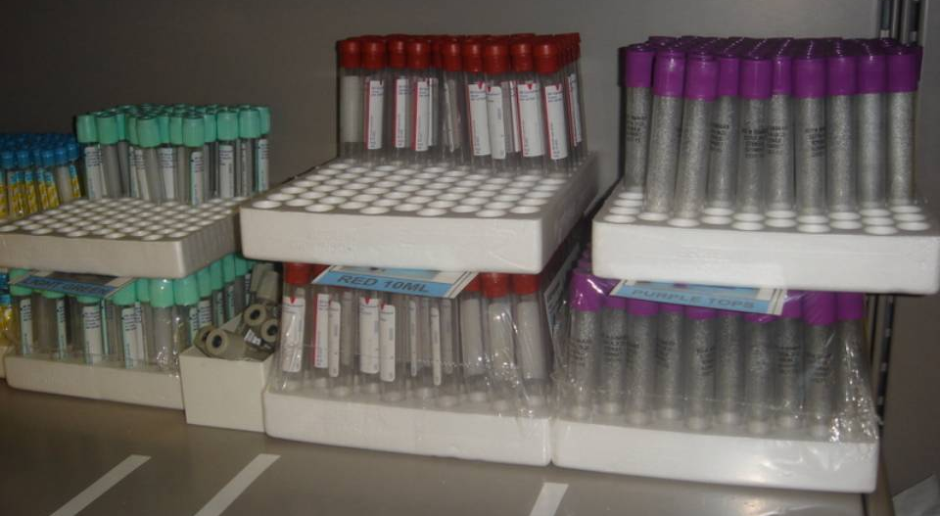
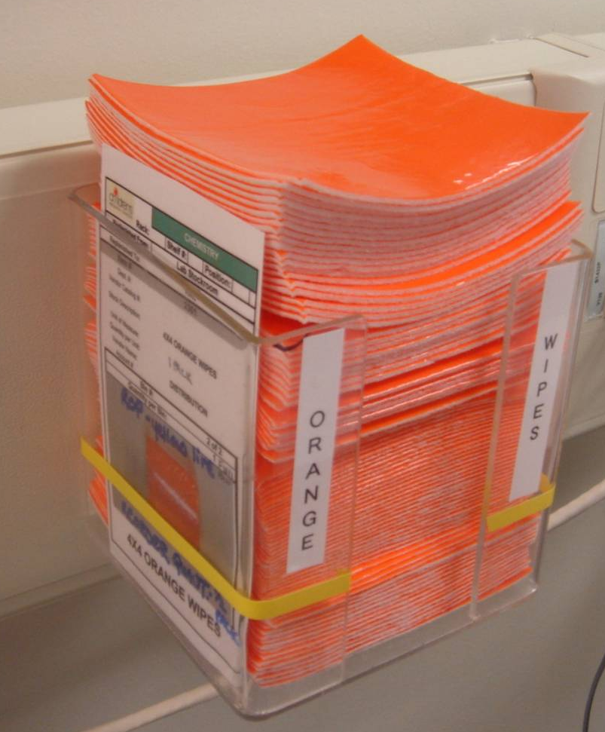
Reorder Point
Re-Order Point

Slide 21
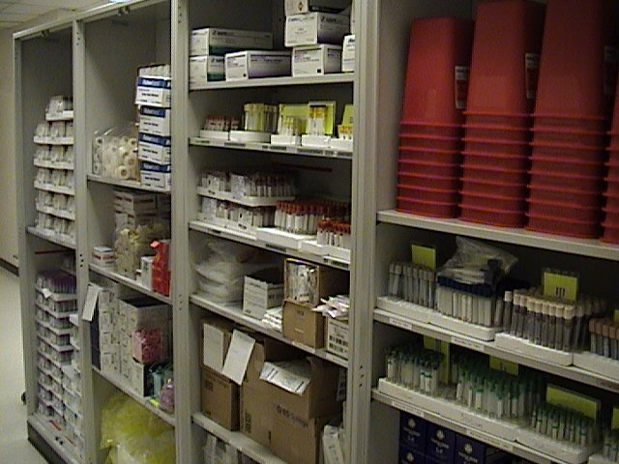
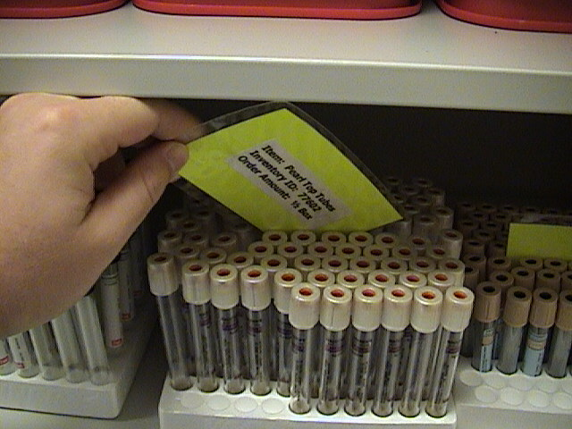
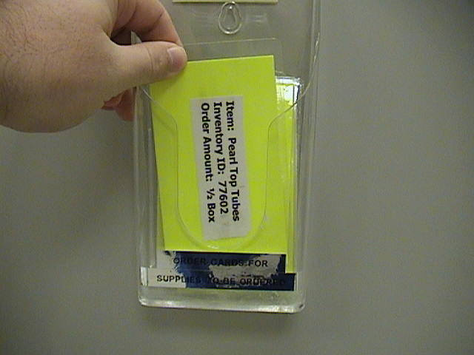
Material Control with Kanban
Proper organization
of supplies
When removing supplies
pull card when you get to it
Reorder Point
Items to Order

Slide 22
Kanban in On-Going
Not just one-time setup
To be successful, this requires:
  Training and communication
  Attention to detail
  Discipline
  Management oversight
  Clear ownership of the process and cards

Slide 23
Kanban Guidelines for Staff
  Know what to do when a Kanban container is empty or when a re-order point is hit
  Do not order material before it is needed
  If running out of material before more arrives or expediting, adjust the Kanban system

Slide 24
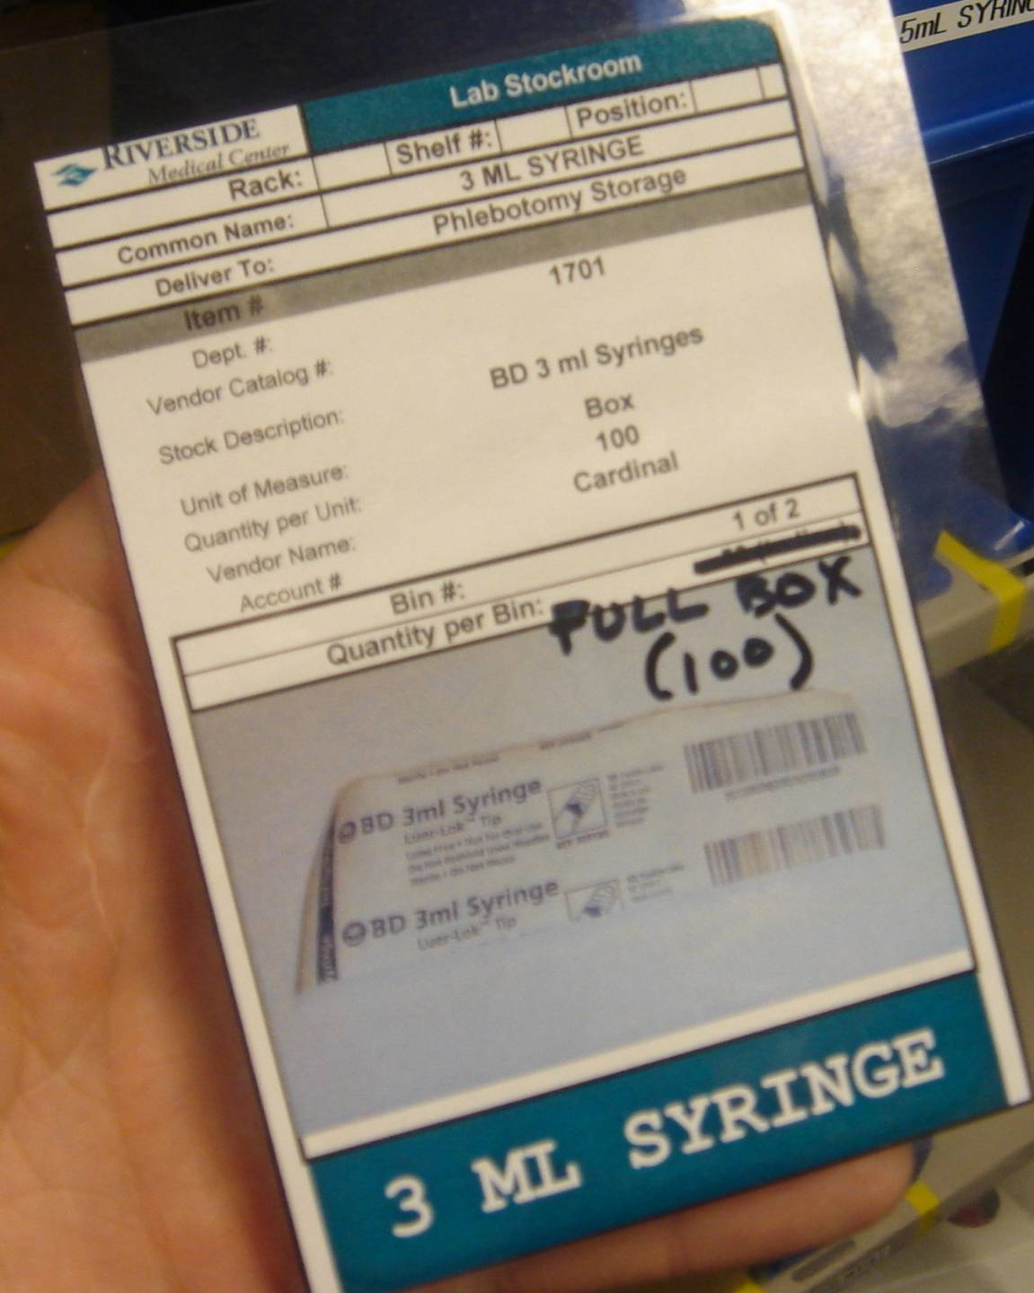
Reacting to Problems
If Kanban was not sized properly, need proper reaction
  Short-term: Expedite the items
  Long-term: Adjust the Kanban system
Long-term change:
  Adjust the system
  Change card / bin size
This can be done manually

Slide 25
Seasonal Variations in Stocking
Ways to handle seasonal supply needs:
  Increase bin quantities for busy season (two-bin)
  Temporarily add bins (multiple-bin)
  Increase re-order point and quantities

Slide 26
Kanban Formal Review
Daily:
  Are stock areas organized?
  Are cards/bins being moved properly?
  Tip: once things are working well, card/bin checks can be done less often
Monthly:
  Evaluate stock levels
    Has volume / demand increased for department?
    Any recurring stock outs or problems?

Slide 27
Kanban
What Kanban Looks Like in the Laboratory

Slide 28
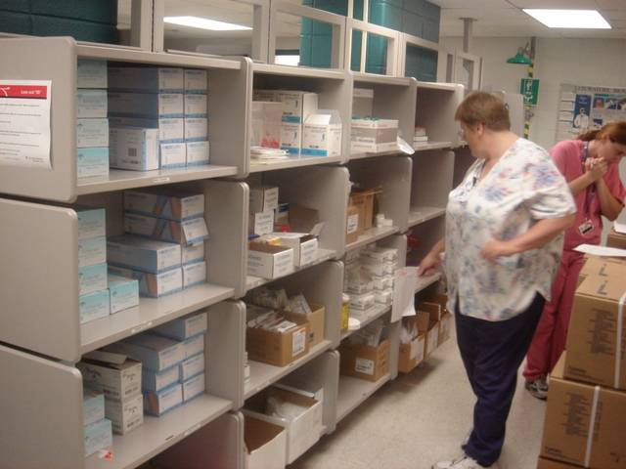
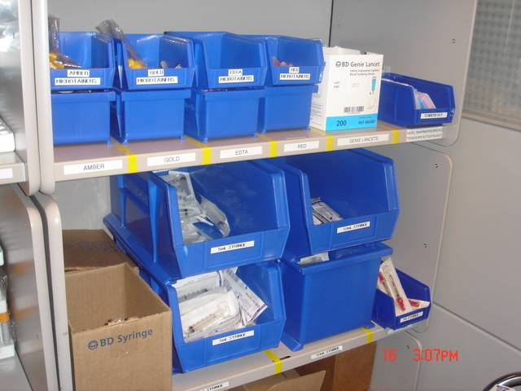
Phlebotomy
Before:
Stored far from front of lab
Location blocked flow
Uncontrolled inventory quantities
Inconsistent restocking process
After:
Closer to front of lab & phlebotomy carts
Reduced 6 linear feet of storage
More frequent & standardized replenishment

Slide 29
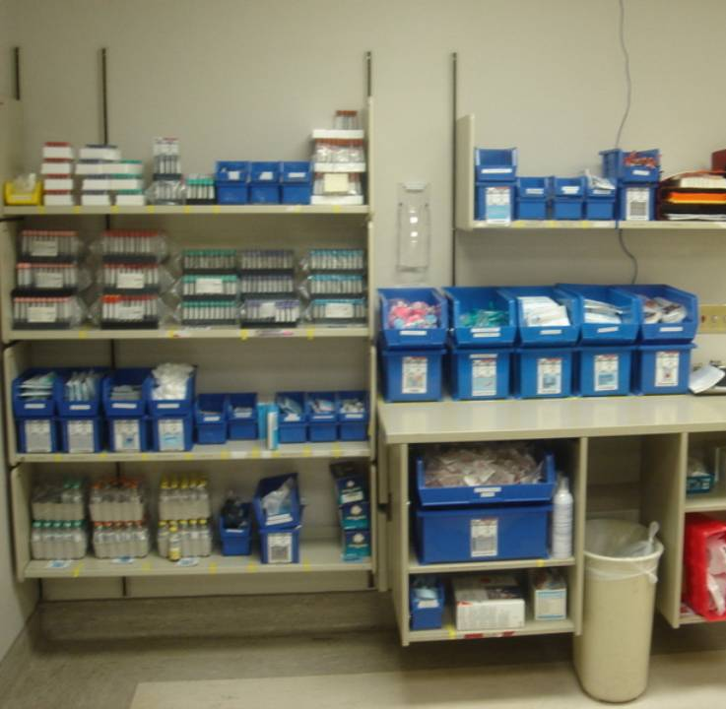
Phlebotomy
Tube stock:
  No dumping into bins
  Helps maintain FIFO & avoid expiration

Slide 30
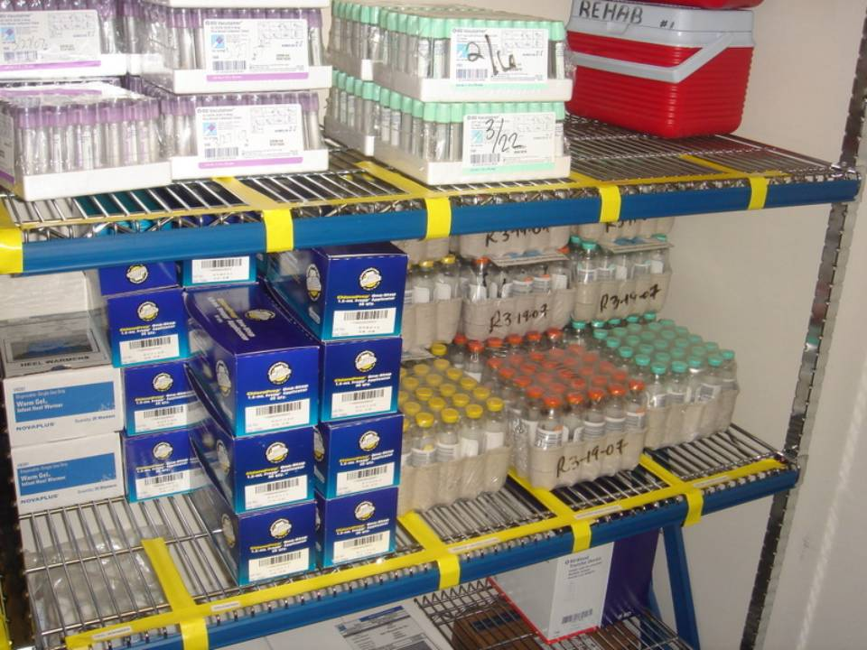
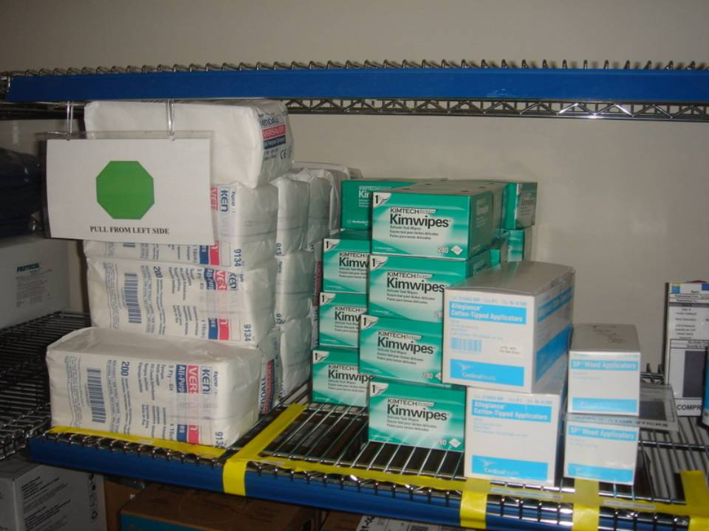
Stockroom
Reminder to pull material from Left to Right (for FIFO)

Slide 31
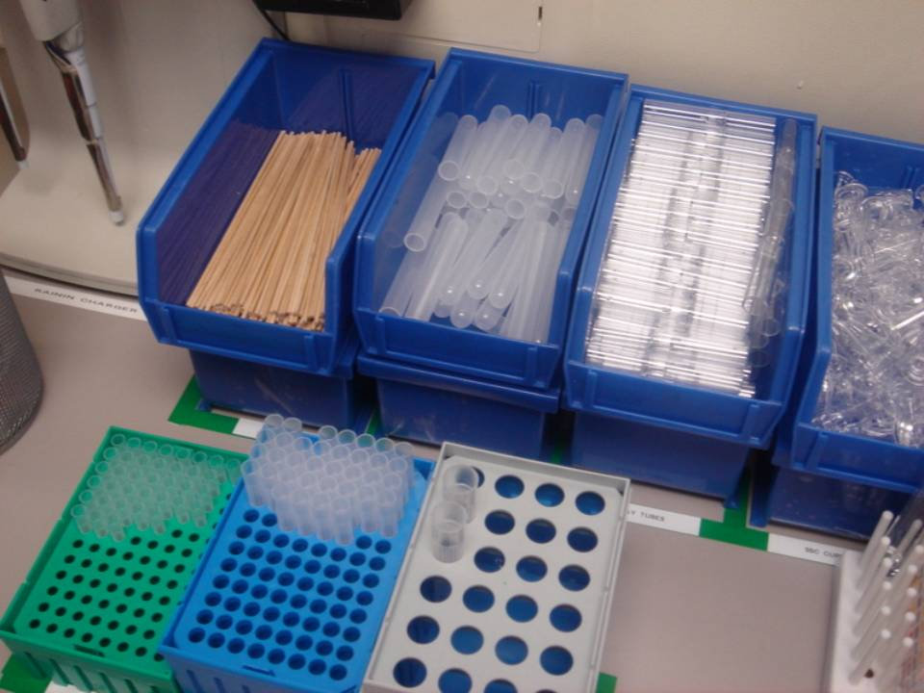
Two-Bin Example Lab Bench
Kanban and 5S practices
Bottom bin turned around – why?
Top bin in use
Lower bin full
and ready for
use when top one
is empty.

Slide 32
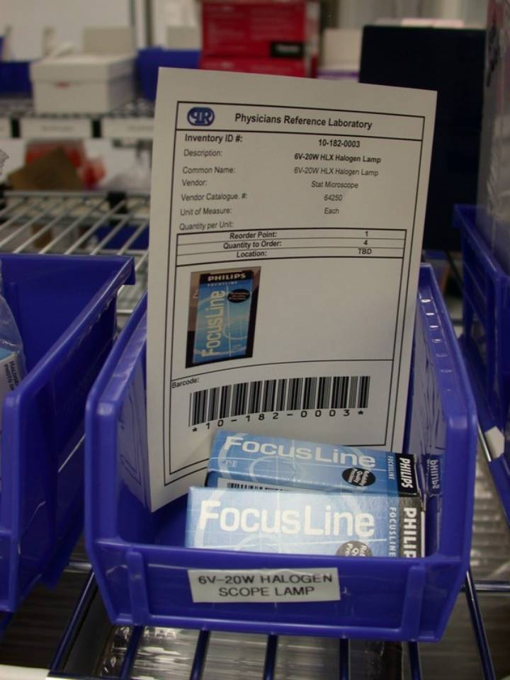
Reorder Point Example
Card in bin
  Meant to be visual indicator
  “Re-Order Point =1”
  “Quantity = 4”
  Problem?

Slide 33
Lean & Kanban 5S Concept
“5S”:
  Sort, Set in Order, Shine, Standardize, and Sustain
  Clear the workplace of unneeded clutter
  Put frequently used items where they are used
  “A place for everything and everything in its place”
The goal of 5S is not just neatness but:
  Reducing waste (walking, looking for things)
  Make problems easily identifiable

Slide 34
Kanban Improvement for our Lab?
We needed a process that works
  Protects the patient → no stock outs
  Protects the hospital → controls costs
We needed a standard process
  Not dependent on any one individual
  A system that can work consistently
We needed an adaptable process
  A system that works well over time
  Can react to growth and change

Slide 35

YES!
Thumbs up for Lean and Kanban!

Slide 36
Competency Assessment
There is an MTS exam associated with this training module:
Score of 100% is required
http://www.medtraining.org/ltac2/default.aspx

Slide 37
Competency
Close this document
Check the box verifying review of the document
Click “Take Test” to open exam

