Slide 1
BSWH All Saints Clinical Laboratory
Lean and Kanban Processes

Slide 2
What is “Lean”?
A fanatical devotion to the elimination of waste and non-value added activities
WASTE

Slide 3
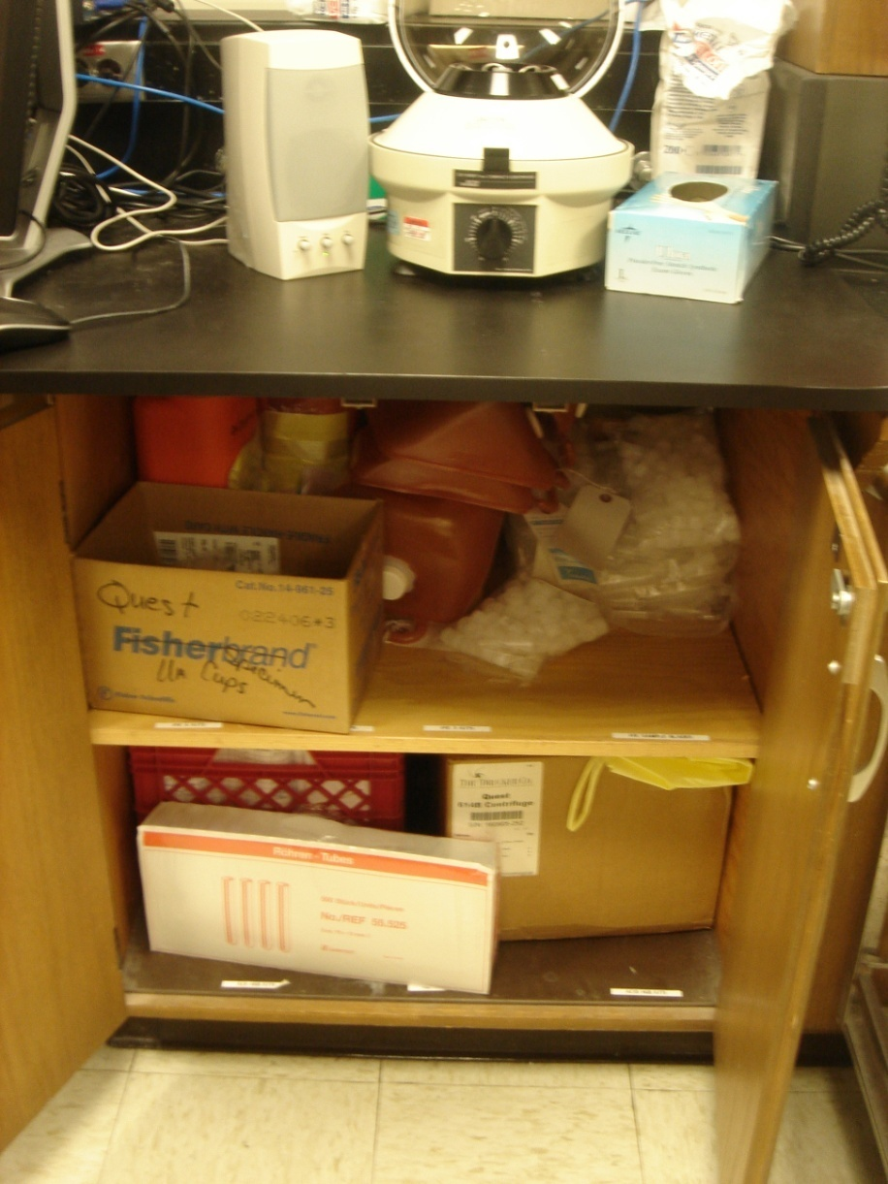
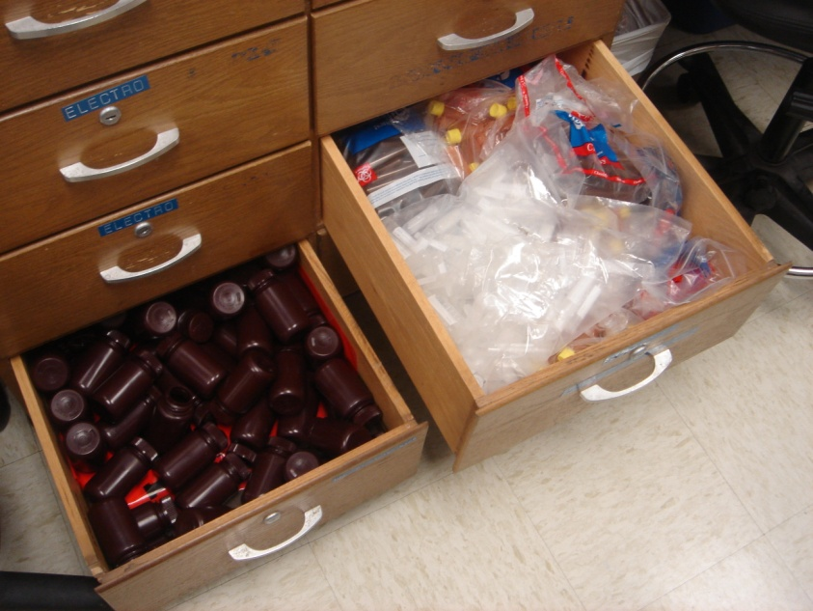
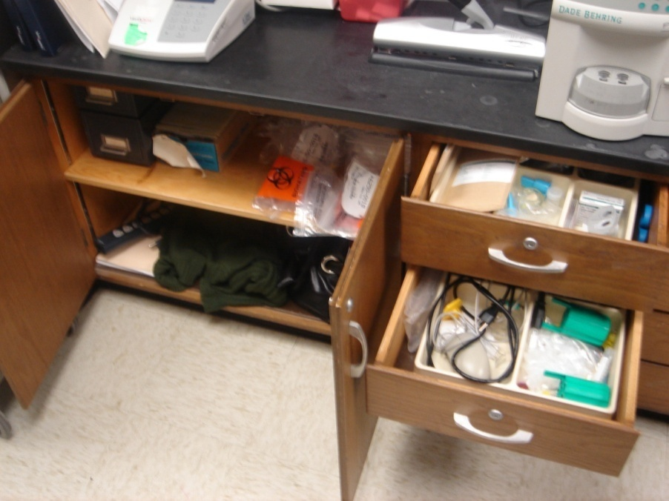
Storage the “old” way…

Slide 4
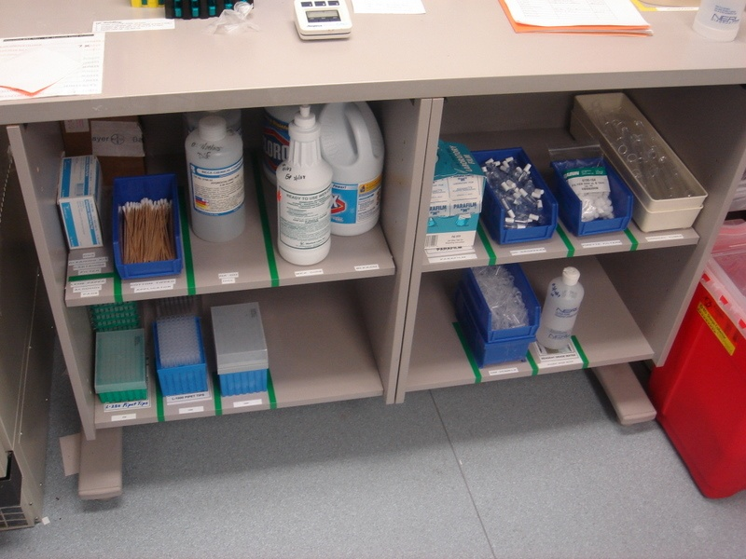
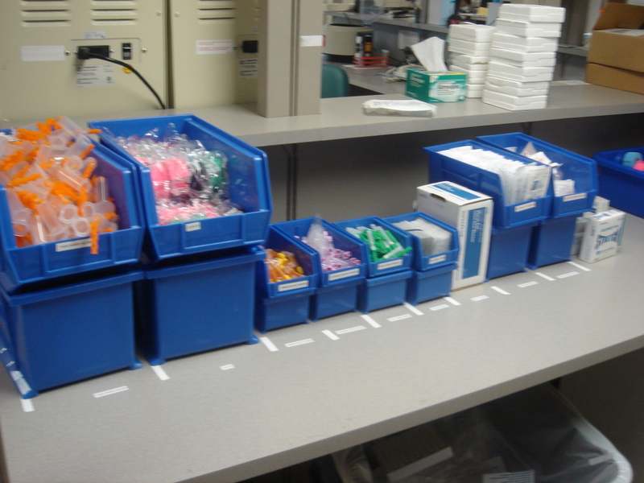
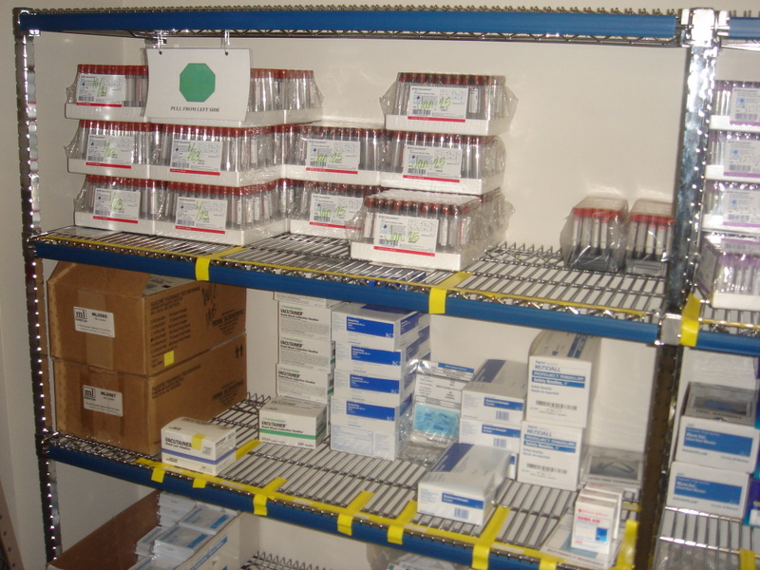
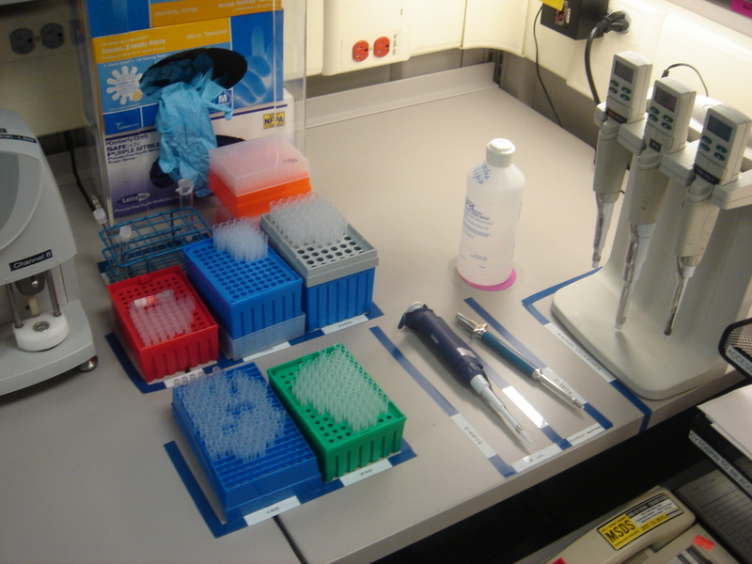
…and the Lean way

Slide 5
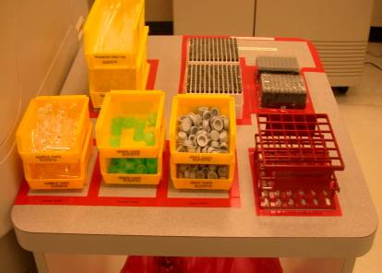
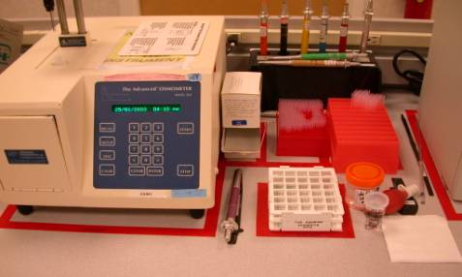
Work Areas Formatted
A taped “footprint” for all instruments and supplies ensures an orderly work area and gives user a quick visual of any items missing from bench.

Slide 6
What is “Kanban”?
Kanban: Japanese word meaning “signal” or card
Kanban is a method of keeping a minimal amount of inventory and pulling items when needed
Kanban is a systematic method of ordering materials and supplies.

Slide 7
Lean & Kanban
Implementing Kanban does not make you “Lean”
Kanban is just a tool
The primary goal is not “zero inventories”
Goal one: No interruptions
Goal two: Minimum cost

Slide 8
What is“FIFO”?
FIFO = First In First Out
Critical for avoiding expiration of supplies
Concept
Old supplies to the front and new supplies behind.
Always pull supplies from LEFT to RIGHT

Slide 9
Types of Kanban
Two-bin
Empty bin → Replenishment Trigger
Multiple-bin
On regular cycle, # of bins used = # to order
Re-order point
When inventory reaches a certain level, order a planned quantity

Slide 10
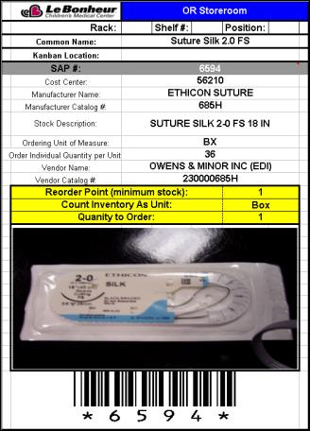
Kanban Reorder Point System
Pre-printed cards containing order information for each supply item are used to “mark” the order point for that item.
The card is placed at a predetermined point to “trigger” the user to order the item.

Slide 11
Two Bin
When one bin is empty, a second one is ready to complete the current task. Then, the empty is replenished and placed as the second bin. Placement can be stacked or one behind the other.

Slide 12
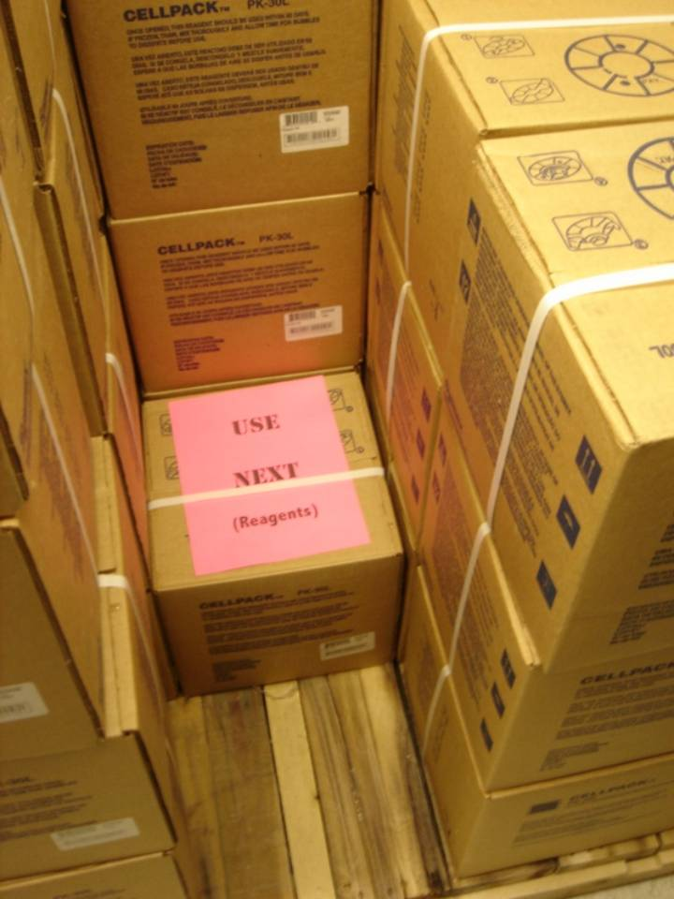
Multiple Bin
Works the same as two-bin, but not limited to just two containers

Slide 13
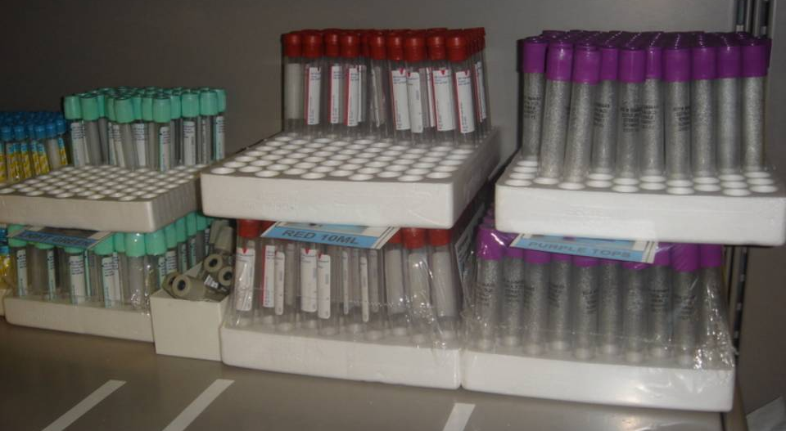
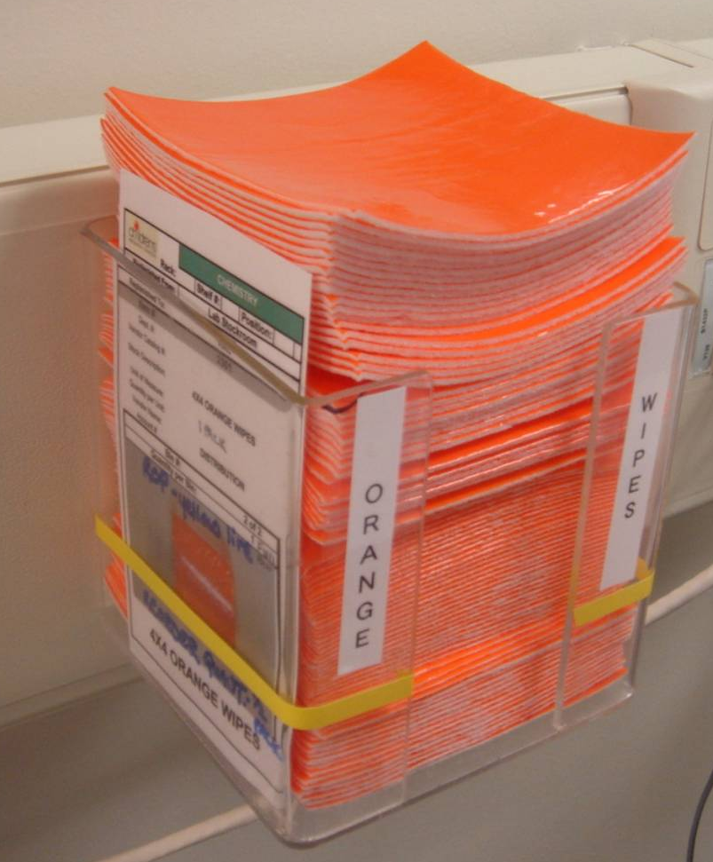
Reorder Point
Re-Order Point

Slide 14
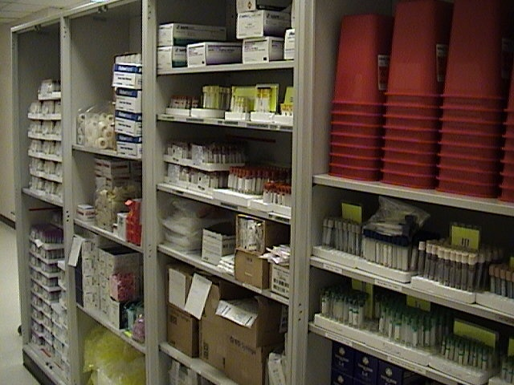
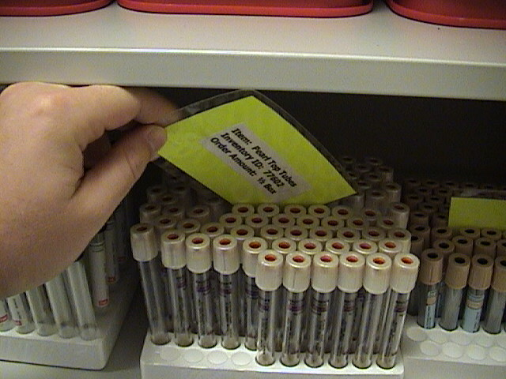
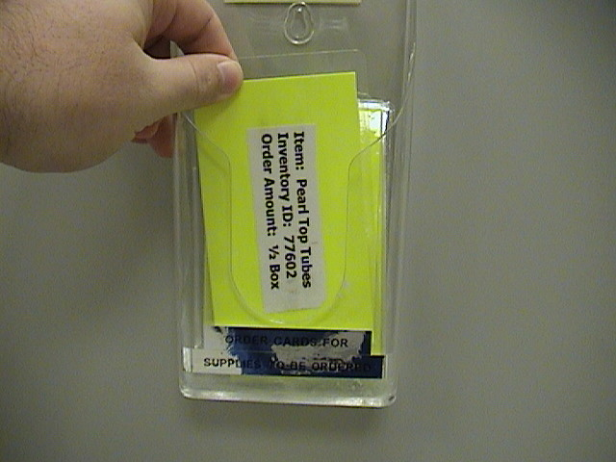
Material Control with Kanban
Proper organization
of supplies
When removing supplies
pull card when you get to it
Reorder Point
Items to Order

Slide 15
Kanban Guidelines for Staff
Know what to do when a Kanban container is empty or when a re-order point is hit
Do not order material before it is needed
If running out of material before more arrives or expediting, adjust the Kanban system

Slide 16
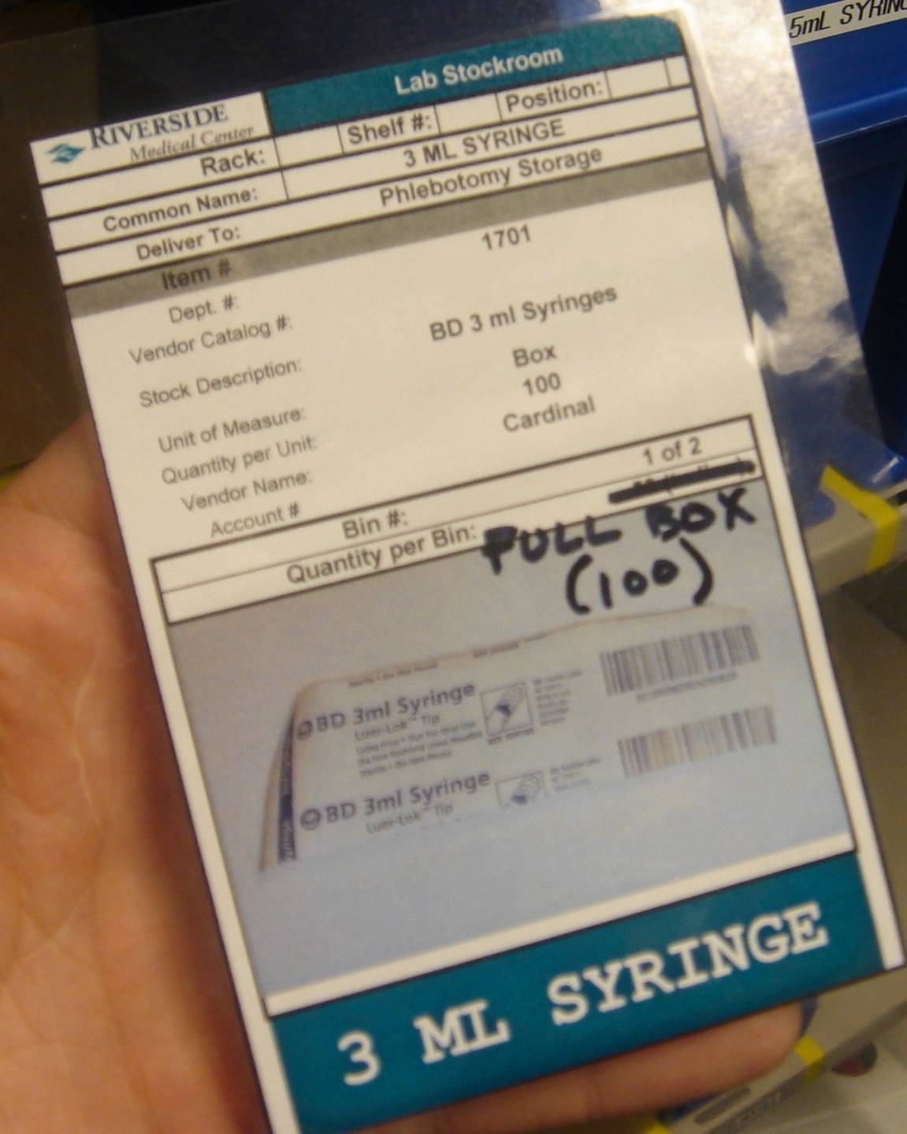
Reacting to Problems
If Kanban was not sized properly, need proper reaction
Short-term: Expedite the items
Long-term: Adjust the Kanban system
Long-term change:
Adjust the system
Change card / bin size
This can be done manually

Slide 17
Seasonal Variations in Stocking
Ways to handle seasonal supply needs:
Increase bin quantities for busy season (two-bin)
Temporarily add bins (multiple-bin)
Increase re-order point and quantities

Slide 18
Kanban Formal Review
Daily:
Are stock areas organized?
Are cards/bins being moved properly?
Tip: once things are working well, card/bin checks can be done less often
Monthly:
Evaluate stock levels
Has volume / demand increased for department?
Any recurring stock outs or problems?

Slide 19
Kanban
What Kanban Looks Like in the Laboratory

Slide 20
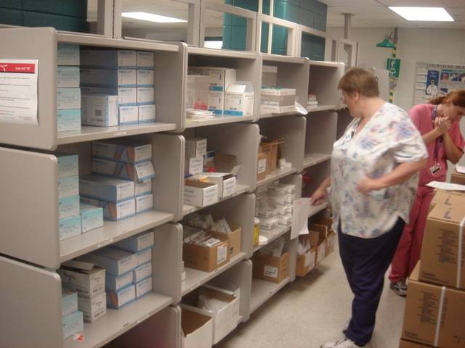
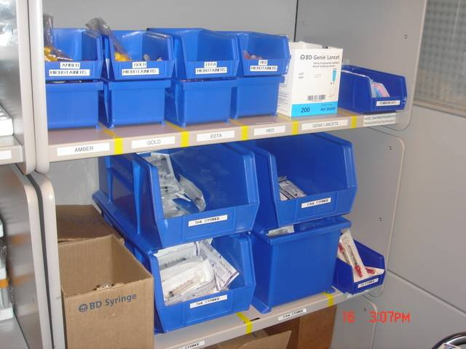
Phlebotomy
Before:
Stored far from front of lab
Location blocked flow
Uncontrolled inventory quantities
Inconsistent restocking process
After:
Closer to front of lab & phlebotomy carts
Reduced 6 linear feet of storage
More frequent & standardized replenishment

Slide 21
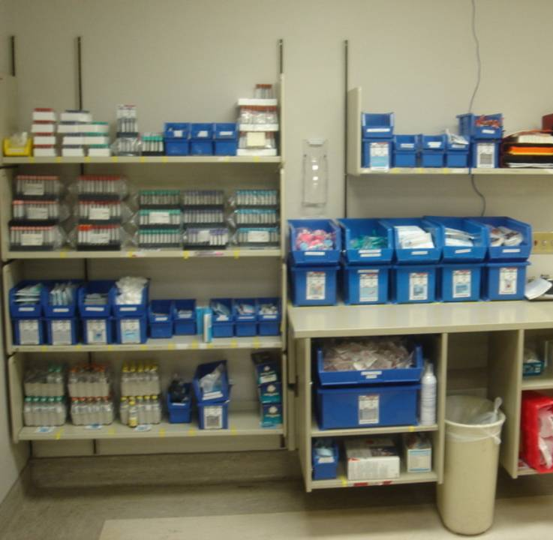
Phlebotomy
Tube stock:
No dumping into bins
Helps maintain FIFO & avoid expiration

Slide 22
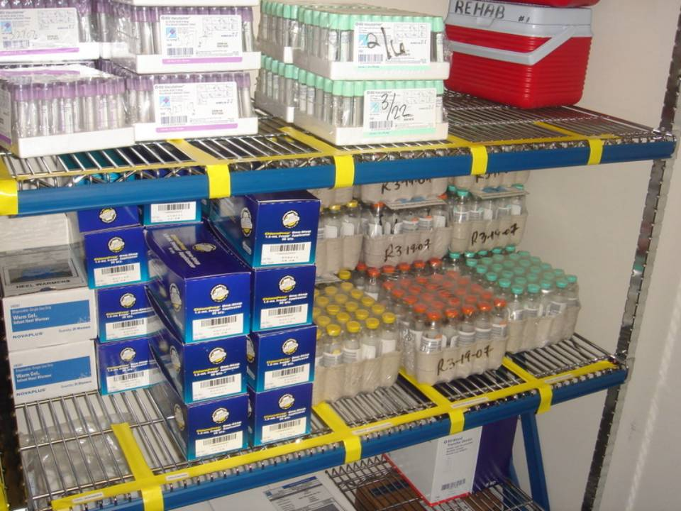
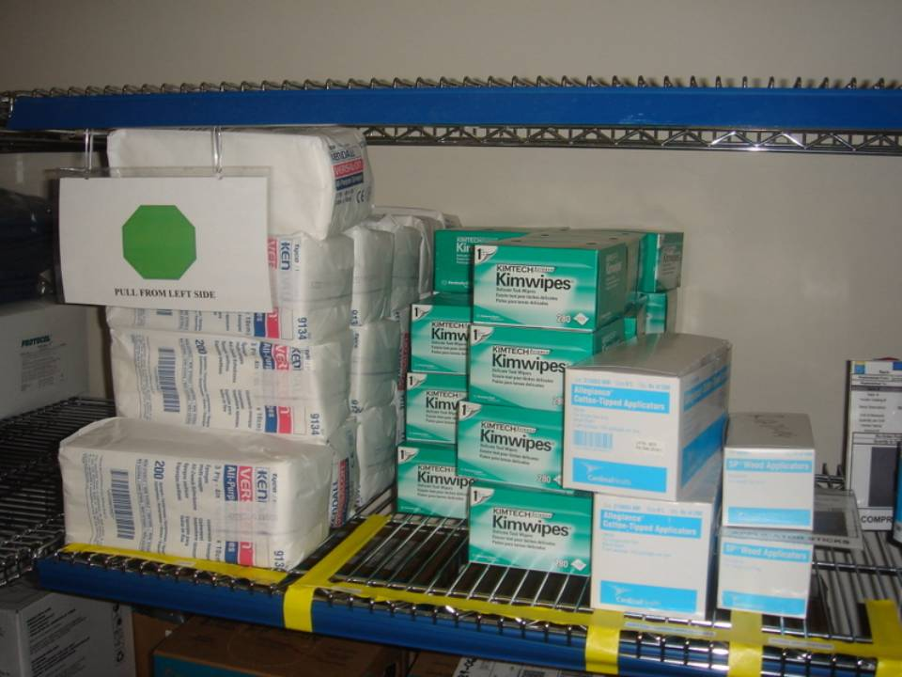
Stockroom
Reminder to pull material from Left to Right (for FIFO)

Slide 23
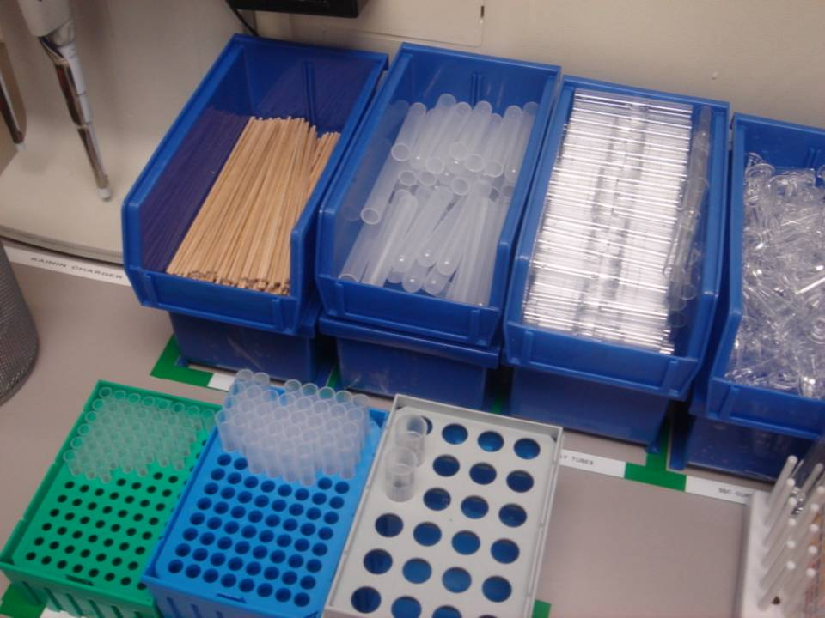
Two-Bin Example Lab Bench
Kanban and 5S practices
Bottom bin turned around – why?
Top bin in use
Lower bin full
and ready for
use when top one
is empty.

Slide 24
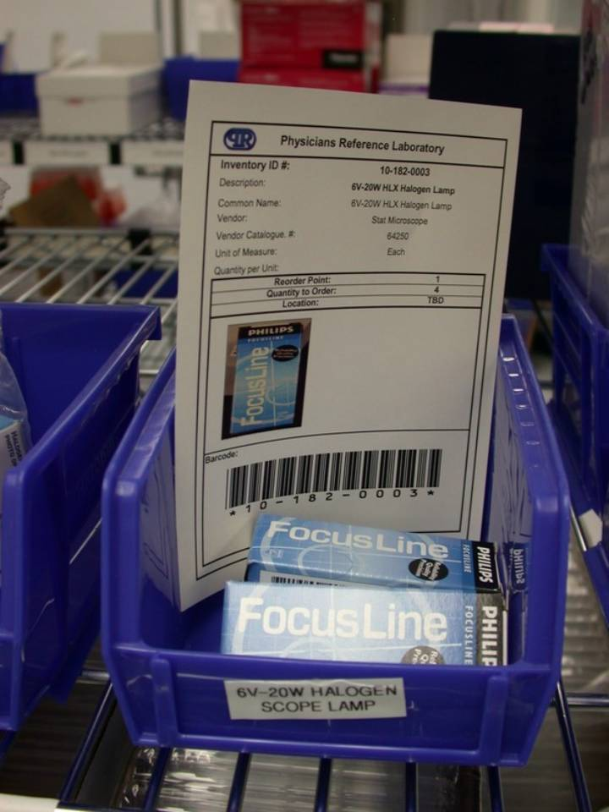
Reorder Point Example
Card in bin
Meant to be visual indicator
“Re-Order Point =1”
“Quantity = 4”
Problem?

Slide 25
Lean & Kanban 5S Concept
“5S”
Sort
Set in Order
Shine
Standardize
Sustain

Slide 26
Competency
Close this document
Check the box verifying review of the document
Click “Take Test” to open exam

