Slide 1
MIDAS REPORTING
TRAINING GUIDE

Slide 2
Select
New Baylor home page: Select “Clinical Links” under myLinks.
Notes:
Need to change this page and add how to place this onto staff mylinks.

Slide 3
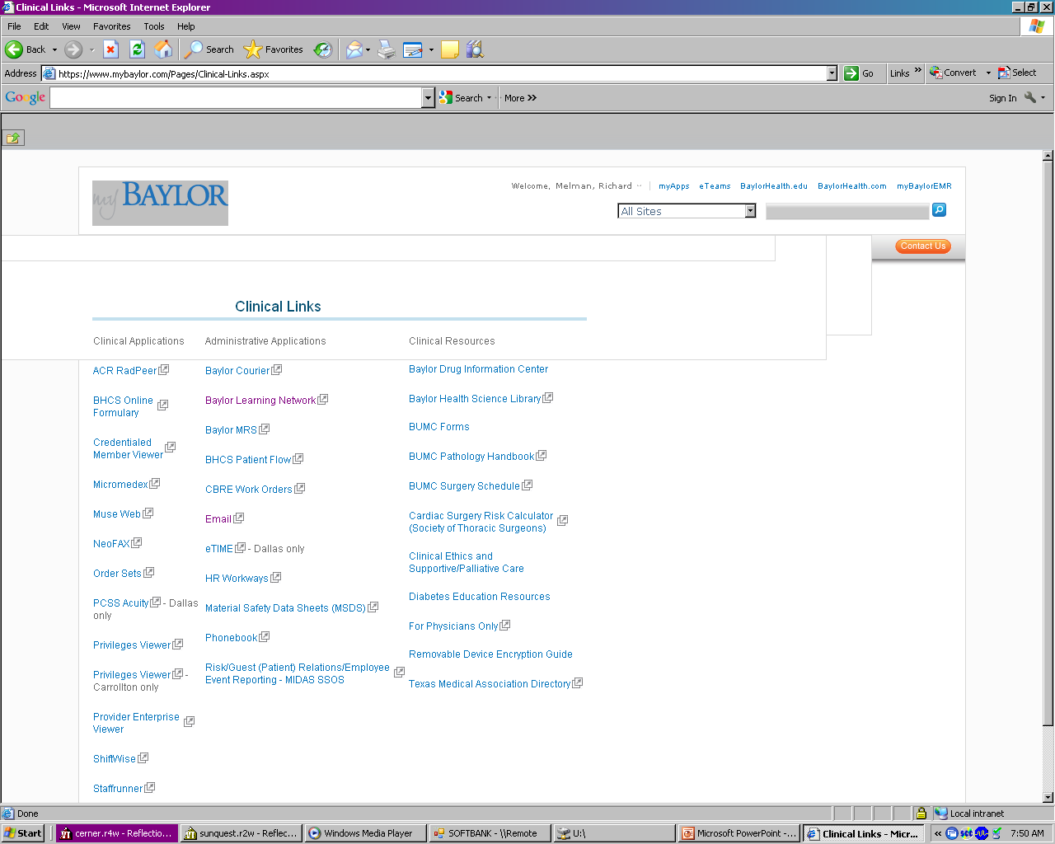
Select
Under Clinic Links, select “Risk/Guest(Patient) Relations/Employee Event Recording – MIDAS SSOS”
Notes:
Replace with instructions

Slide 4
Select Lab

Slide 5
Click on drop down arrow and select ALS-ALL SAINTS

Slide 6
Date event occurred
Type the event date in the box
OR
Click on calendar icon and choose the event date
In most cases the date will be the day your are making the report.
Occasionally you may need to enter an event occurring on a previous date.

Slide 7
Select Patient if this is a BAS patient
Select Non-Patient if Out Reach Client
ACI
Employee Health
Pre-Admit
Lab Patient
Baylor Surgical
SOLIS

Slide 8
Non-Patient
Enter the patient name (last name, first name)
Enter the unique identifier for the non-patient
Complete remainder of report
the same as for reports for “Patient”

Slide 9
Patient
You can look up the patient two ways:
1. Name 2. Number
ID Type is “MRN”
ID Number is patient’s MRN#
Enter patient last and first name
Notes:
You can select the patient by either using the patient’s name or MRN#.

Slide 10
Once you enter
either NAME or NUMBER,
Click on “Lookup”
Smith
Jane

Slide 11
Enter Last Name and First Name Select Correct Patient
Smith
Jane
Smith, Jane
Smith, Jane
Smith, Jane
Smith, Jane
Smith, Jane
Smith ,Jane
Smith, Jane
Smith, Jane
Smith, Jane
Smith, Jane
Smith, Jane
Smith ,Jane
If there is more than one encounter, locate and click on the correct admission date then click “YES”
(Scroll down if the date does not display on the initial screen)

Slide 12
Fields labeled in BOLD
must be answered

Slide 13
Where did Event Occur?
Click to open drop down menu; location list will display.
Scroll down or click “Next”, then click on desired location.

Slide 14
Entered by?
(who is entering this report)
Type in your employee number (digits only, no “e”) OR last name
Then click on the dots to open drop down menu.
Choose your name from list

Slide 15
Event Type
Click on drop down box and choose from list

Slide 16
Circumstances of Event
Click on drop down box ; use scroll bar if needed.

Slide 17
*Example of Circumstance of Event for Specimen Labeling
Major Error
Unlabeled specimen
Specimen label and accompanying order don’t correspond
WBIT (Wrong blood in tube)
(example: Orders for blood draw on Patient A; Specimen collected on Patient B but labelled “Patient A”)
WSIC (Wrong specimen in container)
(example: Orders for non-blood specimen on Patient A; Specimen collected from Patient B but labelled
“Patient A”)
Minor Error
Incomplete labeling
(Missing patient information, date/time of collection, ID of collector, specimen source/site if applicable).
*This is not a comprehensive list of Circumstances of Event

Slide 18
What Departments should be Notified?
Click on drop down box to search or enter department number*
NOTE: Multiple entries for this field
The first entry is always the department where incident occurred.
The second entry is “BAS-ALS-LABORATORY” or “BAS Cardiopulmonary (required).

Slide 19
Significance
Click here
to open drop down list
A, B, C, D or E are used for lab entries.
F thru J is used by Risk Management
NEVER use “J” unless instructed to do so by supervisor/manager.

Slide 20
Significance Commonly Used by Lab
A – The capacity to cause error
Clotted or hemolyzed
Mislabel
Contaminated specimen
B – Did not reach patient (near miss/good catch)
Delta check failure
C – Did not cause patient harm
D Required Monitoring to Confirm it Resulted in No Harm(error reached patient)
Wrong results given
No formalin on specimen
Transfusion reaction
Results to HIS
E Temp Injury Requiring Intervention
Blood Bank

Slide 21
LAB-Who Drew/Collected Specimen?
Click box for drop down list
then
Choose appropriate title for person who collected the specimen.

Slide 22
LAB-What was the Specimen Type?
Click box for drop down list
NOTE: This is not a “BOLD” field, however, it is required on all MIDAS entries.

Slide 23
Describe what happened
Enter :
Accession #
Test Name
Date/Time of event
Last, first name and credentials of staff contacted
Time of contact
State the Issue:
Facts only
No opinions
No accusations
No assumptions
NOTE: This is not a “BOLD” field, however, it is required on all MIDAS entries.

Slide 24
Sticking to the facts in the description:
CBC specimen clotted. Acc# 1234567, collected 2/2/17@1400 by e13592
Called to Mary Jones, RN 2/2/17@1420. RN indicated patient hard stick and requested lab perform recollect.
CBC specimen clotted. Acc# 1234567, collected 2/2/17@1400 by e13592
Called to Mary Jones, RN 2/2/17@1420. She told me it couldn’t be clotted because she drew it herself and was very rude the entire conversation. RN indicated patient hard stick and requested lab perform recollect. This nurse always sends us poor specimens; maybe she needs additional training.

Slide 25
Once description of event is completed:
Click to Submit
CBC specimen clotted. Acc# 1234567, collected 2/2/17@1400 by e13592
Called to Mary Jones, RN 2/2/17@1420. RN indicated patient hard stick and requested lab perform recollect.

Slide 26
Submitting the Report
If you have another
event to report,
click here
If this is the only event being reported,
click here
Close RDE will open this box:
Choose YES to complete the report.

