Slide 1

Electronic Storage of Continuing Education Documents
All Saints Laboratory

Slide 2

The Advantages of Electronic Document Storage
Reduces paper usage
Ease and efficiency of storage
Ease and efficiency of retrieval
Standardized

Slide 3
Location of Records
All CE documents will be stored on the laboratory or “I” drive:
Lab/I drive
Folder labeled “CE FY1X”
Individual folder for each employee

Slide 4
Filing Emailed Certificate
For CE certificates that are sent to you via email:
Open attachment (view Document)
Click on “File” tab
Click on “Save As”
Choose lab drive (I)
Choose folder “Staff CE FY XX” (current fiscal year)
Open folder with your name
Click OK to save in your folder

Slide 5
Filing a scanned document
For hard copy CE certificates, it is necessary to scan the document in order to transfer to your CE folder on the lab/I drive.
For this process, you will use the copier located in the pathology office.

Slide 6
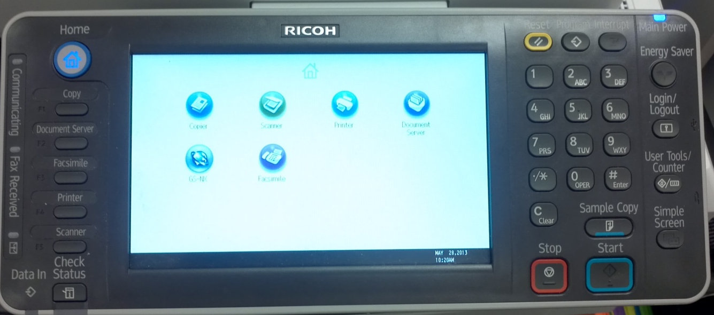
Scanning a document
Press “Home” button on control panel to display icon menu
Using touch screen select blue icon labeled “GS-NX”. (not the icon labeled “Scanner”)
Keyboard displays on touch screen: enter your system sign-on user name
Using touch screen, enter your system sign-on password
Using touch screen, select “Log In”
Place document on feeder, face up
Press the square “Start” button
Document will scan through
Retrieve original document and select “Log Out” on touch screen
Document should now be in your outlook inbox (email)
Home
GS-NX
Start

Slide 7
Saving scanned document
Once you receive the document that you scanned and emailed to yourself, follow the same process as you would for certificates emailed to you from an outside source.

Slide 8

Back-up plan
We strongly suggest that you also create a CE FY13 folder on your personal drive (U) to keep a backup copy.
Once you have saved the document to the lab drive, click SAVE and then click SAVE AS
Choose your personal drive from the drop down menu
Click SAVE
Note: It is no longer necessary to print any of the certificates that are sent electronically.

Slide 9
Remember to always exercise caution when you are storing your documents. Another employee’s folder is directly above/below yours and it is easy to open another folder or misfile a document.
If you find a document in your folder that does not belong to you, please notify someone in the safety/QA office.

Slide 10
ALMOST DONE!
Instructions for competency assessment follow on the next slide; you may complete independently or request a demo from one of the compliance staff (by schedule/appointment only):
Alice Brown
Lisa Lingenfelter

Slide 11
Competency assessment
Once you have viewed this training module:
Notify Lisa Lingenfelter by email of your completion
You will receive two CE certificates; one emailed and one hard copy.
Scan and file the hard copy certificate to your CE folder on the I drive (Lab/I drive, CE FYXX, folder bearing your name).
File the certificate that is emailed to you to your folder on the Lab/I drive.
You will receive 0.5 CE for successful* completion of this exercise
(*Success=both documents in your folder on the lab/I drive)
There is no exam for this module
Close this document
Check the box verifying review of the document

