Slide 1
Electronic Devices
A Guide for Use of These Devices at work

Slide 2
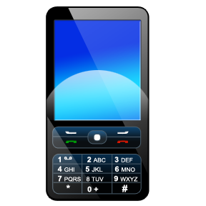

We Love Technology!
We depend upon technology to keep us:
in touch,
entertained,
and informed.

Slide 3
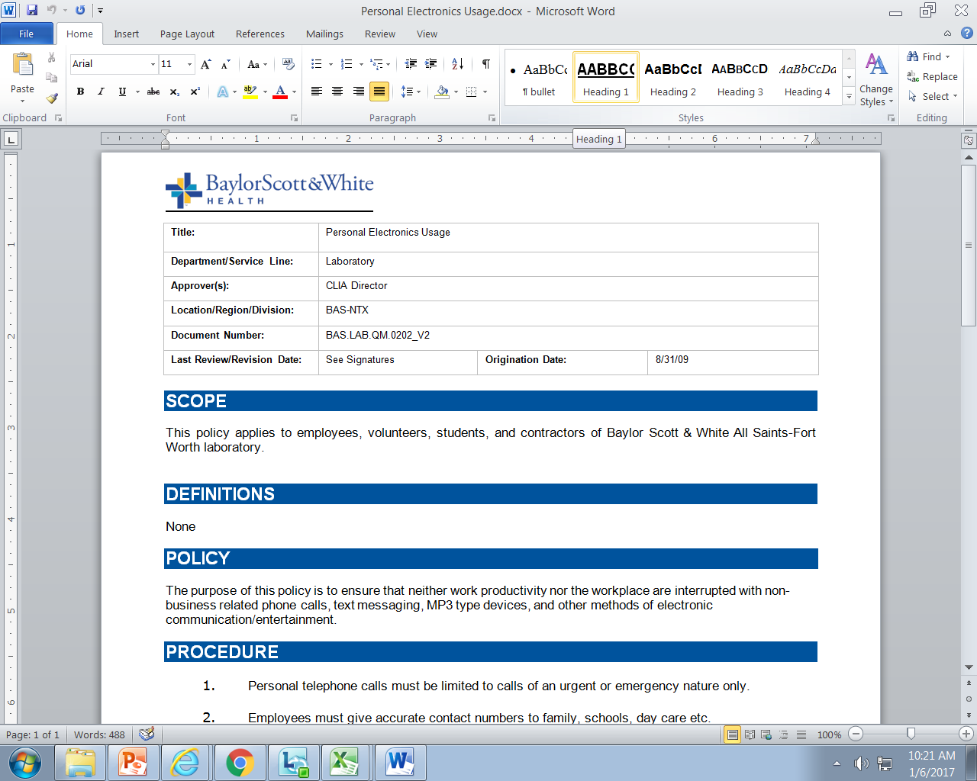
Did You Know?
There is a policy that addresses use of Personal Electronics
During the lab orientation process you will review this and all Lab Quality policies

Slide 4
Policy Specifics
This policy states:
“Cell phones, ear buds, MP3 players or other personal electronic devices which are non-business related are to be placed in a locker or other secure area and not be personally carried or worn while working.”

Slide 5
BSWH General Policy Statement
“The purpose of this policy is to ensure that neither work productivity nor the workplace are interrupted with non-business related phone calls, text messaging, MP3 type devices, and other methods of electronic communication/entertainment.”

Slide 6
Internet Personal Use
“Limited personal use of BSWH Internet resources is acceptable as long as it does not interfere with normal business operations, conflict with business interests, or have an adverse impact on the reputation of BHCS.”
“BSWH Internet resources must not be used in a manner that conflicts with BSWH mission and values, or interferes with normal business activities and operations.”
Normal laboratory business operations include (but are not limited to):
All tasks related to patient specimen collection/testing, including maintenance/QC
PT and competency assessment
Continuing Education
PI Projects
Staff training/education
Personal use of internet should never take place when any tasks related
to normal business operations have not been completed.

Slide 7
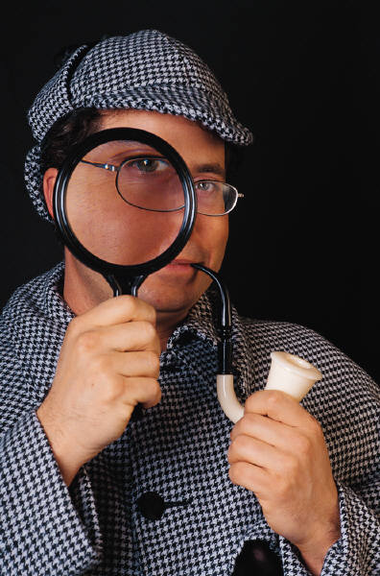
Internet and Email Privacy
“BSWH reserves the right to monitor and review all activities
and messages using BSWH Internet resources.”
“Users must have no expectations of privacy
when using BSWH Internet resources.”

Slide 8
Close this document
Check the box verifying review of the document
Click “Take Test” to open exam

