Slide 1
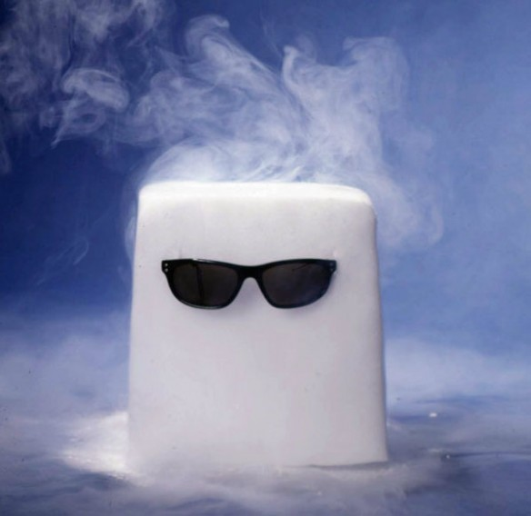
Safe Handling of Cryogens

Slide 2
Cryogens
Cryogens are substances used to produce very low temperatures, such as liquid nitrogen that are commonly used in laboratories. Although not a cryogen, solid carbon dioxide or dry ice which converts directly to carbon dioxide gas at -78°C (-109°F) is also often used in laboratories. Cryogens, as well as dry ice, can be hazardous to workers if not handled properly.

Slide 3
Cryogenic materials such as dry ice (solid carbon dioxide) and liquid nitrogen are extremely cold and can cause serious burn-like injuries.
Chips of dry ice or splashes of liquid nitrogen in the eyes can cause irreversible damage.

Slide 4
Required PPE
Handling Dry Ice
Insulated gloves
(loose fitting so they can be removed quickly)
Making Dry Ice (Liquid Nitrogen)
Insulated gloves
(loose fitting so they can be removed quickly)
Eye protection
Lab Coat
Lab Apron

Slide 5
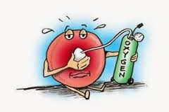
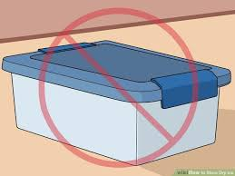
Both materials if used in confined spaces may cause asphyxiation by increasing atmosphere concentrations of carbon dioxide.
Both materials become gaseous forming carbon dioxide and nitrogen gas respectively and can become explosive when stored in closed containers.

Slide 6
Storage
Liquid nitrogen or dry ice containers must be used or stored only in well ventilated areas
No storage container unless capable of withstanding extreme pressures will be hermetically sealed

Slide 7
It is not permissible for employees
to lower their heads into dry ice or
liquid nitrogen storage vessels

Slide 8
Close this document
Check the box verifying review of the document
Click “Take Test” to open exam

