Slide 1
iAttest Tutorial
Reviewing Policies and Procedures On-Line

Slide 2
All employees are required to review all policies applicable to their job duties during the orientation/training period when hired.
Thereafter, all policies that are added to the library or are revised will be reviewed through the “iAttest” function in the on-line policy library.

Slide 3
There is a specific format for the naming of a policy:
BAS.LAB.QM.XXXX.P_V1
A B C D E
A: System (BHCS, BSWH, NTX) or Facility (BAS) Identifier
B: Department within the system or facility identifier (Lab, Nursing, Admin, etc.)
C: Specific discipline within the department (Quality, Hematology, POC, etc)
D: Unique policy number
E: Version of the policy
You may be required to read similar policies with differing identifiers; for example:
BAS.LAB.QM.0201.P_V1 Dress code specific for All Saints Laboratory
BSWH System.HR.WKPL.001.P Dress code general for Baylor Scott & White

Slide 4
Notification to Review
You will receive an email from your supervisor/manager of documents that are due for your review however you can log on and check iAttest at anytime for documents that need to be reviewed.
Note:
You may be required to review not only those Policies/Procedures that are department specific,
but also some of the general LIS, Quality, Safety, etc.

Slide 5
Access Documents for Review
Click on:
Tools and Resources
Click on:
Policy and Procedure Library
Click on:
Baylor All Saints Medical Center

Slide 7
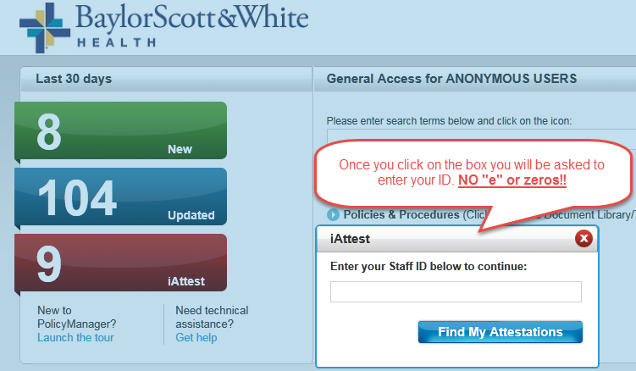

Slide 8
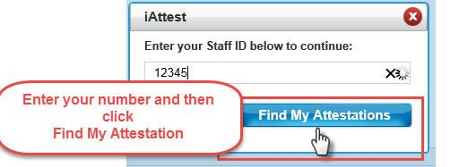
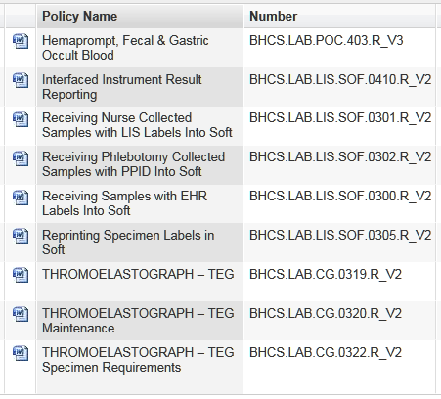
A list of documents will be displayed to be reviewed:
NOTE:
The list of documents is comprehensive and
will contains some that don’t pertain to your
position. If you click on the “Number” column, this
will sort the documents to make it easier to determine
which you need to review.
Example: A tech in corelab would sort and then review
those policies with “CHM, HEM, etc” in the number.
Remember all laboratory staff is responsible to
review P&P that contain “QM” and “SAF” in the number.
If you are unsure if a particular policy applies to you: open the document, look under the “SCOPE” header; this will specify to whom this policy applies. If your position is not Included in the scope statement, you needn’t review it.

Slide 9
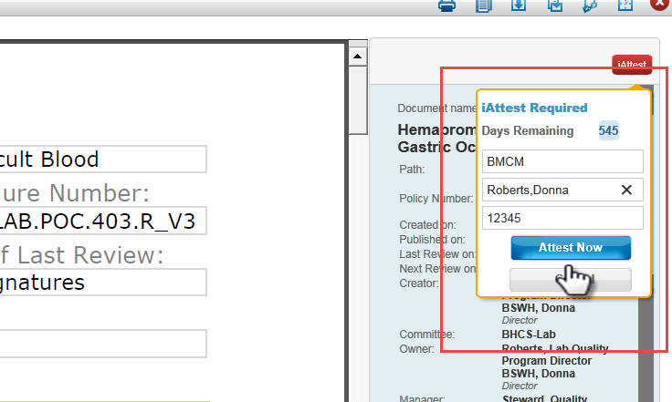
Click on a policy. The document will open and in the right hand corner the iAttest box will be displayed.
After you review the policy (this is VERY important to follow specifically)
Enter the facility abbreviation (BAS) in the “First Name” box .
Enter your Last Name, First Name in the “Last Name” box. (Your ID will already be filled in)
Click the “Attest Now” button.
Click the red “x” in the upper right hand corner to close the document and return to the list.
Repeat process until all documents are reviewed

Slide 10
This tutorial, and others, can be found on the I drive if needed in the future:
I:\_Tutorial Library

Slide 11
If you have difficulties or questions about iAttest, please ask for assistance
from your supervisor, manager, or one of the quality team staff.
Close this document
Check the box verifying review of the document
Click “Take Test” to open exam

