Slide 1
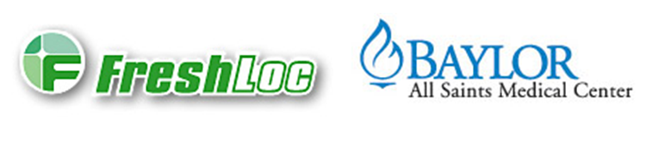

FreshLoc Training

Slide 2
What is FreshLoc
  A wireless, constant monitoring of all refrigerators, freezers, heat blocks, room temperature, and humidity where indicated. This is a system controlled remotely by a 3rd party vendor in which access is granted to view, change, and correct temperature readings.

Slide 3
Why FreshLoc?
  This product helps standardize Laboratory procedures with regards to refrigerator, freezer, room temperature, and heat block monitoring in accordance with CAP standards. Data is also recalled faster for instances where a look-back is necessary. It is a continuous monitoring system.

Slide 4
Where is FreshLoc?
  FreshLoc is located in all refrigerators, freezers, heat blocks, and where applicable room temperature readings are needed.

Slide 5
Who has access to FreshLoc?
    Manager, Lab Supervisor and DPICs (Designated Person In Charge) are ultimately the Super Users
    All lab personnel have access

Slide 6
Alert for Temperature Failure
FreshLoc constantly monitors the temperatures; in the event of a temperature failure, an alert will be sent. At our facility, this alert is received via the freshloc tablet located in hematology, by email and by text.

Slide 7
The Alert
When the alert goes off it will display:
  Emit a beeping sound
  And the corresponding sensor will be in red (out of temperature range) or yellow (temperature reading not seen) depending on the alert.

Slide 8
When an alert is received…
Immediately notify the department the alert is for.
All alerts should be followed-up promptly with a appropriate documentation of resolution.
Engineering is notified if needed (document in corrective action).
There are three alerts levels.

Slide 9
First Alert
Sent when a monitored temperature falls out of the specified range.
The individual who responds to the alert checks the monitored environment and documents within freshloc.net, or on the tablet, the corrective action taken.
If the cause for the temperature change is not evident (e.g., refrigerator door left open, etc.) perishable products should be moved to another appropriate monitored environment.
After corrective action has been performed allow sufficient time for the temperature to adjust (up or down) before taking action again.

Slide 10
Second alert
Sent if no corrective action is taken after the first alert, or the problem is not resolved after 30 minutes for the general laboratory and 15 minutes for blood bank monitored devices.
The second alert is sent to a) a tablet that resides within the laboratory and a b) text message to a designated freshloc administrator.

Slide 11
Third alert
Sent if no corrective action is taken after the second alert, or the problem is not resolved after 45 minutes for the general laboratory and 30 minutes for blood bank monitored devices.
A third alert is sent to a) a tablet that resides within the laboratory and a b) text message to a designated freshloc administrator.

Slide 12
Freshloc downtime procedure
Downtime temperature forms should be used to record all temperatures during this downtime until the issue is resolved.
Downtime forms are located in eteams, under document control, Lab General

Slide 13
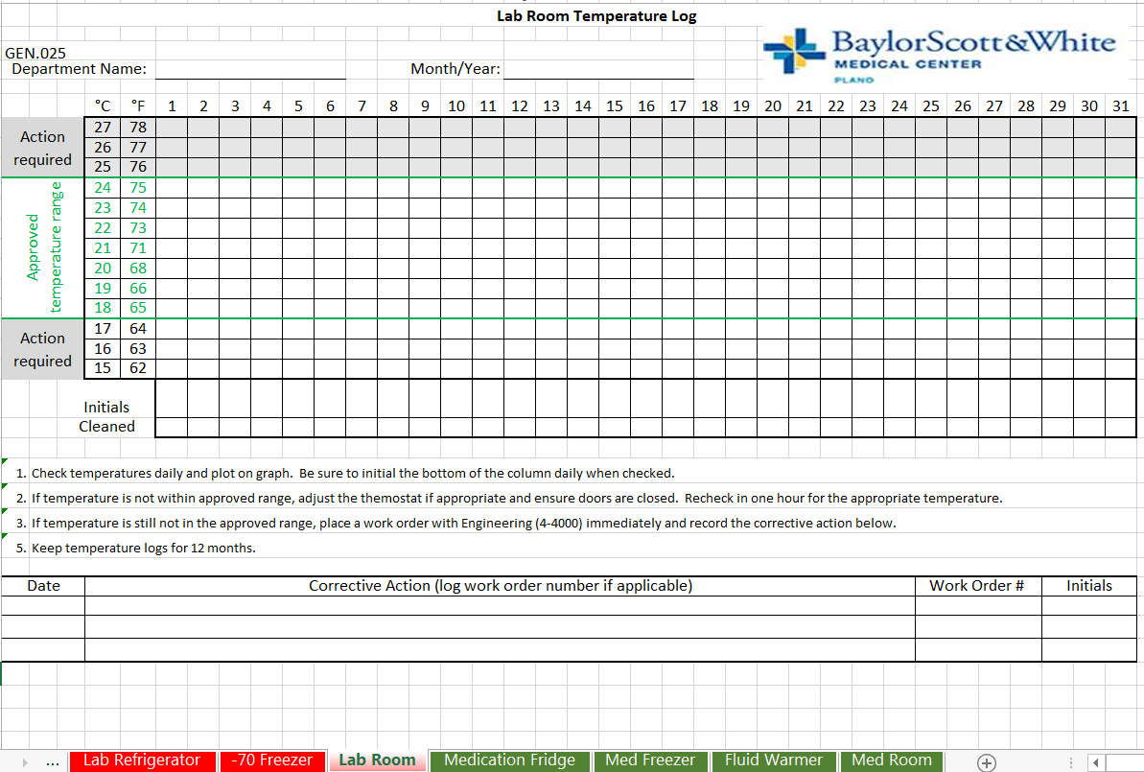

Slide 14
Competency Assessment
Please log onto MTS* and take the exam to complete this module.
(score of 100% is required)

