Slide 1
Emergency Response Guide
A Closer Look at Guidelines

Slide 2
Plain Language Codes
The Texas Hospital Association began this initiative to standardize alerts at hospitals across the state. Use of plain language codes are also recommended by state and federal agencies, including the U.S. Department of Homeland Security.
Plain language codes are designed to remove the confusion or worry typically associated with the use of cryptic color codes—instead, providing patients, visitors and staff with direct information. They also eliminate the possibility staff may mix up codes, and reduce stress and confusion for those working at multiple locations using different codes.

Slide 3
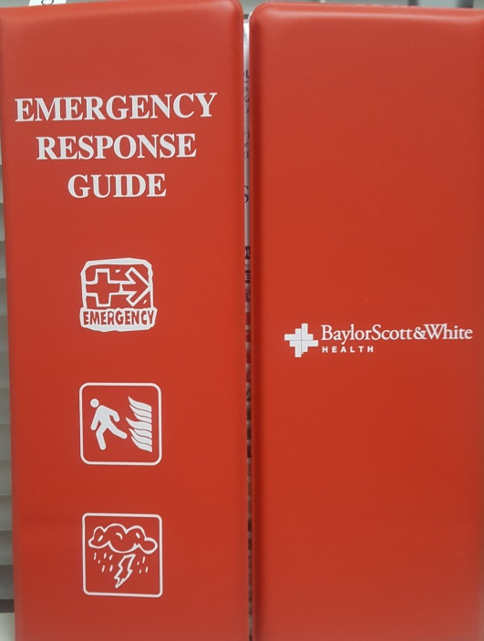
Emergency Response Guide (ERG)
The Emergency Response Guide
is designed to assist you
during emergencies.

Slide 4
ERG Contents
The ERG contains information tabs for:
Medical Alert
Weather Alert
Security Alert
Facility Alert

Slide 5
Medical Alert
Cardiac arrest
"medical alert + code blue/pediatric code blue + [location]“
Rapid response team
"medical alert + rapid response team (inpatient/outpatient) + [location]"
STEMI and stroke and trauma
"medical alert + STEMI/stroke/trauma team + [location]"

Slide 6
Weather Alert
Severe thunderstorm warning (no action from staff)
"weather alert + severe thunderstorm warning + hazardous conditions exist + please
use caution if going outdoors“
Tornado watch (staff prepare for potential impact)
"weather alert + tornado watch + conditions are favorable for a possible tornado today + please use caution if going outdoors"
Tornado warning (staff activate tornado protocols)
"weather alert + tornado warning + please remain inside until the weather clears"

Slide 7
Security Alert
Missing patient (infant, child or adult)
"security alert + missing [child/person] + [description including approximate age,
gender, attire] + last seen with [description of person] + last seen [location] + please
notify staff if you see someone that fits this description“
Person with a weapon or active shooter
"security alert + person with a weapon/active shooter + last seen [location] + please
avoid this area“
Suspicious package
"security alert + suspicious package + [location] + please avoid this area"

Slide 8
Facility Alert
Fire or fire drill
"facility alert + fire alarm activation/fire drill + [location] + please avoid this area"
Haz-mat spill
"facility alert + hazardous spill + [location] + please avoid this area"
Emergency operations plan activation
"facility alert + emergency operations plan activation + [incident description;
examples: EPIC outage, utility outage, etc.]"

Slide 9
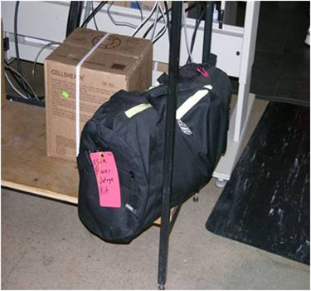
Power Outage
In the event of a power outage, there is a power outage kit located in Corelab. The bag contains 2 tabletop lanterns, leather gloves, flashlights, glow sticks, and head lanterns.
To ensure the contents are available in an emergency, the opening is secured with a zip-tie. It you notice the tie has been broken, you should contact your department safety officer, supervisor, or lab safety officer.

Slide 10
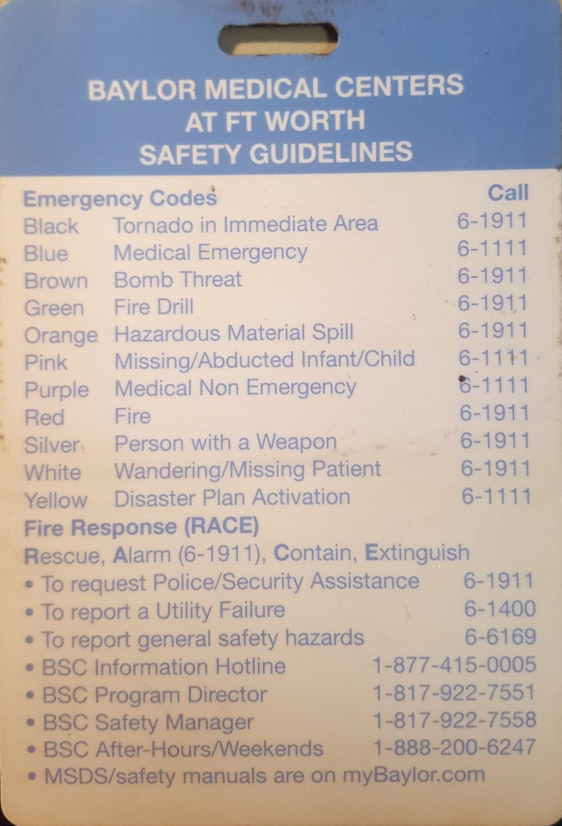
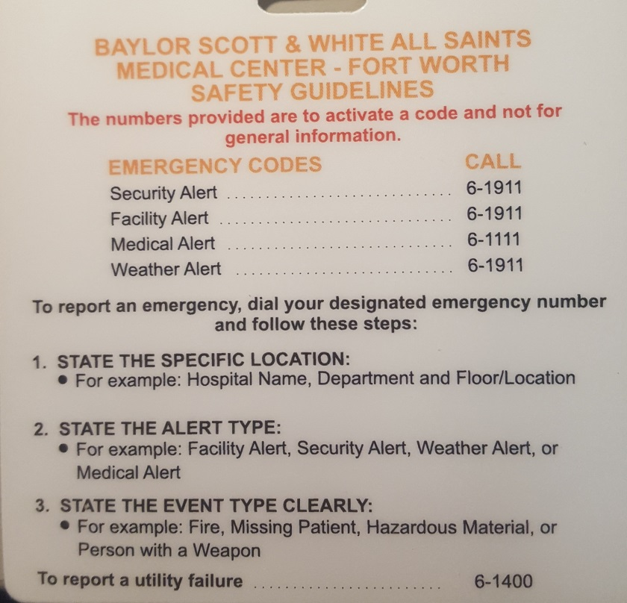
Badge Buddy
Plain language code information is also available on a Badge Buddy.
If you do not have the updated version, please see your supervisor.
Out with the
OLD
In with the
NEW

Slide 11
DEOP
There is a laminated Department Emergency Operations Plan (DEOP) in the back of the Emergency Response Guide

Slide 12
Attestation
Close this presentation with the “Esc” key
Place a check in the box to verify you have reviewed the information
Click “Submit”.
There is no test associated with this document

