Slide 1
Fire, Chemical, Biohazard, Electrical

Slide 2
Fire Safety
To report a fire:
Call 6-1911 using plain language code: “Specific Location/Facility Alert/Fire”
Activate fire alarm at pull station near entrance to lab
Move to safety if fire in immediate area, closing doors behind as you exit.
Unless in immediate peril, do not evacuate unless directed by leadership for fire alarms or fire drills.

Slide 3
Chemical
Review the Chemical Hygiene Plan
Be familiar with location and contents of general Chemical Spill Kit
Corelab and safety storage closet
Be familiar with location and contents of Formalin spill supplies
Histology and morgue
Know how to report a large spill: Call 6-1911 and state Specific location/Facility Alert/Chemical Spill.

Slide 4
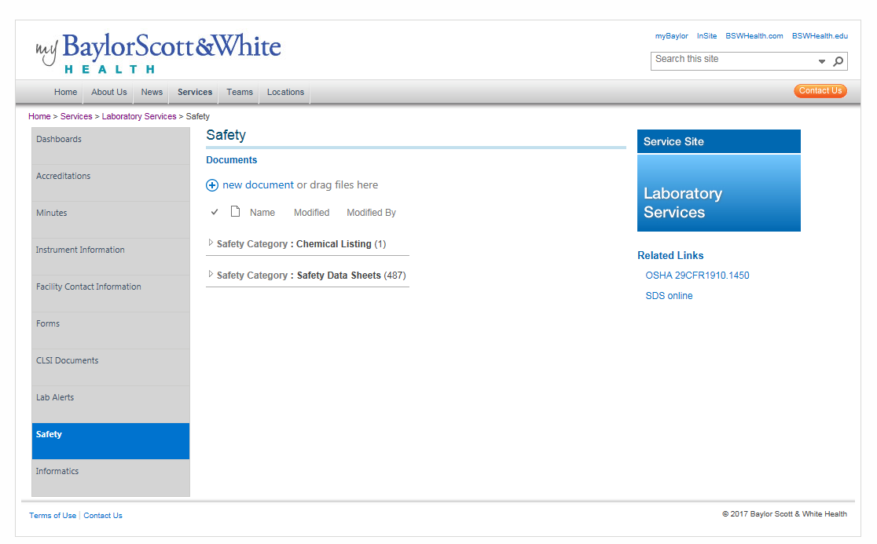
SDS
SDS can be located online at my Baylor Scott & White:
Click Home/Services/Laboratory Services/Safety
Go to my Baylor Scott & White now and access:
Chemical Listing (BSWHealth system document)
Safety Data Sheets (BSWHealth system document)
SDS On-line web access

Slide 5
Biohazard
Review the Bloodborne Pathogen Policy
Be familiar with location and proper use of PPE
Be familiar with clean and dirty areas of the lab.
Monitor and address biosafety non-compliance.
The most common non-compliance is related to the prohibition of
smoking, eating, drinking, applying cosmetics and lip balm, manipulating contact lenses and mouth pipetting in all technical areas. Food/drink and personal items cannot be kept in the work areas of the lab.

Slide 6
Electrical & Compressed Gas
Electrical
Power strips must be off the floor
Frayed or damaged cords are reported to Biomed at 6-2022
Compressed Gas
Must be secured with strap or chain
When stored
When transported
Must be capped when not in use`

Slide 7
Access and review the following policies in the online P&P library.
Chemical Hygiene Plan
BSWH.LAB.SAF.0613.P_V1
Bloodborne Pathogens Policy
NTX.LAB.SAF.608.P_V2

Slide 8
Close this document and click on “Take Test” to complete this module.

