Slide 1
Golf Cart Training
2017 Club Cart Golf Cart

Slide 2
Objectives
Understand Driver/Vehicle Safety Program Policy
Understand what to do in the event of an Accident Report
Understand Club Car Usage
Understand Route
Understand Schedule for routine delivery to Cancer Center

Slide 3
Driver/Vehicle Safety Program
Policy
  BSWH. Risk.005.P
A Driver of BSWH Vehicles or whose job duties include driving as per HR job description, Home Care/Hospice, or as designated by Risk Management, regardless of fault, circumstance, time, place, injury, damage, and whether it occurred during work time or personal time, is required to report as soon as possible or within twenty-four (24) hours:
Arrests related to operating a vehicle,
Traffic citations,
Accidents while the individual was operating a vehicle,
Loss or suspension of a driver’s license,
Medications or injuries that may prevent the safe operation of a vehicle, and
Any other loss of his/her ability to drive

Slide 4
Driver/Vehicle Safety Program
Policy
  BSWH. Risk.005.P
A Driver should report the accident and/or citations, violations, loss/suspension of driver’s license to his/her supervisor and/or Risk Management:
  Central Texas (254-724-3001)
Supervisors should contact Risk Management.
A Driver may be required to promptly provide, upon request, applicable documentation relating to an accident or incident. The individual is required to fully cooperate with BSWH and law enforcement officials throughout any investigation. The Driver may be responsible for any applicable penalties, fines/fees, or other adverse actions.

Slide 5
Driver/Vehicle Safety Program
Policy
  BSWH. Risk.005.P
A Driver should report the accident and/or citations, violations, loss/suspension of driver’s license to his/her supervisor and/or Risk Management:
  Central Texas (254-724-3001)
Supervisors should contact Risk Management.
A Driver may be required to promptly provide, upon request, applicable documentation relating to an accident or incident. The individual is required to fully cooperate with BSWH and law enforcement officials throughout any investigation. The Driver may be responsible for any applicable penalties, fines/fees, or other adverse actions.

Slide 6
Driver/Vehicle Safety Program
Post-Accident Drug Screening
Regardless of fault, circumstance, place, injury/damage, a post-accident drug screening is required for:
  A Driver involved in an accident while operating any vehicle for BSWH company business.
  The drug screen should be collected as soon as feasible after the accident but no later than twenty-four (24) hours after the accident. The collection should be done in a department trained in the procedure using the applicable chain of custody and permission forms or at an approved collection facility.
  Refer to Controlled Substance and Alcohol Policy for Commercial Motor Vehicle Operators (BSWH.HR.COND.007.P) for information related to drug and alcohol testing for commercial vehicle operators.

Slide 7
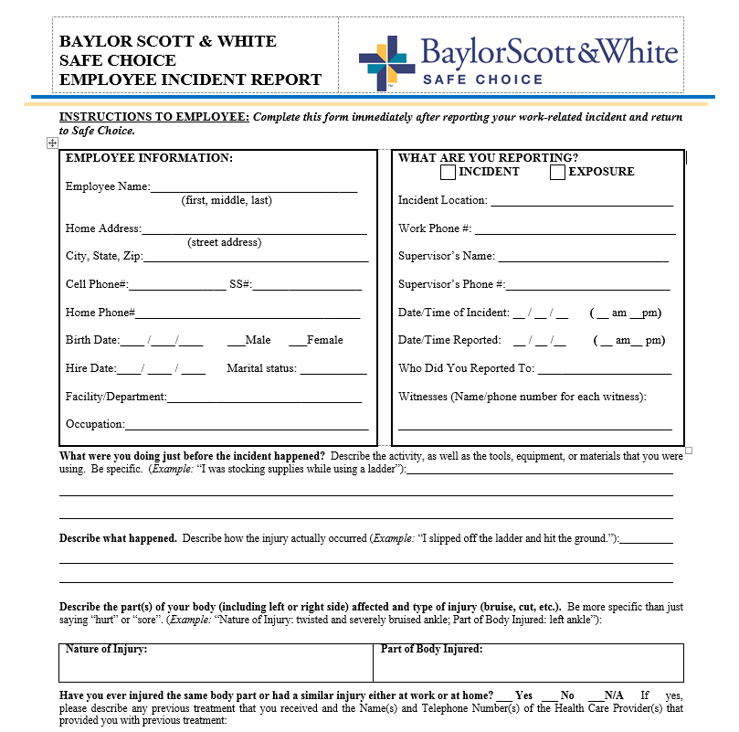
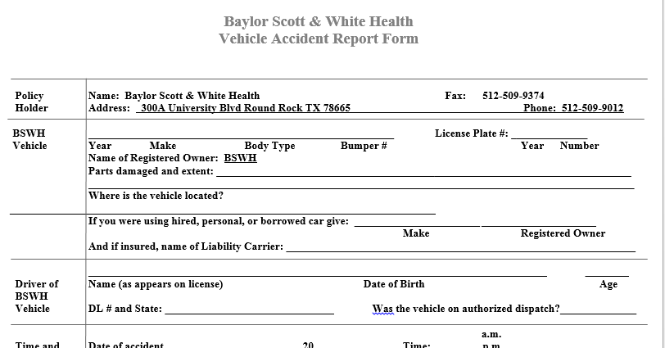
Driver/Vehicle Safety Program
Accident Process
Report Incident to supervisor and risk
  (254-724-3001)
Fill out Employee Incident Report
Fill out Vehicle Accident Report

Slide 8

Club Care 100
WARNING FORWARD/REVERSE CONTROL
  DO NOT shift the Forward/Reverse switch while the vehicle is moving. To avoid damage to the vehicle.
    Always bring the vehicle to a full stop before shifting the Forward/Reverse switch.

Slide 9

Club Care 100
FORWARD/REVERSE CONTROL
  The Forward/Reverse rocker switch is located on the seat support panel
  The F=Forward and R=Reverse are clearly marked
  Push down the FORWARD side of the switch to operate the vehicle in the forward direction, or push down the REVERSE side of the switch to operate the vehicle in reverse.
  When the rocker switch is in the NEUTRAL position, with neither side down, the vehicle will not operate if the accelerator pedal is pressed
  The reverse buzzer will sound as a warning when the switch is in the REVERSE positions.
  The vehicle operates at reduced speed in reverse.

Slide 10
Club Care 100
HEADLIGHT CONTROL
  The headlight control is located on the dash to the left of the key switch.
    Pull out to turn lights on
    Push in to turn the lights off.
Note: Using the headlights for extended periods of time without the engine running will discharge the battery.

Slide 11
Club Care 100
CHARGE INDICATOR LIGHT
  The electric vehicle features a charge indicator light located at the top of the instrument panel.
    The light serves two functions
      Battery low state-of-charge warning
        The light comes on and remains solid when the battery state of charge falls below 20%
        The Light begins flashing when the battery state of charge falls below 10%
      Charge confirmation
CAUTION: when the light indicates a low state of charge, the vehicle should be placed on charge as soon as possible.
CAUTION: Do not use an extension cord when charging.

Slide 12
Club Care 100
ACCELERATOR PEDAL
  Located on the right with the word GO molded into it.
  Operation differs from automobile
    When Key switch is in the ON position
    AND the Forward/Reverse switch is in either Forward or Reverse
      Pressing the accelerator pedal will automatically release he park brake and start the vehicle moving.
      As the Accelerator pedal is pressed, speed will increase until full speed is reached.
    When the accelerator is released, power will be cut off and the motor or engine will stop running.

Slide 13
Club Care 100
ACCELERATOR PEDAL cont’d
    Walk-Away Braking
      This feature prevents the vehicle form rolling away uncontrolled should the driver park on a slope and leave the vehicle without locking the park brake.
      The vehicle will roll at about 1 to 3 mph.
      If the walk away braking function remains engaged for two seconds or more:
        A warning buzzer will sound to alert the driver that the motor break has been activated
WARNING: Feature does not work on very steep grades. Do not operate vehicle on slopes with a grade of 20% or more

Slide 14
Club Care 100
ACCELERATOR PEDAL cont’d
    Pedal Up Motor Braking
      When the vehicle is above 11mph, releasing the accelerator pedal will activate motor braking, which slows the vehicle speed.
      Motor braking deactivates and the vehicle will cost, once speed slows to less than 11mph if the accelerator is still released
    Pedal Down Motor Braking
      This feature helps to control vehicle downhill speed.
      Motor braking is activated when the vehicle reaches the programmed top speed and holds the vehicle at that speed.
      Motor braking is automatically disengaged when vehicle speed slows below the programmed top speed.
WARNING: When batteries are fully charged, a warning buzzer will sound during motor braking to alert the driver that motor braking is operating at a reduced level of performance. When this occurs, use the brake pedal to control vehicle speed.

Slide 15
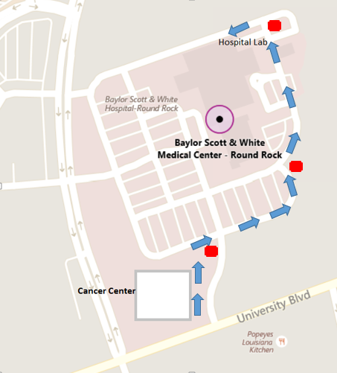
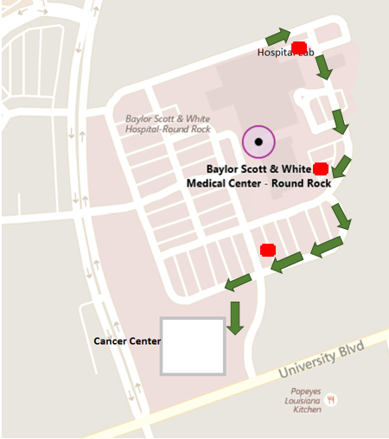
Golf Cart Route
Route from Cancer Center:
Caution for incoming and outgoing traffic from University
Route to Hospital:
Caution for incoming and outgoing traffic from University

