Slide 1
Microscope,
DIFF PAD Walk Through
And
Diffing A Good Diff
By; Michell McAdams
&
Emily Gehring
12/2012

Slide 2
Microscope Basics
Operation, Care, and Supplies

Slide 3
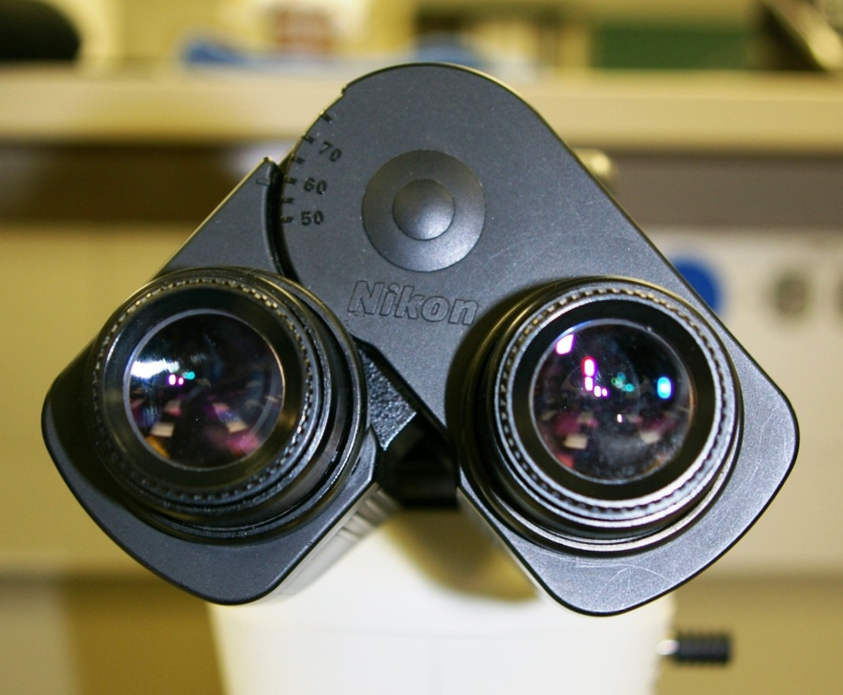
Adjusting the Eye Piece
Focus on cells
Adjust “Interpupillary Distance”
  Can be adjusted to eye width. (Should make one big circle when looking with both eyes through the oculars)
Adjust “Diopter Distance”
  Turn both eyepieces to align ring flush with front of ocular receptacle
  Close right eye. While looking thru left ocular turn the fine focus knob until image is sharp.
  Close left eye. While looking thru the right ocular turn the eyepiece until the image is sharp.
  Look thru both oculars with both eyes. The image should be sharp for both eyes.
Interpupillary Distance
Diopter Distance

Slide 4
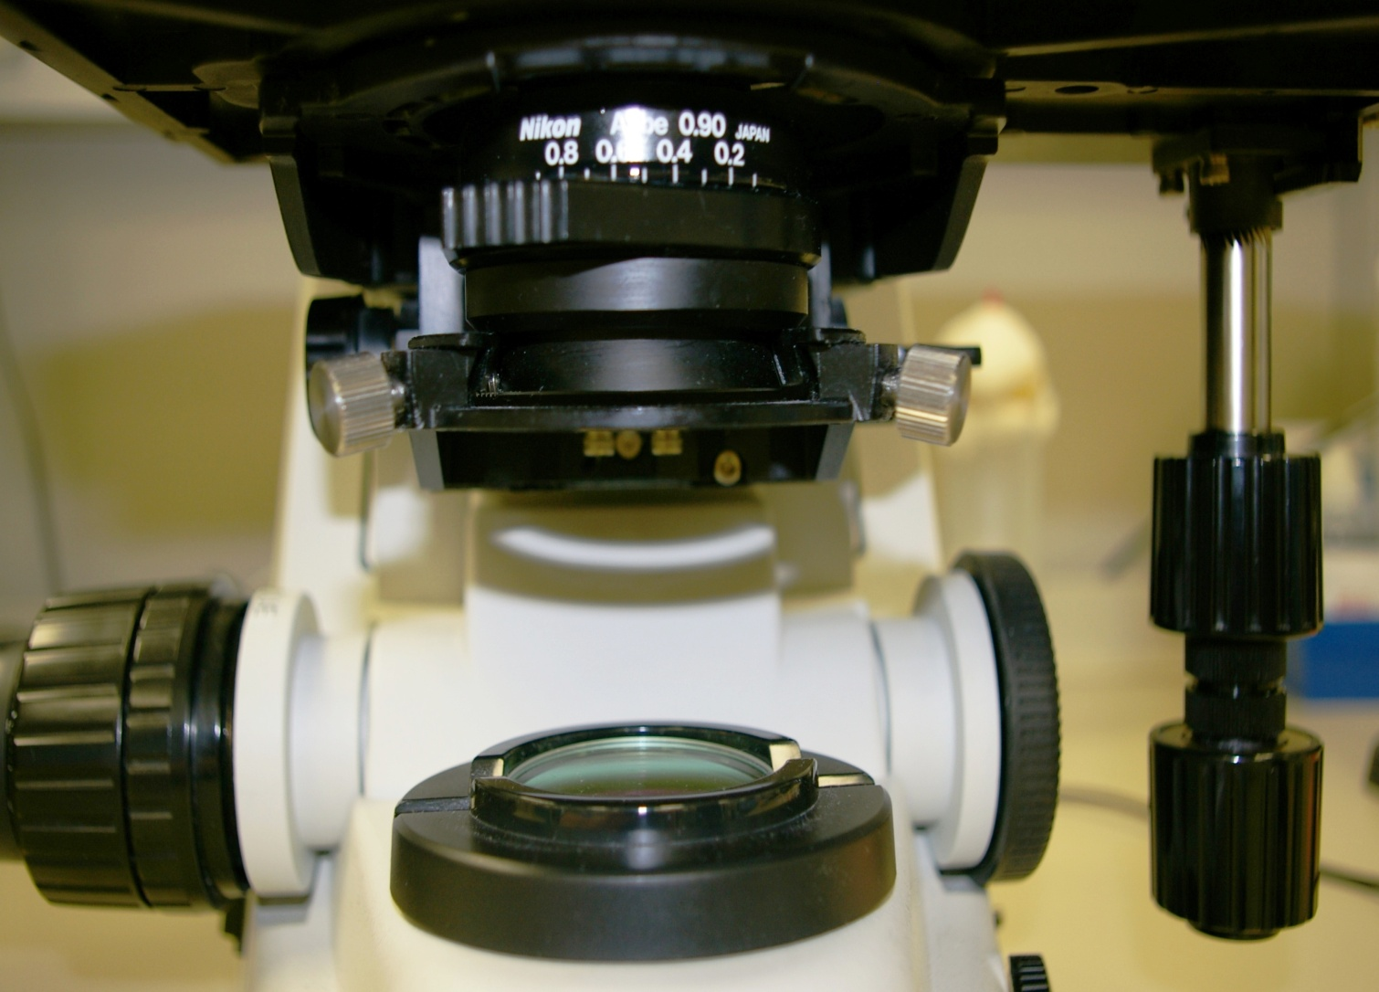
Adjusting the Stage
Condenser Diaphragm (0.7)
Condenser
Up & Down
Light
Condenser
Condenser
Centering
Stage
Adjustment
Coarse
Focus
Fine
Focus
Lamp Filter

Slide 5
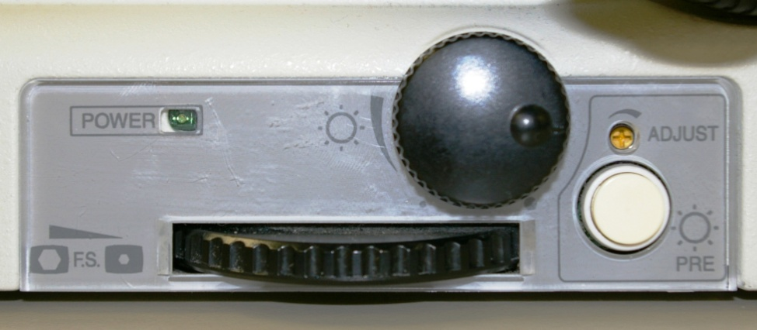
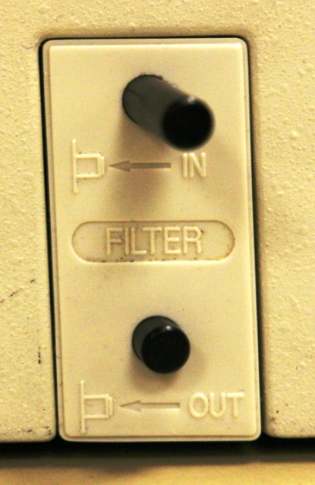
Adjusting the Light
Light
Intensity
Use the Light Intensity knob if you want your light brighter or dimer
The Photo Lamp Lock will not allow you to adjust the light
The filter will lower your Light Intensity when on a lower objective power. This saves time from needing to adjust the light source each time.
Photo
Lamp Lock
***Push the “IN” to lower your light and “OUT” to make the light brighter

Slide 6

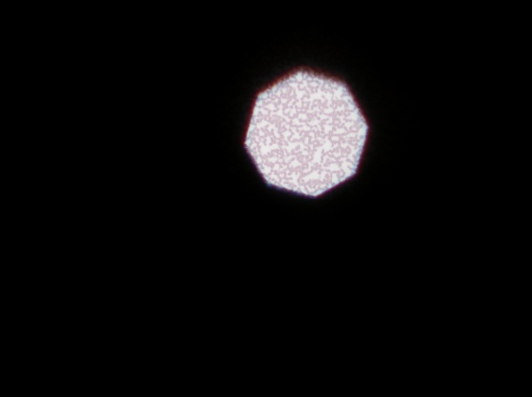
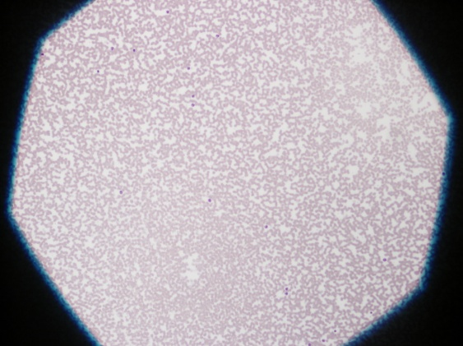
Koehler Illumination
Focus using 10x dry
Adjust “light condenser” knob to form the sharpest octagon image on the specimen surfaces.
Center the light condenser in field of view
Open the “lamp diaphragm” until it almost goes out of field of view.
Fine tune centering the condenser.
Set condenser diaphragm to 0.7 as a general rule.
  Objective performance # is the 2nd number (example: 50x / 0.9)
  Multiple 2nd # by 0.75 ➔ aperture setting

Slide 7
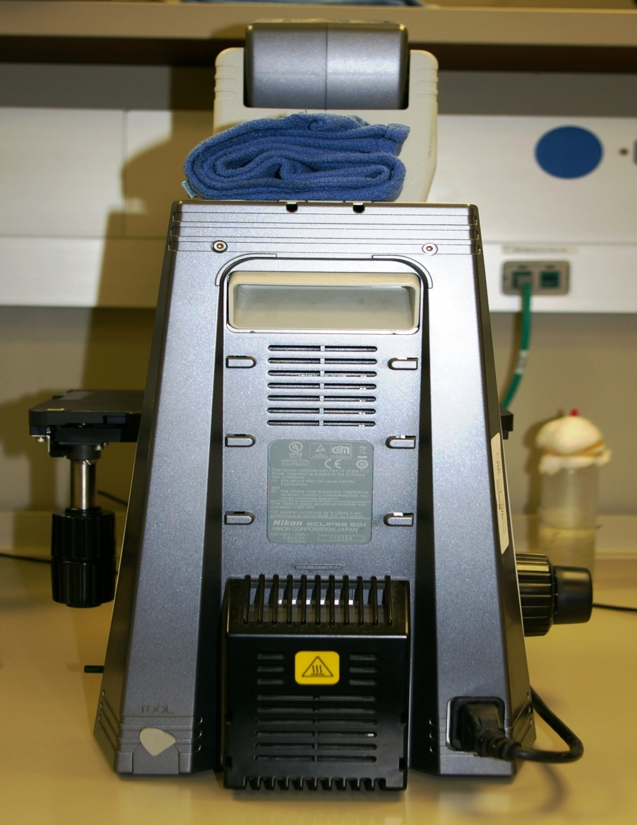
Lamp Replacement
UNPLUG SCOPE before replacing bulb
DO NOT handle bulb with fingers; handle using gauze or plastic
Lamp Wattage
& Voltage
(scope specific)
Lamp Cover

Slide 8
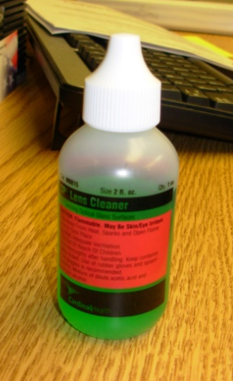
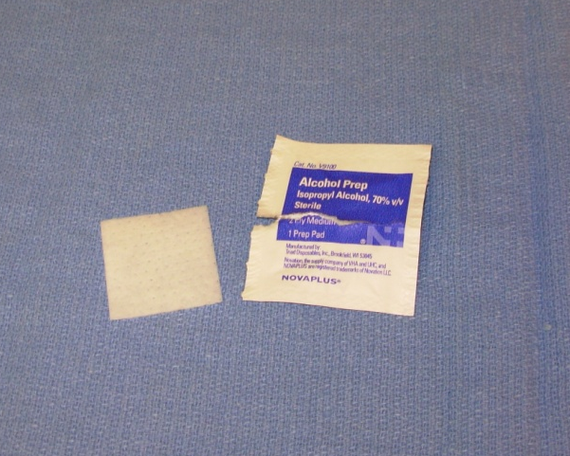
Maintenance
Keep Your Microscope Clean For Best Performance !
Clean Glass Lens
  Alcohol or Lens Cleaning Solution
  Dry With Soft Gauze or Lens Paper
  Eye pieces, Objectives, Condenser and Bright light Lamp Lens
Wipe Surface Of Scopes To Remove Dirt & Oil
Lens Cleaner
Alcohol Prep

Slide 9
Microscope Oil
ONLY USE manufacturer approved oil
DO NOT use Nikon oil on Olympus scopes
DO NOT use Olympus oil on Nikon scopes
DO NOT leave oil on objective lens
DO NOT use excess oil
Oil deteriorates objective seals and seeps into the interior of the objective (blurs images)
Oil attracts dust and dirt that causes gears to bind
Oil refill stored at hematology’s diff-bench

Slide 10
DIFF PAD
Walk Through

Slide 11
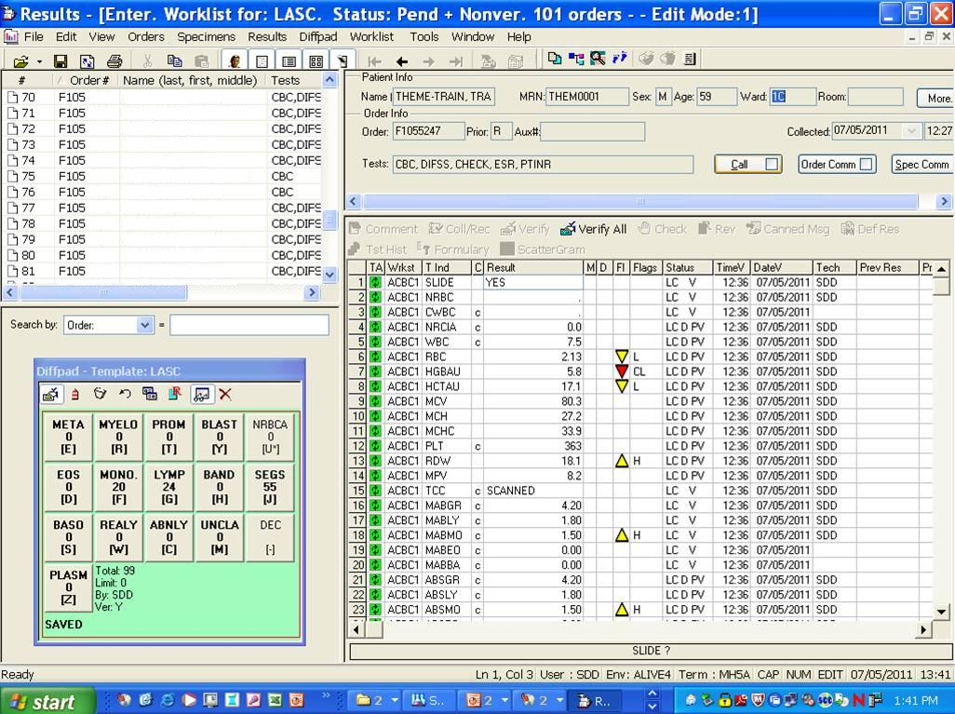
Worklist for LASC
Patient Demographics Pane
Worklist Pane
Resulting Pane
Diff Pad

Slide 12
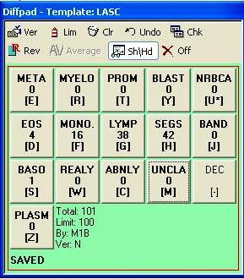
Diff Pad
The Diff Pad is a separate window within the Worklist screen. It can be moved around the screen by clicking and dragging the blue title bar.
To access the Diff Pad from the Resulting Pane you may either click on the Diff Pad with the mouse or use the TAB key on the keyboard. (The TAB key toggles back and forth between the Results and the Diff Pad.)
The tool options at the top of the Diff Pad can be added or removed by right clicking in the tool bar area by checking or unchecking the tool in the menu.

Slide 13
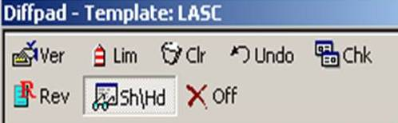
Diff Pad Menu

Slide 14

Ver = Verify Diff Pad Tests
This button will verify all Diff Pad numbers including zeros. The result values are verified simultaneously on the patient report.
This DOES NOT verify the Hemogram results.

Slide 15

Lim = Changes Diff Pad Limit
This button changes the counting limit of the keypad. This number is set to default at 100.
Change the limit when you have a WBC <1.0. if you change the limit IT MUST be a multiple of 100 (i.e. 5, 10, 20, 25, 50,…) not an odd number (i.e. 15, 35) this gives strange values when reporting out.

Slide 16

Clr = Clear Diff Pad Results
This button clears the Diff pad area and all numbers will become zero (0).
A prompt box will appear that must be answered YES to clear the results.
You must use Enter or click on Yes with your mouse. DO NOT use Y for Yes.

Slide 17
Undo = Restore Diff Pad Results
This button will restore the previously cleared results if the Diff Pad results are cleared using the previous (Clr) command.

Slide 18

Chk = Displays Check-up Diff Pad
This button will display a blank Diff Pad to the right of the “working” Diff Pad. You must click on the newly opened blank Diff Pad or press TAB to access it.
This option gives the operator a blank pad to preform a manual diff so you are able to compare your results to the automated results.

Slide 19
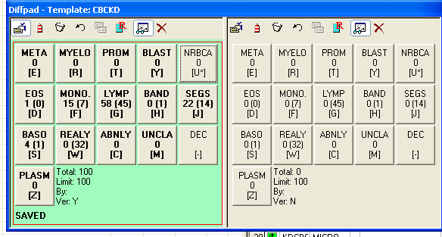
Diff Pad Check-Up
If using the Diff Pad Check-up to confirm instrument values complete diff in the second Diff Pad.
If you want to keep the results from the second Diff Pad verify by clicking the verify icon on the second Diff Pad, then close the second Diff Pad, your values will then populate the original Diff Pad.

Slide 20

Rev = Review
THIS OPTION IS NOT USED. The CBC report is sent as a group test for the Pathologist to review. If a CBC needs to be sent for a review, say YES to the REVIEW line, this will reflex the review.

Slide 21

Sh\Hd = Show\Hide
This button toggles between the automatic diff results and a zeroed out manual Diff Pad.
If this option is “on” (light shaded background) it will show the Sysmex 5 cell differential and the previous diff results.

Slide 22

Off = Close
This button will close the Diff Pad window.
If the Check-up Diff Pad is used, the button will only close one Diff Pad.

Slide 23
Diffing
A
Good Diff

Slide 24
Worklist for LASC
Patient Demographics Pane
Worklist Pane
Resulting Pane
Diff Pad

Slide 25
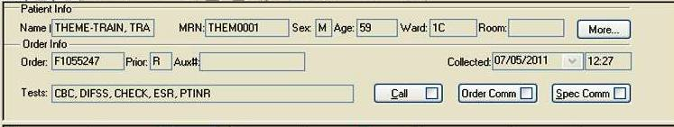
Patient Demographics Pane
(Top Right Corner)
This pane shows Patient Information along with all tests ordered on selected accession number
Other useful information could be included in the “Order Comm” and “Spec Comm” boxes

Slide 26
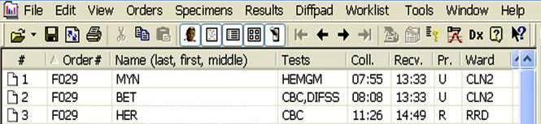
Worklist Pane
(Top Left Corner)
Order Number
Test ordered
Patient Name
Col/Rec Times
Pay Attention to your received times
Columns will sort when clicked on

Slide 27

Resulting Pane
(Below Patient Demographics)
MOST COMMONLY USED ICONS
Comment = Used to make additional comments such as criticals.
Verify = Verifies each test line individually
Verify All = Verifies ALL test together
Check = Click on individual test then click check for reference ranges
Test History = Gives patient history for individual tests

Slide 28
Starting A Diff
Select the patient you are wanting to Diff
Check Patient information to ensure you are on the correct patient (Look at slide, paper and computer screen)

Slide 29

YES To Slide
YES
On Line number 1 say YES to Slide
Saying Yes states there is a slide available in the lab

Slide 30
NRBC
The NRBC line must have a place holder {.} or a value entered or the Diff will not verify
If your NRBC count has a difference of >10 from the instrument value, use your NRBC result
To do a manual calculation:
  Corrected WBC = WBC / (100+ NRBC)
YES
.

Slide 31
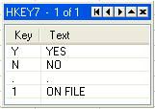
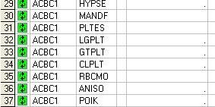
Manual Differential
There is no default, you MUST answer the MANDF line
Answering YES will allow you to verify a manual diff and will change the TCC (Total Cells Counted) accordingly
Answering NO will allow you to verify the instrument diff and changes the TCC to SCANNED
{.} and {ON FILE} are rarely used
YES

Slide 32
Platelet Estimate
Does your PLT Estimate COMPARE with the instrument PLT Result?
  Evaluate the impact of Microcytes and Schistocytes on the PLT Count
    If in doubt, do a slide PLT estimate

Slide 33
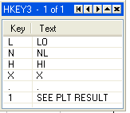
Platelet Estimate
Determine your PLT estimate according to what you see on the slide
  LO is <2 – 149
  NL is 150 – 450
  HI is >450
  {SEE PLT RESULT} is used when you change the instrument value line or a comment is added EX: Xing your PLT value
  {X} is only used to modify a verified result
NL

Slide 34
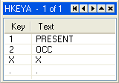
Platelet Description
Assess the size of the PLTs by using the MPV and comparing to NORMAL sized RBCs
Answer PRESENT or OCCASIONAL if observed
Leave the default {.} if you have normal PLTs
“PLT ABN DISTRIBUTION” and “PLT ABN SCATTERGRAM” flags may appear if there are large PLT, giant PLT, or PLT clumps
.
.
.

Slide 35
Platelet Clumping
Your instrument PLT count is X’ed when clumping is present on the slide
See PLT Clumping Power Point for more details

Slide 36

RBC Morphology
There is no default, you MUST answer the RBCMO line
Use NL if the RBCs are normal
Use the {.} with any abnormal findings
.

Slide 37
WBC, RBC, PLT, Microorganism
There are detailed power points explaining each of the above

Slide 38
2nd Tech Reviews
The 2nd Tech Reviewer usually is not allowed to call any blast without the patient having history. In this case the slide will be sent to a pathologist.
2nd Tech Reviewer is usually a senior tech that can “look over” a slide that may have abnormalities.

Slide 39

2nd Tech Reviews
Setting up a 2nd tech review
After completing your differential and additional review is required there is a few steps that must be taken.
Before verifying your patient completely scroll down your resulting pane until you find

Slide 40
2nd Tech Review
This line defaults to NO; do not change unless needed for a 2nd tech to review
If there is a MORP; DO NOT OPEN for review

Slide 41
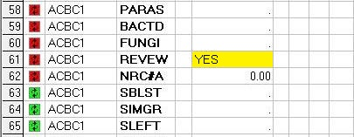
2nd Tech Review
Change the NO to YES
Verify your results and save
Send to your 2nd tech review person.

Slide 42
Pathologist Reviews
Depending on your facility the 2nd tech and pathology reviews may be internal or external.
A Pathologist Review is any slide with blast, a drastic change in the appearance of the patient, or if the 2nd tech feels the slide is beyond their review criteria.

Slide 43
2nd Tech Reviews
When looking at your pending any review will show as HREVW
If you are the second tech review person you will need to refresh your worklist for HREVW to show

Slide 44
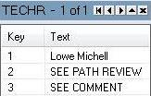
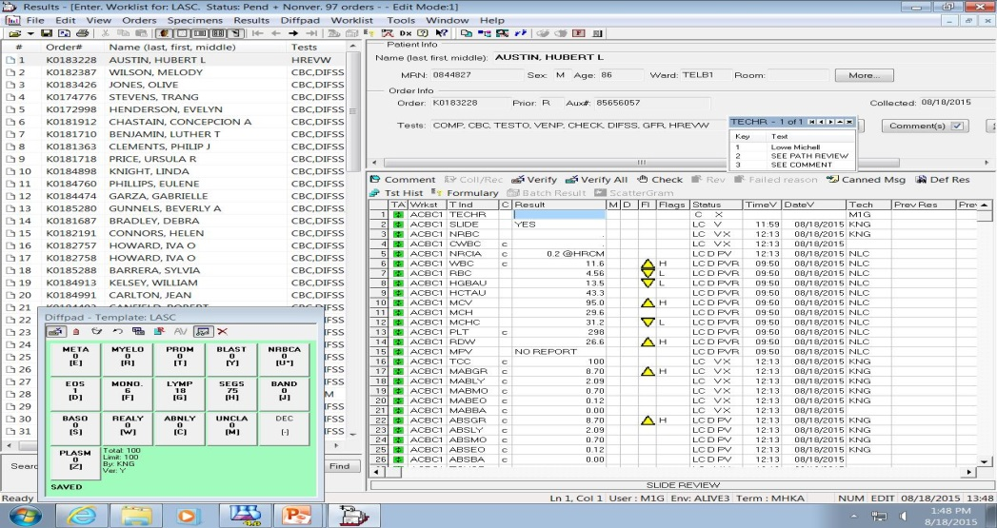
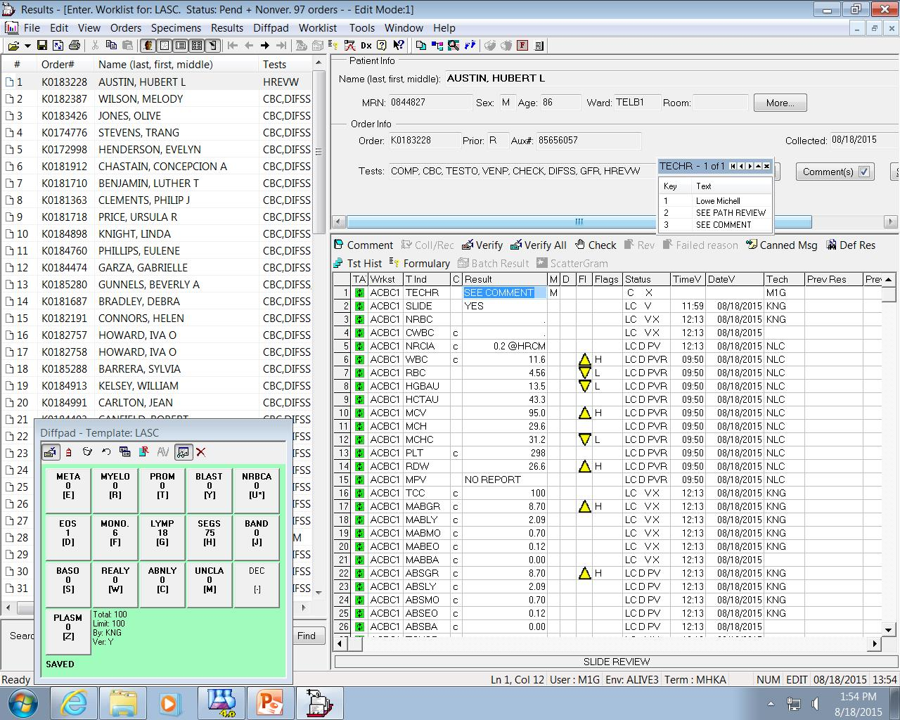
2nd Tech Review
2nd Tech person looks at the slide
Puts in a comment under TECHR
Use the #3 option (See Comment)
Verify and Save

Slide 45
Path Review
If a Path review is needed DO NOT USE COMMENT
See the next slide to set up a Path Review

Slide 46
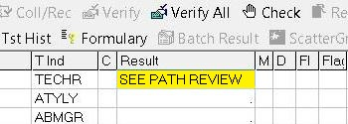
Pathology Review
On the TECHR choose #2 (See Path Review)
Verify and Save

Slide 47
Path Review
After refreshing your pending the Path Review will show up as HPATH

Slide 48
~The End~
☺

