Slide 1
RBC’s
Morphology, Grading
And
Artifacts
By: Emily Gehring
&
Michell McAdams
01/2013

Slide 2
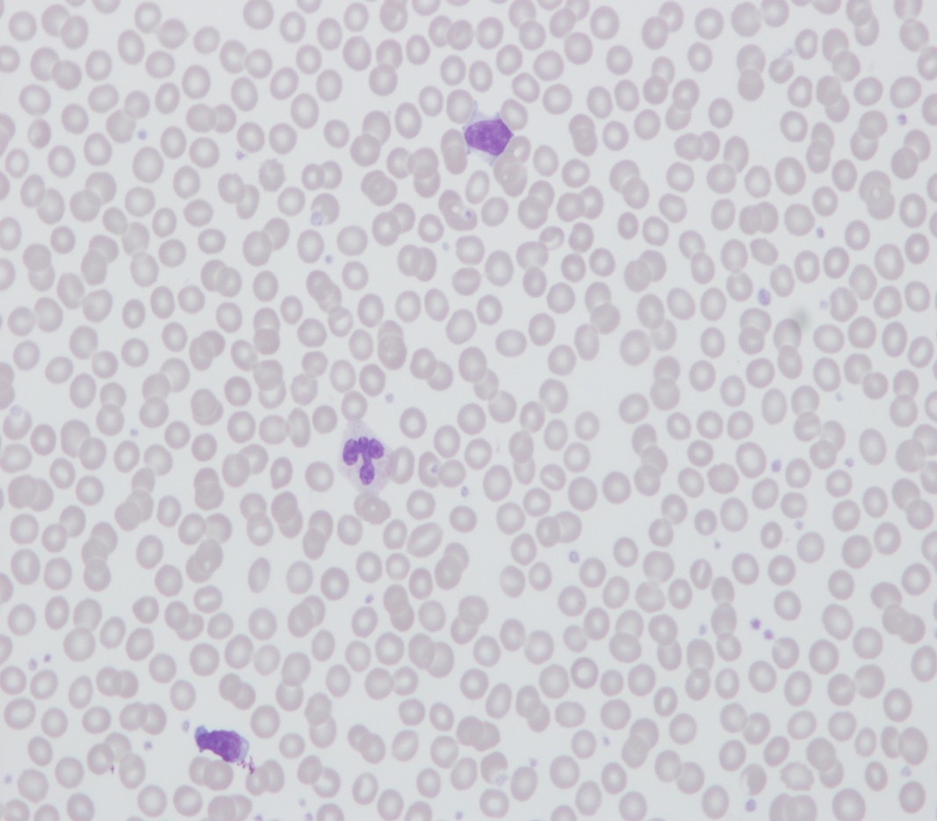
Normal RBC’s
RBC’s Seen on 50X

Slide 3
RBC Morphologic Characteristics
- - - - - - SHAPES - - - - - -
Anisocytosis
Macrocytes
Microcytes
Acanthocytes
Burr Cells
Elliptocytes (Ovalocytes)
Stomatocytes
Sickle Cells
Target Cells
Tear Drops
Spherocytes
Schistocytes
RBC Agglutination
RBC Rouleaux
- - - - - - Color - - - - - -
Hypochromia
Basophilic Stippling
Polychromatophilia
- - - - - - Inclusions - - - - - -
NRBCs
Howell-Jolly Bodies
Pappenheimer Bodies
Hemoglobin Crystals

Slide 4
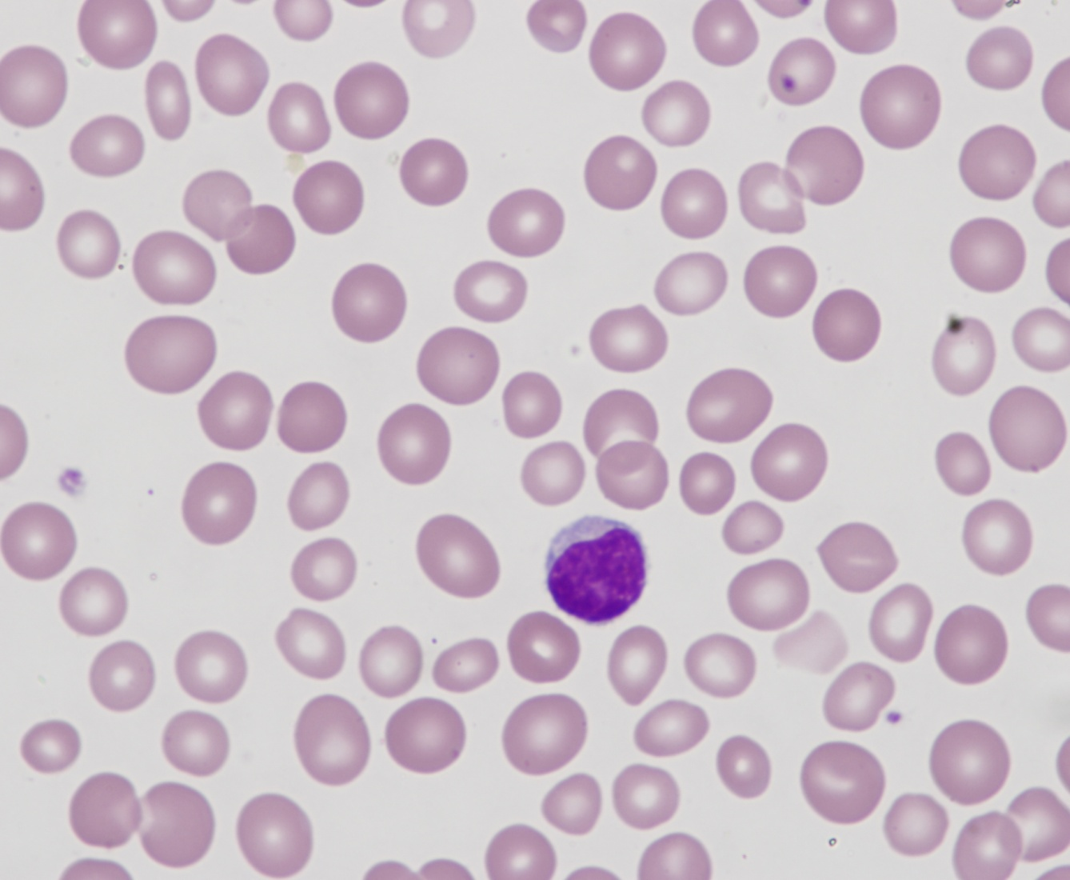
Anisocytosis
RDW - CV Guide (g/dL)
Slt = 15-18, or 4-20 cells per 50X field
Mod = 18-24, or 21-40 cells per 50X field
Mrk = > 25, or >40 cells per 50X field
Only use RDW as a guide
Interferences distort values

Slide 5
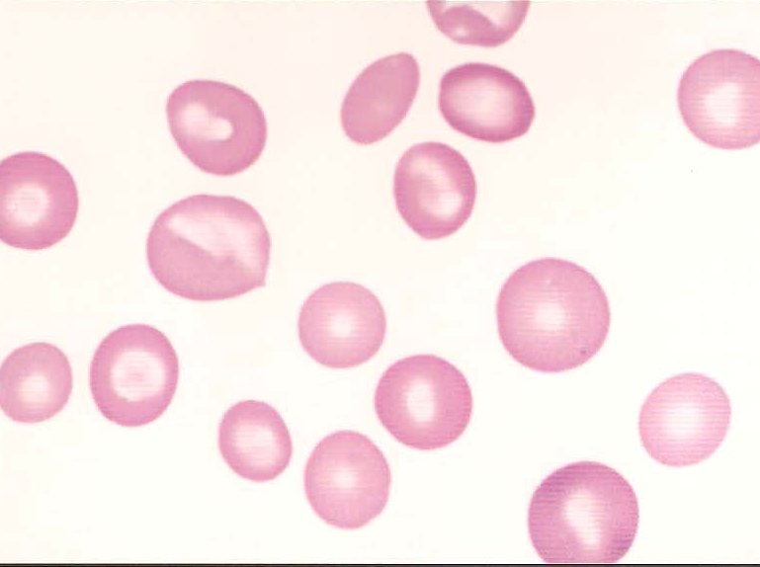
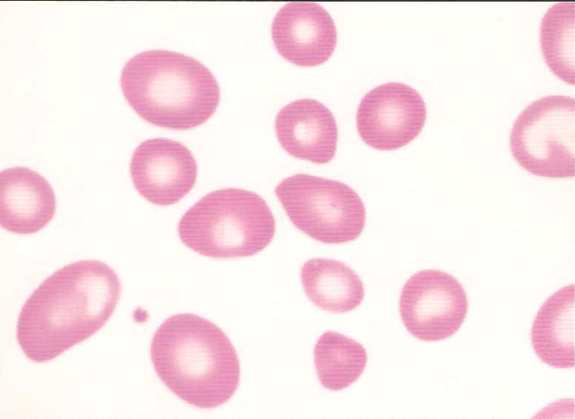
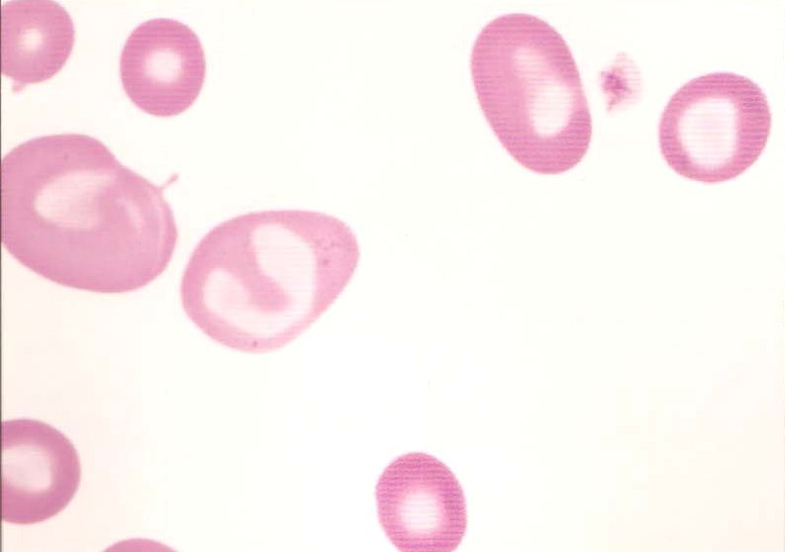
Aniso Grading
OCC
SLT
MOD
MKD

Slide 6
Macrocytosis
APPEARANCE: larger than a normal red blood cell, round or oval shape; oval forms have sides that are not parallel to each other normal hemoglobinization; no polychromasia

Slide 7
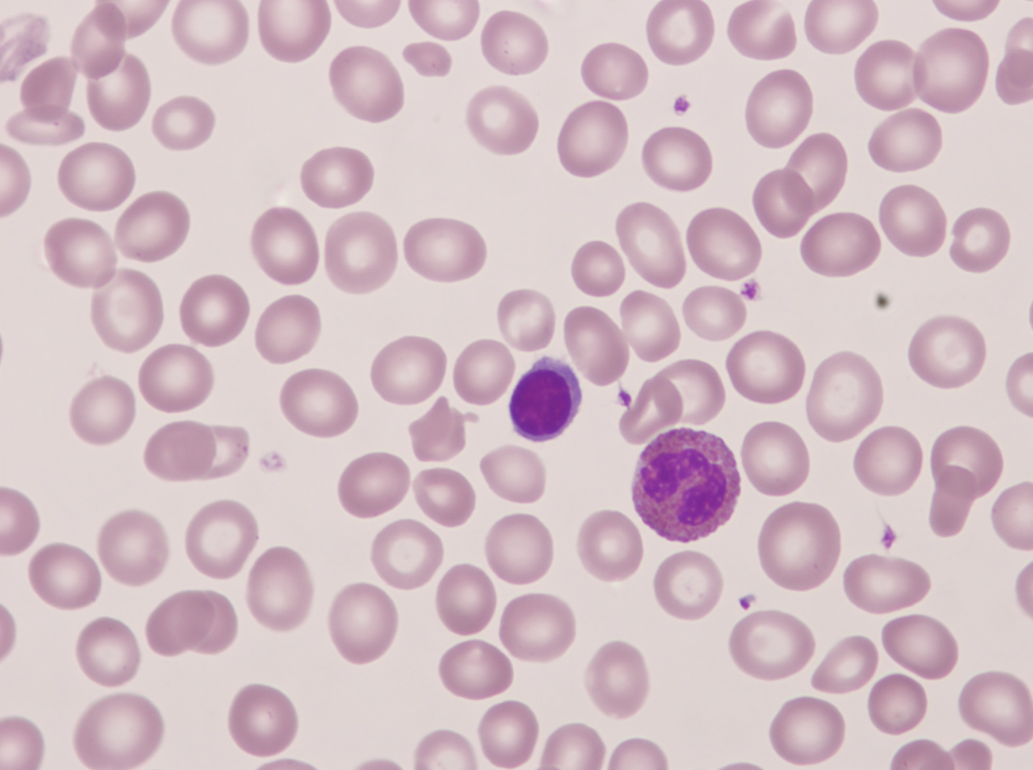
Macrocytes
Use the MCV as a guide
Slt = 100-110 fL
Mod = 111-120 fL
Mrk = >120 fL
Use the Lymph Nucleus to compare to RBC’s

Slide 8
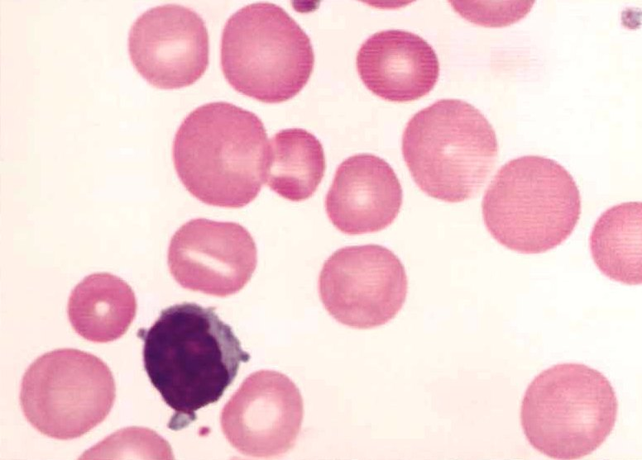
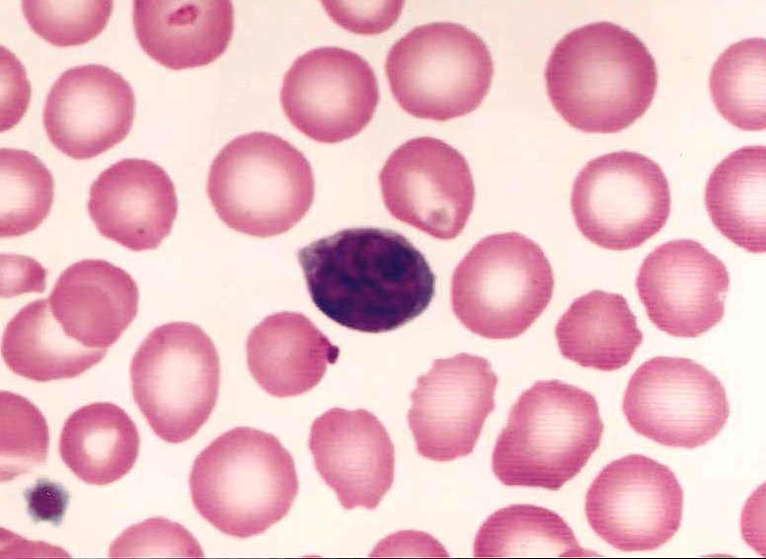
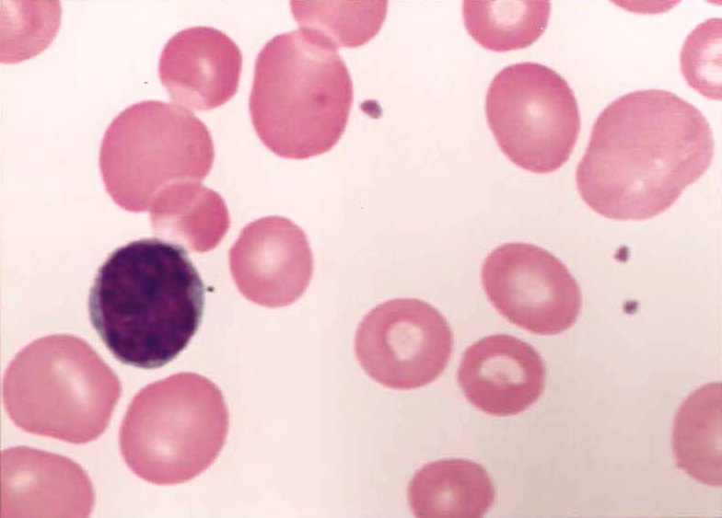
Macrocyte Grading
OCC
SLT
MOD
MKD

Slide 9
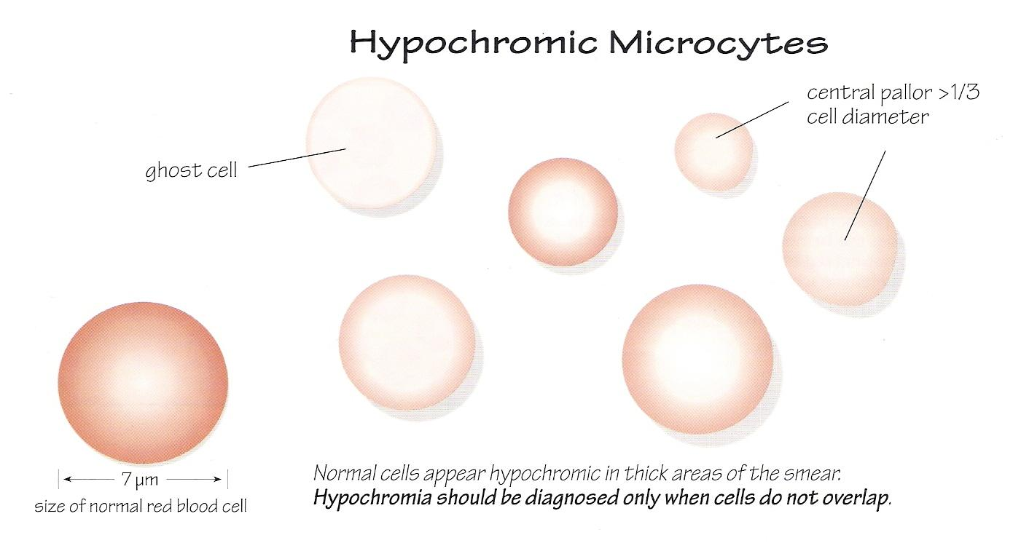
Microcytes
APPEARANCE: smaller than a normal RBC with cytoplasm that is hypochromic with a central pallor > 1/3 of RBC diameter, some cells contain so little HGB that they are “ghost cells”

Slide 10
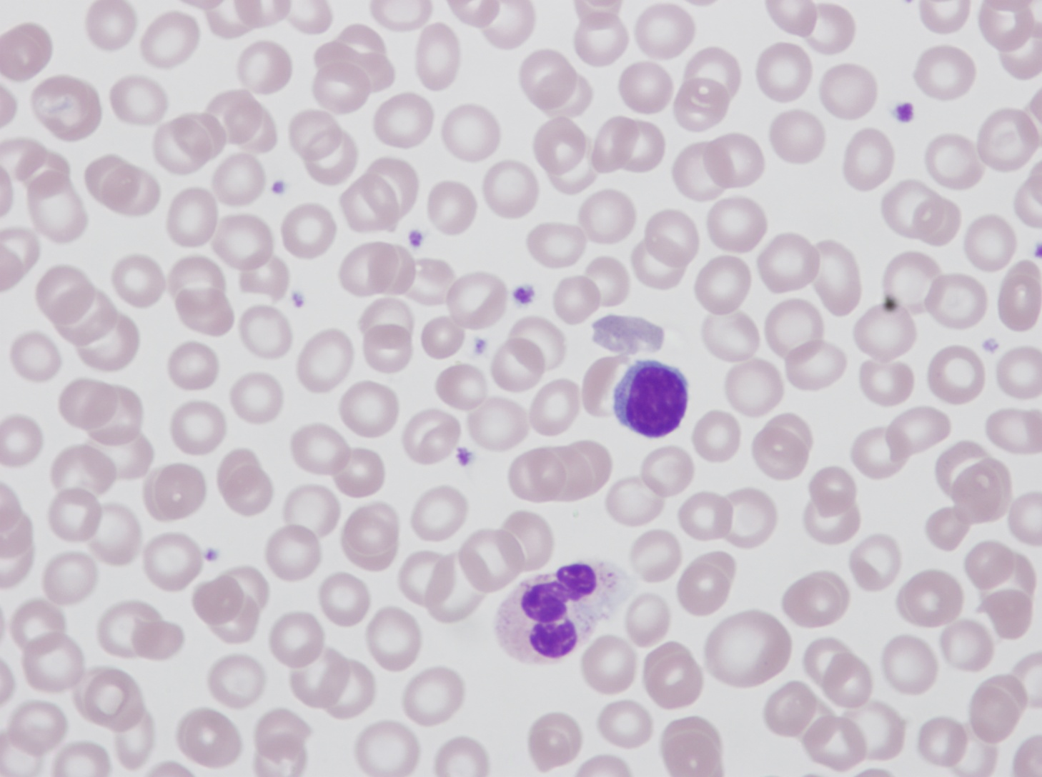
Microcytes
Use the MCV as a guide
Slt = 79-70 fL
Mod = 69-60 fL
Mrk = < 60 fL
Use the Lymph Nucleus to compare to RBC’s

Slide 11
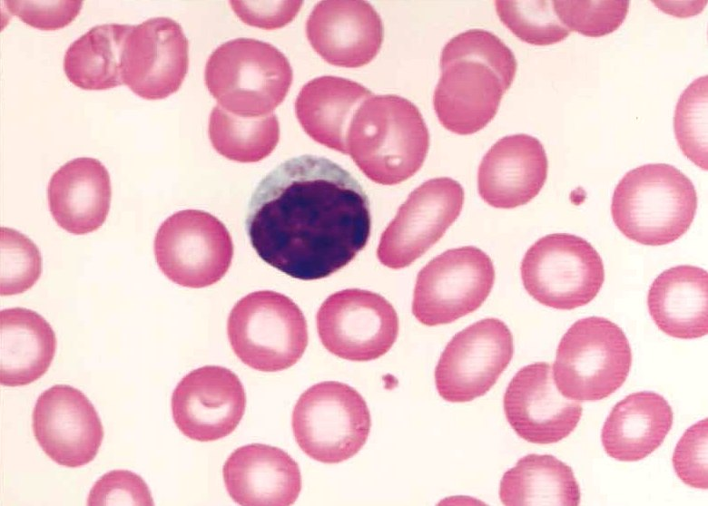
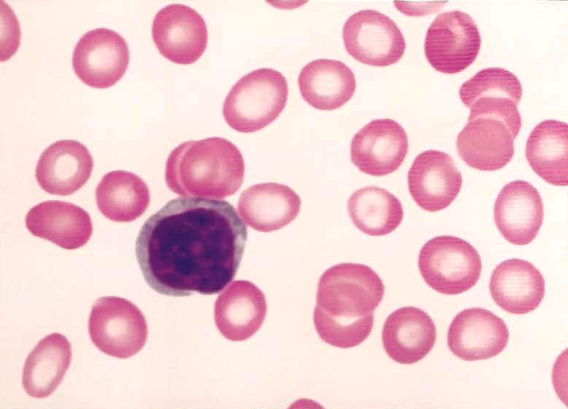
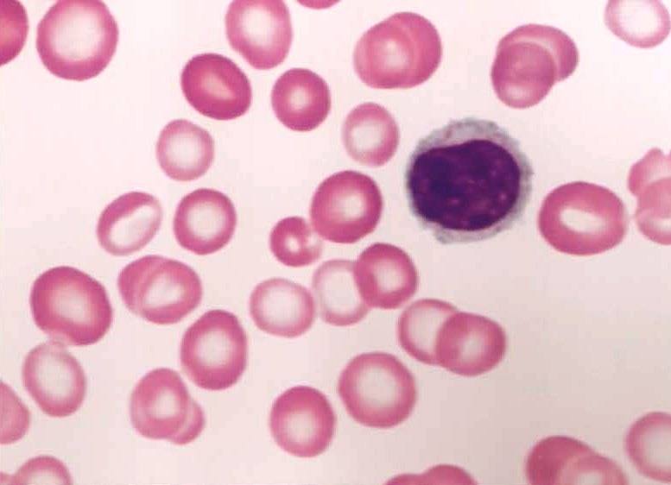
Microcyte Grading
OCC
SLT
MOD
MKD

Slide 12
Anemia Graph

Slide 13
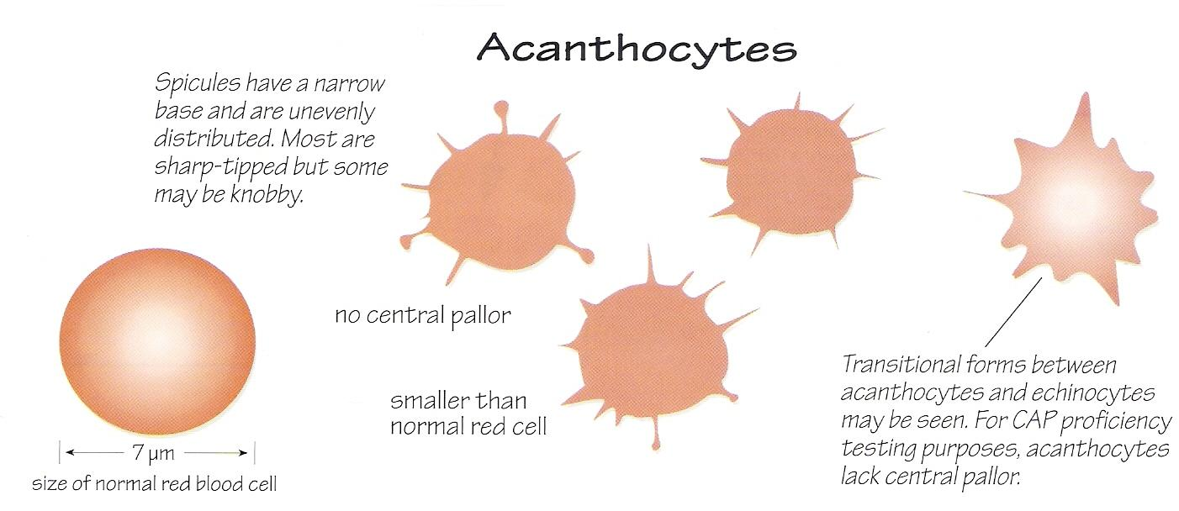
Acanthocytes
APPEARANCE: Crenated RBC with very spiny, irregular projections unevenly spaced with no central pallor

Slide 14
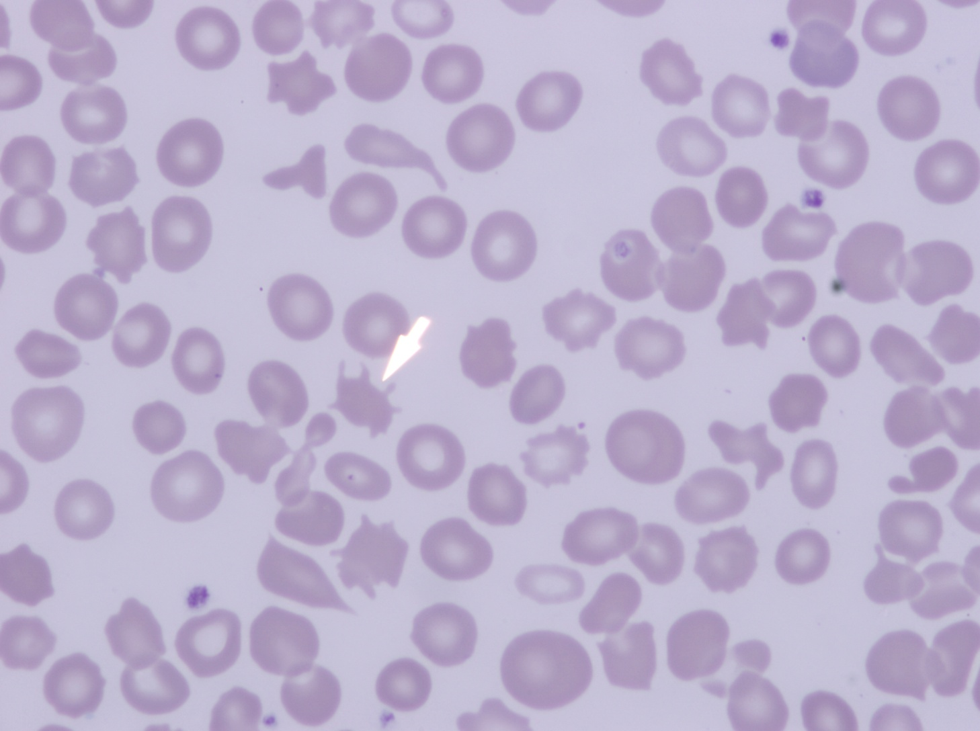
Acanthocytes
Grading Criteria per 50X Field
Occ = 1-3
Slt = 4-10
Mod = 11-20
Mkd = > 20

Slide 15
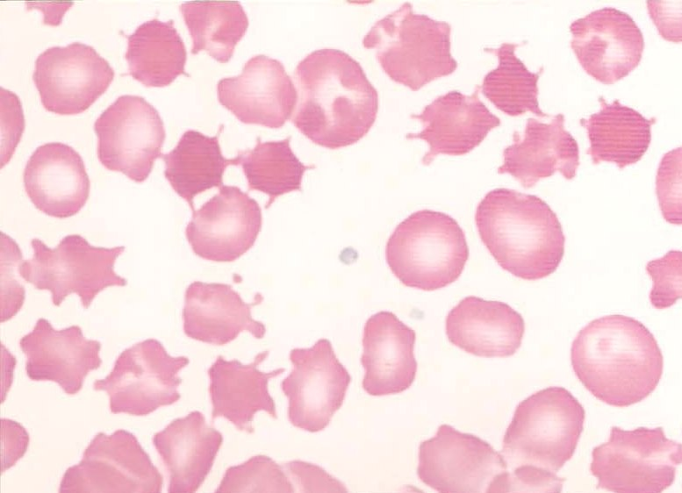
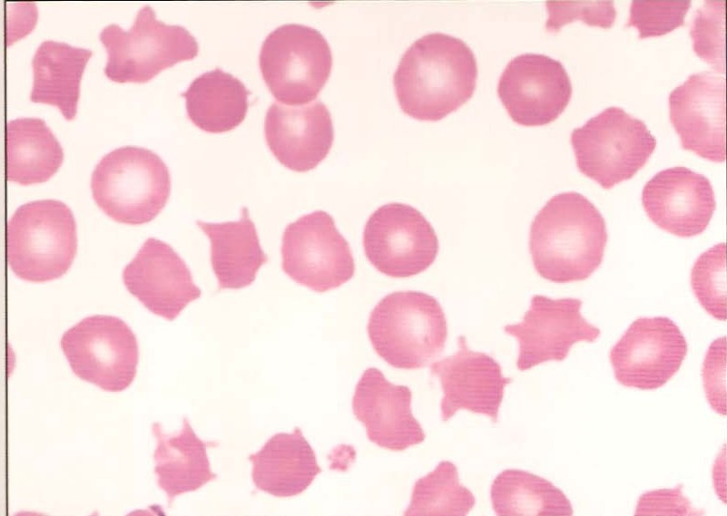
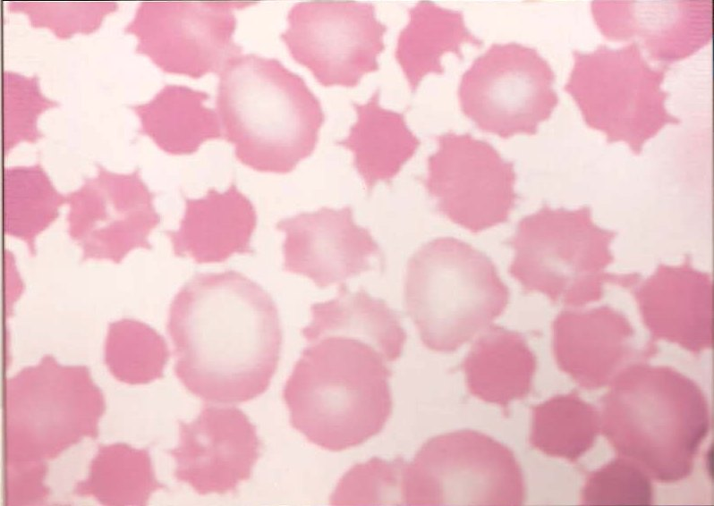
Acanthocytes Grading
OCC
SLT
MOD
MKD

Slide 16
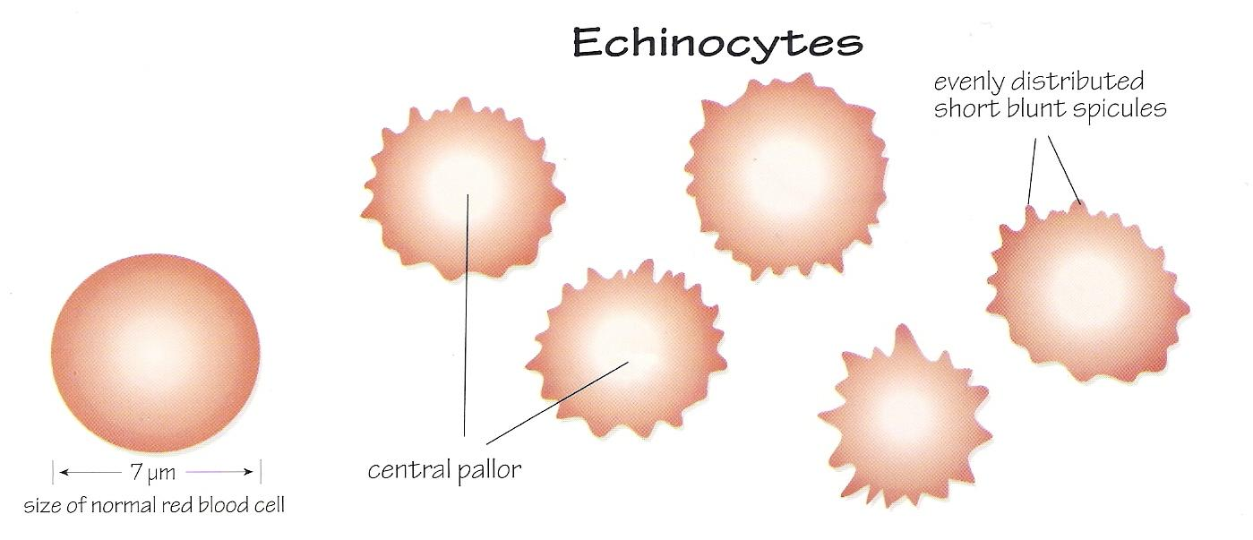
Burr Cells (Echinocytes)
APPEARANCE: evenly distributed short blunt projections uniformly sized with a central pallor.

Slide 17
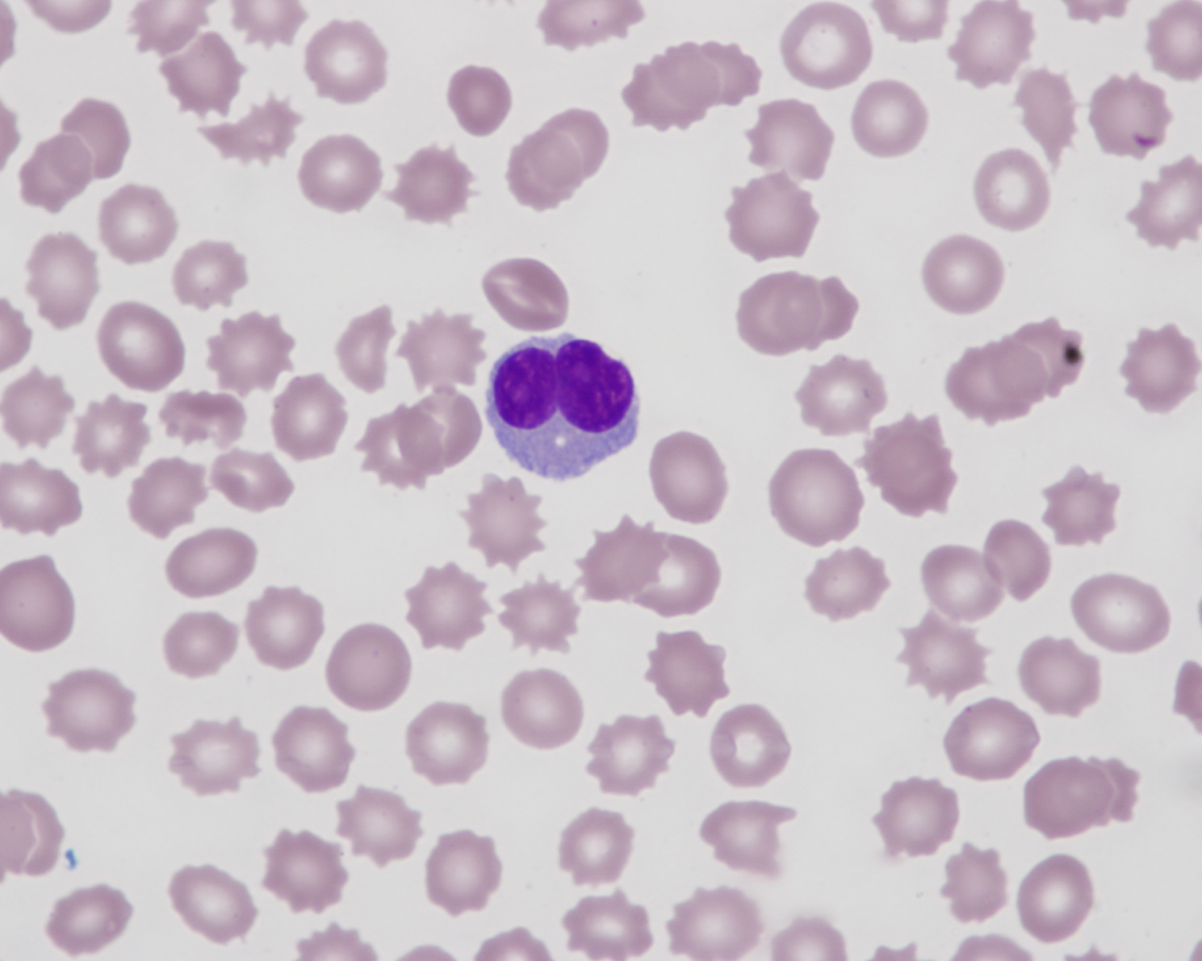
Burr Cells
Grading Criteria per 50X Field
Occ = 1-3
Slt = 4-20
Mod = 21-40
Mkd = > 40

Slide 18
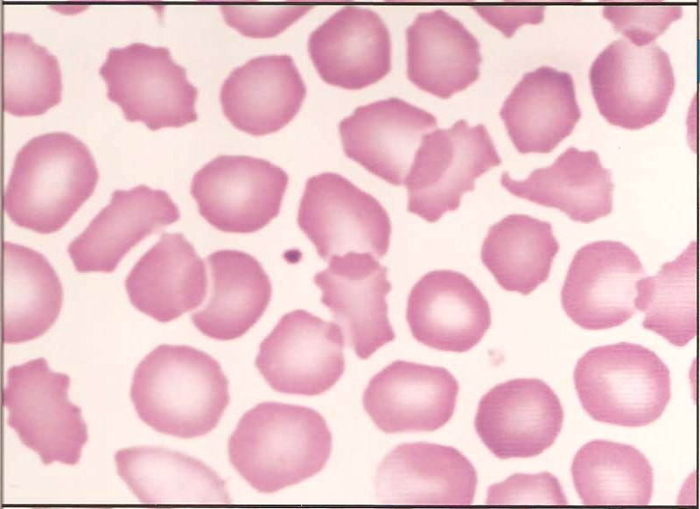
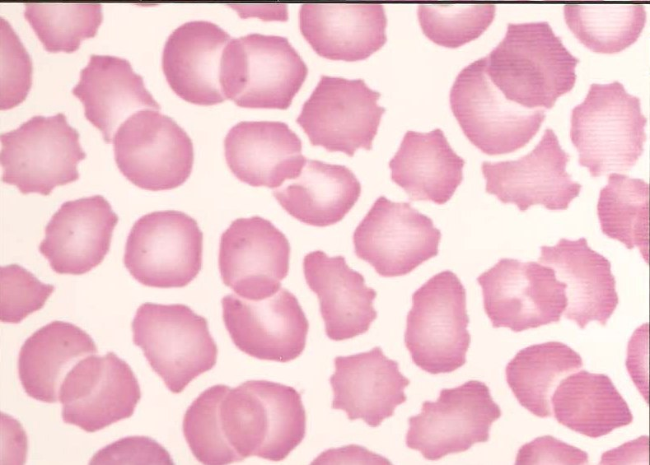
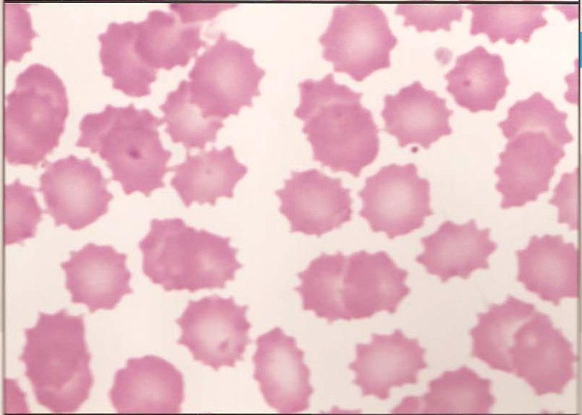
Burr Cell Grading
OCC
SLT
MOD
MKD

Slide 19
Acanthocytes vs. Burr Cells
Irregular Projections without Central Pallor
Uniform Projections with Central Pallor

Slide 20
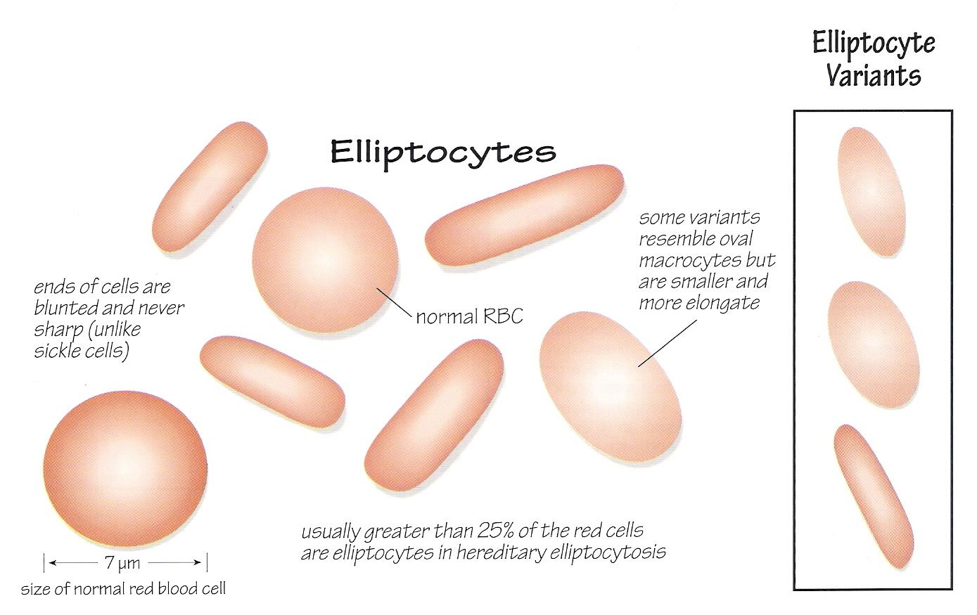
Eliptocytes (Ovalocytes)
APPEARANCE: usually longer than a normal red cell and much more narrow, with a uniform rod shape.
Hemolytic anemia subtypes have microelliptocytes, comma-shaped and teardrop forms
Ovalocytes in excess of 10% suggest hereditary ovalocytosis (> 25% is diagnostic)

Slide 21
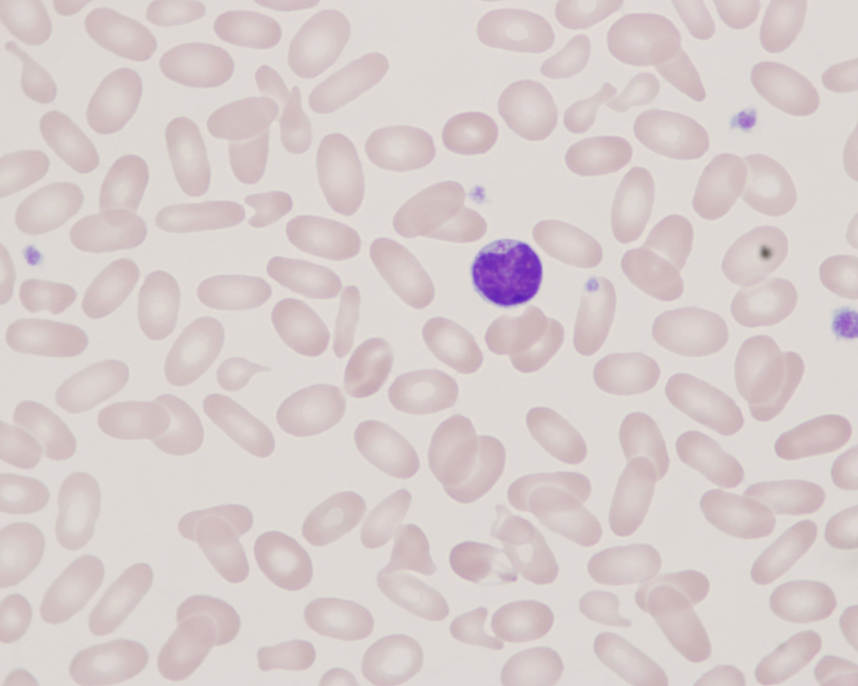
Eliptocytes (Ovalocytes)
Grading Criteria per 50X Field
Occ = 1-3
Slt = 4-20
Mod = 21-40
Mkd = > 40

Slide 22
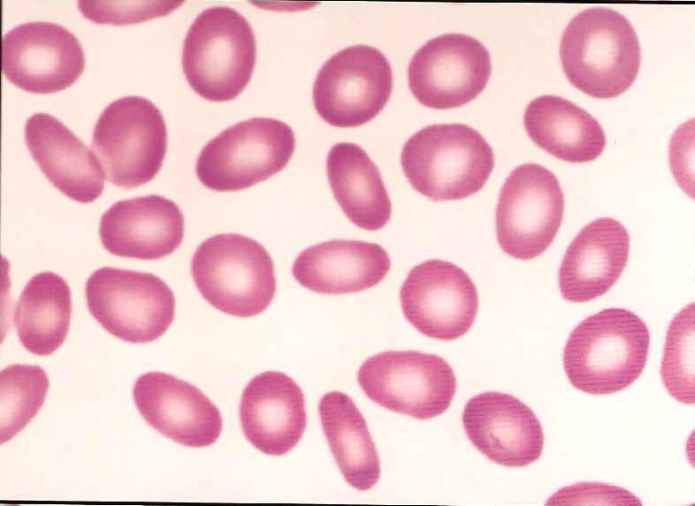
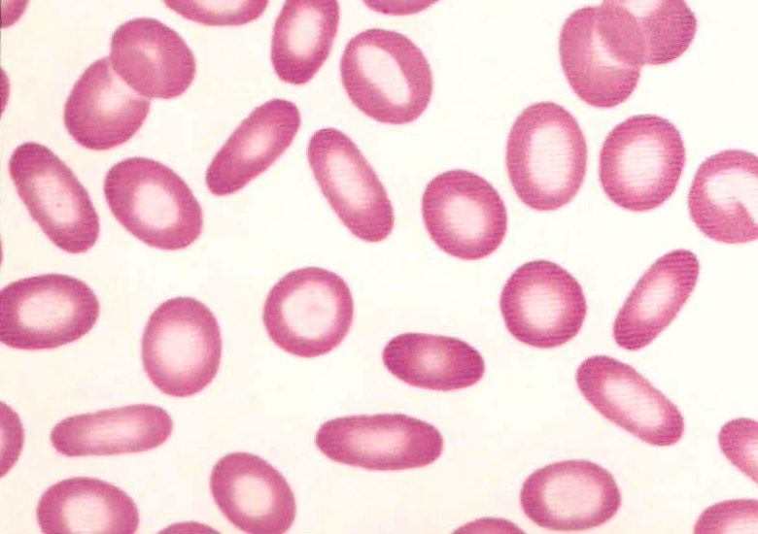
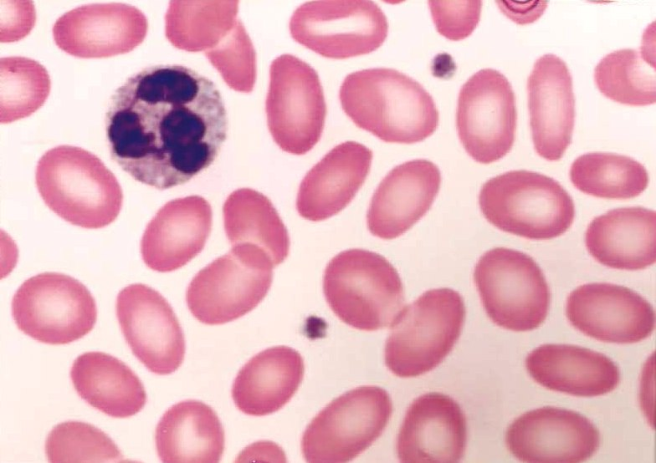
Eliptocyte Grading
OCC
SLT
MOD
MKD

Slide 23
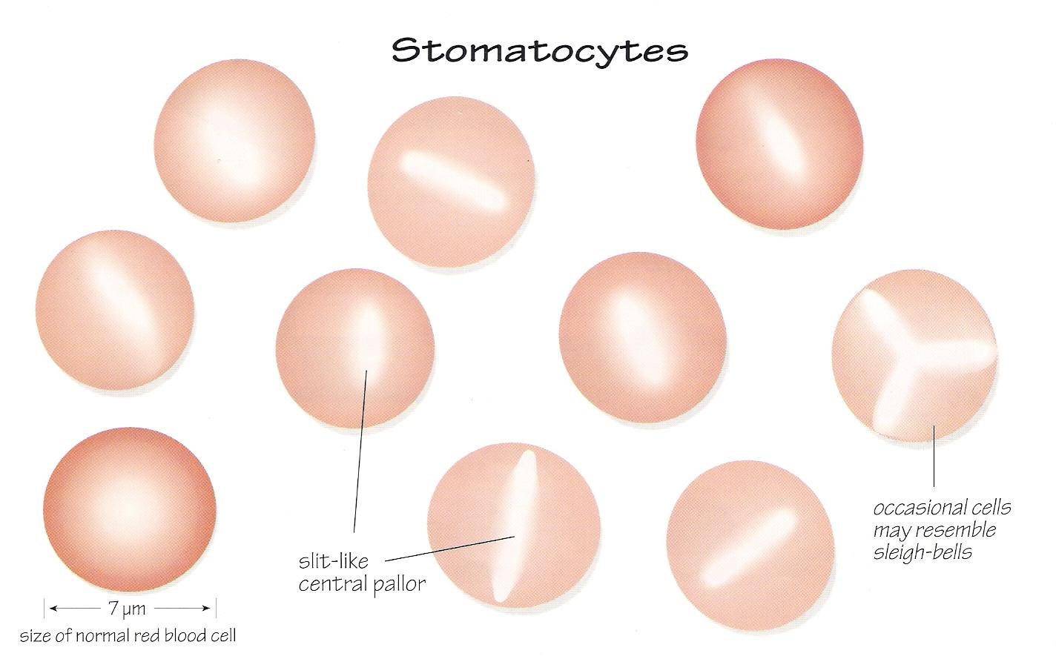
Stomatocytes
APPEARANCE: RBC with a slit as a central pallor with normochromic cytoplasma, few cells may have tri-polar pallor creating cells that resemble sleigh bells. May swell as intracellular water increases; MCV increases (up to 150 fL) and MCHC decreases

Slide 24
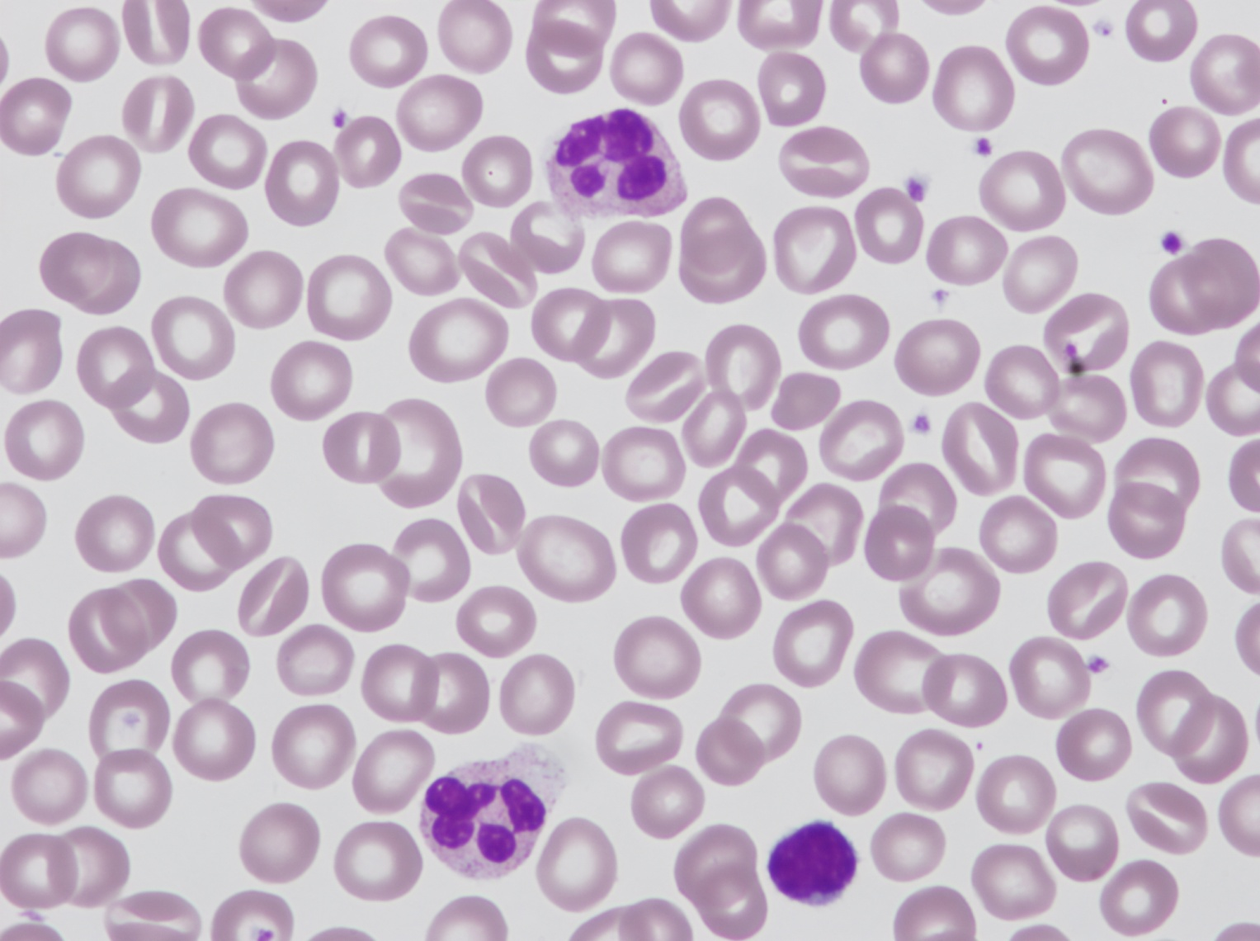
Stomatocytes
Grading Criteria per 50X Field
Occ = 1-3
Slt = 4-20
Mod = 21-40
Mkd = > 40

Slide 25
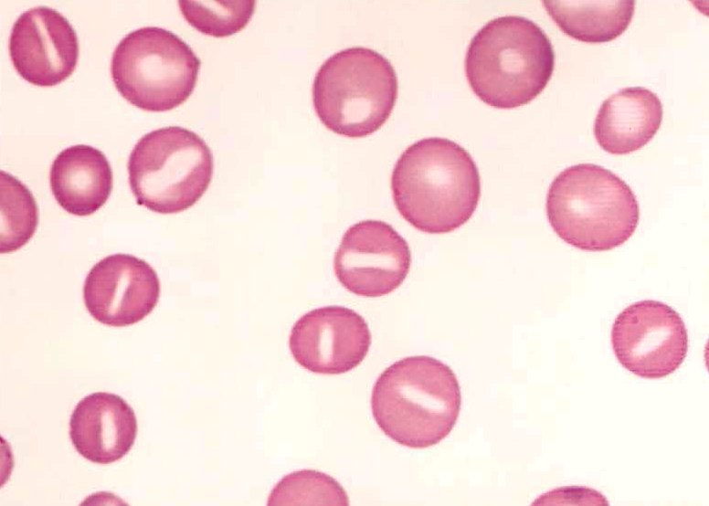
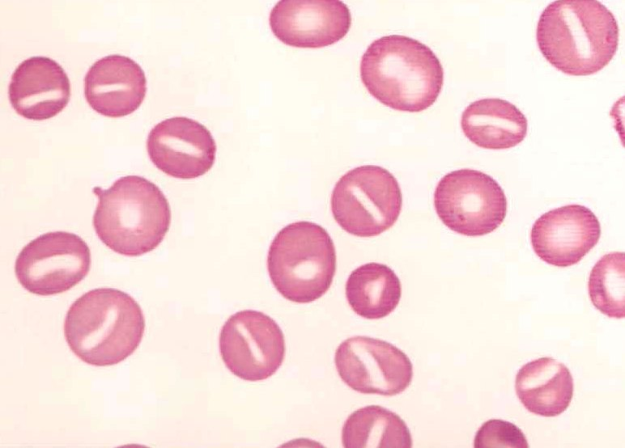
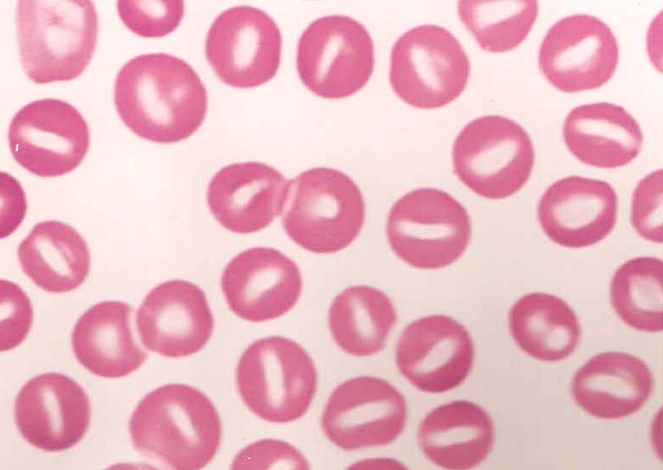
Stomatocyte Grading
OCC
SLT
MOD
MKD

Slide 26
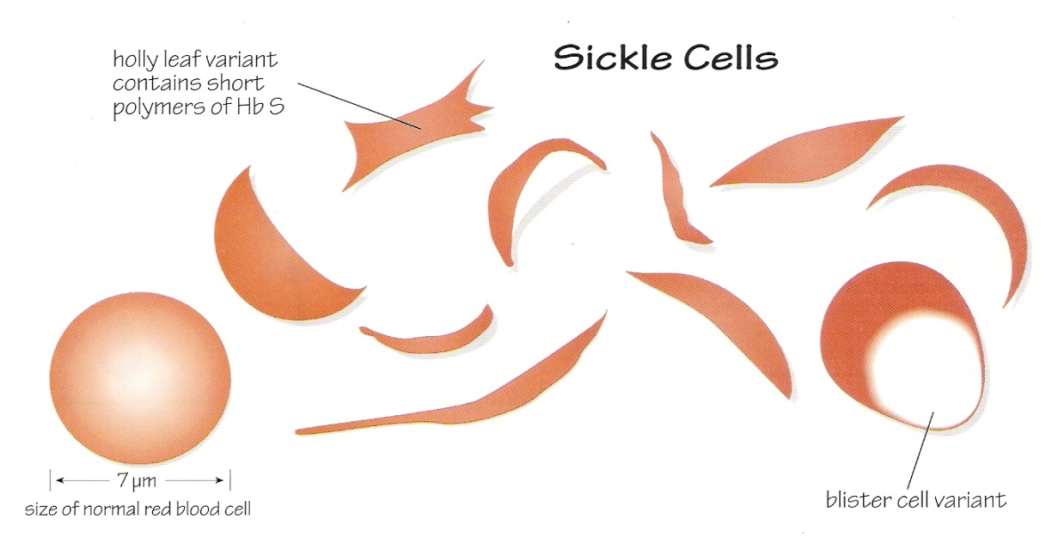
Sickle Cells
APPEARANCE: Usually a thin crescent shaped cell, with points on both ends, may also be crescent-shaped, boat-shaped, filament shaped, holly-leaf form (rarely) and envelope shaped. There is no central pallor; very dense HGB concentration (normochromic to hyperchromic)
The blood in sickle cell anemia show a normochromic-normocytic anemia as well as ovalocytes, target cells, polychromsia, basophilic stippling, NRBCs, and if autosplenectomy has occurred, Howell-Jolly bodies and Pappenheimer bodies; there is also a leukocytosis and thrombocytosis; modest eosinophillia is common; abnormal HGB ELP with an increase in HGB-S and the presence of HGB-F; HGB A2 is normal but HGB-A is absent.

Slide 27
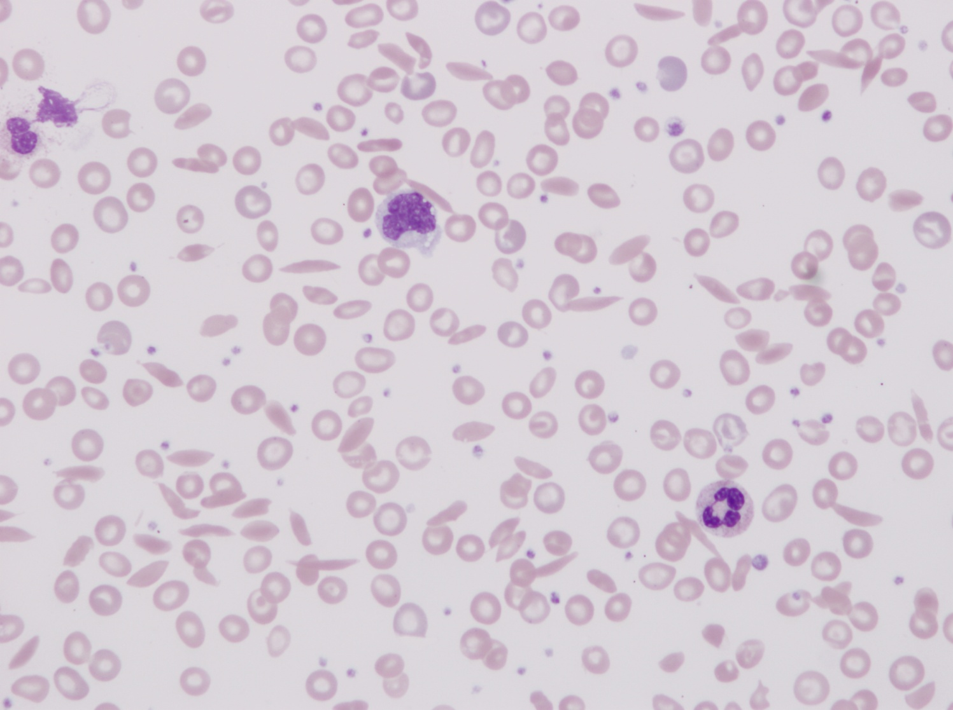
Sickle Cells
Grading Criteria per 50X Field
Occ = 1-3
Slt = 4-20
Mod = 21-40
Mkd = > 40

Slide 28
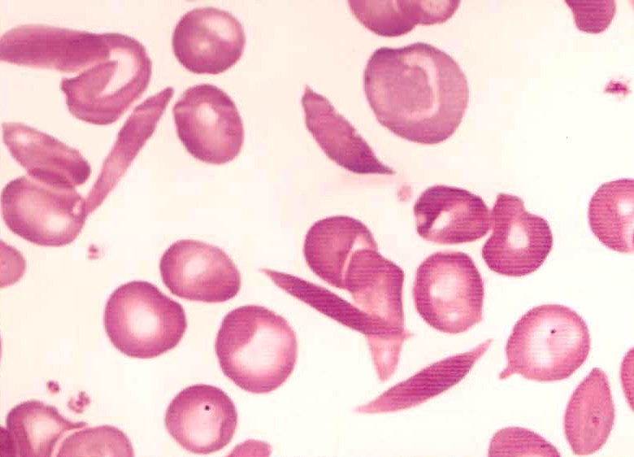
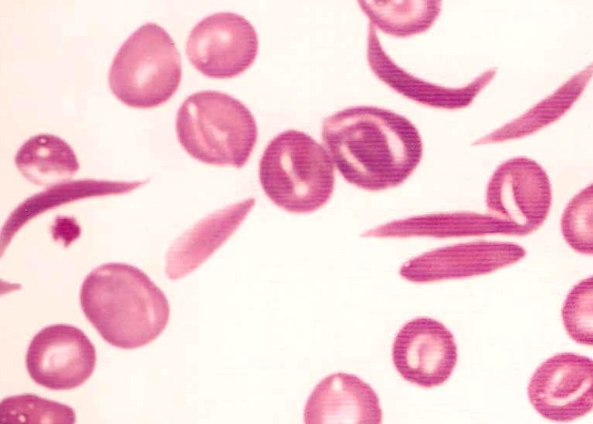
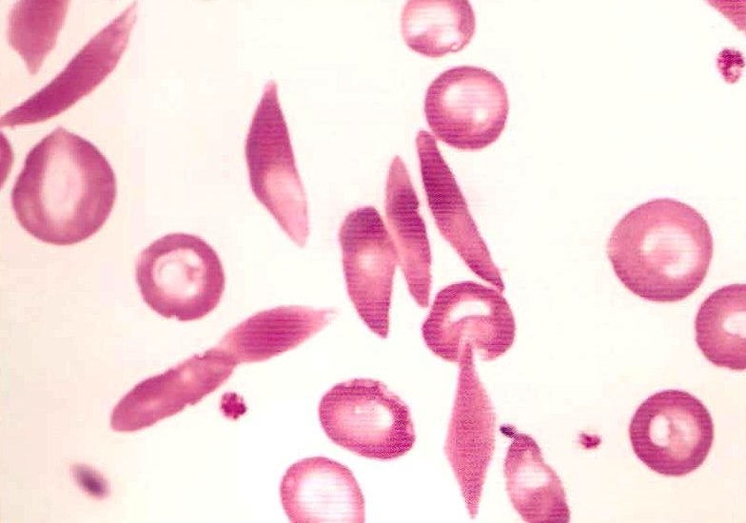
Sickle Cell Grading
OCC
SLT
MOD
MKD

Slide 29
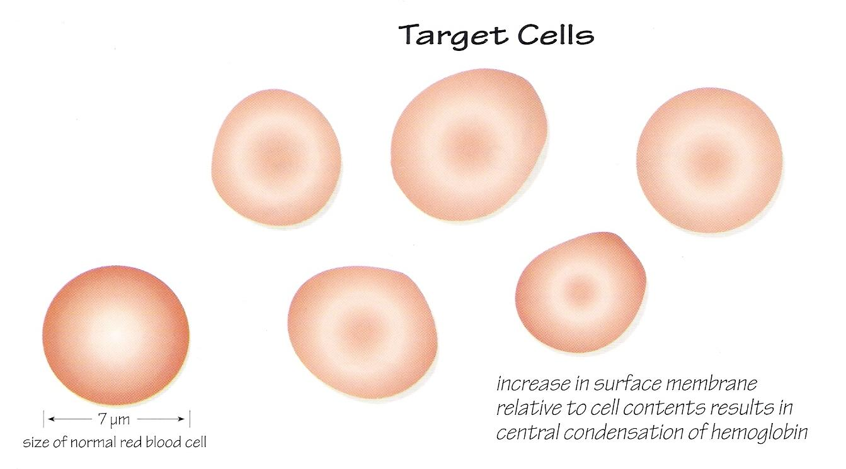
Target Cells
APPEARANCE: RBCs have a bull’s-eye appearance due to an increased surface membrane to volume ratio. AKA : codocyte

Slide 30
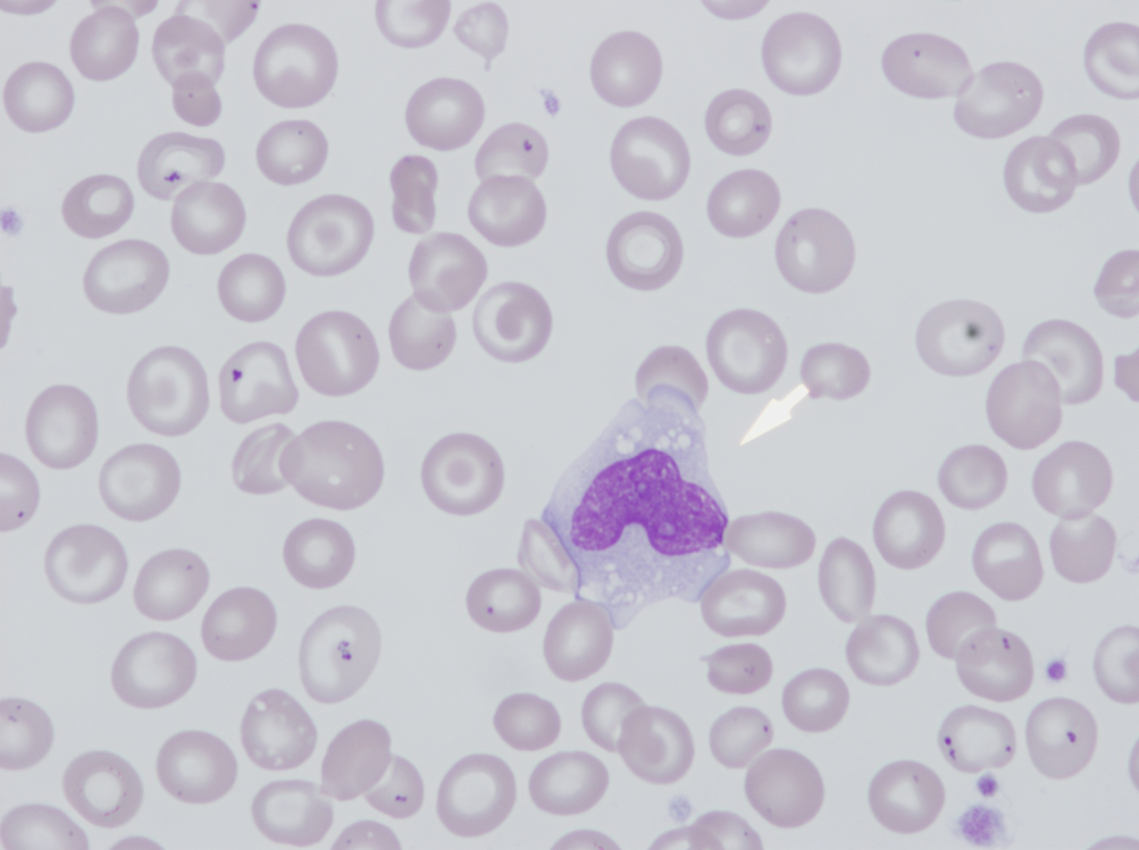
Target Cells
Grading Criteria per 50X Field
Occ = 1-3
Slt = 4-20
Mod = 21-40
Mkd = > 40

Slide 31
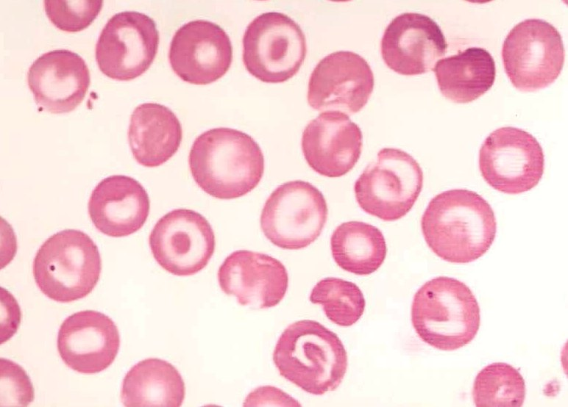
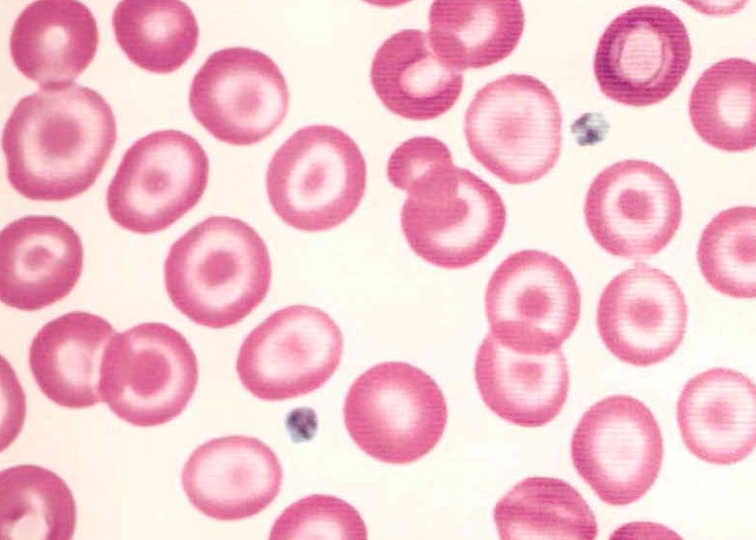
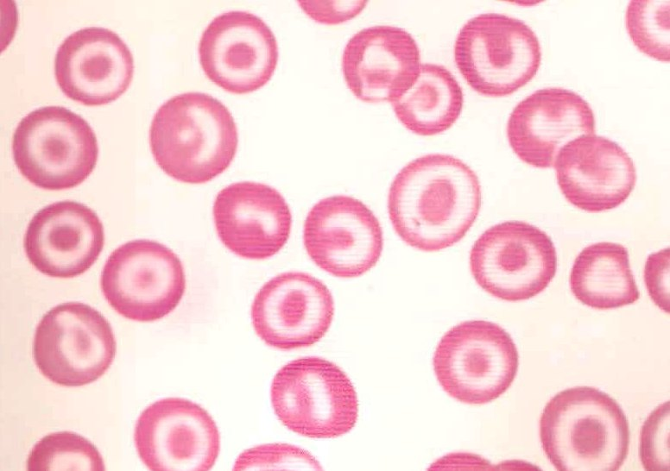
Target Cell Grading
OCC
SLT
MOD
MKD

Slide 32
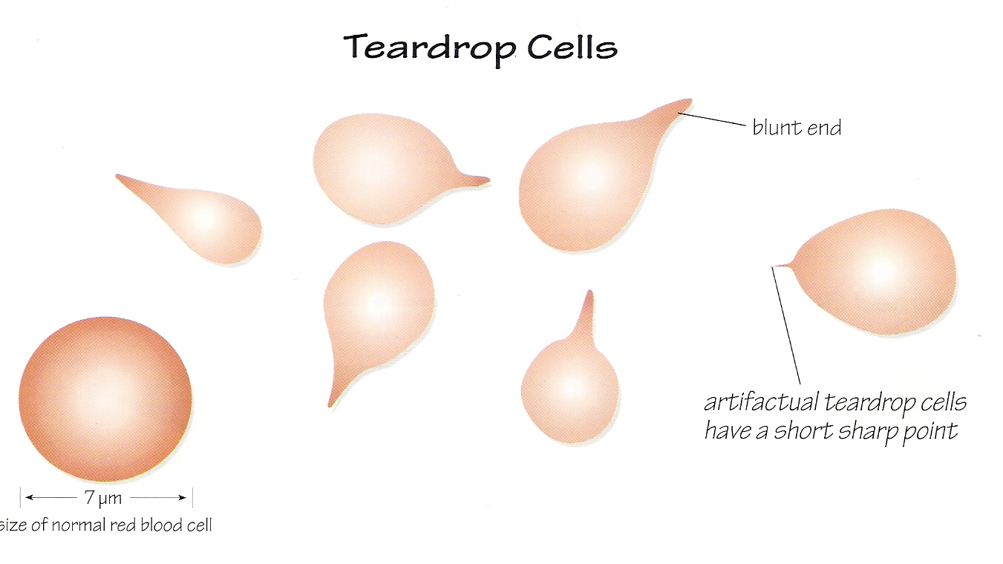
Teardrops
APPEARANCE: Round cells with elongated tail or point; resembles a teardrop

Slide 33
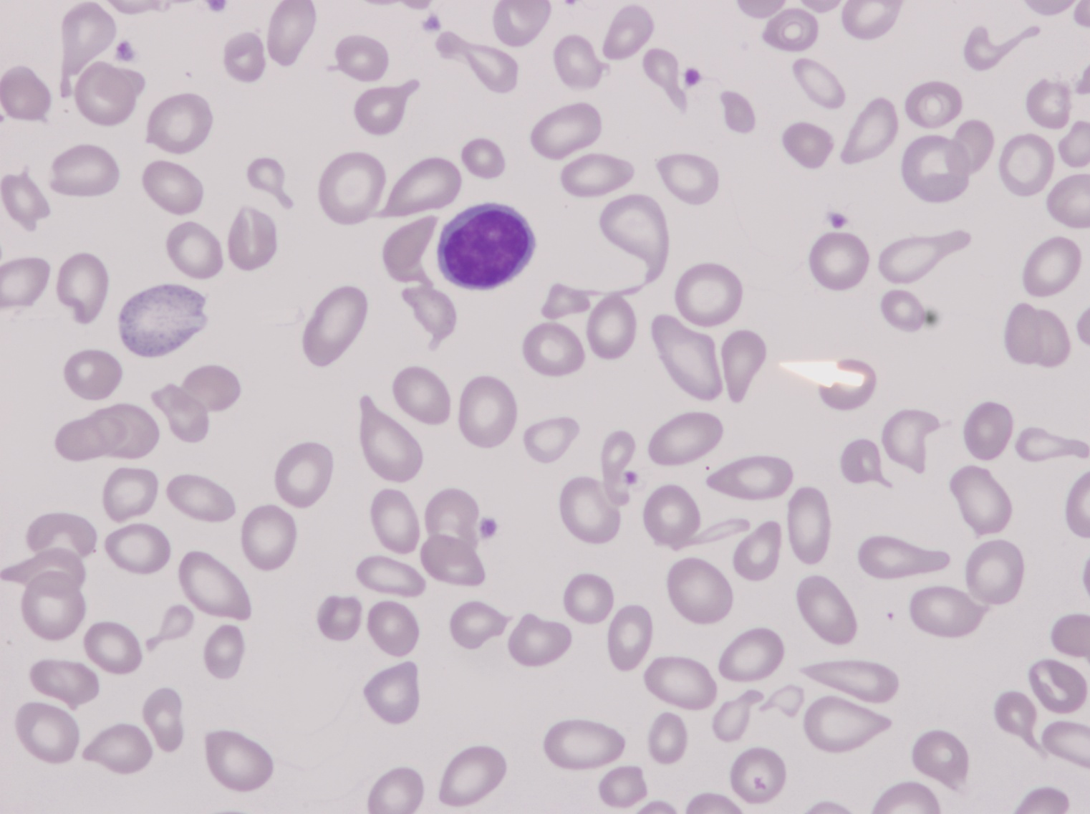
Teardrops
Grading Criteria per 50X Field
Occ = 1-3
Slt = 4-20
Mod = 21-40
Mkd = > 40

Slide 34
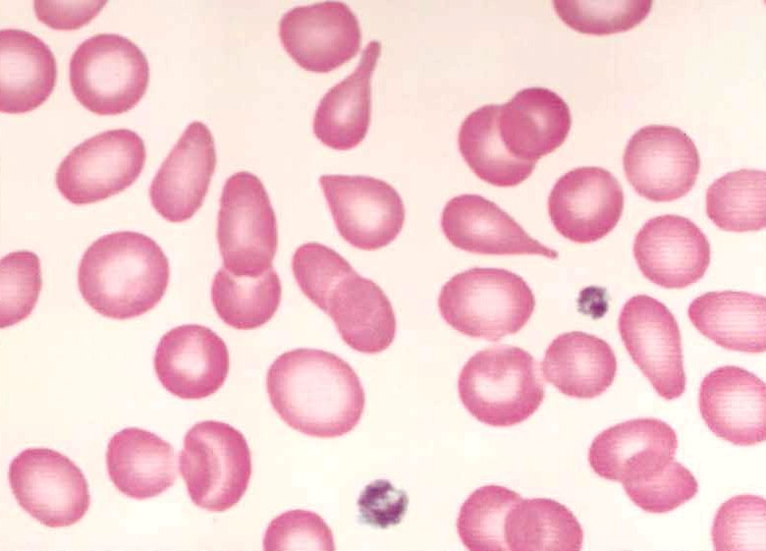
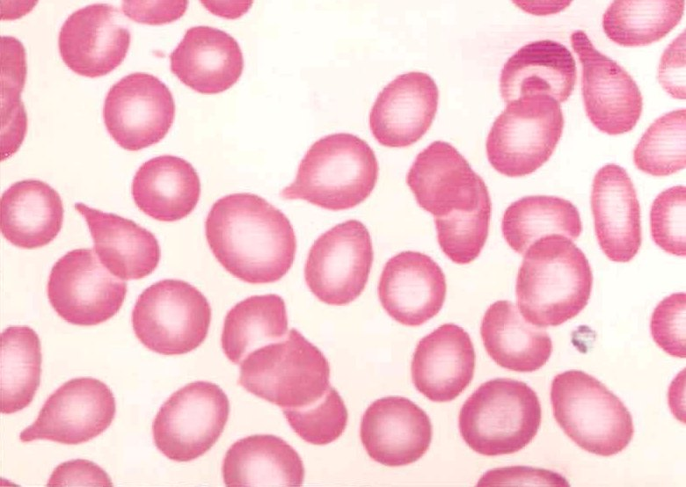
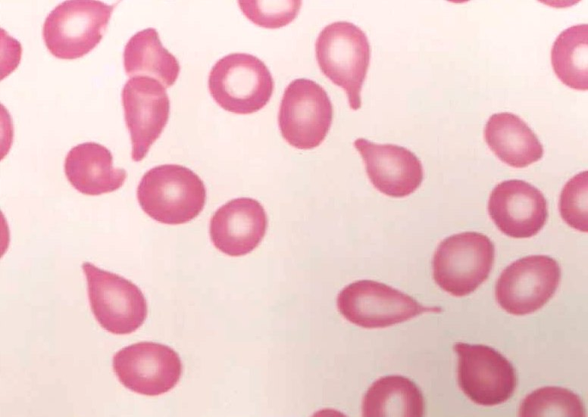
Teardrop Grading
OCC
SLT
MOD
MKD

Slide 35
Spherocytes
APPEARANCE: Cells appear perfectly round and have no central pallor. They are often smaller than normal RBCs.

Slide 36
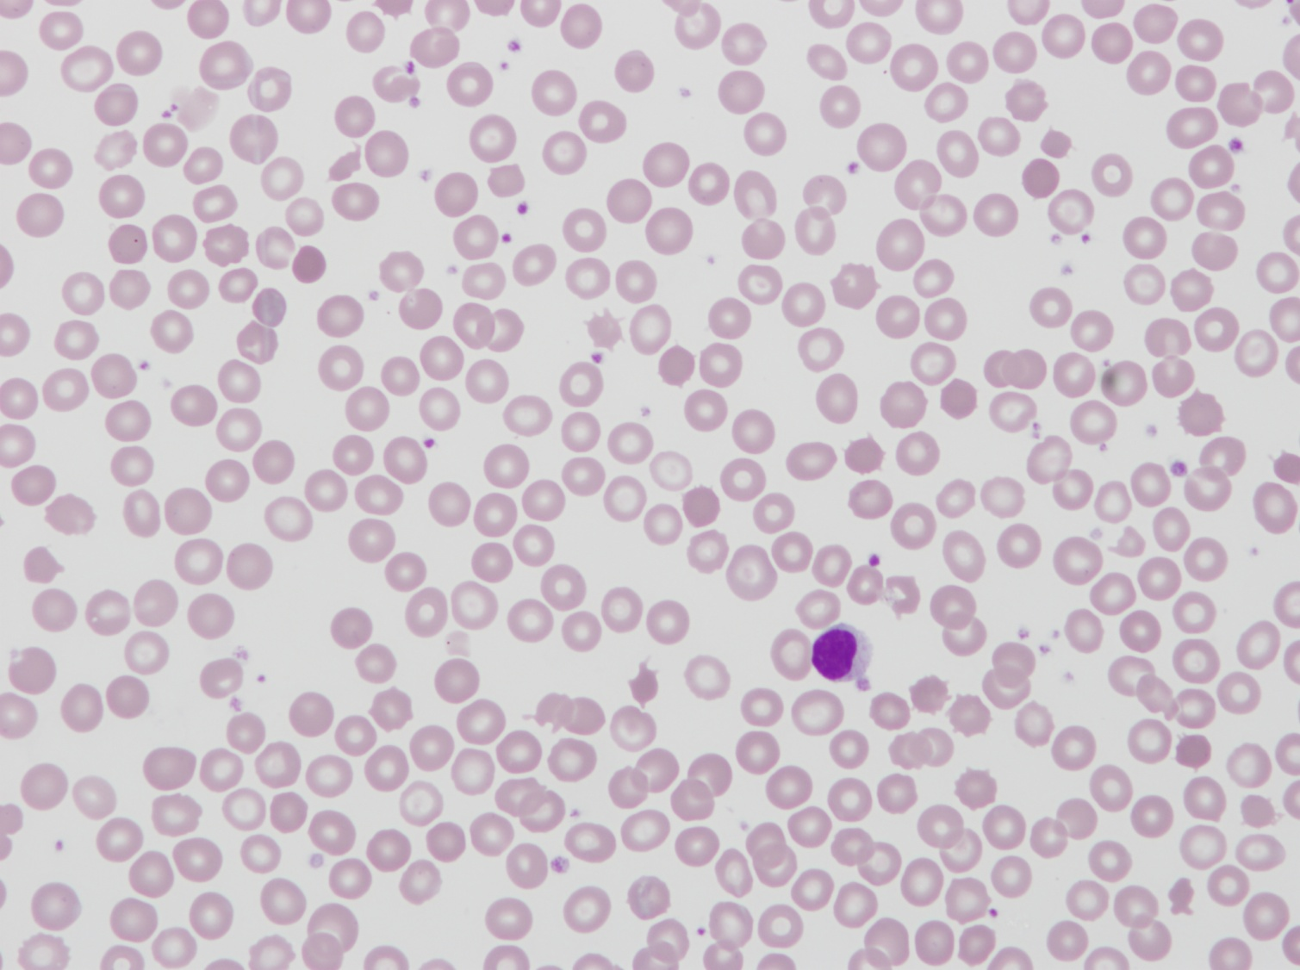
Spherocytes
Grading Criteria per 50X Field
Occ = 1-3
Slt = 4-10
Mod = 11-20
Mkd = > 20

Slide 37
Spherocyte Grading
OCC
SLT
MOD
MKD

Slide 38
Schistocytes
APPEARANCE: Pieces of RBCs that can have vast variety of sizes and shapes, shapes that vary from helmet to triangular to unclassified fragments.

Slide 39
Schistocytes
Grading Criteria per 50X Field
Occ = 1-3
Slt = 4-10
Mod = 11-20
Mkd = > 20

Slide 40
Schistocyte Grading
OCC
SLT
MOD
MKD

Slide 41
Hypochromia
Size: microcytic or macrocytic cells
Cytoplasm: hypochromic with central pallor > 1/3 of RBC diameter (increased central pallor); some cells contain so little HGB that they are “ghost cells”

Slide 42
Hypochromia Grading
Grading Criteria per 50X Field using the MCHC
Slt = 32-30
Mod = 30-28
Mkd = <28

Slide 43
Polychromasia
Appearance: Diffused basophilia, polychromatophilic RBCs that are slightly larger to much larger than mature RBCs

Slide 44
Polychromasia
Grading Criteria per 50X Field
Occ = 1-2
Slt = 3-5
Mod = 6-8
Mkd = > 8

Slide 45
Polychromasia Grading
OCC
SLT
MOD
MKD

Slide 46
Basophilic Stippling
DESCRIPTION: Medium sized, blue-black dots (granules) uniformly throughout RBCs. Differentiated from pappenheimer bodies because of a more uniform shape but mainly because they are evenly dispersed throughout the RBC.

Slide 47
Basophilic Stippling
Grading Criteria per 50X Field
Occ = 1-2
Slt = 3-5
Mod = 6-8
Mkd = > 8

Slide 48
Basophilic Stippling Grading
OCC
SLT
MOD
MKD

Slide 49
NRBC’s
Appearance: RBC with small, dense pyknotic nucleus; nucleated RBC that is slightly larger than a normal RBC; the nucleus is small pyknotic with dense chromatin.

Slide 50
NRBC’s
NRBC’s are counted as a % of 100 cell count
NOTE: If you have NRBCs present check your final WBC count and make sure it correlates with what you are seeing on the slide.

Slide 51
Agglutination
DESCRIPTION: irregular overlapping of red blood cells in a clump or cluster; length and width of this arrangement is usually about the same; this effect usually disappears with warming of the sample

Slide 52
Agglutination
Grading on 50X:
Either Absent or Present

Slide 53
Rouleaux
Description: linear arrangement of four or more red blood cells, simulating a "stack of coins"; length of arrangement is much greater than width and cells form a regular, uniform pattern

Slide 54
Rouleaux
Grading on 50X:
Either Absent or Present

Slide 55
Howell – Jolly Bodies
APPEARANCE: Large singular dark purple inclusion, spherical or oblong blue-purple or blue-black inclusion; eccentrically located (off center). AKA : nuclear fragment; HJ bodies

Slide 56
Howell – Jolly Bodies
Grading on 50X:
Either Absent or Present

Slide 57
Pappenheimer Bodies
Appearance: blue-purple granules with irregular, sharp edges (not round); usually found along the periphery of the cell; one or two irregular small blue-purple-green granules; if present in multiples, they form irregular closely aggregated clusters. Visible on Wright stain; iron stain positive – which is a presumptive identification.

Slide 58
Pappenheimer Bodies
Grading on 50X:
Either Absent or Present
If unsure, make a new slide and do an iron stain

Slide 59
Hemoglobin “C” Crystals
Appearance : Dense staining, angular crystalline form that varies in shape; may be rectangular rod shaped, tetragonal, octahedral crystal (Washington monument, gold bar, clam shell); spherocytic, rhomboid, hexagon or bird wings; RBC often pale or colorless; there is generally a clear area around the crystal; some RBCs may be “envelope forms” which resemble a clam-shell; this type of crystal is also seen in thalassemias and sickling disorders.

Slide 60
Hemoglobin “SC” Crystals (glove cells)
For crystals if it is the 1st time seen it must be put up for review, after that a comment can be put under the RBC field about crystals seen.

Slide 61
~The End~
Reference: Glassy, Eric M.D., Color Atlas of Hematology

