Slide 1
Acute & Chronic
Lymphoblastic
Leukemia
&
Hairy Cell Leukemia
Classification & Images
When you see a blast they may be similar, but they do have different characteristics.
By: Michell McAdams & Emily Gehring
07/17/12

Slide 2
Acute
Lymphoblastic
Leukemia

Slide 3
Acute Lymphoblastic Leukemia
Acute Lymphoid Leukemia is a clonal proliferation of lymphoid cells that have been “frozen” at a given stage of maturation with features of an early lymphocyte or lymphoblast.
Acute Lymphoblastic Leukemia (ALL) is mostly a disease of children and rare in adults.
ALL is associated with anemia, neutropenia, thrombocytopenia, lymphoblasts and prolymphocytes
ALL does not have Auer rods and usually not dysplastic

Slide 4
Acute Lymphoblastic Leukemia
Classification relies on immunophenotypic, molecular, and cytogenetic characteristics of the clonal blast population along with the morphologic features of the blast.
Special stains are used to distinguish between AML and ALL.
The WHO classification does not rely on the FAB morphologic classification, rather it relies on whether the leukemia is a precursor B or precursor T cell lineage.
FAB classification is helpful to differentiate between myeloblasts, lymphoblasts and reactive lymphocytes.

Slide 5
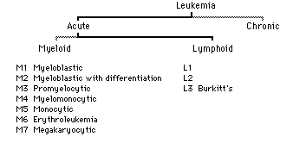
Acute Lymphoblastic Leukemia

Slide 6
Acute Lymphoblastic Leukemia
FAB Classification
L1 – Small, uniform lymphoblasts
L2 – Large, pleomorphic lymphoblasts
L3 – Burkitt’s type (vacuolated and deeply basophilic cytoplasm)

Slide 7
Acute Lymphoblastic Leukemia
L1
Cell Size – Predominantly small
Nuclear Chromatin – Homogeneous in any one case
Nuclear Shape – Regular, occasional clefting
Nucleoli – Inconspicuous
Cytoplasm – Scanty
Cytoplasmic Vacuolation – Variable
L1 has a high N:C ratio and the nucleoli is absent.
L1 has 90% blasts and is associated with the best prognosis
L1 occurs mostly in children.
MPO stain is always negative.
Most are pro B or pre B lineage

Slide 8
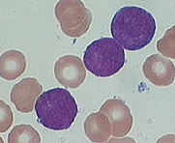
Acute Lymphoblastic Leukemia
L1

Slide 9
Acute Lymphoblastic Leukemia
L2
Cell Size – Large, heterogeneous
Nuclear Chromatin – Heterogeneous
Nuclear Shape – Irregular, clefting and indentation common
Nucleoli – One or more, often large
Cytoplasm – Variable; often moderately abundant
Cytoplasmic Vacuolation – Variable
L2 has a low N:C ratio and the nucleoli is present.
L2 has 50% blasts and has a worse prognosis then L1
L2 tends to be seen in adults.
L2 may be of pro B or pre B lineage, but cases of T cell are more likely.
L2 blasts may have granular or “chunky” PAS positive with negative cytoplasmic background.
NSE staining is usually negative.
MPO staining is always negative.

Slide 10
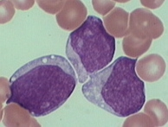
Acute Lymphoblastic Leukemia
L2

Slide 11
Acute Lymphoblastic Leukemia
L3
Cell Size – Large, homogeneous
Nuclear Chromatin – Finely stippled, and homogeneous
Nuclear Shape – Regular (round or oval)
Nucleoli – One or more, prominent
Cytoplasm –Moderately abundant, strongly basophilic
Cytoplasmic Vacuolation – Prominent
L3 is associated with the worst prognosis.
MPO staining is always negative
NSE is negative, but may show focal cytoplasmic positivity
Vacuoles are PAS negative, but classically positive for the neutral lipid stain O Red O

Slide 12
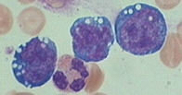

Acute Lymphoblastic Leukemia
L3
Positive O Red O Stain

Slide 13
Chronic
Lymphoblastic
Leukemia

Slide 14
Chronic Lymphoblastic Leukemia
CLL is the most common type of leukemia.
CLL affects B-cell lymphocytes, which originate in the bone marrow and develop in the lymph nodes. Normally B-cells fight infection by producing antibodies.
CLL is a disease of adults, but in rare cases can occur in teenagers and occasionally in children. Most new diagnosed people are over the age of 50, the majority are men.
The cause of CLL is unknown. There are no links to radiation, cancer-causing chemicals, or viruses.

Slide 15
Chronic Lymphoblastic Leukemia
STAGING
There are two systems used to stage CLL
  Rai system uses numbers 0 – IV to group CLL into low, intermediate, and high risk categories. The higher the number the more advanced the cancer.
  Binet system uses letters A – C to stage CLL according to how many lymph node groups are involved and whether you have a drop in the number of red blood cells or platelets.

Slide 16
Chronic Lymphoblastic Leukemia
SYMPTOMS
These Symptoms may occur
  Abnormal bruising
  Enlarged lymph nodes, liver, or spleen
  Excessive sweating, night sweats
  Fatigue
  Fever
  Infections that keep coming back
  Loss of appetite or becoming full too quickly
  Unintentional weight loss

Slide 17
Chronic Lymphoblastic Leukemia
Diagnosis
Diagnosis is based on the demonstration of abnormal population of B lymphocytes in the blood, bone marrow, or tissues that display an unusual but characteristic pattern of molecules on the cell surface.
The combination of the microscopic examination of the peripheral blood and analysis of lymphocytes by flow cytometry is needed to establish the diagnosis.

Slide 18
Chronic Lymphoblastic Leukemia
TREATMENT
Early stages of CLL are normally not treated. Treatment focuses on controlling the disease and its symptoms rather than on a cure.
Chemotherapy is the most common treatment.
Bone marrow or stem cell transplants may be used and are the only therapy that offers a potential cure.

Slide 19
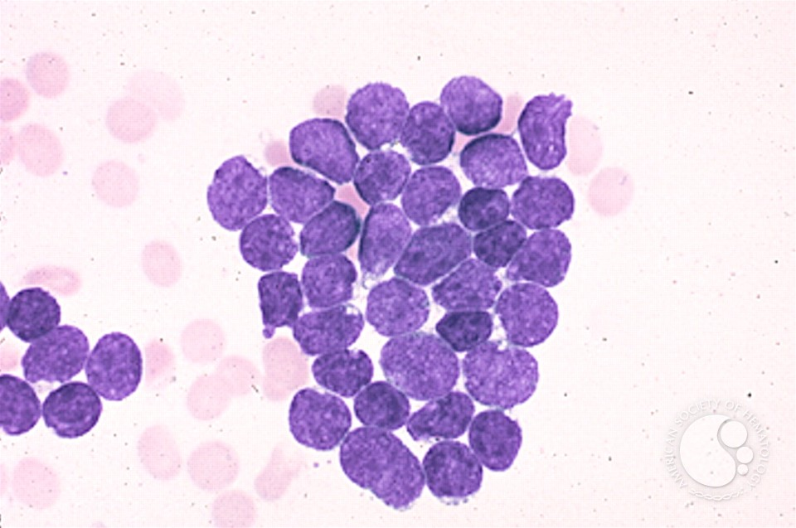
Chronic Lymphoblastic Leukemia
BLAST CELLS
Blasts in this case of precusor B-cell ALL are relatively small with a high nucleo-cytoplasmic ratio.

Slide 20
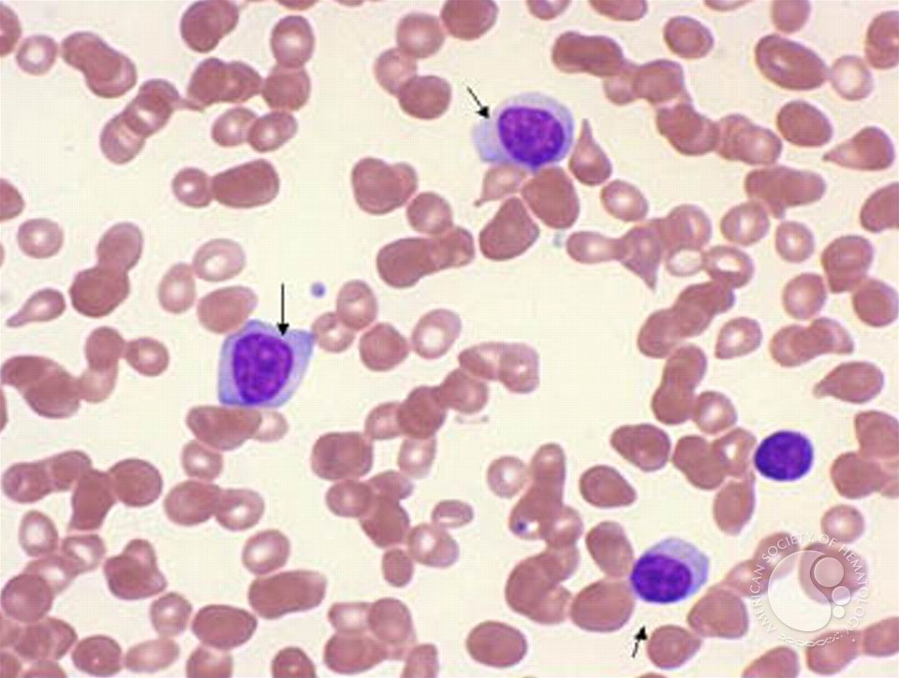
Chronic Lymphoblastic Leukemia
PROLYMPHOCYTES
Peripheral smear showing prolymphocytes (arrows) and a small lymphocyte. The prolymphocytes have abundant cytoplasm and large nucleolus. In CLL, prolymphocytes may constitute up to 14% of the lymphocyte population

Slide 21
Hairy Cell
Leukemia

Slide 22
Hairy Cell Leukemia
Hairy cell leukemia is a chronic lymphoproliferative disease of B cell origin.
It occurs most commonly in mid-aged to elderly males.
Commonly associated with massive splenomegaly and pancytopenia

Slide 23
Hairy Cell Leukemia
Hairy Cell Characteristics
  Size: 12 to 20µm
  N:C Ratio: 4:1 to 2:1
  Cell Shape: Round to Ovoid
  Chromatin: Fine to slightly coarse; parachromatin is scant and evenly dispersed
  Nucleoli: one or more; small; rarely single and prominent
  Cytoplasm: Moderate to abundant; pale blue to gray-blue and agranular; fine (hairy) irregular filamentous projections; the projections can be think, blunted, smudged, or serrated; small vacuoles may be present
  ***NOTE: Some cases lack projections and have smooth cytoplasmic border

Slide 24
Hairy Cell Leukemia
Key Differentiating Features
  Larger than a normal, mature lymphocyte
  The chromatin is finer than in a normal lymphocyte or chronic lymphocytic leukemia cell
  Fine, filamentous projections
Potential Look-A-Like Cells
  Reactive Lymphocytes
  Prolymphocytes
  Lymphoma Cells
  Sézary Cells
  Monocytes
  Promonocytes

Slide 25
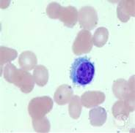
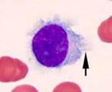
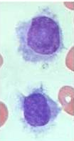
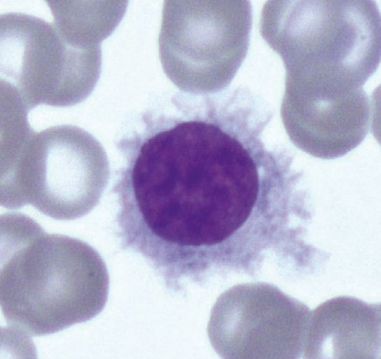
Hairy Cell Leukemia

Slide 26
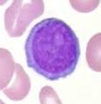
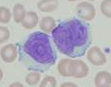
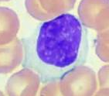
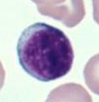
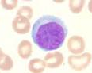
Look-A-Like Cells
Hairy Cell
Prolymphocyte
Lymphoma Cells
Reactive Lymphocyte
Reactive Lymphocyte
Sézary Cells

Slide 27
References
Clinical Hematology and Fundametals of Hemostasis. Fifth Edition. Denise M Harmening. 2009.
http://imagebank.hematology.org/
B-cell Chronic Lymphocytic Leukemia – Wikipedia http://en.wikipedia.org/wiki/B-cell_chronic_lymphocytic_leukemia
Chronic Lymphocytic Leukemia – MedlinePlus http://www.nlm.nih.gov/medlineplus/ency/article/000532.htm

