Slide 1
Un-received specimens
Michell McAdams & Emily Gehring
09/2012

Slide 2
Un-received specimens
You may have a sample that is not received. The following slides takes you step-by-step on how to receive the sample from Multiple Records Posting.

Slide 3
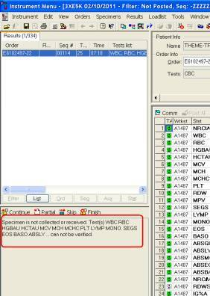
Un-received specimens
Specimen Un-Received will display a message seen below.

Slide 4

Un-received specimens
Bridge to Oder Entry

Slide 5
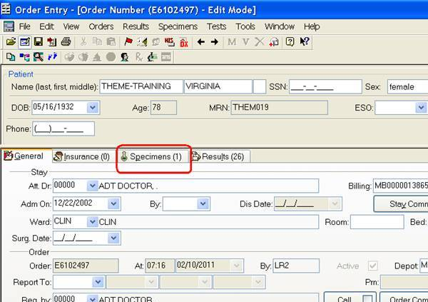
Un-received specimens
Once in Order Entry – Click on “Specimen” tab

Slide 6
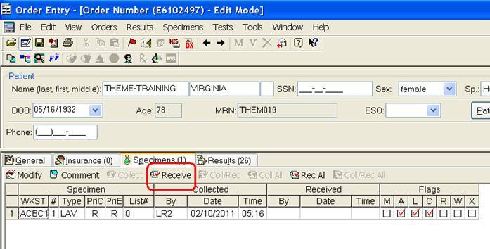
Un-received specimens
Receive specimen into Lab

Slide 7
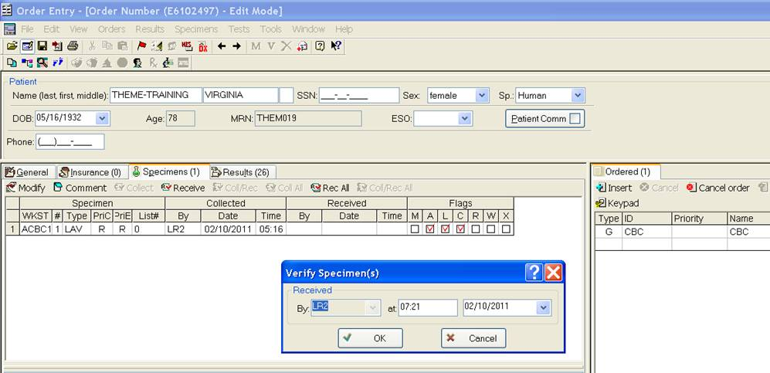
Un-received specimens
Click OK

Slide 8
Un-received specimens
Save changes

Slide 9
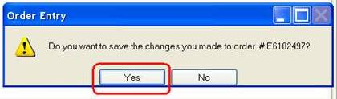
Un-received specimens
Yes to save changes

Slide 10
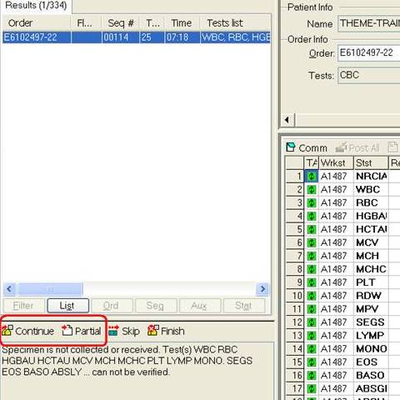
Un-received specimens
Return to the Sysmex Instrument Interface
At the Interface, Click Continue or (F12) for a Normal Specimen or Partial (Ctrl +B) for an Abnormal Specimen to resume standard operation for Sysmex Workstation

Slide 11
Un-received specimens
Single Records Posting a box will pop up stating the specimen in not received.
  Click on Order Entry Icon
  Go to Specimen tab
  Receive specimen
  Save
  X out and go back to posting results

Slide 12
Un-received specimens
The End
☺

