Slide 1
Softlab Downtime
Written by Joan Matiasek and Leslie Yukuno, Nov 7, 2012

Slide 2
Table of Contents
Pre-Downtime Notes
Downtime
  Sysmex
  Coag
  UA
Recovery
  Sysmex
  Coag
  UA
Posted analyzer Instructions
  Sysmex
  Coag
  UA
NOTE: Click on Hyperlink to go directly to topic; use return arrow to come back to Table of Contents

Slide 3
Specimens that will be run during Downtime
ED
ALL Critical Care Units (ICU, MICU, PICU, etc)
ALL STATs
ALL TIMED (clinic or hosp)
ALL ONCOLOGY (VC, VK)
ALL URINES (all locations)
ALL BLUE TOPS (process Sp. Coag)
CCH
Any special requests to RUN a sample (stat or routine)

Slide 4
Specimen Processing
SP will separate samples into those that need to be run and those that will be stored
  Samples to run will be given to lab sections
  Stored samples will be kept in SP
Samples to be run will have one of three labels
  Softlab (ordered prior to downtime and labels pre-printed)
  Puppy Dog (all hospital/clinic samples without Softlab labels)
  4Medica (all outreach samples without Softlab labels)
SP will make Puppy Dog labels for hospital/clinic samples without Softlab labels

Slide 5
Hematology
Prior to receiving the first downtime samples:
  Organize Hematology processing table
  Place all downtime instructions on analyzers
  Post critical value ranges at the verifying benches along with the critical value labels
  Organize each section as needed (downtime storage boxes, racks for specimens, etc)
  Clear pending and exception reports (30-60 min. before the system goes down, if scheduled)
  Complete as much testing as possible before Downtime begins (use dip-quick stain if needed)
NOTE: Downtime forms and boxes found outside Chief Tech’s Office on top of file cabinet

Slide 6
Hematology Processing Table
Sort samples by section
Assign and fill-out downtime cover page
  White cover page for Puppy Dog and 4Medica labels
  Yellow cover page for Softlab labels
  Write pneumatic tube number or fax number in cover page box located in top right corner.
    NOTE: Use pneumatic tube to send copies of results to Hospital and ED. Outreach results are placed in box on their front desk (glass window). Fax results to special off campus locations (e.g., CCH).
  Print numbers and letters clearly on downtime pages.
    NOTE: If extra downtime labels are needed, you must create Puppy Dog
    labels using Softlab order number, 4Medical number or existing Puppy Dog order number.
Attach SMS/paper requisition to cover page with paper clip along with extra Puppy Dog labels
Take specimens and paperwork to appropriate bench

Slide 7
Sysmex Operator-Testing Phase
Follow the instructions on each analyzer for downtime settings.
Run samples on XE-1 only (will make recovery easier)
Screen data for abnormalities; handle in usual manner (call criticals, perform dilutions, etc). If critical results are called, place CV sticker on cover page with required information.
If differential is needed, place in rack on Startyard for stainers
If differential and no other hematology test is needed, store sample in rack (do not Spec-Track)
Run Manual tests with same paperwork.
Mark a “slash” through the tests on the cover page as they are completed
Photocopy completed packet, staple together and place in designated spot for “Ready to Tube” reports. Staple original packet and place in alphabetized Heme downtime box.
  When photocopying Sysmex print-out, use Reference Range sheet to cover graphs and flags
Every 10 -15 minutes send reports to nursing units. This may be handled by a runner.

Slide 8
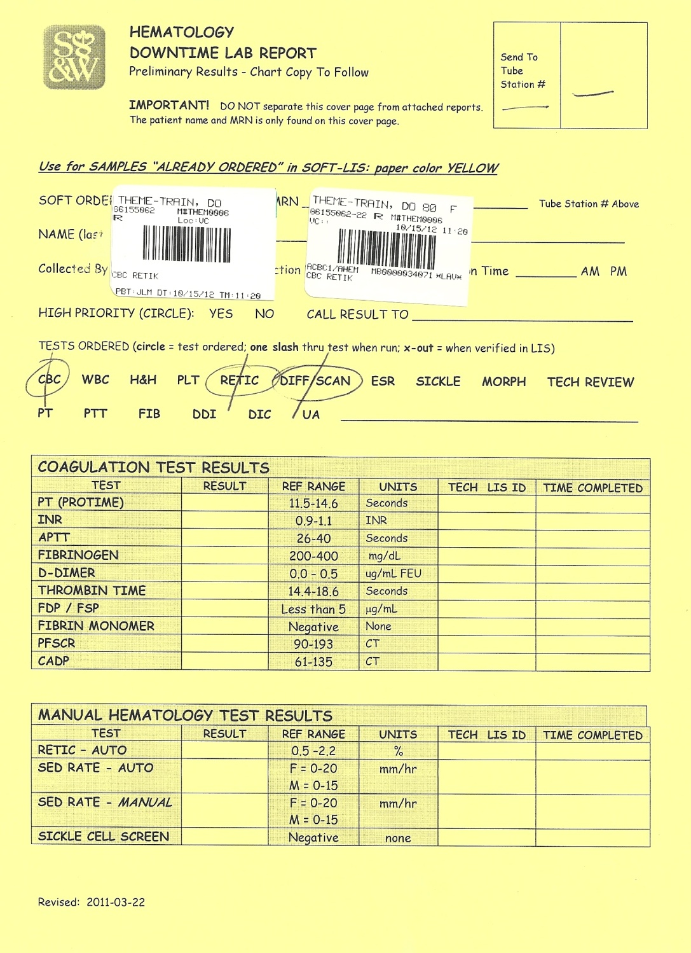
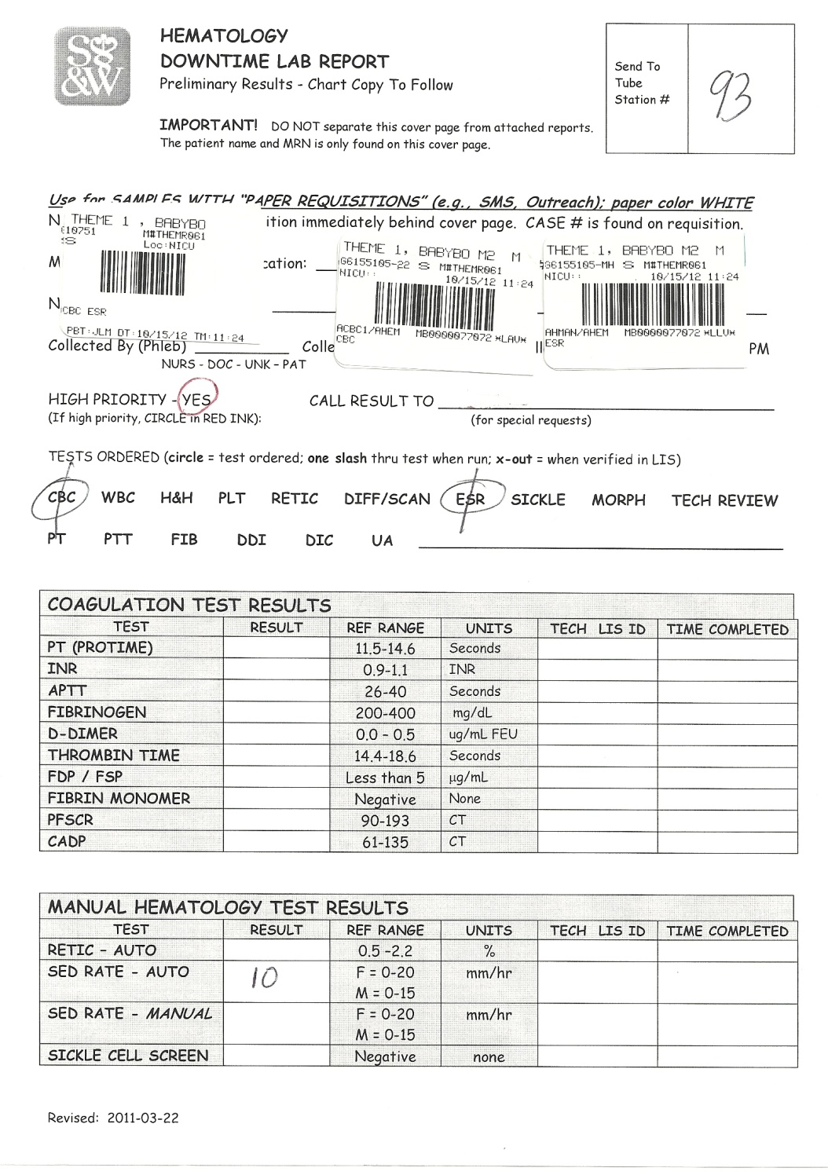
Examples of Heme Downtime Cover Pages:
Return

Slide 9
IMPORTANT
All hand written information – must be - “print format” using well formed letters that are easily read by everyone.
DO NOT work the processing bench if you have poor hand writing!
When talking to nursing/HUC/physician, do not refer to paper requisition forms as “SMS Tickets”. Instead, use the term “LAB ORDER TICKETS”. Most SW nursing units use NET ACCESS to place orders and print requisitions, not SMS.

Slide 10
Coag Bench –Testing Phase
Follow instructions on Stago for downtime settings.
Run samples in Manual mode.
Write final results on downtime cover page
Call critical results . Place CV sticker on cover page and fill in required information.
Mark a “slash” through the Coag order when testing is completed.
Keep samples in rack; do not Spec-Track
Photocopy completed packet, staple together and place in designated spot for “Ready to Tube” reports. Staple original packet and place in alphabetized Coag/UA downtime box.
Every 10 -15 minutes send reports to nursing units. This may be handled by a runner.
If Special Coag testing is required process sample for storage; label with Puppy Dog label, and store in Special Coag freezer. Leave SMS/paper requisition on Special Coag primary bench.

Slide 11
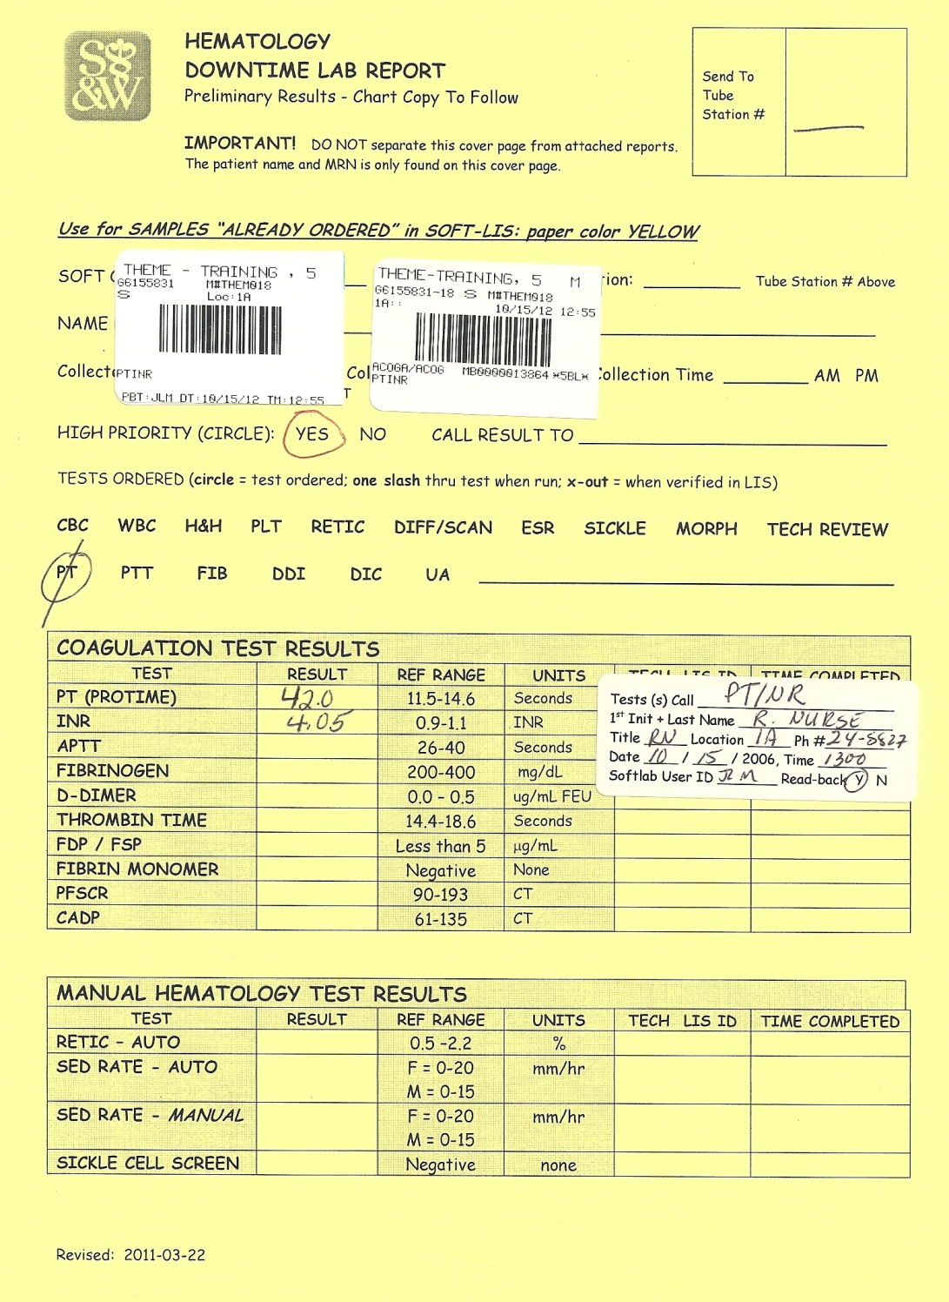
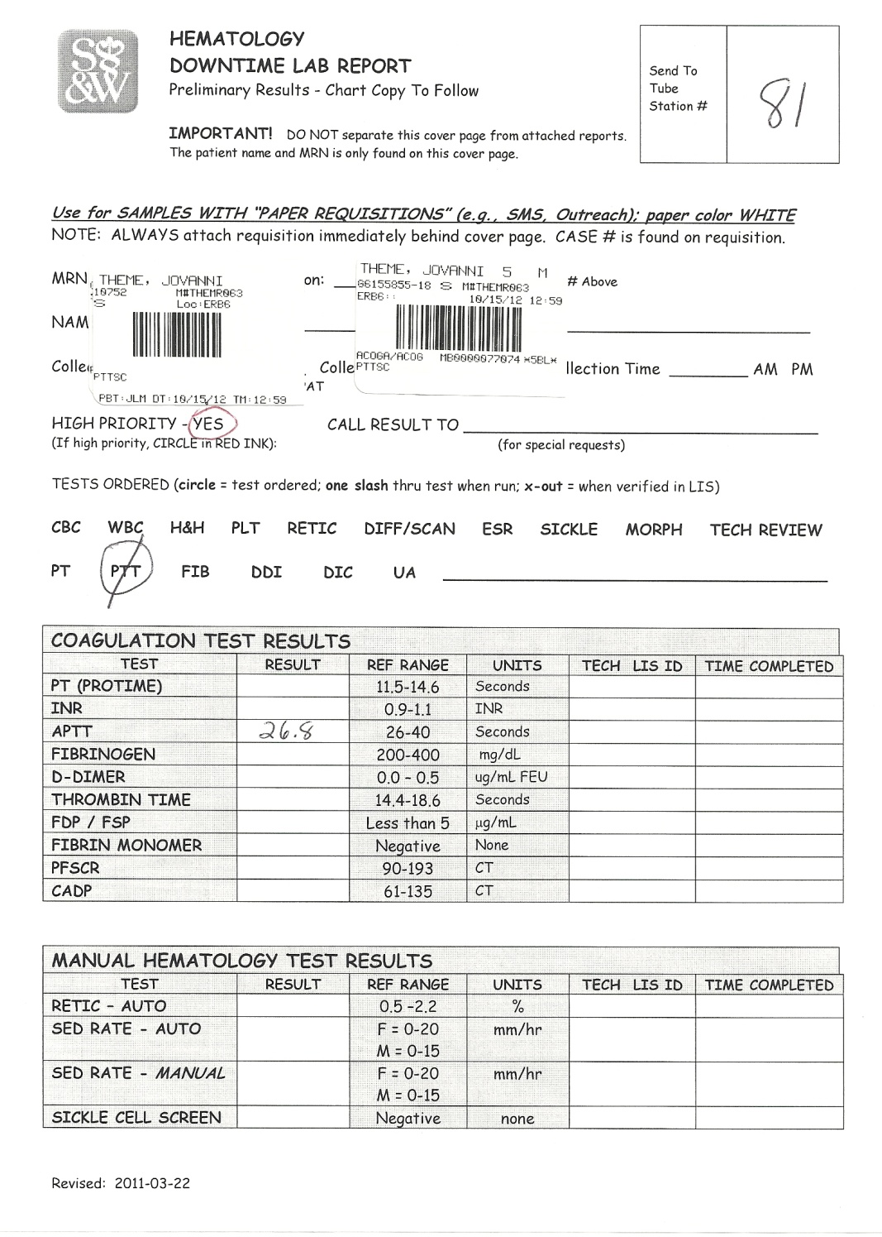
Examples of Coag Downtime Cover Pages:
Return

Slide 12
UA Bench –Testing Phase
Follow instructions on the Iris for downtime settings.
Use Iris 200 for Downtime Testing.
Place Puppy Dog label on original container, Iris aliquot tube, and culture aliquot tube.
Run sample, review and edit results as usual, (may need to adjust urine chemistries in the Iris after confirmation testing; uncheck abnormal box next to result if needed ).
Put appropriate Puppy Dog label on UA Report and initial report if is was auto-released.
For Manual UA, record results on Manual UA Report.
Attach Report to Downtime Cover Sheet and mark a slash through UA when testing is completed.
Photocopy completed packet, staple together and place in designated spot for “Ready to Tube” reports. Staple original packet and place in alphabetized Coag/UA downtime box.
  When photocopying IRIS report, fold report to cover the Audit Trail at the bottom of the page.
Every 10 -15 minutes send reports to nursing units. This may be handled by a runner.
For shared samples:
  Culture: Label culture tube with puppy dog label; send SMS ticket and specimen to Micro.
  Chemistry: Once UA is complete, give original sample and SMS ticket to Chem processing table.
Keep specimen in rack; do not Spec-Track

Slide 13
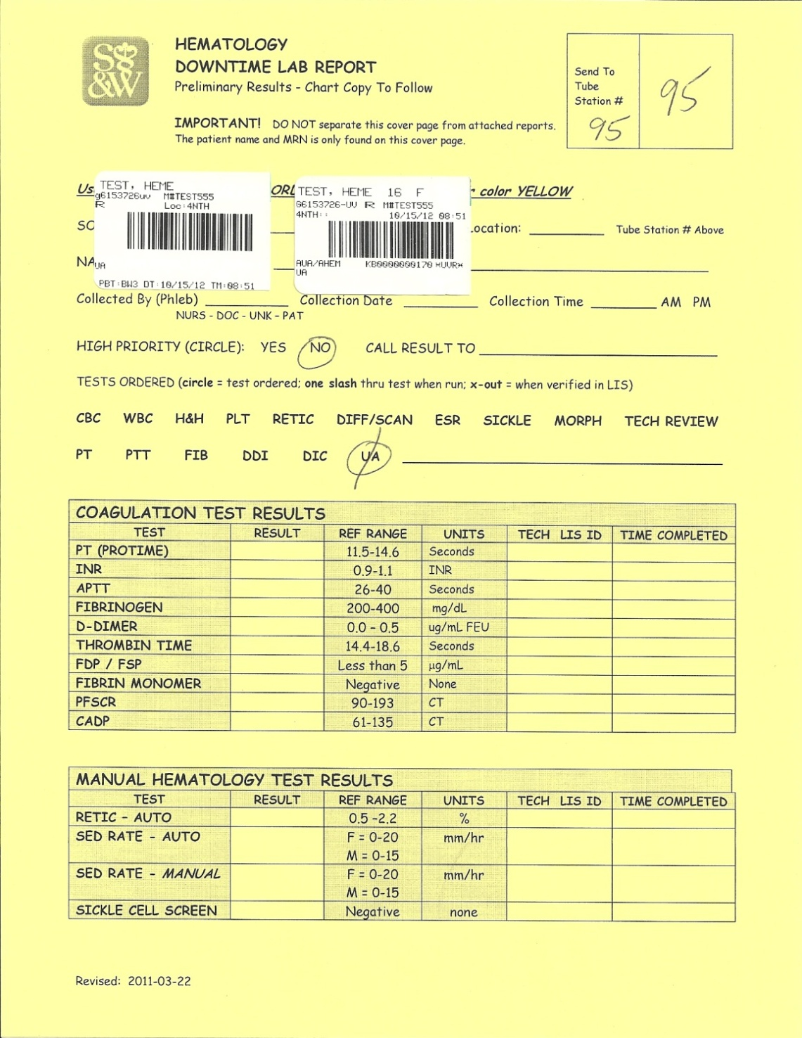
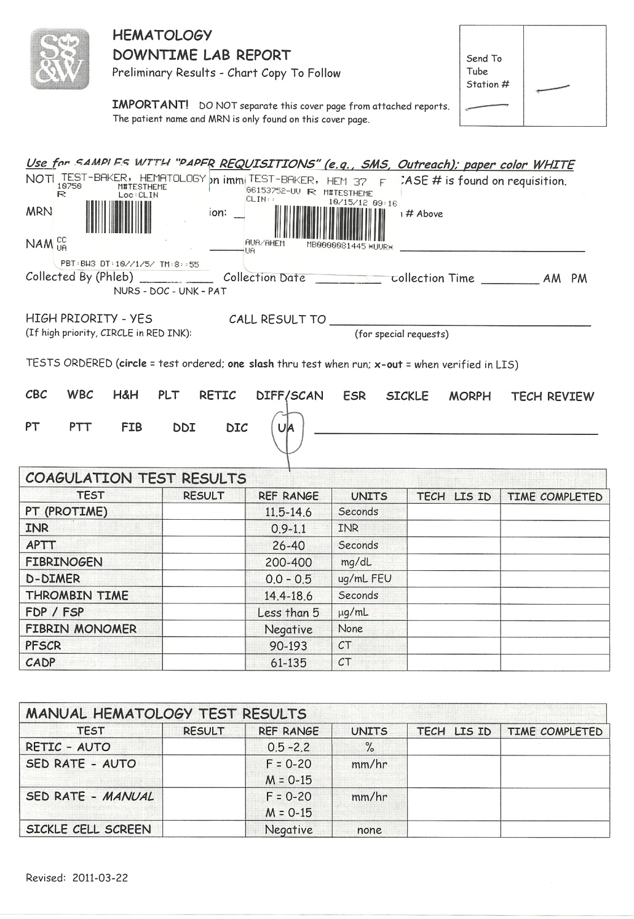
Examples of UA Downtime Cover Pages:
Return

Slide 14
Recovery
Follow instructions on analyzers for recovery
  Turn on host transmission
  Stop/Start interfaces
One sample will be run on each analyzer by the Hematology LIS Specialist or assigned tech to verify the interfaces are operational
Recovery phase is divided into 3 Sections
  Running live samples
  Entering results for samples with Yellow cover page
  Entering result for samples with White cover page
If staffing is limited, process sections as follows:
  Coag
  UA
  Heme

Slide 15
Running Live Samples - Sysmex
Do not run on XE-1 (designated downtime analyzer)
Run samples on the HST using XE-2 and XE-3
Use individual analyzer interfaces for auto posting of results.
Review and finalize results as normal.

Slide 16
Sysmex-Entering Downtime Results with Yellow Cover Pages
Follow Recovery Instructions Posted on XE-1
Collect and Receive Softlab orders
Transmit Softlab orders on XE-1 to Host
-only transmit 10-15 orders at a time.
Review and finalize Softlab orders on Interface
Complete ESR, Sickle screens, and Smear Exams
-Use “CBC” template to result diff/scan results
-Attach submitted slide and paperwork for Morph
Place additional slash mark on completed test codes to form an X. This indicates verification is complete.

Slide 17
Sysmex-Entering Downtime Results with White Cover Pages
Follow Recovery Instructions on Analyzers
Find Orders in Soft lab; Collect and Receive
Enter AUX# (puppy dog or 4Medica barcode)
-AUX field found on General Tab of Order screen.
Transmit Downtime Order Numbers on XE-1 to Softlab. (10 to 15 samples at a time)
Change downtime order number to Softlab barcode number in the interface. Put Softlab label on Cover Sheet.
Review and finalize results as usual.
Complete ESR, Sickle screen, and Diff (Morph) Exams per previous slide.
On the Cover Page place X through completed tests

Slide 18
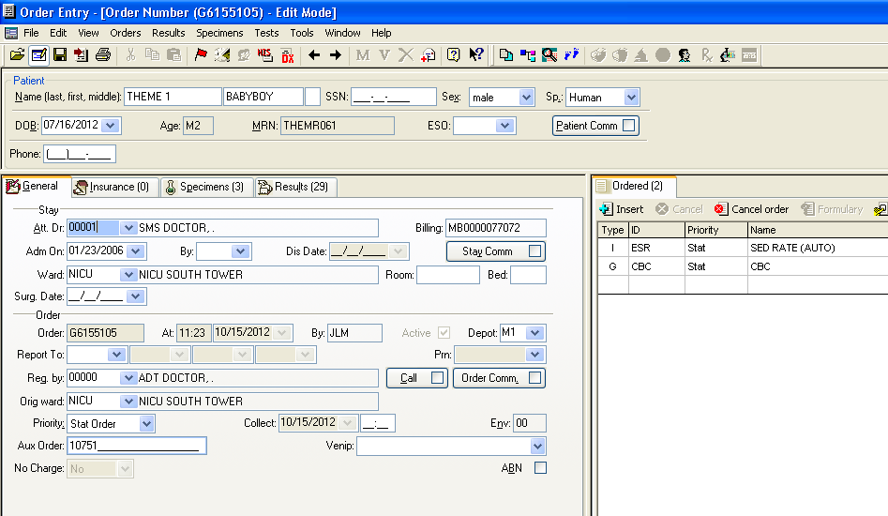
Where to find Aux field in Order Entry:
Return

Slide 19
Running Live Samples -Coag
Review go live instructions posted on front of Stago.
Only run samples that have been completely ordered and received in Softlab.
Run live samples; review and finalize as usual

Slide 20
Coag-Entering Results with Yellow Cover Pages
Collect and Receive Softlab orders
Manually enter results recorded on cover page
Confirm patient name and ID on the screen match the downtime cover page
Add appropriate comments; review results and finalize.
Place X through completed test on cover page.

Slide 21
Coag-Entering Downtime Results with White Pages
Find Orders in Softlab, Collect-Receive.
Enter AUX # (puppy dog or 4Medica barcode)
-AUX field found on General Tab of Order screen.
Put Softlab label on cover page.
Manually enter results recorded on cover page.
Confirm patient name and ID on the screen match the downtime cover page
Add appropriate comments and review results and finalize
Place X through completed test on cover page .
Return

Slide 22
UA Recovery- Running Live Samples
Follow Recovery Instructions posted on Iris.
Only run live samples on IQ 202 that have been completely collected and received.
Review and finalize results as usual.

Slide 23
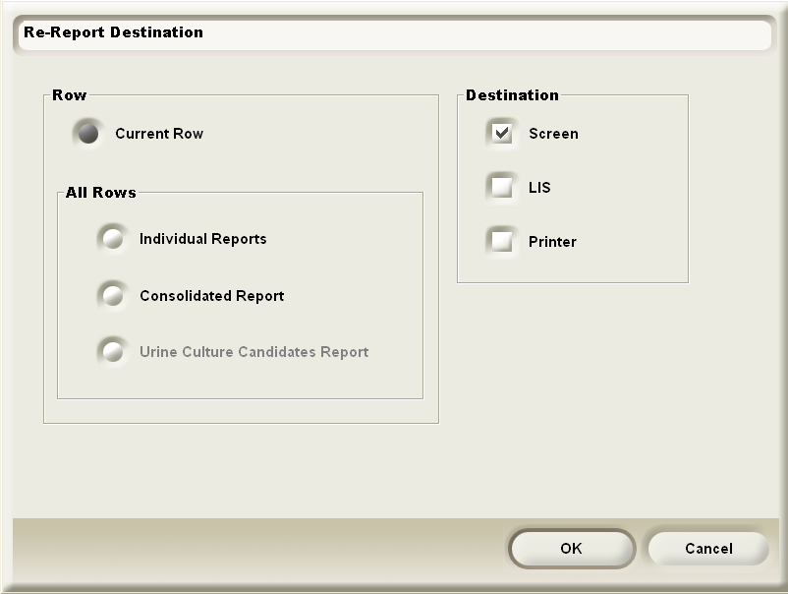
UA-Entering downtime Results with Yellow Pages
Find orders in Soft lab, Collect, Receive.
Transmit Soft lab Results on IQ to Soft lab
1. At IRIS Standby screen, select WORKLIST tab
2. Click on SEARCH (bottom of screen)
3. Search by Date; adjust time accordingly
4. Click on order to be transmitted.
5. Click on RE-REPORT (blue button on right side
of screen)
6. Uncheck SCREEN and Check LIS, then click OK
Once transmitted these results should be released
Confirm with Pending Report or Lab Query.
Place X through completed test on Yellow Cover Sheet.

Slide 24
UA Entering Downtime Results with White Pages
Find orders in Softlab, collect and receive.
Enter AUX # (from puppy dog or 4Medica label)
Place Softlab label on White Cover Sheet.
Find downtime orders on IRIS and transmit to Soft lab
1. At IRIS Standby screen, select WORKLIST tab
2. Click on SEARCH(bottom of screen)
3. Search by Date; adjust time accordingly
4. Click on order to be transmitted.
5. Click on RE-REPORT(blue button on right side
of screen)
6. Uncheck SCREEN and Check LIS, then click OK
Confirm patient name and ID on the screen matches Downtime Cover sheet.
In interface, change the AUX # to the Softlab order number
Review and finalize Downtime Orders in Interface.
Place X through completed test.
Return

Slide 25
Note:
Orders should cross-over from Net Access to Softlab once Softlab is back up. The process can be slow, so specimens that already have Softlab orders can be resulted first while waiting for the other orders to cross-over.
On occasion, there will be an order that does not cross over into Softlab. If this occurs, techs may place orders into Softlab using the information from the SMS tickets that came with the sample. For step-by-step directions, see the Downtime Procedure Manual

Slide 26
Recovery Wrap-Up
Clear Exception Report ( 48 HOURS BACK)
  Delta checks during downtime will not need comments or investigation
Clear Pending Reports (48 HOURS BACK)
  Received pending
  Non-received pending
Return all downtime packets to the downtime boxes
  Packets will be kept for seven days
Store specimens in Spec-Track

Slide 27
Completed Results
Available Through Net Access
In Site
*Favorites
Net Access Enterprise
Appropriate Facility-S&W(Main Campus); CCH; UMC; BHC
Login
  USER ID = last 3 digits of Passport login
  PASSWORD = Passport password
MR # Inquiry
Enter MR # and Search
Click on Name
Click on Laboratory
Click on Hematology
4Medica Client Results can be obtained from Ref Lab until 12:00pm

Slide 28
Softlab Downtime Procedure Manual
See Downtime Procedure Manual for complete Downtime Instructions.
Settings for each analyzer that will be posted on the instrument are available in the Downtime Procedure Manual.

Slide 29
POSTED ANALYZER INSTRUCTIONS
REVIEW & DISCUSSION

Slide 30
IRIS - Urinalysis
POSTED ANALYZER INSTRUCTIONS

Slide 31
IRIS-IQ-”200” During Downtime Phase
During Downtime:
A. During DOWNTIME:
1. Run only samples received while LIS is down.
2. Log in as ADMIN (user ID and password = ADMIN)
3. Click on GO OFF LINE button (System Status) near bottom of screen.
NOTE: ON-LINE status changes from BLACK to RED (OFF-LINE)
4. Click on SETTINGS, click OK to prompts.
5. Click on LIS Interface.
6. Uncheck the box next to “Obtain specimen information from LIS” (All boxes in the middle section will be unchecked)
7. Click OK. There will be a prompt to Restart to save changes.
8. Restart (Maintenance—Restart)
9. Login using your user ID. Make sure you are “ON LINE”.

Slide 32
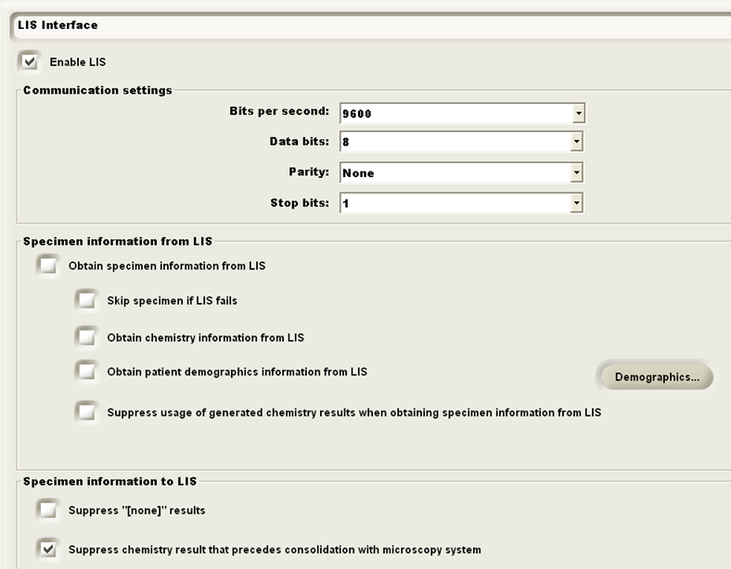

Slide 33
IRIS-IQ-”200” During Recovery Phase
During Recovery:
1. DO NOT USE this analyzer until all downtime samples are transmitted, finalized and pending report is cleared.
2. Log in as ADMIN (user ID and password = ADMIN)
3. Click GO OFF LINE (System Status) which is near the bottom of screen.
  NOTE: ON-LINE status changes from BLACK to RED (OFF-LINE).
4. Click on SETTINGS, click OK to prompts.
5. Click on LIS Interface.
6. Place check in boxes next to the following items:
  “Obtain specimen information from LIS”
  “Obtain patient demographics information form LIS”
  “Suppress usage of generated chemistry results when obtaining……”
7. Click OK. There will be a prompt to Restart.
8. Restart (Maintenance—Restart)
9. Login using your user ID. Make sure you are “ON LINE”.
10. Check LIS HOST setting on Main Screen.
11. TRANSMIT SOFTLAB ORDERS ON IQ TO SOFTLAB
  a. At IRIS Stand by Screen
  b. Select WORKLIST tab
  c. Click on SEARCH (bottom of Screen)
  d. Search by DATE; adjust time accordingly
  e. Click on RE-REPORT(blue button on right)
  f. Uncheck SCREEN and check LIS, then click OK
    NOTE: Transmit and process small batches of 15-20 patient samples at time.
12. CLEAR “UA” LONG PENDING with “look back” period as length of downtime + 1 day.
13. After clearing pending, release the analyzer to routine service.

Slide 34
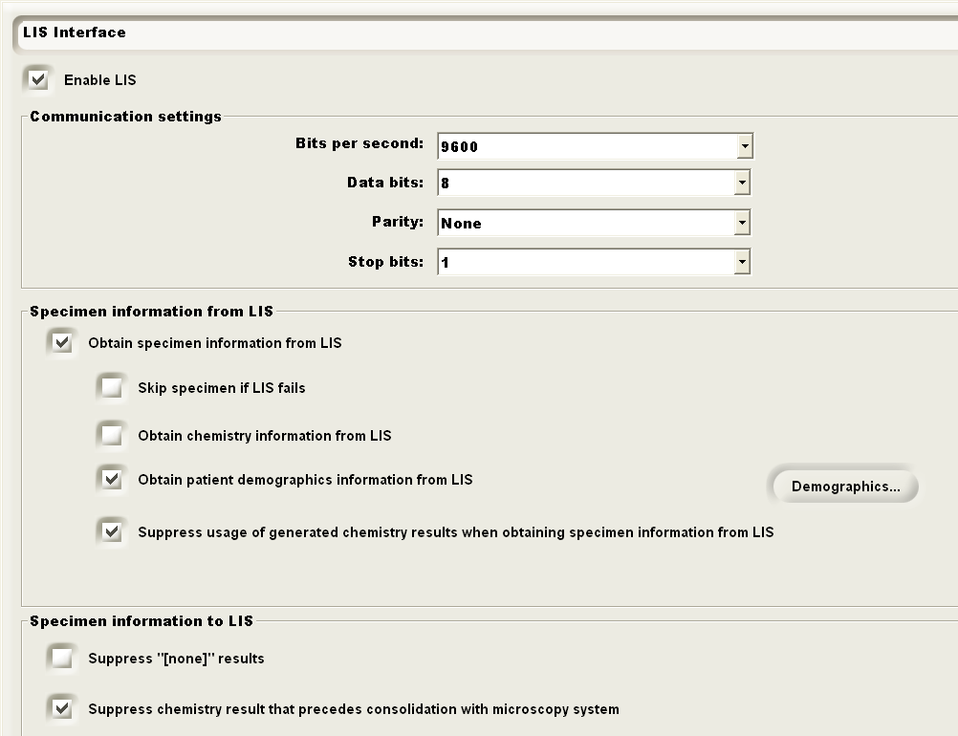

Slide 35
IRIS-IQ”202” DOWNTIME & RECOVERY Phases
During DOWNTIME:
  DO NOT USE this analyzer unless absolute necessary.
During RECOVERY:
  ONLY run all newly ordered Softlab samples when LIS comes up
Return

Slide 36
SYSMEX - Hematology
POSTED ANALYZER INSTRUCTIONS

Slide 37
XE-1 Analyzer & Conveyor During Downtime
I. During DOWNTIME:
  NOTE 1: XE-1 is designed to run “ALL” downtime samples!
  NOTE 2: DO NOT use STARTYARD #1 during downtime.
  XE-1:
    Turn “OFF” Host Communications:
      XE Main Screen menu bar >> SETTING >> HOST SETTING >> uncheck HOST (HC) CONNECT >> click APPLY >> click OK.
    Turn “ON” Negative Graphs:
      SYSMEX PC >> SETTINGS >> AUTO REPORT >> click on “NOT OUTPUT” box for GP NEGATIVE >> APPLY >> OK. NOTE: Setting NOT OUTPUT changes to OUTPUT.
    Only run samples received during downtime on this analyzer.
  XE-1 CONVEYOR,
    1. Localize XE-1 Conveyor.
    2. Load Downtime Samples directly on XE-1 Conveyor.
    3. Place POS graph samples on line at STARTYARD #2 to make blood smears.

Slide 38
XE-1 Analyzer & Conveyor During Recovery Phase
II. During RECOVERY (LIS up):
  NOTE 1: Load racks on STARTYARD #1.
  NOTE 2: Leave CONVEYOR #1 in local mode.
  NOTE 3: Only use the individual “XE-1” interface to verify results.
  A. XE-1:
    Turn “ON” Host Communications:
      XE Main Screen menu bar >> SETTINGS >> HOST SETTING >> check HOST (HC) CONNECT >> click APPLY >> click OK.
    Turn “OFF” Negative Graphs:
      XE Main PC Screen menu bar >> SETTINGS >> AUTO REPORT >> click on “OUTPUT” box for GP NEGATIVE >> APPLY >> OK. NOTE: Setting OUTPUT changes to NOT OUTPUT.
    DO NOT run this analyzer until all Sysmex-DIFF pending reports are clear!
    CLEAR “CBCMN” LONG PENDINGS with “look back” period as length of downtime + 1 day.
    After clearing pending reports, release the analyzer to routine service.
  XE-1 CONVEYOR:
    Localize the XE-1 Conveyor.
    Only after all downtime Sysmex results have been verified and the pending has been cleared, switch the conveyor mode back to normal rack transport and remove this communication note.

Slide 39
XE-2 & XE-3 Analyzers & Conveyors During Downtime
I. During DOWNTIME:
  XE-2 and XE-3 Analyzers:
    DO NOT USE XE-2 or XE-3 during downtime unless absolutely necessary.
    DO NOT change existing settings.
  CONVEYORS (XE-2 and XE-3):
    Do not touch; leave on normal rack transport mode.
    Do not place racks on STARTYARD #1
  LASC:
    DO NOT change settings.
    RETICs are automatically defaulted to run.

Slide 40
XE-2 & XE-3 Analyzers & Conveyors During Recovery
II. During RECOVERY:
  A. XE-2 and XE-3 Analyzers:
    Use only XE-2 and XE-3 to run newly ordered Softlab samples after LIS is up.
    Use individual XE-2 or XE-3 interface to verify results; DO NOT use the group instrument interface ID until all downtime samples are finalized.
    Use STARTYARD #1 to load samples on line.
  B. CONVEYORS (XE-2 and XE-3):
    No setting changes.
  C. LASC:
    DO NOT change settings

Slide 41
SP-1 & SP-2 Analyzers & Conveyors
I. During DOWNTIME:
  SP-1 & SP-2:
    Run only POS graph samples and hand-made smears
    Load racks at STARTYARD #2.
  CONVEYORS (SP-1 and SP-2):
    Do not touch; leave on normal rack transport mode.
    Load racks at STARTYARD #2.
II. During RECOVERY:
  SP-1 & SP-2:
    No setting changes; run racks using normal rack transport mode.
    Load racks at STARTYARD #1.
  CONVEYORS (SP-1 and SP-2):
    No setting changes; run racks using normal rack transport mode
Return

Slide 42
STAGO - COAGULATION
POSTED ANALYZER INSTUCTIONS

Slide 43
STAGO During Downtime Phase
During DOWNTIME PHASE
  Turn “OFF” Stago LIS Communication option:
    At Test Panel, press ESCAPE
    At STATUS on Menu Panel, press ENTER
    Press arrow down to On-Line Transmission and press ENTER to change from YES to NO.
  Turn “ON” Stago “Manual Run Mode” option:
    At TEST PANEL, press F1
    Door of analyzer will open; press ESCAPE
    Down Arrow to MANUAL ; press ENTER.

Slide 44
STAGO During Downtime Phase
During RECOVERY:
  Turn “ON” Stago LIS Communication option:
    At Test Panel, press ESCAPE.
    At STATUS on Menu Panel, press ENTER.
    Press arrow down to On-Line Transmission and press ENTER to change from NO to YES.
    Return to operation status.
  Turn “ON” Stago Auto Test option:
    At TEST PANEL, press F1
    Door of analyzer will open; press ESCAPE.
    Down Arrow to AUTO and press ENTER.
  CLEAR “ACOGA” LONG PENDING with “look back” period as length of downtime + 1 day.
Return

Slide 45
THE END

