Slide 1
Newborn Screen

Slide 2
More Than Drops on a Card
What are newborn screens?
Why do we do newborn screens?
Why is timing critical?
Watch video

Slide 3
Policy and Procedure
Newborn Screens: Collection and Handling
CTX.LAB.PHL.001.R
Click here

Slide 4
How to Collect New Born Screens
Collection Between 24-48 hours (Hospital)
2nd sample between 1-2 weeks old (Clinic)
Parents fill out Parent information form
2mm lancet
Wipe first drop
Allow blood to soak through only one side.
Watch Video

Slide 5
Newborn Screening Kit Completion
Avoid using a highlighter
Complete all areas
Watch Video

Slide 6
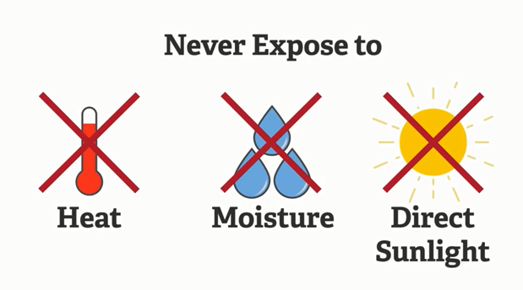
Newborn Screening Blood Spot Card Submission
Drying and Protecting
Dry 3-4 hours flat
L&D
Collect in EPIC (This prevents accidental cancellation)
Place specimen to dry
Send to Laboratory
Lab
Check with L&D around 06:30 and 14:30 for dried specimens that have not been sent to lab (This helps ensure they are prepared for shipping)
Check for acceptability immediately upon receiving in lab
Reject if collected <24 hours after delivery if patient is still in house
Check that all data is properly filled out on the card
Watch Video

