Slide 1
PPE: Personal Protection Equipment
Keeping Safe While You Work
Please view in Full Screen Mode

Slide 2
What is PPE?
Personal protective equipment (PPE) : specialized clothing or equipment worn by an employee for protection against infectious materials. (OSHA)
Personal protective equipment (PPE) is any type of face mask, glove, or clothing that acts as a barrier between infectious materials and the skin, mouth, nose, or eyes (mucous membranes). When used properly, personal protective equipment can help prevent the spread of infection from one person to another. (FDA)

Slide 3
Is PPE my only protection?
Using personal protective equipment is essential, but it is generally the last line of defense after engineering controls, work practices, and administrative controls.
Engineering controls involve physically changing a machine or work environment.
Administrative controls involve changing how or when workers do their jobs, such as scheduling work and rotating workers to reduce exposures.
Work practices involve training workers how to perform tasks in ways that reduce their exposure to workplace hazards.

Slide 4
When and Where to Use PPE?
Always use appropriate PPE in areas where exposure to/contact with blood, body fluid, or other infectious agents might occur. In our laboratory, these areas are designated as “dirty”: lab coat and gloves are always required.
(Our laboratory has clearly designated “dirty” and “clean” areas.
PPE should never be worn in areas marked as “clean”.)
In the laboratory, staff also comes into contact with many chemical agents. Information concerning PPE for handling chemicals can be found on SDS sheets. Section 8 on each SDS designates the types of special protective equipment (respirator, gloves, eye protection, ventilation) that are recommended to be used when working with the chemical. Remember, there are various types of protective equipment that are specially designed for certain tasks.

Slide 5
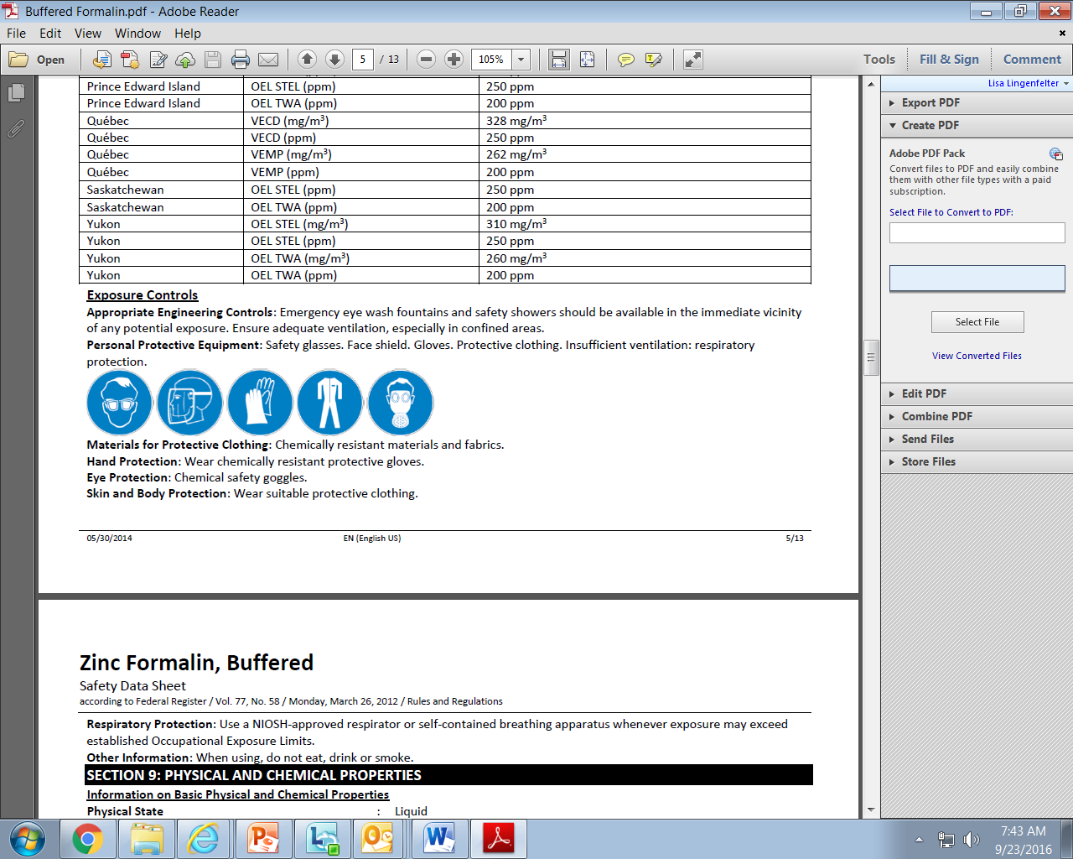
Example of SDS, Section 8 (PPE)

Slide 6
Types of PPE
Gloves – protect hands
Gowns/aprons – protect skin and/or clothing
Masks and respirators– protect mouth/nose
Respirators (PAPR) – protect respiratory tract from airborne infectious agents
Goggles – protect eyes
Face shields – protect face, mouth, nose, and eyes

Slide 7
Gloves
Gloves should fit properly
Gloves should be replaced immediately when torn or contaminated
Do not wash or disinfect gloves for reuse
Use hypoallergenic gloves when indicated by patient or health care provider history
Decontaminate hands after glove removal using an effective antimicrobial method

Slide 8
PAPR
PAPR = Powered Air Purifying Respirator
The equipment is battery operated, consists of a half or full face piece, breathing tube, battery-operated blower, and particulate filters (HEPA only).
A PAPR uses a blower to pass contaminated air through a HEPA filter, which removes the contaminant and supplies purified air to a face piece.
A PAPR is not a true positive-pressure device because it can be over-breathed when inhaling.
A face shield may also be used in conjunction with a half-mask PAPR respirator for protection against body fluids.
Used when a regular mask is not sufficient

Slide 9
Factors Influencing PPE Selection
Type of exposure anticipated
  Splash/spray versus touch
  Category of isolation precautions
Durability and appropriateness for the task
Fit

Slide 10

True or False
When pouring from one container to another,
eye protection should be worn to guard from splash exposure.
This statement is TRUE . Eye protection should be worn anytime a splash hazard exists.

Slide 11

True or False
Although PPE is always available,
it is up to the discretion of the staff when to use it.
This statement is FALSE. PPE is available and is to be used according to established safe practice standards.

Slide 12
PPE and Handwashing
PPE reduces but does not completely eliminate the possibility of infection. PPE is only effective if used correctly. The use of PPE does not replace basic hygiene measures such as hand washing - handwashing is still essential to prevent transmission of infection

Slide 13
Who is Responsible?
It is the responsibility of BSWH All Saints to have adequate PPE available to each team member.
It is the responsibility of each team member to be familiar with and to utilize the PPE appropriate for each work task.

Slide 14
Cheesy but true…
Safety is a cheap and effective insurance policy. ~Author Unknown
Working safely may get old, but so do those who practice it. ~Author Unknown
  Personal protective equipment is self-defense. ~Author Unknown

Slide 15
Competency Assessment
There is no test associated with this module
Close this document
Click on the box to verify review of the document
Revised 8-13-18

