Slide 1
KP-C 2018
Self-Reported Training
CAP® this material is for internal use only to full-till the Self-reported training requirements for this survey not for distribution

Slide 2
Case History

Slide 3
BCP-21 Graded

Slide 4
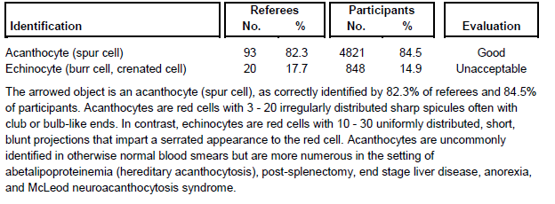
BCP-21

Slide 5
BCP-22 Graded

Slide 6
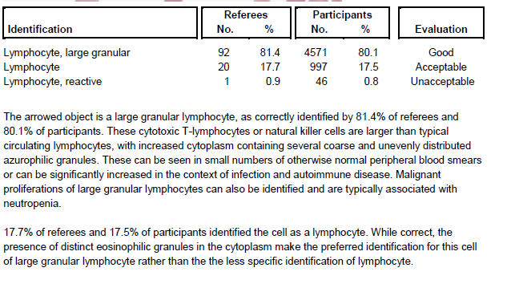
BCP-22 Graded

Slide 7
BCP-23 Graded

Slide 8
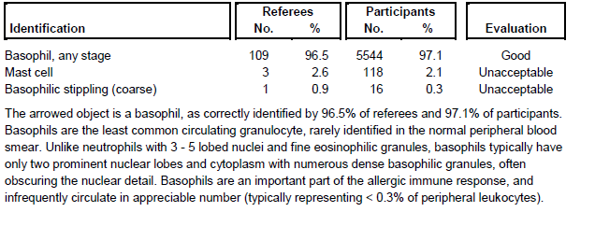
BCP-23 Graded

Slide 9
Bcp-24 graded

Slide 10
Bcp-24 graded

Slide 11
Bcp-25

Slide 12
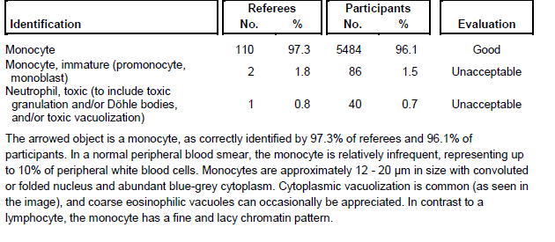
Bcp-25

Slide 13
Case discussion
CASE DISCUSSION: NEUROPATHY – MCLEOD SYNDROME
Neuropathies, diseases affecting the function of peripheral nerves, are commonly encountered in clinical practice. Patients can present with impaired movement, sensation, or other organ dysfunction, but identifying the underlying cause is often difficult, as numerous disorders can affect nerve function. Diagnosis often requires extensive testing, including thorough physical and neuromuscular exam, metabolic and other blood tests, cerebrospinal fluid evaluation, and electrodiagnostic studies.
In the developed world, the most frequent cause of peripheral neuropathy is type 2 diabetes mellitus, and testing to establish diagnosis or extent of the damage can be very focused. Careful attention to other presenting symptoms, clinical and family history are key to timely diagnosis and appropriate management.
In this case, the patient’s neuropathy is also associated with abnormal involuntary movement disorder known aschorea. While the differential diagnosis of peripheral neuropathy is broad, the constellation of findings including chorea presenting in a man approximately 50 years of age and a blood smear with numerous acanthocytes narrows the diagnostic considerations significantly and underscores the importance of a thorough peripheral blood smear review. Together, the findings are strongly suspicious for McLeod neuroacanthocytosis syndrome.

Slide 14
Case Discussion (cont’d)
GENETIC AND CLINICAL PRESENTATION
McLeod syndrome is an X-linked recessive disease caused by mutations of the XK gene. The specific function of the expressed protein is not entirely clear, but mutations are associated with weak expression of the Kell red blood cell antigens. Over 30 different mutations have been identified in the XK gene, and associate with a variety of neuromuscular findings including myopathy, peripheral neuropathy, muscle atrophy, chorea, and seizure disorders. Cardiac manifestations include arrhythmias and dilated cardiomyopathy.
As the disorder is X-linked, the disease manifests in men, but the reason as to why the presentation is delayed
until age 40-50 is not entirely understood. Also, the disease is variably penetrant, while most patients with the
mutation are symptomatic, a few individuals show no or minor neuromuscular manifestations.

Slide 15
Case Discussion (Cont’d)
DIAGNOSIS
Although none of the clinical or conventional laboratory tests are entirely specific, the constellation of findings is often diagnostic.
PERIPHERAL BLOOD EVALUATION
The hematology laboratory plays an important role in establishing the diagnosis of McLeod syndrome, as significant acanthocytosis is an uncommon blood finding. A well-prepared peripheral blood smear from a freshly collected sample confirms numerous acanthocytes (spur cells), with 3 - 20, thin, irregular projections with club-like ends. While acanthocytes can be seen in small numbers in otherwise normal blood smears, true acanthocytosis is rare.

Slide 16
Case Discussion (Cont’d)
DIFFERENTIAL DIAGNOSIS
The differential diagnosis of acanthocytosis is relatively narrow. In addition to McLeod syndrome, numerous acanthocytes can be seen in the context of abetalipoproteinemia (hereditary acanthocytosis), post-splenectomy, end stage liver disease, and anorexia or severe malnutrition. Further clinical laboratory evaluation can distinguish between these diagnostic considerations. Of note, abetalipoproteinemia is also an inherited genetic disorder associated with dysfunctional absorption of lipid and fat-soluble vitamins. Symptoms can include muscle weakness, poor balance and coordination, and movement disorders, but these typically manifest in childhood along with steatorrhea and failure to thrive.

Slide 17
Case Discussion (Cont’d)
PROGNOSIS AND THERAPY
Patients with McLeod syndrome presenting in adulthood typically have a life expectancy of 5 - 7 years after
diagnosis and related to degree of cardiac or neuromuscular dysfunction. There is no cure for disease, and care
is largely supportive, with dopamine antagonists used to treat chorea. Monitoring for progressive cardiac
dysfunction is necessary, and medical therapy or cardiac pacemakers may be necessary.

Slide 18
References
Yuri D. Fedoriw, MD
Hematology and Clinical Microscopy Resource Committee
REFERENCES:
1. Perkins S. Hereditary erythrocyte membrane defects. In: Kjeldsberg CR. Practical Diagnosis of
Hematologic Disorders. 4th Edition, volume 1. Chicago, IL: ASCP Press; 2006.
2. Glassy EF. Color Atlas of Hematology: An Illustrated Field Guide Based on Proficiency Testing. Northfield
IL: College of American Pathologists; 1998.
3. Storch A, Kornhass M, Schwarz J. Testing for acanthocytosis A prospective reader-blinded study in
movement disorder patients. J Neurol. 2005;252:84–90.
4. Danek A, Rubio JP, Rampoldi L, Ho M, Dobson-Stone C, Tison F, Symmans WA, Oechsner M, Kalckreuth
W, Watt JM, Corbett AJ, Hamdalla HH, Marshall AG, Sutton I, Dotti MT, Malandrini A, Walker RH, Daniels
G, Monaco AP (2001) McLeod neuroacanthocytosis: genotype and phenotype. Ann Neurol 50:755–764.8

Slide 19
Case HIstory

Slide 20
BCP-26 Ungraded

Slide 21
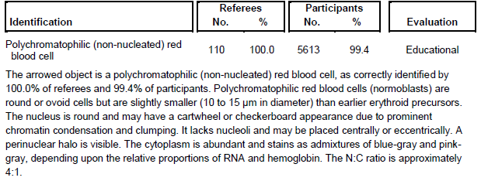
BCP-26 Ungraded

Slide 22
BCP-27 ungraded

Slide 23
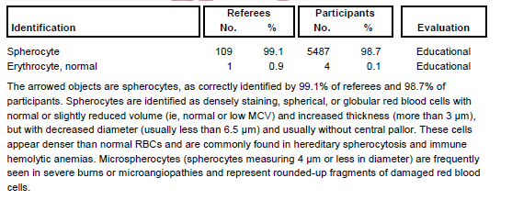
BCP-27 ungraded

Slide 24
BCP-28 ungraded

Slide 25
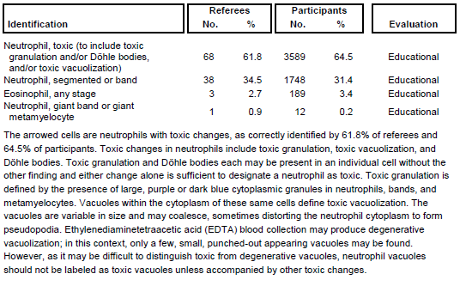
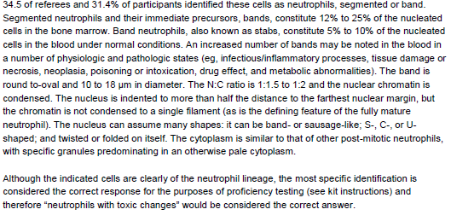
BCP-28 ungraded

Slide 26
BCP-29 ungraded

Slide 27
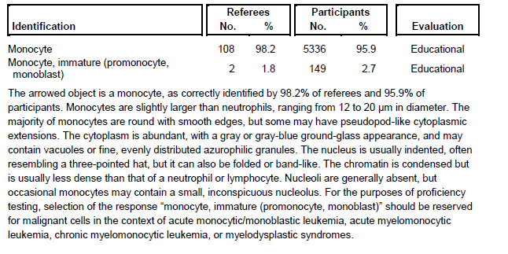
BCP-29 ungraded

Slide 28
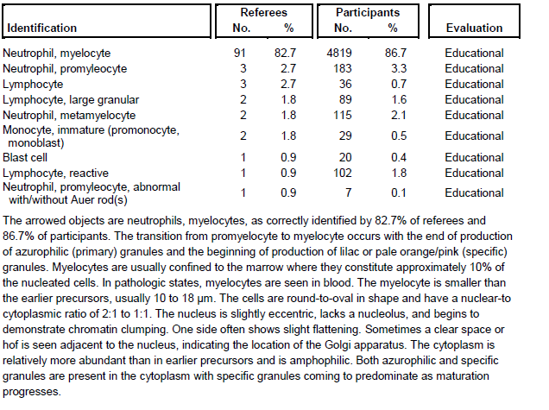
BCP-30 ungraded

Slide 29
Don’t forget
Sign the Attestation of Participation sheet in the Read me book, once everyone is complete Dr. Cleaves will sign the pages.

