Slide 1
iAttest Tutorial
Reviewing Policies and Procedures On-Line

Slide 2
All employees are required to review all policies applicable to their job duties during the orientation/training period when hired.
Thereafter, all policies that are added to the library or are revised will be reviewed through the “iAttest” function in the on-line policy library.

Slide 3
There is a specific format for the naming of a policy:
BAS.LAB.QM.XXXX.P_V1
A B C D E
A: System (BHCS, BSWH, NTX) or Facility (BAS) Identifier
B: Department within the system or facility identifier (Lab, Nursing, Admin, etc.)
C: Specific discipline within the department (Quality, Hematology, POC, etc)
D: Unique policy number
E: Version of the policy

Slide 4
Notification to Review
You will receive an email from your supervisor/manager of documents that are due for your review however you can log on and check iAttest at anytime for documents that need to be reviewed.
Note:
You may be required to review not only those Policies/Procedures that are department specific,
but also some of the general LIS, Quality, Safety, etc.

Slide 5
Access Documents for Review
From BSWH Home Page:
Click on “Policies and Procedures then chose our facility

Slide 7
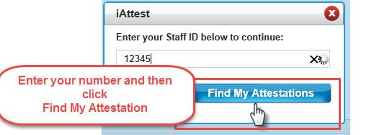
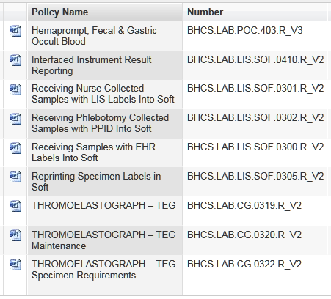
A list of documents will be displayed to be reviewed:
NOTE:
The list of documents is comprehensive and
will contains some that don’t pertain to your
position. If you click on the “Number” column, this
will sort the documents to make it easier to determine
which you need to review.
Example: A tech in corelab would sort and then review
those policies with “CHM, HEM, etc” in the number.
Remember all laboratory staff is responsible to
review P&P that contain “QM” and “SAF” in the number.
If you are unsure if a particular policy applies to you: open the document, look under the “SCOPE” header; this will specify to whom this policy applies. If your position is not Included in the scope statement, you needn’t review it.

Slide 8
Click on a policy. The document will open and in the right hand corner the iAttest box will be displayed.
1st Box: BAS
2nd Box: Last name, First name
3rd Box: employee ID#
Disregard the labels that appear in the first two boxes
NOTE: this step is critical to ensure you get credit for all policies you review!
After you review the policy enter the information in the “iAttest Required box”.
The data must be entered EXACTLY as shown above;
any deviations will cause your name to be omitted when compliance audits are generated.
Repeat process until all documents are reviewed

Slide 9
This tutorial, and others, can be found on the I drive if needed in the future:
I:\_Tutorial Library

Slide 10
If you have difficulties or questions about iAttest,
please ask for assistancefrom your supervisor or manager.
Close this document
Check the box verifying review of the document

