Slide 1
Trash Talk
Separation of Laboratory Waste
Biohazard
Non-Biohazard
Recycling

Slide 2
Taking a Closer Look
A modern hospital is a complex, multidisciplinary system which consumes thousands of items for delivery of medical care and is a part of physical environment. All these products consumed in the hospital leave some unusable leftovers i.e. hospital waste (waste generated, discarded and not intended for further use in the hospital).
Amount and composition of hospital waste generated
Country Quantity (lb/bed/day)
U. K. 5.0
U.S.A. 9.0
France 5.0
Spain 6.0
India 3.0
Hazardous/non-hazardous
Hazardous` 15%
a) Hazardous but non-infective 5%
b) Hazardous and infective 10%
Non-hazardous 85%
World Environment Day observed by ISEB on June 5, 1999 at NBRI, Lucknow.

Slide 3
Separation of Trash
Separation is the essence of waste management and should be done at the generation source of medical trash. The responsibility of separation should be with the generator of biomedical waste i.e. doctors, nurses, technologists, etc.
Separation of pathological and infectious waste from regular waste is also important, both from pollution and cost considerations. In some hospitals all waste that has come in contact with patients is routinely placed in “red-bag” trash bins; however, “red-bag” infectious waste costs five times more to dispose of than regular trash

Slide 4
Federal Requirements
Under OSHA:
contaminated reusable sharps must be placed in containers that are: puncture resistant; labeled or color coded; and leakproof on the sides and bottom,
reusable sharps that are contaminated with blood or other potentially infectious materials must not be stored or processed in a manner that requires employees to reach by hand into the containers,
specimens of blood or other potentially infectious material are required to be placed in a container that is labeled and color coded and closed prior to being stored, transported or shipped,
contaminated sharps must be placed in containers that are: closeable, puncture resistant, leakproof on sides and bottoms, and labeled or color coded,
regulated wastes (liquid or semi-liquid blood or other potentially infectious materials, contaminated items that would release blood or other potentially infectious materials in a liquid or semi-liquid state if compressed; items that are caked with dried blood or other potentially infectious materials and are capable of releasing these materials during handling, contaminated sharps, and pathological and microbiological wastes containing blood or other potentially infectious materials) must be placed in containers that are: closeable, constructed to contain all contents and prevent leakage of fluids, labeled or color coded, closed prior to removal.

Slide 5
Regular Trash?
Clear bags are appropriate for most laboratory trash:
Gauze (not saturated with blood/body fluid)
Disposable lab coat
Gloves
Paper Masks
Paper Towels
Tissue

Slide 6
Biohazard?
Red= BIOHAZARD
When disposing of blood stained gauze, lab coats, and other textiles: only those so saturated that you could “squeeze” blood from the item go into the red bags.
Not saturated = clear trash bags.
Ask yourself:
“Does it really belong in
a biohazard bag?”

Slide 7
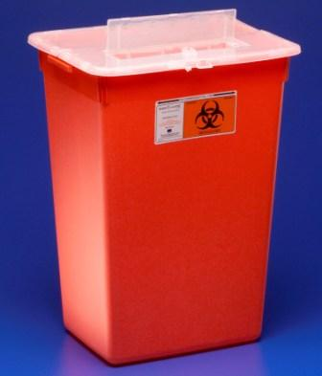
Sharps?
Broken Glass
Glass Vials/Ampules
Needles and Syringes
Razor/Scapel Blades
Specimen Tubes
Disposable Sets/Scissors
Urine C/S Vacutainer
YES
Paper Towel
Tissue
Gloves
Lab Coat
Mask
Gauze
Bandages
Misc. paper
Alcohol Swab
NO

Slide 8
Recycling
Paper (HIPAA and non-HIPAA)
Shred Bins*
Cardboard
Blue Recycling Containers
Aluminum Can Pull Tabs
Ronald McDonald box in breakroom
If you have a question about what can/cannot go into the shred bins, guidelines are
posted on the top of each bin.

Slide 9
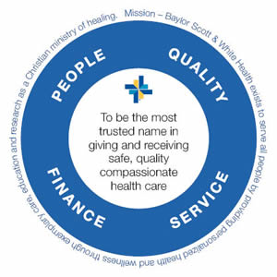
There is financial benefit to recycling and
proper separation of non-biohazardous /biohazard trash
Baylor Scott & White Circle of Care

Slide 10
There is no test associated with this module
Close this document
Click on the box to verify review of the document

