Slide 1
Sysmex interface &
Worklist
How to get started
By: Michell McAdams & Emily Gehring 11/2018
Updated: 04/30/2019

Slide 2
Sysmex interface

Slide 3
Sysmex Interface
This power point shows the basic information for the Sysmex Interface.
Each instrument has its own interface, but they all display the same.

Slide 4
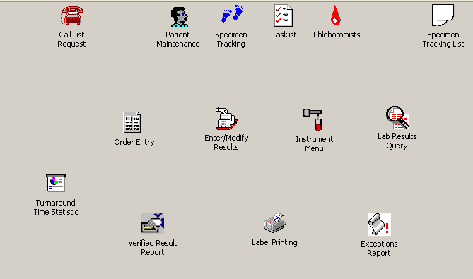
Sysmex Interface
From the Main Soft Screen go to Instrument Menu

Slide 5
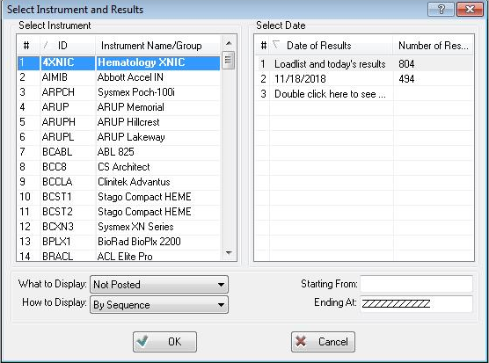
Sysmex interface
Once in the instrument menu click on Hematology XN’s (4XNIC)
This is a combination of all four instruments. Then click ok (you can also double click on the instrument to open it)

Slide 6
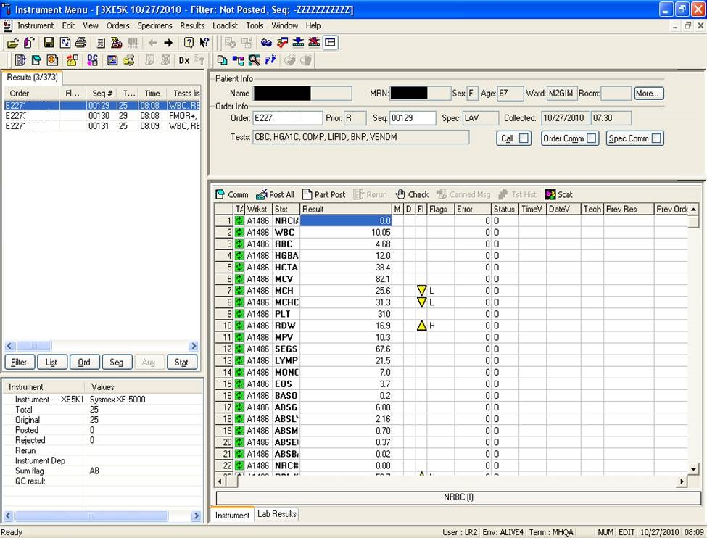
Sysmex interface
Main Tool Bar
Patient Information
Each Patient Ran
Test Results
Instrument Information

Slide 7

Sysmex interface
Main Toolbar
Save
Refresh
Multiple Records Posting
Order Entry
Lab Results Query
Worklist
These are the main icons that are used on the Main Toolbar.

Slide 8
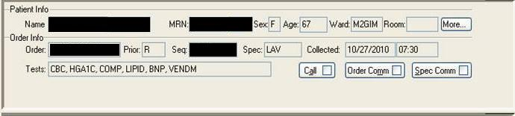
Sysmex interface
Patient Information Bar
Gives you all the information needed for the patient:
Name, Sex, Age, Order #, MRN, Tests ordered, Collection, Priority

Slide 9
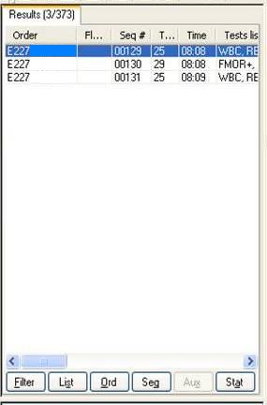
Sysmex interface
Under the results tab there is a list of each person that has ran on the instrument. When you click on each order it will show the patient’s info in the Patient Information window .
The count next to “Results” is how many results are in the interface/how many total samples that have ran for the day.

Slide 10
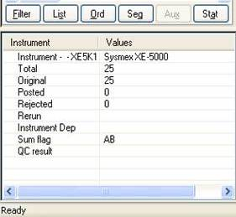
Sysmex interface
Instrument Information Panel

Slide 11
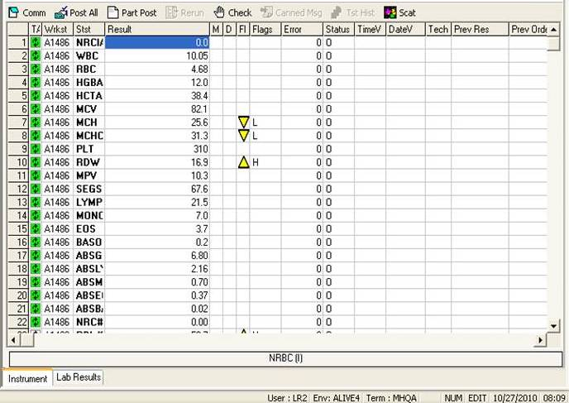
Sysmex interface
Test Results
Gives you a list of all the test for one patient that is ran

Slide 12
Sysmex interface
“Cancelling” Results Off the Interface
When results need to be removed from the interface (re-runs, clotted specimens, etc), the results need to be “cancelled” off the interface
Cancelling results from the interface does NOT cancel the test; it only removes the results from the interface screen

Slide 13
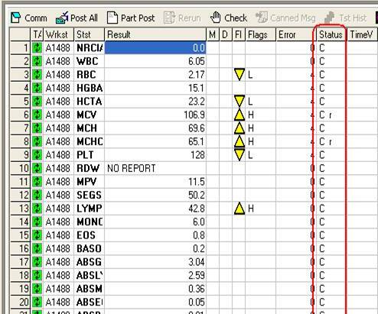
Sysmex interface
To remove results from the interface press Shift&F4 (at the same time) on the keyboard
“C” will appear next to the results in the Status column
Save changes

Slide 14
The work list

Slide 15
iNTRO
Comments are required for critical and delta results. They are also needed for results requiring extra work (dilution, warming, etc).
Canned comments are readily available in the interface.
The comment for value(s) called must contain the First Name, Last Name, Title, and Location of the person you gave the critical value to, along with the time, date, and your Soft Initials.

Slide 16
Critical results
Critical results stop in the interface; they are flagged as critical high or critical low .
Follow the critical value policy, using the doctor’s location not the ward (there are a few exceptions).
Every critical value must have a comment entered.
  You can copy and paste the comment if more than one critical is present per patient.

Slide 17
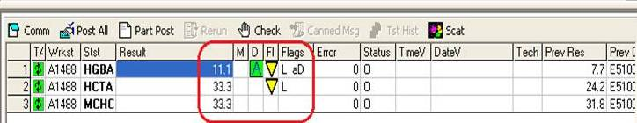
Delta results
Delta results are flagged green in the interface
Confirm the results (rerun sample and check label).
Follow Delta policy and enter the appropriate comment. Every Delta must have a comment.

Slide 18
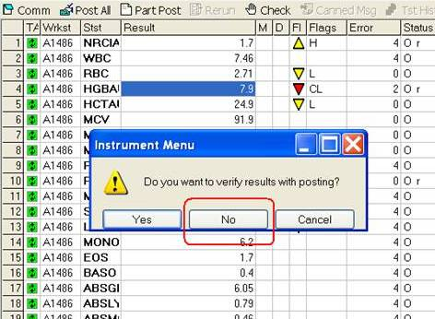
Bridging over
To bridge from the Interface to the Worklist, click on the icon
A box will appear asking to verify results with posting; always say “No”.
Results will be verified on the Worklist screen.

Slide 19
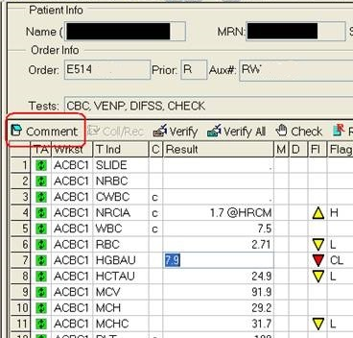
Adding A Comment
To add a message to the specific value(s) on the Worklist screen: click on the result; then click on the “Comment” icon or use the “ \ ” key.
NOTE: Critical, Delta, and other comments can be put into place from the instrument screen.

Slide 20
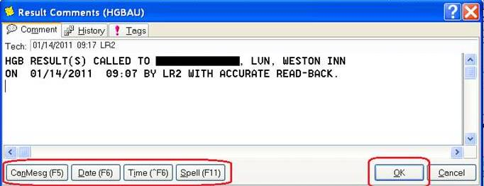
Can Messages
Enter the appropriate message in the comment box.
Take advantage of the “CanMesg”, “Date”, “Time” and “Spell” icons in the comment box to help minimize errors.
Click on OK in the comment box to save the message.

Slide 21
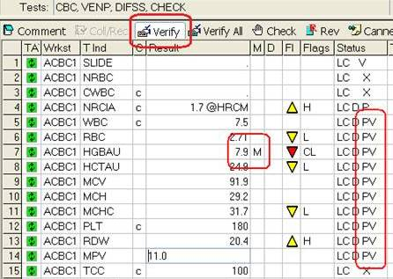
Verify Comment
After the message is saved there will be a “M” next to the result.
To verify the hemogram, line verify using the “Verify” icon or “ [ ” key on the keyboard. Only verify from WBC to MPV.
Click on the save icon.
Say “Yes” to save the changes

Slide 22
FINAL NOTES
Ensure every Critical/ Delta have comments under specific test.
Dilutions, plasma replacement, and warmed samples should all have comments placed under the RBC test as to the workup process. i.e. (results obtained from a pre-warmed sample)

Slide 23
~ THE END ~
☺

