Slide 1
Un-received specimens
Michell McAdams & Emily Gehring - 11/2018
Updated – 04/30/2019

Slide 2
Un-received specimens
You may have a sample that is not received. The following slides takes you step-by-step on how to receive the sample from Multiple Records Posting.

Slide 3
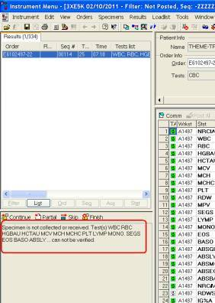
Un-received specimens
Specimen Un-Received will display a message seen below.

Slide 4
Un-received specimens
Bridge to Order Entry

Slide 5
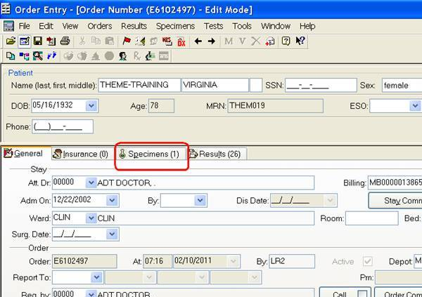
Un-received specimens
Once in Order Entry – Click on “Specimen” tab

Slide 6
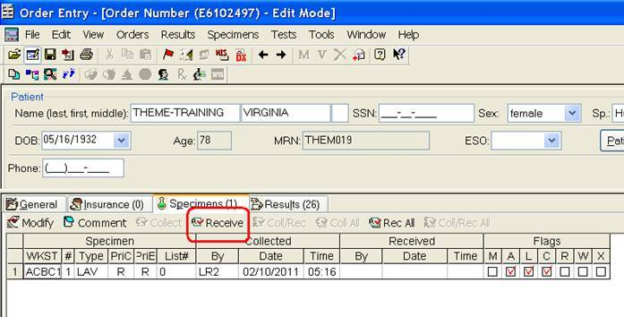
Un-received specimens
Receive specimen into Lab

Slide 7
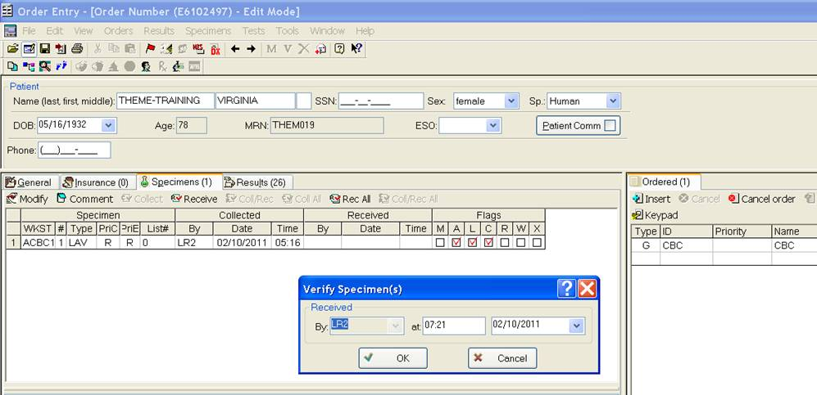
Un-received specimens
Click OK

Slide 8
Un-received specimens
Save changes

Slide 9
Un-received specimens
Yes to save changes

Slide 10
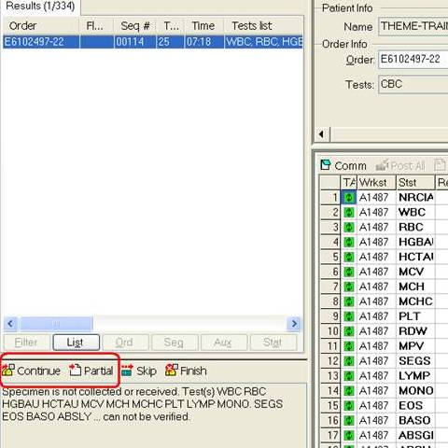
Un-received specimens
Return to the Sysmex Instrument Interface
At the Interface, Click Continue or (F12) for a Normal Specimen or Partial (Ctrl +B) for an Abnormal Specimen to resume standard operation for Sysmex Workstation

Slide 11
Un-received specimens
Single Records Posting to the left side of the results is either a RED, GREEN, YELLOW, or WHITE box.
The WHITE box next to the line number is a statement that the specimen may not be received.
Click on Order Entry Icon
Go to Specimen tab
Receive specimen
Save
X out and go back to posting results

Slide 12
Un-received specimens
The End
☺

