Slide 1
Key Points
&
Reagents
By: Michell McAdams
06/2013
Updated: 06/2019

Slide 2
Key Points

Slide 3
Key Points
REMOVE ALL STOPPERS, place min/max reducer into designated vials then replace cap before loading onto the instrument
***NOTE: PTT Reagent DOES NOT need an insert
Be sure to remove the stir bar from the PT (NEO) prior to discarding the bottle
Block Sample Pipetting – This usually means that the instrument has run out of something. Load what is needed to continue use.

Slide 4
Key Points
PT reagents require a stir bar and a reducer before loading on the instrument. The reducer helps prevent evaporation and prevents the needle from hitting the stir bar which could potentially demagnetize the needle’s level detection.
Reagents needing a reducer:
    PT, TT, Desorb = Max reducer
    FIB, FXa & D-DI (both bottles) = Mini reducer
    PTT does not require a reducer

Slide 5
Key Points
Reagents have designated sections to be placed in. The drawer is labeled R0, R1, R2 (Use appropriate slot according to bottle size)
      All 3 areas require Desorb. There is no designated slot for reagents but is suggested to use the five back positions of the drawer (19, 21, 22, 28, 29) for Desorb.
        The reason you want these slots is because the Desorb is used to wash the needles and they are the closes to the wash well to help prevent contamination
      R0 – Controls, Calibrators & Diluents
      R1 – Intermediate Reagents (reagents added before incubation) EX: PTT
      R2 – Start Reagents EX: Thromboplastin, CaCl₂

Slide 6
Key Points
Needle 1 is used for patient samples and R0 of drawer. Needle 1 has the smallest bore of all the needles. It has it’s own stylet. The stylets that come with needle 2 & 3 are larger in diameter; they should NOT be used on needle 1 at all. Needle 1 is usually the one that will become clogged first.
Needles 2& 3 are reagent needles. Needle 2 is used for R1 of the drawer. Needle 3 is used for R2 of the drawer and is the thermal needle where reagents such as CaCl₂ is flash heated at 37° before being added to the cuvette.

Slide 7
Key Points
Database will only hold 5000 samples. Files will delete as a 1st in 1st out (there is no need to delete patient files)
Product screen (List of Products) tells Product ID, Name, Product Type, Position, Lot Number, Stability, Expiration time/date, Actual volume of reagent (including dead space), Number of Cuvettes available, Amount of wash solution available. The Forecast will give a margin number which is testing volume.

Slide 8
Key Points
It is very important to program the correct sample size. It is possible to crash a probe if the instrument does not recognize the correct sample size. (Example: Micro-Cups)
When changing a new roll of cuvettes it is a good idea to clean out the rest of the cuvettes and start fresh. Be Sure to line the plastic inside the metal feeder or your cuvettes will not load.

Slide 9
Reagents

Slide 10
Reagents
Neoplastine Cl Plus 10 (PT)
PTT
Thrombin
Fibrinogen
D-DI (Buffer and Latex)
Owren-Koller
Desorb U
CaCl
Anti-Factor Xa – 2 Reagents
Anti-Thrombin III – 2 Reagents
PFA – COL/EPI & COL/ADP

Slide 11
Reagents
Most reagents needed for General Coagulation are in the 1st slide door or the 3rd door refrigerator
The CaCl is at the bottom of the 2nd door
The EPI/ADP for PFA is mid-way of the 3rd door
If there is something missing look in the walk-in refrigerator in Sp. Coag
When first arriving to the COAG bench it is good practice to check your Product List.
This tells what reagents may expire soon, what may run out, or what may have already expired.

Slide 12
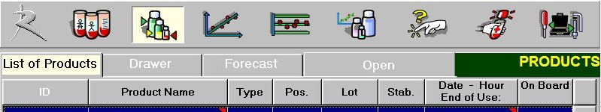

Reagents
To get to the Product List:
  Click the Reagent Icon on the screen
  Click List of Products tab
  **You can also use the
  Drawer tab
    This will give you what is on board
    Green is good, yellow is either low volume or will expire soon, red is expired, out, no calibration, or a problem occurred and can not be used

Slide 13
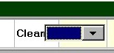
Reagents
To load a Reagent:
    Click on Reagent Icon
    Open tab – this will open the reagent drawer
    Scan barcode
    If not sure where to put reagent click the drop down arrow next to the reagent on the screen. This will inform you where the reagent should be put in the section of the drawer.
    Change any information (EX: Time bottle was made, volume if moved, etc)

Slide 14
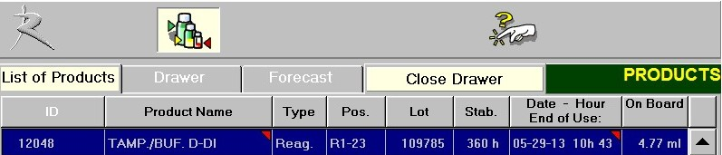
Reagent
To load a Reagent (Continued):
    Put reagent into appropriate slot
    A light will come on next to the position and the STAGO will put the position into the computer.
    Press Close Drawer tab when done loading reagents. The drawer will close.

Slide 15


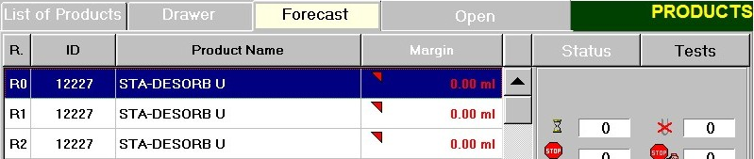
Reagent
REAGENT FORECAST
    If a product is missing or not sufficient to run tests, the , or icon(s) will blink at the bottom of the Test Panel screen.
    Click on the icon blinking
    Reagent missing will be listed with RED triangle
    Load necessary product and the tests will resume

Slide 16

Reagent
    If you need into the product drawer quicker:
    You can use the Block Sample Pipetting (this tells the instrument that you want in and will not pick up anything else).
    When the instrument is at a stopping place it will let you open the drawer.
    ***Note: It takes approximately 4 minutes to clear everything out of the incubation stations.

Slide 17
Reagent
PTT reagent should be mixed well before placing on the STAGO.
Do not shake, but vortex to mix the reagent.
Once reagents are placed on the STAGO DO NOT LIFT THEM OUT of the drawer. Once the sensor recognizes that it has be removed, it is gone and you will need to rescan before placing it back on. If you do this you MUST adjust the volume and time. The instrument will then want to run controls for that reagent.

Slide 18
~ The End~
☺

