Slide 1
Quality Control (QC)
&
Maintenance
By: Michell McAdams
07/2013
Updated: 01/2019

Slide 2
QC
QC is run every 8 hours and/or when new test reagents are loaded on the instrument
QC Reagents are: Coag N & ABN and Lia N & P
Coag N & ABN are used to QC: PT, PTT, FIB, TT
Lia N & P are used to QC: D-DI
Once reconstituted LIA N & P are good for 8 hours; Coag N & ABN are good for 24 hours
Lia N & P uses 1mL or 1000µL of Reagent Grade Water; Coag N & ABN uses 2mL or 2000µL of Reagent Grade Water; all 4 controls stand at room temp for 30 minutes; then gently swirl prior to loading

Slide 3
QC
If the control is left in the original bottle the dead space is 0.5mL, if the control is put into a microcup the dead space is 0.2mL
If used, Microcups must be placed in an adapter to be placed on the instrument

Slide 4

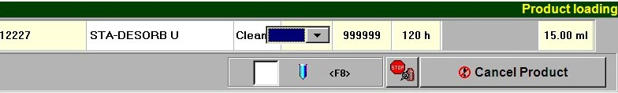
QC
To Load QC:
  Click on Product then open the product drawer
  Scan the barcode (if you put the QC in a microcup be sure to check the box or hit F8)
  Load QC into a proper slot for QC. If unsure where it belongs hit the drop down box
  Select close the drawer
  You may now run QC

Slide 5
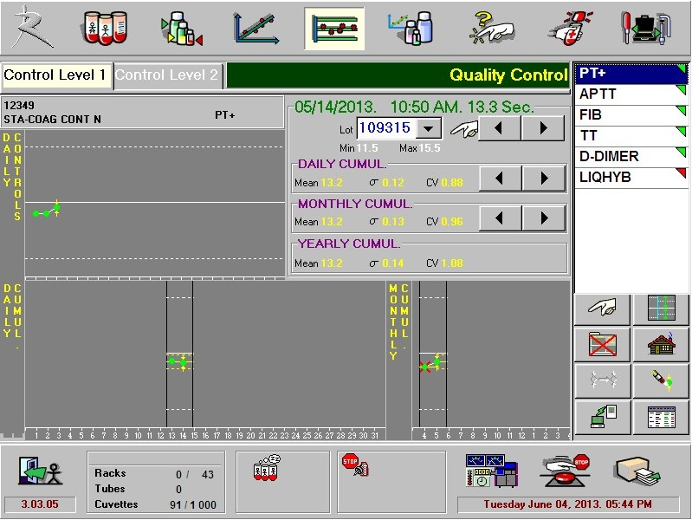
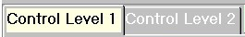
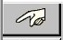
QC
To Run QC:
  QC can be run by ordering manually from the Quality Control Menu
  Click the control icon
  Locate the test for which a control must be run by clicking the abbreviation
  Select the level you want
  Click the finger below the QC abbreviations to start your QC
  If you want to run all levels of all controls then highlight all the test by dragging your finger down the test list, using the Shift key to select all, or use the Ctrl key to select certain test.

Slide 6
QC
On the test panel you should see the QC in progress.
You can click on the icon below the list of QC to view all QC that was ran that day.
If QC fails a red triangle will appear next to the test.
Click the test and the level to rerun.

Slide 7
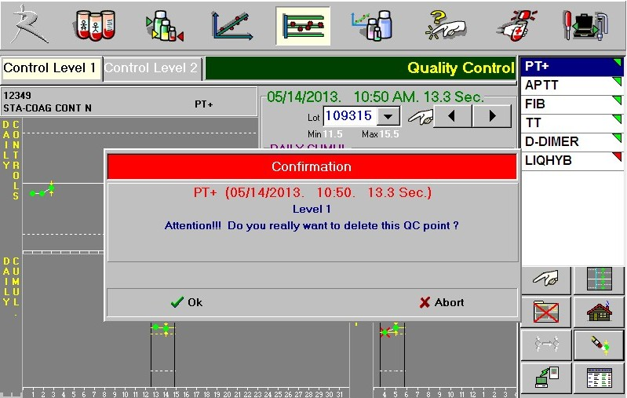
QC
If you choose the wrong QC you can delete the QC by:
Click on the test
Clicking on the level you want to delete
Click on the eraser
Click OK on the pop up box
Put in a reason why you are deleting it and Validate.

Slide 8
STAGO
&
PFA-100 Maintenance

Slide 9
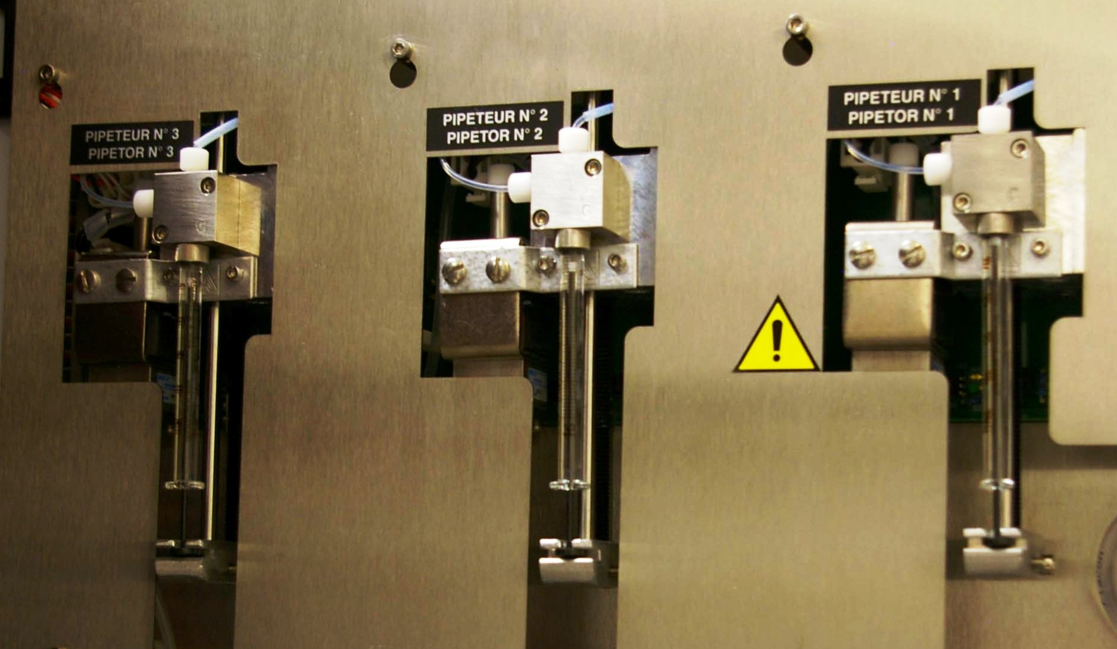
Stago
LEFT SIDE PANEL
Syringes

Slide 10
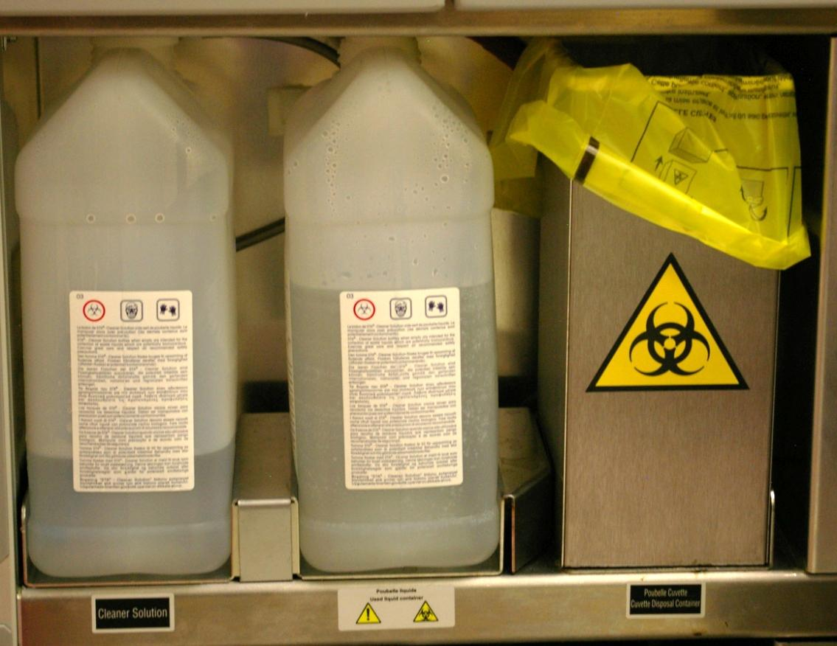
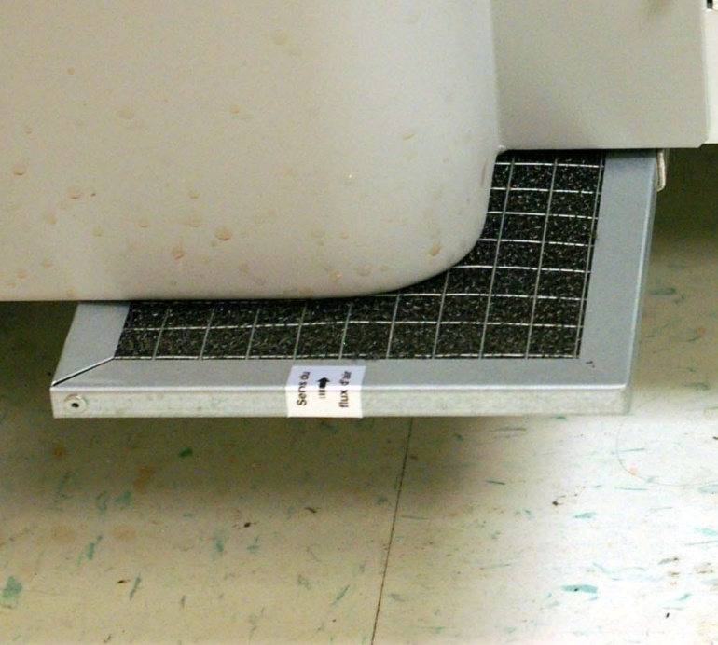
Stago
front PANEL
Wash Solution & Waste
Air Filter
(Under Wash Solution)
Cleaner
Waste
Cuvette
Waste

Slide 11
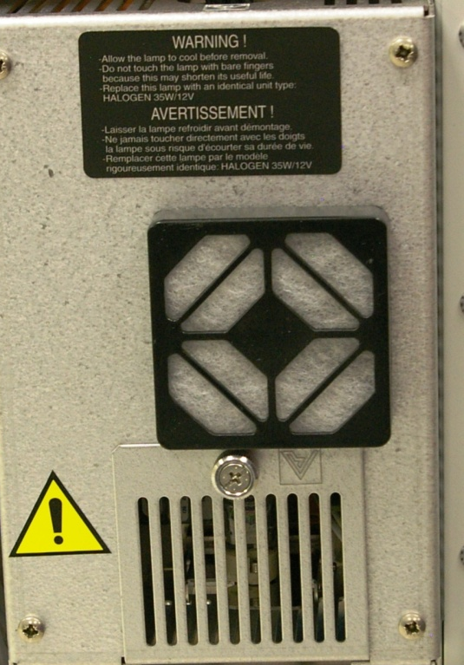
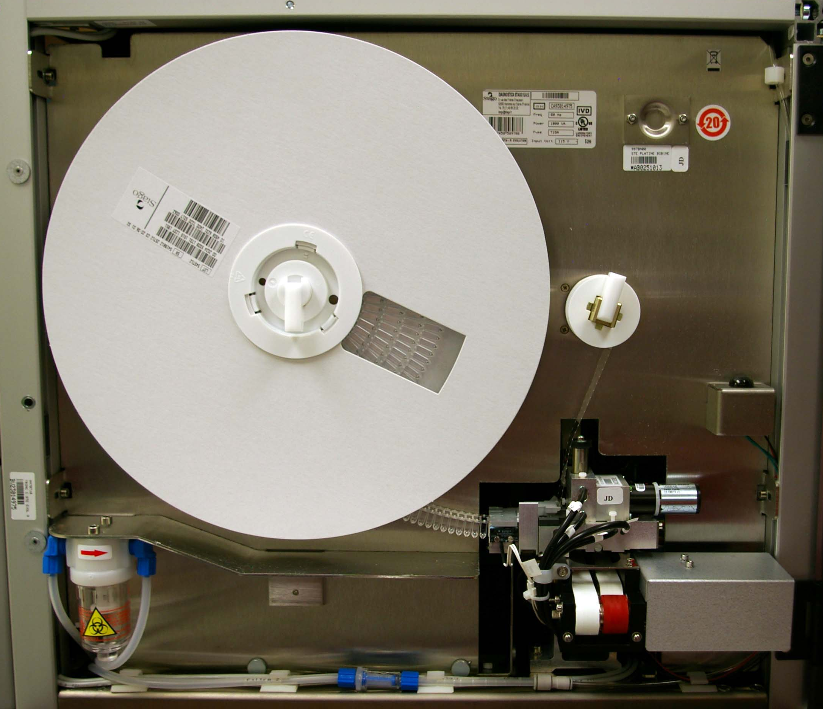
Stago
Right SIDE PANEL
Cuvette Roll
Air Filter
Lamp
Belts

Slide 12


Stago Daily Maintenance
Check Temperatures – Systems Status Icon
Check % on Syringes – System Status Icon
Review Quality Control – Quality Control Icon
Check Wash Solution – System Status or Reagent Icon
Clean Touch Screen
Check Condensation Trap

Slide 13
Stago Weekly Maintenance
Clean Air Filter (2) – One on the right side (see slide #11) and one under the wash solution (see slide #10)
Clean Wash Wells with Bleach Solution
Clean Needles using stylets or mandrels
Clean Drawers and Measurement Plate with warm water and wipe dry
Clean Measurement and Incubation Wells with cotton swab+alcohol
Clean and Inspect Suction Tip with H₂O
Clean Conveyor Belts and Shuttles – Use a dry lint free tissue for belts and ethanol for shuttles
Perform Acid Wash – Weekly or as needed
Perform Needle Purge – Maintenance, Maintenance, Needle Purge
Power Down and Restart Sta-R (Leave off at least 1 minute)

Slide 14
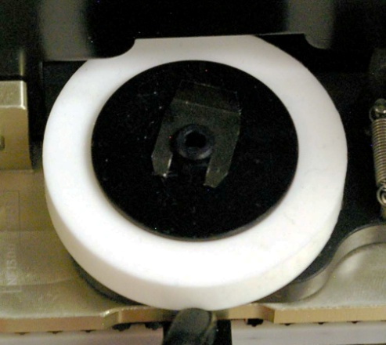
Stago Monthly/Quarterly Maintenance
Replace syringe tips and O rings (see slide #9 for location)
Replace lamp if indicated (<50%) (see slide #11 for location)
Review Quality Control
Save Test Configurations To A Disk
QUARTERLY
Replace barcode reader wheel

Slide 15
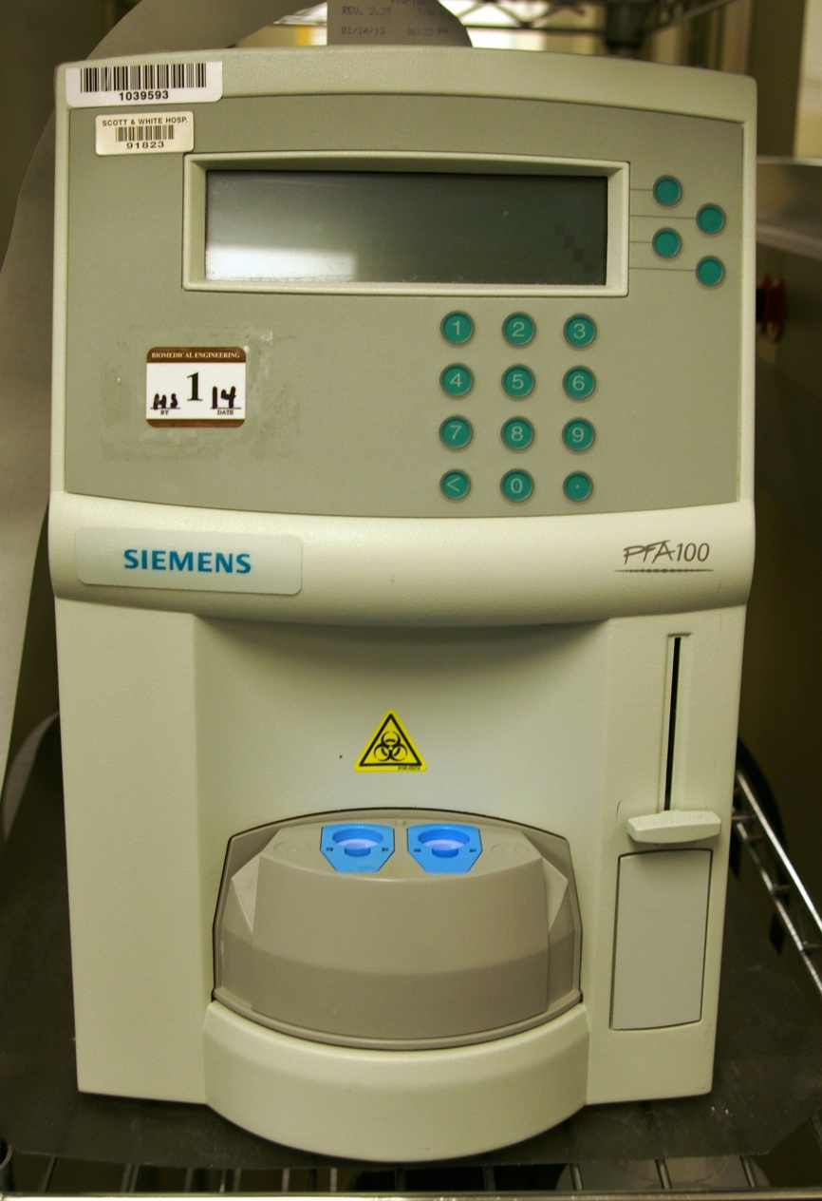
PFA
Printer Paper
Soft Keys
Cartridges
Trigger Solution

Slide 16
PFA Daily Maintenance
Clean instrument – Wipe it down
Check printer paper
Perform self test
  Check trigger solution (Volume and Exp Date: 60 days opened)
  Be sure the blue cartridges are in place
  Press the soft key next to Menu
  Press #2 (Maintenance)
  Press #2 (Self Test)
  Press the soft key next to yes then next to continue
  The system will check for cartridges
  Place a sponge in the center of instrument when it comes around; add alcohol to the sponge. Press continue
  After removing sponge Press continue
***NOTE: The Self Test is done at least once per shift or as needed.

Slide 17
PFA Yearly Maintenance
Replace O Ring (Special Coag Department, Beside PFA100, Getting Started Training Guide - Page 22; OR you can use the quick guide, O-Ring Maintenance)

Slide 18
~ The End~
☺

