Slide 1
Sed Rate
By: Tina Gorup

Slide 2
Sed Rate
What The Test Detects:
The ESR (erythrocyte sedimentation rate) is used to help detect conditions associated with acute and chronic inflammation. It is considered a nonspecific marker for inflammation because elevated results do not tell the doctor what is causing the inflammation or where in the body inflammation is. ESR values can also be affected by other conditions besides inflammation.

Slide 3
Sed Rate
Examples of Some Conditions Associated With Elevated ESR Results:
Acute & Chronic Infections
Rheumatoid Arthritis
Myocardial Infarction
TB
Subacute Bacterial Endocarditis
Hepatitis
Menstruation
After the 3rd month of Pregnancy

Slide 4
Sed Rate
ESR values may also be a useful prognostic indicator of Hodgkin’s disease.
One study showed that asymptomatic patients with an ESR of less than 10mm/h had an excellent survival rate whereas patients with an ESR of 60mm/h or greater had a survival rate as poor as those with systemic symptoms.

Slide 5
Sed Rate
Low ESR results are usually not a cause for concern but can be seen in conditions like:
Polycythemia
Extreme Leukocytosis
Some Protein Abnormalities
Sickle Cell Anemia

Slide 6
Sed Rate
Specimen Requirements:
Collect Specimen in Lavender Stopper Tube or Lavender Bullets
Minimum tube volume: 1.5mL
Lavender Bullets: 3 bullets filled to 500 µL mark
Specimen Stability: 4 hours if specimen is left at room temperature & 24 hours if specimen is refrigerated. Frozen samples are unacceptable.

Slide 7
Sed Rate
Methodology:
ESR is the distance in millimeters that RBCs fall per unit of time, which is usually 30 minutes.
ESR is directly proportional to the RBC mass (Ex. in diseases that form rouleaux [RBCs that appear as stacks of coins] the RBCs are heavier and settle out faster increasing the ESR) and inversely proportional to plasma viscosity (the higher the viscosity, the lower the ESR). In normal whole blood specimens, the RBC mass is small and the cells don’t form rouleaux so the ESR is decreased. In abnormal conditions when the RBC mass is greater, and when RBCs form rouleaux, the cells settle out faster increasing the ESR.

Slide 8
Procedure Overview
The ESR is performed using the Streck Auto-Plus Analyzer. It measures the sedimentation rates of RBCs using vacuum tubes which contain sodium citrate.
Blood is transferred from an EDTA (lavender) tube into a vacuum tube
The vacuum tube is mixed on a rotator for 2 minutes to ensure sample homogeneity.
When the tube is added to the analyzer a baseline reading is stored in memory and at the end of 30 minutes the baseline reading is subtracted from the final reading with the difference converted to ESR results.

Slide 9
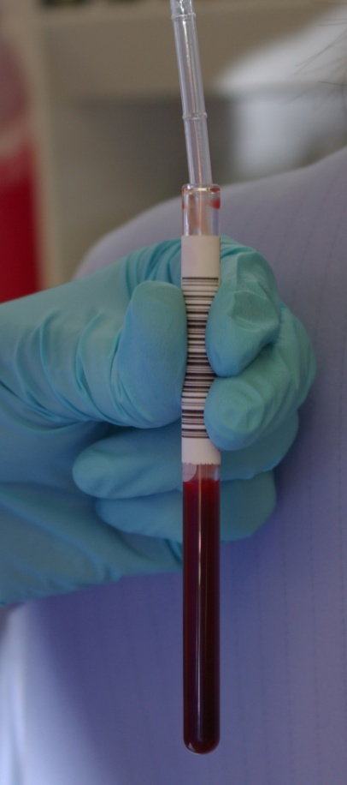
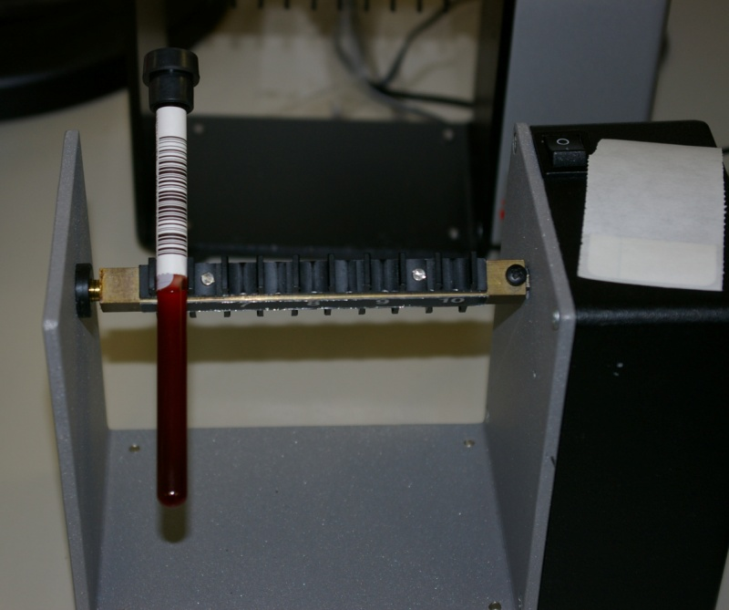
Sed Rate Steps
Blood being transferred from EDTA tube into vacuum tube
Vacuum Tube Mixing on Rotator
Step 1
Step 2

Slide 10
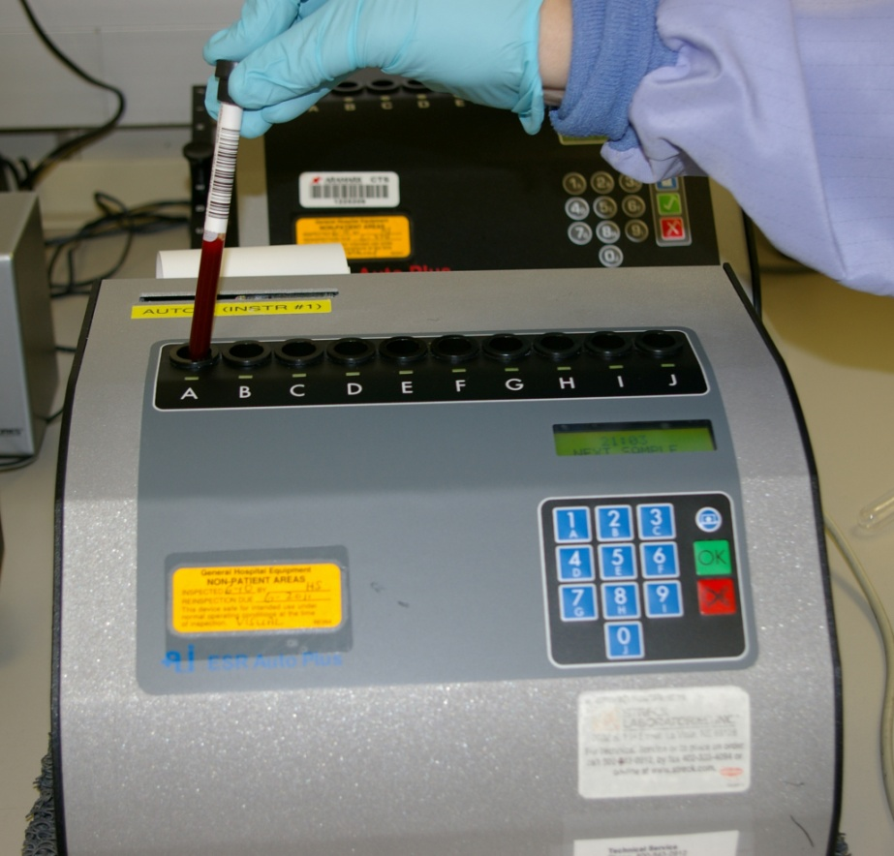
Sed Rate Steps
Placing Vacuum Tube into Analyzer
Step 3

Slide 11
Procedure Overview - Continued
The results are recorded in millimeters (mm) per hour by converting the Quick mode method conversion table. This table is a scientifically developed method for measuring ESRs in only 30 minutes.
The test results are calculated and printed when the test is complete.
Two controls (Level I and Level II) are run at the beginning of each shift and are recorded both electronically and in written format in the Result and QC Log Notebook.

Slide 12
ESR Reference Ranges
Females: 0-20mm/hr.
Males: 0-15mm/hr.
Children: No specific reference range available
Linearity and Reportable Range: 0 – 120mm/hr.

Slide 13
~The End~ ☺

