Slide 1
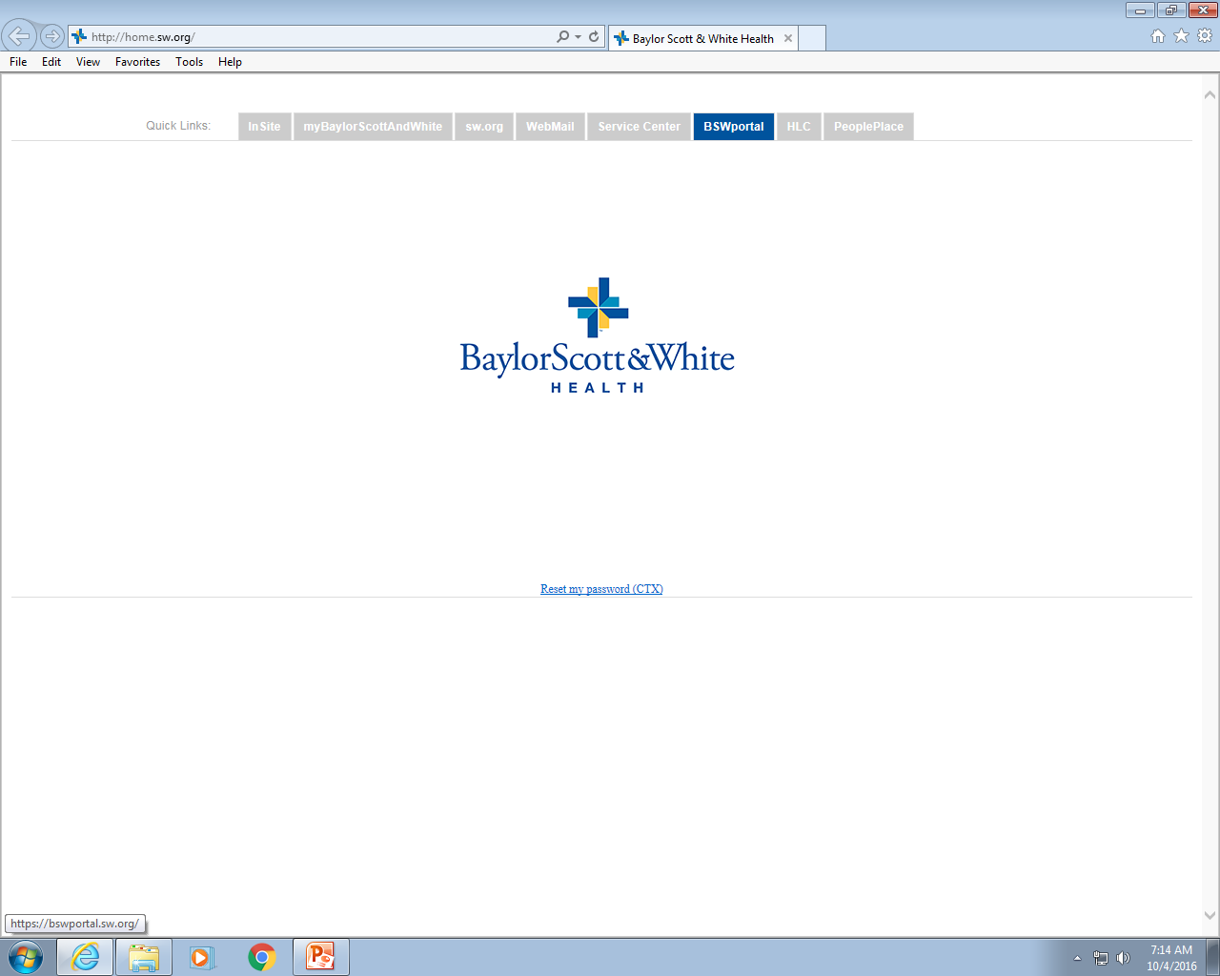
Sickle Cell Screen
Re-written By:
Michell McAdams
&
Emily Gehring
05/2013
Updated: 01/03/2019 – M1G/KJW

Slide 2
Principle
  Purpose:
    The purpose of a Sickle Cell screen is to test for the presence or absence of hemoglobin-S in a blood sample using a rapid and economical method.
  Background and Clinical Significance:
    Sickle Cell disease is a genetic condition resulting in the presence of Hemoglobin S (Hb-S) in the blood.
    Hb-S in a homozygous state (S/S) is known as Sickle Cell Anemia and in a heterozygous state (A/S) as Sickle Cell Trait
    Detection of both states is important, in order to identify high-risk individuals and attempt to reduce symptoms.

Slide 3
Methodology
In the presence of a concentrated phosphate buffer solution, deoxygenated Hb-S is insoluble and a turbid suspension may be observed.
Sickledex® uses Saponin to lyse the red blood cells. Sodium Hyposulfite then reduces the released hemoglobin. Reduced Hb-S is insoluble in the concentrated phosphate buffer and forms a cloudy, turbid suspension. Other sickling hemoglobin subtypes may also give a positive result.

Slide 4
Specimen Requirements
Lavender (EDTA) is the preferred specimen
Other anti-coagulated whole blood is acceptable
Preferred blood volume is 3.0 ml
Minimum volume is 20 ul of whole blood or 10 ul of packed red cells
Specimen Stability: 48 hours if specimen is left at room temperature & 45 days if specimen is refrigerated.
Clotted and frozen samples are unacceptable

Slide 5
Equipment and
General Supplies
  Equipment:
    Sickle Cell Tube Reading Rack
    20µL single action pipette
    10µL single action pipette (for cases requiring special processing)
    40µL single action pipette (for cases requiring special processing)
  General Supplies:
    12 x 75 mm disposable glass tubes
    Paper wipes or gauze
    Reagents

Slide 6
Specimen Storage
  Pre-Analytical:
    Room Temperature (18-26°C): 48 hours (2 days)
    Refrigerated Storage (2-8°C): 45 days
    Frozen: DO NOT FREEZE. Frozen samples are unacceptable.
  Post-Analytical:
    Recap all specimen tubes
    Samples are kept for a minimum of 7 days

Slide 7
Manufacturer Prepared Reagents
  2 Part Sickledex Reagent (Powder, Buffer):
    Reagent Storage and Stability: Unopened bottles are stable until manufacturer’s date of expiration when stored at 2°C to 30°C (room temperature or refrigerated). Room temperature is preferred storage. DO NOT FREEZE.
    Storage Location:
      Unopened: Hematology Storage Rack
      Opened: Walk-in Refrigerator
  Solubility Reagent Powder:
    Description: 4.6 gram vials containing Saponin and Sodium Hydrosulfite (synonym is sodium dithionite)
  Solubility Buffer Solution:
    Description: 2.3 Molar potassium phosphate buffer solution with 0.1% 2-chloroacetamide as a preservative

Slide 8
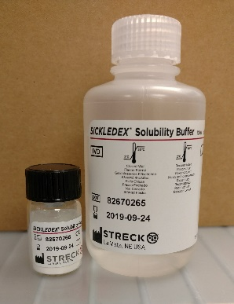
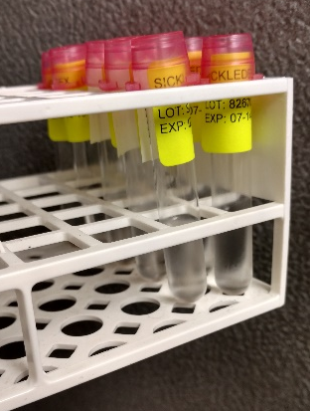
User Prepared
Working Reagents
WORKING Solubility Buffer Reagent:
  Preparation and Labeling:
    Add the contents of one (1) vial of Sickledex Reagent Powder to one (1) bottle of Sickledex Solubility Buffer
    Place a white dispenser cap on the bottle of working solubility buffer. Dissolve the reagent powder completely by vigorous agitation.
    The reconstitution/open expiration date is 45 days once made up.
    Aliquot reagent into 12x75mm glass tubes,
    label tubes properly, when finished
    refrigerate at 2-10°C.

Slide 9
Manufacturer Prepared Reagents
  Streck Negative and Positive Sickle-Chex Control Set:
    Description: The negative control is prepared from homozygous (A/A) RBCs that are negative for Hemoglobin S. The positive control is prepared from heterozygous (A/S) RBCs that is positive for Hemoglobin S
  Preparation and Labeling:
    No reagent preparation required. Control vials are prepared and labeled by the manufacturer in ready-to-use from.
    After opening, label the outside of bottle with date opened, “open” expiration date, and tech initials.
    Controls must be warmed at least 15 minutes undisturbed prior to mixing
    Immediately prior to use re-suspend the cells as follows:
      Hold vials horizontally between palms and roll back and forth for 20-30 seconds.
      Gently invert vials 8-10 times immediately before sampling.
    DO NOT SHAKE OR USE A MECHANICAL MIXER

Slide 10
Streck Negative and Positive Sickle-Chex Control Set
  Control Storage and Stability:
    Unopened vials are stable until the manufacturer’s date of expiration when stored in the refrigerator (2-8°C)
    Opened vial stability is for 100 days or until manufacturer’s date of expiration, whichever occurs first.
    Store vials in refrigerator when not in use
  Storage Location:
    Hematology Reagent Refrigerator

Slide 11
Quality Control
  Frequency:
    First Run per shift: Each shift setting up patient testing is to run a positive and negative control with the first run.
    New Reagent Kit: Run controls immediately after opening a new reagent kit.
  Control Verification: If one or both controls do not give acceptable results:
    DO NOT report patient results until the problem can be resolved
    Review control product package insert and the reagent test kit instructions
    Investigate all components of the test system and identify the source of the problem (i.e., expiration date, reagents, controls, etc.).
    Repeat the run with freshly pipetted control and patient samples
    If unable to resolve the quality control discrepancy, contact the supervisor or designated person in charge.
    DO NOT REPORT PATIENT RESULTS

Slide 12
Limitations
DO NOT perform testing on infants less than 6 months of age. False negative may occur due to the presence of Hemoglobin F.
If the patient’s hemoglobin value is less than 5 g/dl then the test sample volume used for the test is increased.
If the patient’s hemoglobin value is greater than 18 g/dl then the sample volume used for the test is decreased.
Other test interferences include:
WBC > 100,000
MCHC > 36
Platelets > 650,000
Presence of Cold Agglutination
Positive sickle cell results are confirmed with the use of a test called hemoglobin electrophoresis.

Slide 13
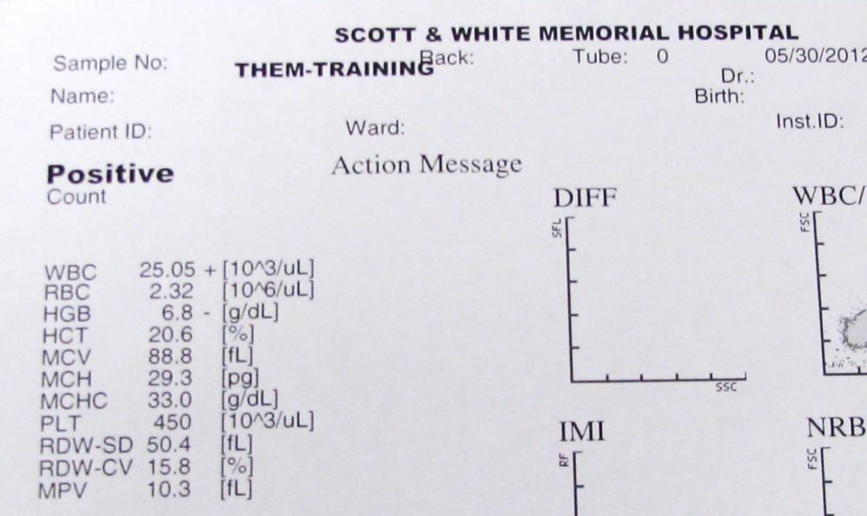
Check for limitations
Prior to testing patient samples, run an automated CBC to check for testing limitations.
CBC values may be used for samples with concurrent CBC order.

Slide 14
Sickle Cell Screen Limitations and Corrective Actions
Descriptions | Corrective Action
Patient age less than 6 months | Cancel due to age; retest after 6-months old
HGB < 5 g/dL | Increase sample test volume to 40 µL
HGB > 18.0 g/dL | Decrease sample test volume to 10µL
MCHC is > 36 g/dL Hyperlipidemia; hyberglobulinemia; hyperparaproteinemia; coarse flocculation WBC is > 100,000 / µL PLT is > 650,000 / µL Large quantities of non-RBC cellular material | Prepare an RBC suspension using the plasma and buffy coat procedure described below Use sample volume based on HGB of the RBC suspension
Cold Agglutination | Prewarm blood and about 4 mL of Cell-Pack at 37ºC for 10-minutes Prepare an RBC suspension using the plasma and buffy coat procedure described below except use the pre-warmed sample and Cell-Pack Use sample volume based on HGB of the RBC suspension
Plasma and Buffy Coat Removal Procedure
Transfer a portion of the sample to a labeled 12x75 tube Fill the tube ¾ full with Sysmex Cell-Pack or 0.9% saline CAP tube and gently invert 6-8 times Centrifuge for 5 minutes at 3600 RPM with RCF of 2500-g Discard buffy coat and supernatant Repeat steps “b” through “e” once more Obtain a 30-40% RBC suspension with Cell-pack or saline (i.e., add diluent of equal volume of RBCs plus ½ more of diluent) Run the dilution on the Sysmex to obtain a HGB, WBC and PLT Repeat washing steps until WBC/PLT is well below criteria Test sample using the correct sample volume (i.e., 10, 20, or 40 µL) based on the HGB of the RBC suspension

Slide 15
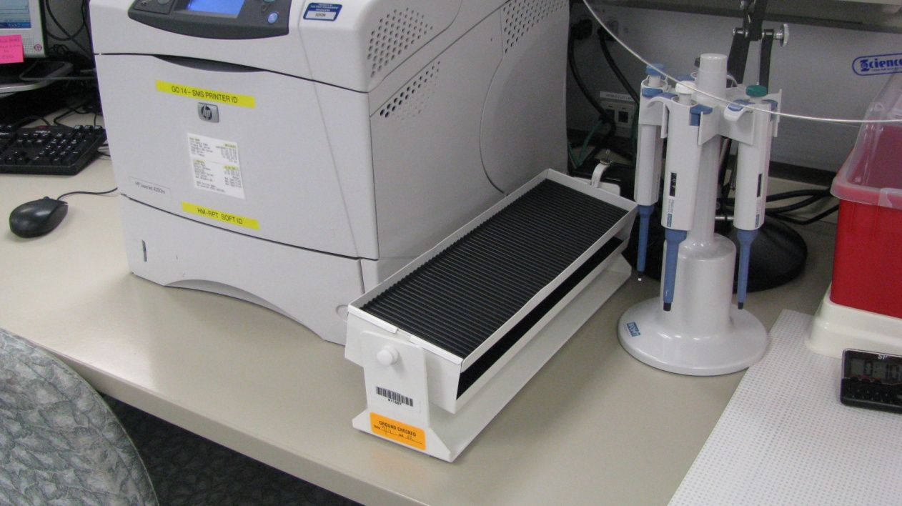
procedure
Patient sample is placed on rocker beside Operator workstation

Slide 16
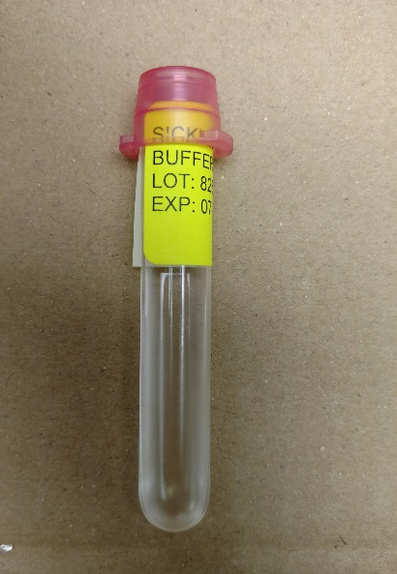
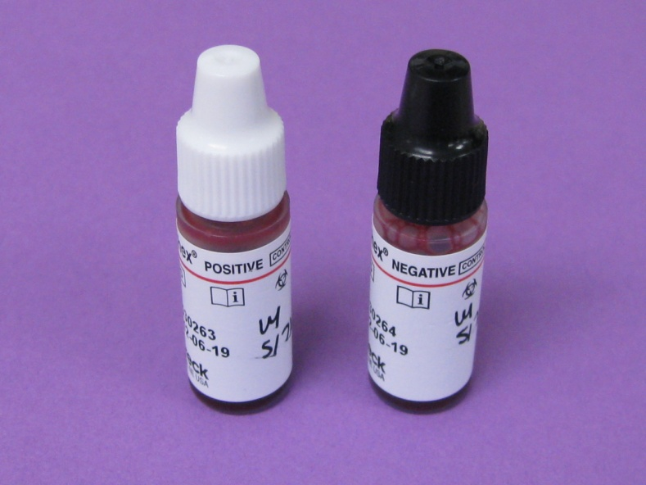
procedure
  Retrieve controls and Reagent:
    Retrieve control materials and Working Solubility Reagent Aliquot from refrigerator (one for each control and patient(s)).
    If volume of “working solubility solution” is insufficient, prepare the solution as described in the reagent section and aliquot solution into glass tubes (be sure to label tubes).

Slide 17
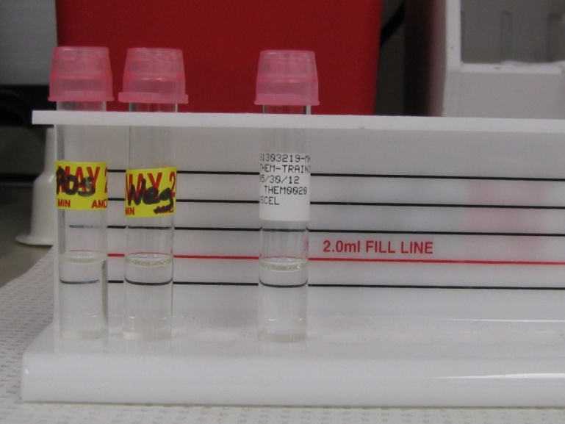
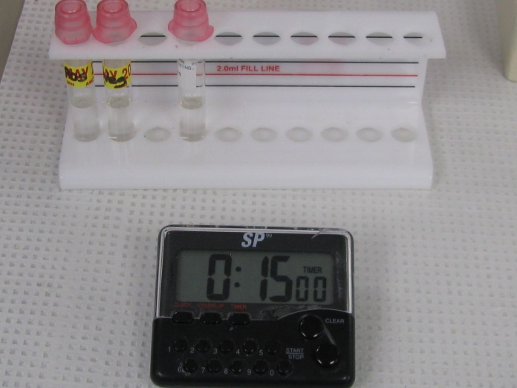
procedure
  Prepare Reaction Tubes:
    Label one 12x75 mm glass test tube for each patient and control.
    Place all tubes in Sickle Cell Testing Rack
    Allow solution in tubes to warm to room temperature for 15 minutes.
      IMPORTANT: The use of reagents below room temperature can give false results.

Slide 18
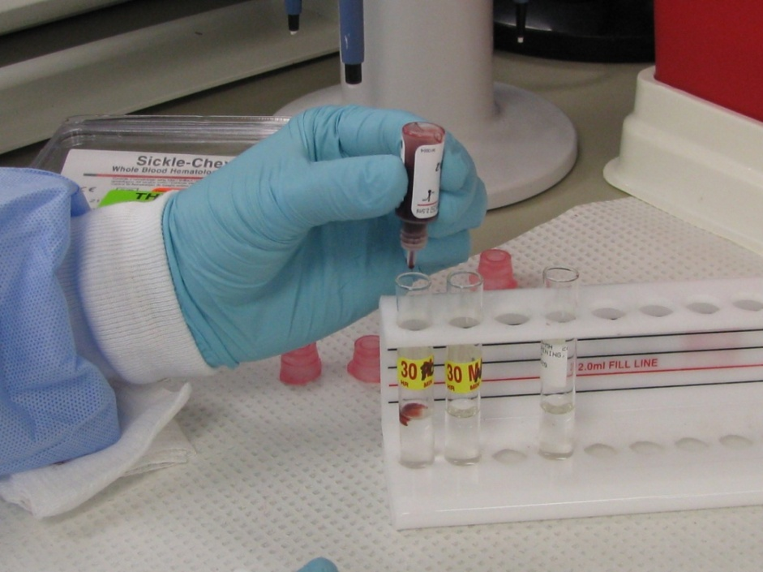
Add blood - controls
Mix control samples well by rolling between palms several times and then inverting several times
Remove cap and wipe dropper tip with gauze.
Holding dropper vertically, dispense one drop of control sample into each respective glass tube

Slide 19
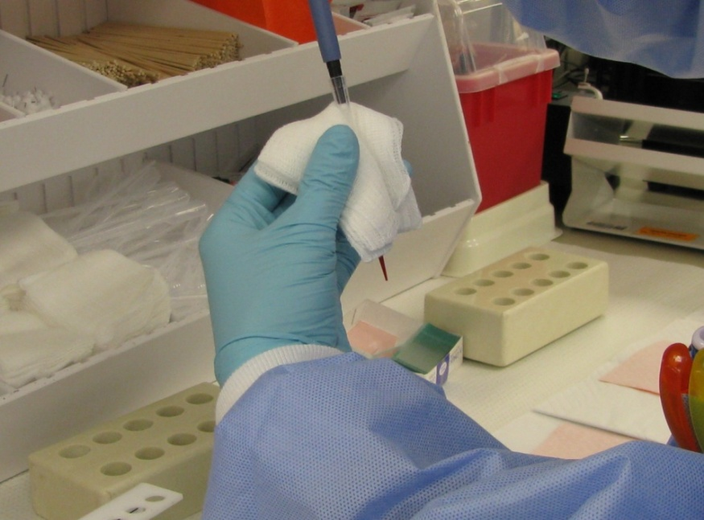
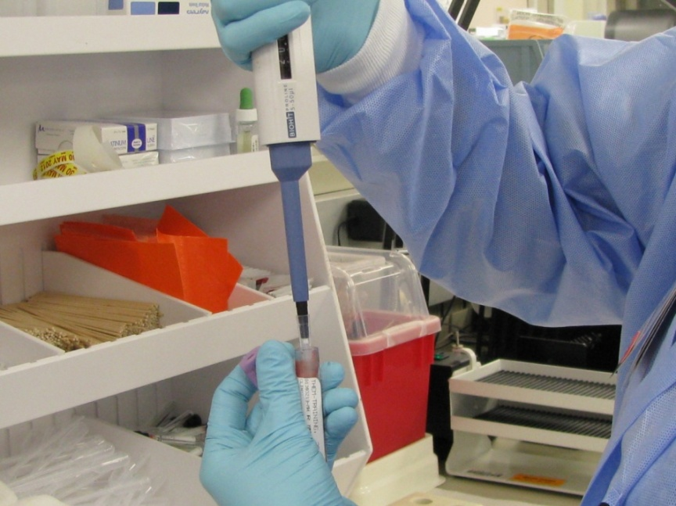
Add blood - patient
Choose pipette volume according to testing limitations table.
Draw up desired volume into pipette tip.
With a downward motion, wipe pipette tip with gauze to remove residual blood.
Dispense blood into respectively labeled glass tube.

Slide 20
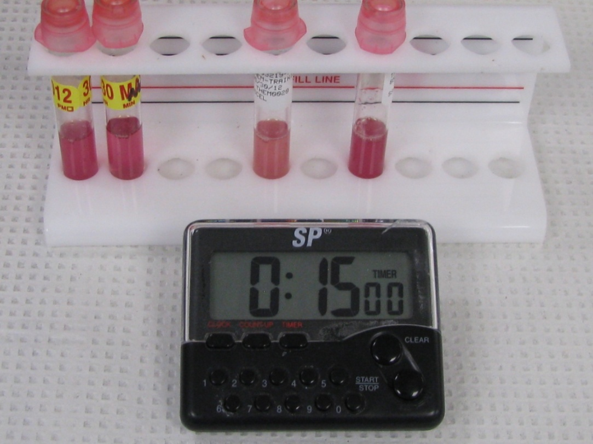
Mix tubes and incubate
Cap all tubes and gently invert 4-6 times to mix reagents and sample
Set timer and allow samples to incubate at room temperature for 15 minutes.

Slide 21
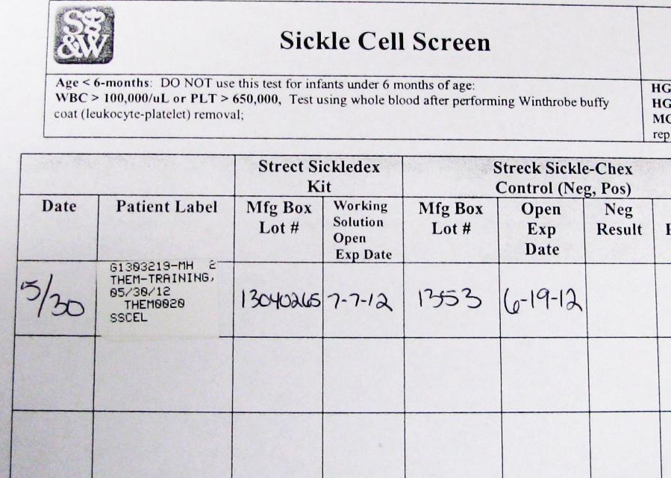
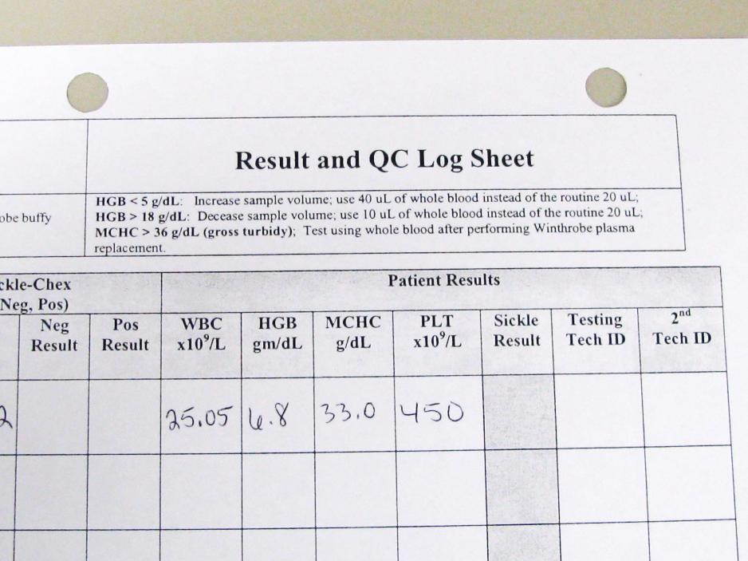
procedure
Input Quality Control and patient information into Sickle Cell Screen log sheet.
QC lot numbers and expirations must be documented.
For Working Solubility Solution, input “prepared” expiration, not manufacturer expiration.

Slide 22
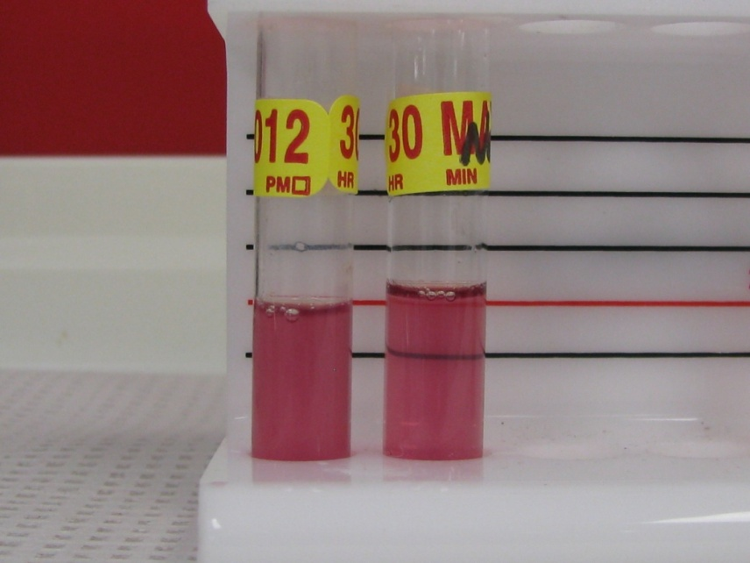
READ REACTIONS
After 15 minutes, examine each tube for turbidity by looking through the reaction tubes and viewing the black lines on the Sickle Cell Tube Reading Rack
A POSTIVE test is indicated by a cloudy, turbid suspension through which the black lines are NOT VISIBLE
A NEGATIVE test is indicated by a transparent suspension through which the black lines are CLEARLY VISIBLE.
POSITIVE
NEGATIVE

Slide 23
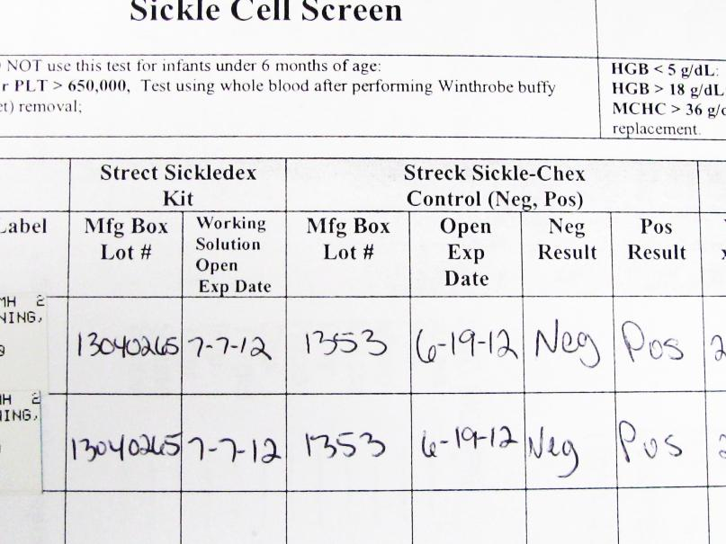
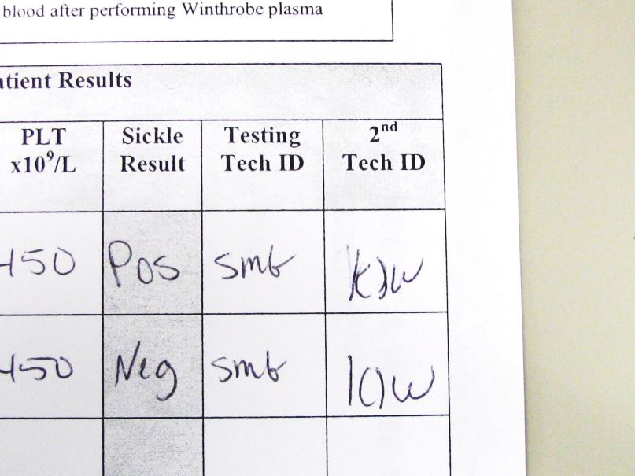
Document patient results
Record control and patient test results on the Sickle Cell Screening log sheet.

Slide 24
Reporting results
Generate a tasklist in LIS and input patient order numbers.
Open tasklist in Enter/Modify Results.
Input patient results and add appropriate result comments as needed.

Slide 25
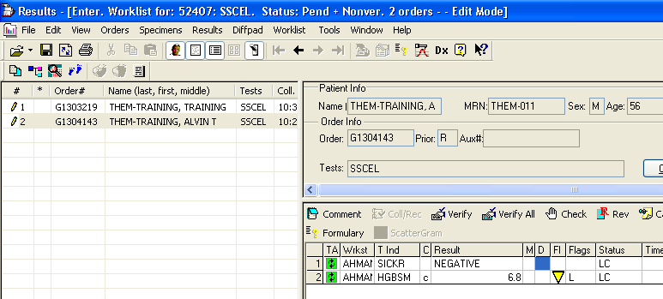
Negative result reporting

Slide 26
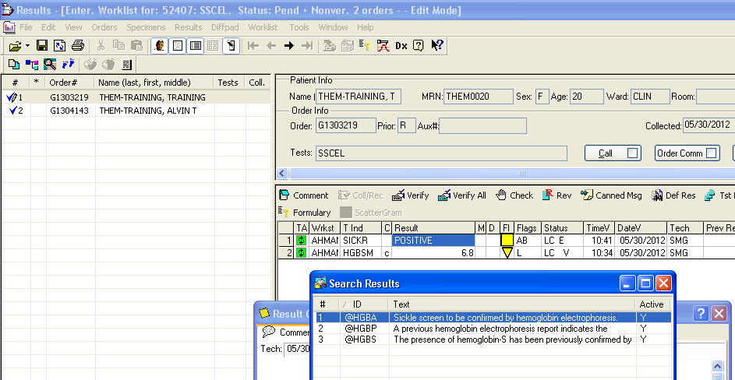
Positive result reporting
You MUST put in a comment when there is a POSITIVE result

Slide 27
Positive result Comment codes
@HGBS Comment= The presence of hemoglobn-S has been previously confirmed by hemoglobin electrophoresis.
@HGBP Comment= A previous hemoglobin electrophoresis report indicates the presence of an abnormal, non-hemoglobin-S, hemoglobin.
@HGBA Comment= Sickle Screen to be confirmed by hemoglobin electrophoresis.

Slide 28
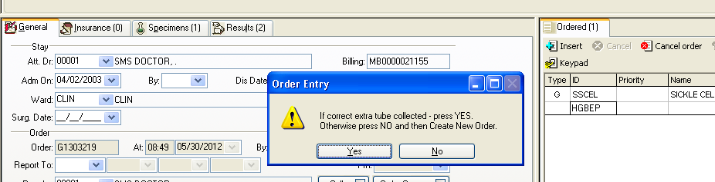
Positive resultS
VERY IMPORTANT FOR POSITIVE RESULTS If patient has no history of HGBEP
  Order HGBEP in Order Entry, Collect and Receive sample Sample then gets a new label for the HGBEP, Place sample in SP Chem white Refrigerator in designated rack.

Slide 29
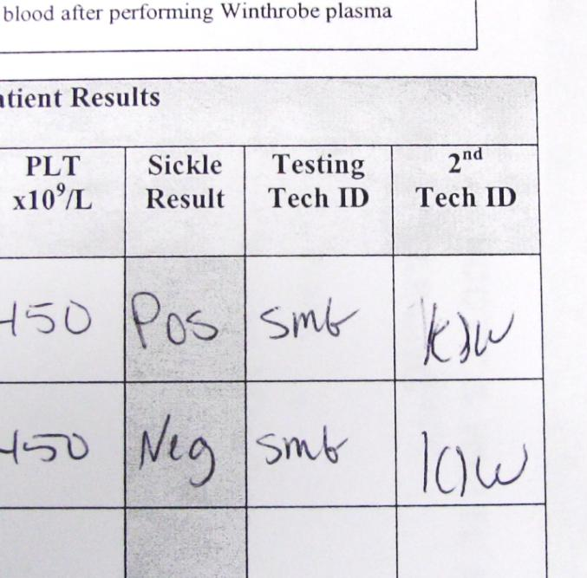
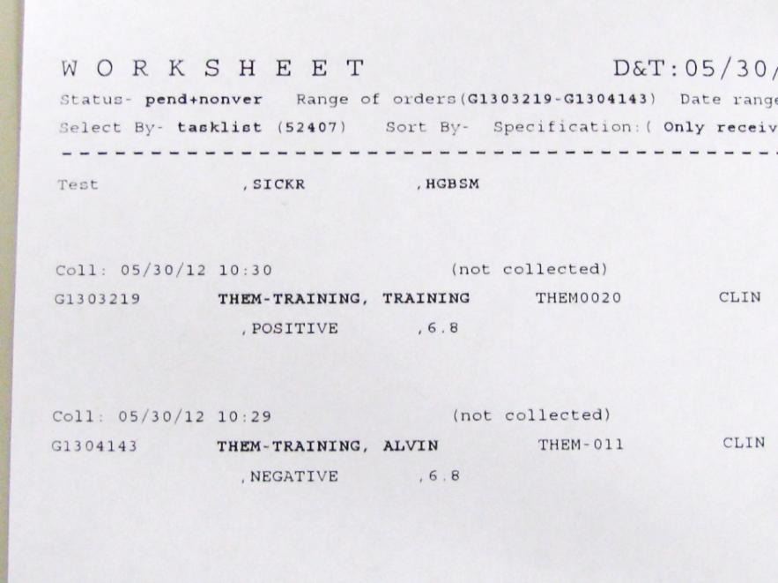
Reporting results
Print the tasklist and have a second tech check and verify results.
Both techs should initial and date tasklist printout and also initial Sickle Screen log sheet.
Printout is placed in designated “reports” shelf

Slide 30
Reporting results
SICKLE SCREEN SAMPLE ROUTING by ORDER CODE
TEST CODE | SICKLE RESULT | PREVIOUS HGB-ELP OR SICKLE SCREEN | INSTRUCTIONS AND STORAGE
*SSCEL* “HEME” PATIENT SAMPLE | NEG | NONE | Comment Code: None Storage: Speck-Track Refrigerator
 | POS | POS Previous | Comment Code: @ HGBS Storage: Spec-Track Refrigerator
 | POS | No Previous, NEG Previous, or NEG Sickle Screen | Comment Code on Sickle Screen: @HGBA Order HGBEP in LIS using sample Softlab accession Click DX to add same diagnosis code Collect and Receive sample to lab Re-Label with HGBEP tube label Track to Special Chemistry Store in “WHITE” ELP-Refrigerator, bottom shelf, ELP rack
 | POS | POS Non-HGB-S | Comment Code: @HGBP Storage: Spec-Track Refrigerator
*SCEL3* Donor Unit (QC) Sample | NEG | NONE | Comment Code: NONE Storage: Spec-Track Refrigerator
 | POS | NA | Comment Code: NONE Storage: Spec-Track Refrigerator

Slide 31
~The end~
☺

