Slide 1

Patient Differential Slides,
Spun hematocrits
&
Leukocyte alkaline phosphatase (LAP)
By: Tina Gorup

Slide 2
Patient Differential Slides

Slide 3
Patient Differential Slides
Differential Slides or Blood Smears are made from blood drawn in lavender (EDTA) tubes.
Differential slides are manually made when:
  Patient samples are drawn in collection tubes with low volume (QNS for stainer)
  When automated slides are not of an acceptable quality
  NOTE: If you have a tall tube, ACD or ALB that needs a slide, you can pour the blood into a aliquot to run on stainer.

Slide 4
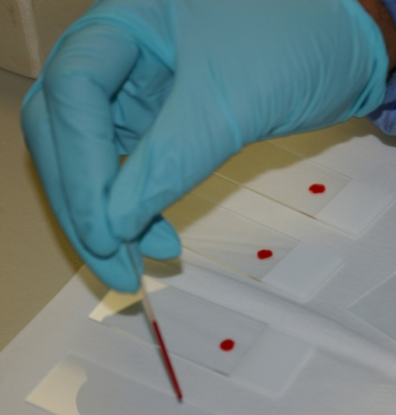
If You need to Make a slide
Obtain two clean glass slides.
  Slides with a white frosted end are for routine patient samples
  Slides with a colored frosted end are for STAT patient samples.
On one slide the blood sample is placed, this is the "sample" slide. The second slide is used to smear the drop of blood, this is the "spreader" slide
Handle slides by edges only (any grease on the slide will cause the dried blood to flake off during staining).
Place a small drop of well mixed patient blood on sample slide by using a diff quick, capillary tube or applicator sticks.

Slide 5
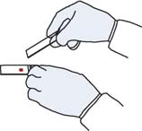
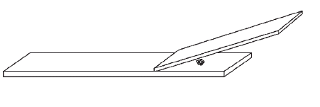
Making a slide
Place the end of the spreader slide on the sample slide so that the short sided edge of the spreader is just below the drop of blood.
Spreader Slide
Sample Slide

Slide 6
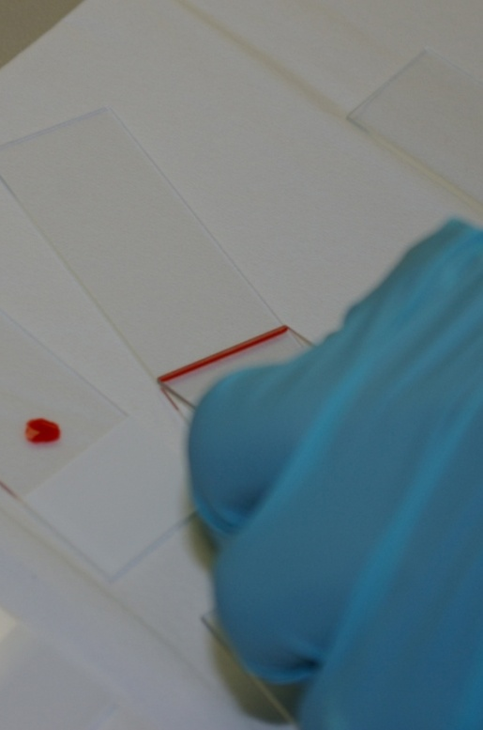
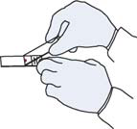
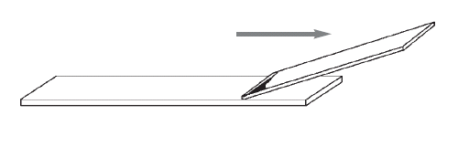
Making a slide
The next two steps should be done quickly to avoid smears that are too thick. Holding the spreader at an angle of 30º (relative to the sample slide), push the spreader so that the edge just barely touches the drop of blood. By capillary action, a thin line of blood will spread along the edge of the spreader .

Slide 7
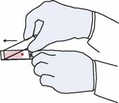
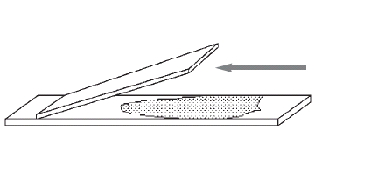

Making a slide
Quickly drag the spreader along the entire length of the sample slide in one fluid motion. Note that the blood is being dragged by the spreader.
The smear should end before the end of the sample slide, it should also end in a "feathered edge" - a region where the blood cells are well separated.

Slide 8
Finishing touches
Place a patient aliquot label over the frosted end of the slide and write your initials in any space available on the label.
Allow the slide to dry before placing in a stainer to be stained.

Slide 9
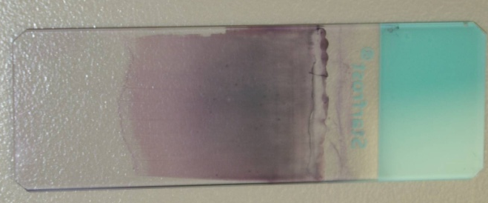
Stained slide
Name
Order #
MRN
Date
Initials
Note the feathered edge and how the smear is free of streaks or holes.

Slide 10
Albumin slides
Some patient conditions create cells known as “smudge” cells (fractured or torn apart white blood cells). These are often associated with certain types of leukemia.
There are also some patients that have protein abnormalities present in their blood making it difficult to create good quality differential slides.
Both of these conditions require the making of Albumin Slides.

Slide 11
Making albumin Slides with stainer
Place one drop of 22% Bovine Albumin Solution in a small glass tube.
Using a plastic pipette, add 4 to 6 drops of well mixed patient blood to albumin in the tube.
Gently mix blood and albumin together by lightly shaking the tube.
Place a patient label onto the glass tube.
Set stainer to run Smear+Stain, program the stainer with the order number with ALB added to the end.
When the slide comes off the stainer, label with an aliquot tube marked with ALB on it.

Slide 12
Making albumin Slides Manually
Place one drop of 22% Bovine Albumin Solution in a small glass tube.
Using a plastic pipette, add 4 to 6 drops of well mixed patient blood to albumin in the tube.
Gently mix blood and albumin together by lightly shaking the tube.
Make a blood smear from the blood and albumin mixture using the same steps for making differential blood smears.
Label both albumin slides with a patient aliquot label, and write your initials and the abbreviation, ALB in any open space on the label.
Allow the slides to dry and then place next to stainer to be stained.
Set stainer to Stain Only, properly place slide to stain.

Slide 13
Spun
Hematocrits

Slide 14
Spun Hematocrits
Spun Hematocrits are considered a manual procedure and can be performed on blood or body fluid specimens.
The purpose of the spun hematocrit is to determine the quantity of red blood cells as a percentage of the blood or body fluid. It may be expressed as a percentage (42%) or as a decimal fraction (0.42 L/L).

Slide 15
Procedure
Using a microhematocrit tube (also called a capillary tube) fill tube approximately 3/4th full of well mixed blood or body fluid.
Seal one end of the tube with modeling clay.
Place filled tube into the radial grooves of the mico-capillary hematocrit centrifuge with the sealed end against the rubber gasket to prevent breakage.
Repeat process filling a 2nd capillary tube from the patient’s blood or body fluid sample.

Slide 16
Procedure
Select a previously run patient specimen as a patient control.
Fill 2 capillary tubes with patient control blood.
Balance the centrifuge by placing the capillary tubes opposite one another in the radial grooves of the centrifuge.
Record which slot you placed both patient control and patient in the binder labeled Result and QC Manual Heme Back-up.

Slide 17
Procedure
Place inside lid over specimens and screw down.
Close the outside centrifuge lid down and set centrifuge timer for 3 minutes.
After the samples have been centrifuged place each capillary tube in the micro-capillary hematocrit reader and record hematocrit values.

Slide 18
Procedure
Duplicate patient control samples should agree ±2 units from the automated blood analyzer.
Record both patient control and patient values in the binder labeled Result and QC Manual Heme Back-up.

Slide 19
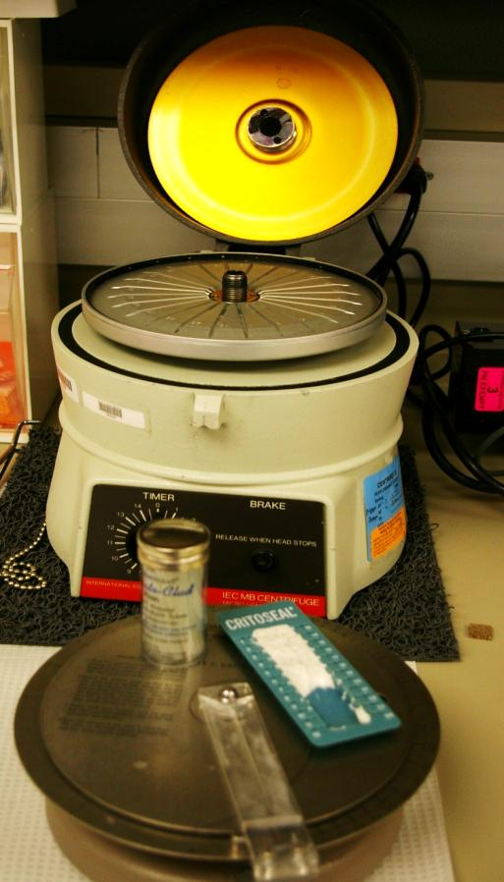
Spun Hematocrits
Microhematocrit Centrifuge, Micro Hematocrit Capillary Reader, Capillary Tubes & Sealing Clay

Slide 20
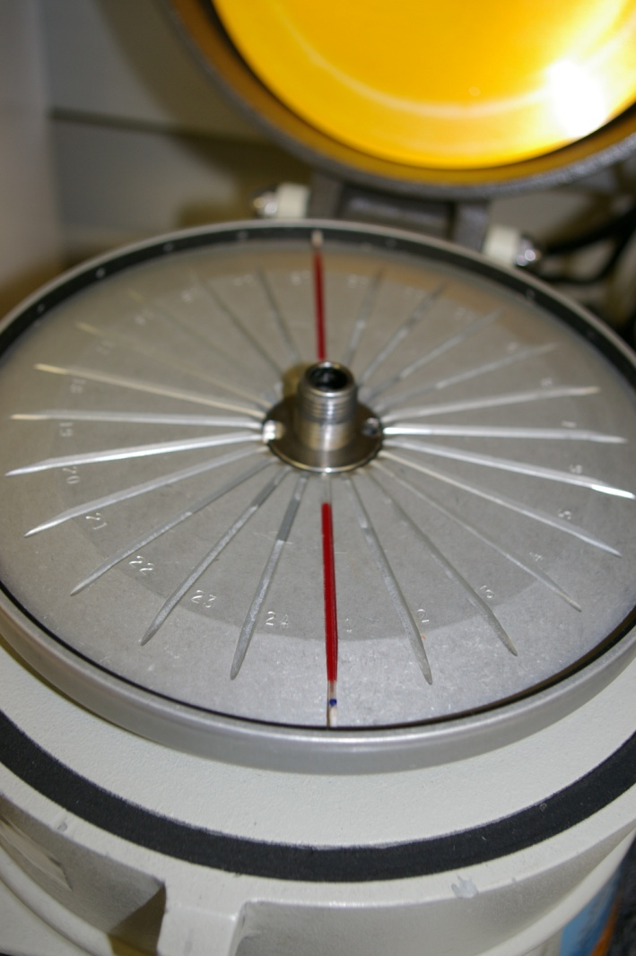
Spun Hematocrits
Balanced Capillary Tubes in Radial Grooves of Centrifuge

Slide 21
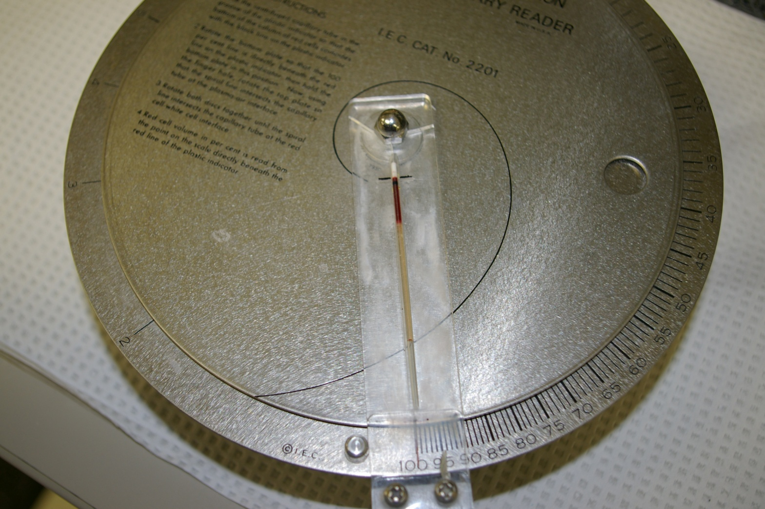
Spun Hematocrits
Correct Placement of Capillary Tube in Micro-Hematocrit Capillary Reader

Slide 22
Spun Hematocrits
Notes on Body Fluid Samples:
  Body fluids usually do not contain a significant number of red blood cells. A measurable hematocrit indicates the presence of bleeding or pooling of blood in the body cavity or location which normally doesn’t contain blood. In general, the higher the body fluid hematocrit the more extensive the bleeding is for the patient.

Slide 23
Leukocyte Alkaline
Phosphatase
(LAP)

Slide 24
methodology
The LAP test is a stain procedure that is performed to assess the amount of alkaline phosphatase enzyme found in the granules of white blood cells known as bands and segmented neutrophils.
LAP is most often used to distinguish between a leukemoid reaction (infections, toxic conditions, and other miscellaneous states) and chronic granulocytic (myelogenous) leukemia
LAP activity can be normal, increased or decreased in a variety of conditions.

Slide 25
Specimen requirements
Collect Specimen in a Green Sodium Heparin Tube
Blood Collected in a Green Lithium Heparin Tube Is Not Acceptable Because it is Toxic to the Living Cells & Can Cease Cellular Functions That May Have Unexpected Effects on LAP Enzyme Activity
Blood Collected in Lavender Tubes with EDTA May Inhibit LAP Enzyme Activity & Can Produce Falsely Lower LAP Scores. It May Only Be Used in Non-Recoverable Circumstances with the Permission of a Pathologist

Slide 26
Specimen stability
Blood Smears Must Be Made Within 24 Hours After Blood is Collected
After the Tube is Drawn, Protect the Specimen From Light.
  Aluminum Foil can be used to protect the specimen from light
Light Inactivates Alkaline Phosphatase Activity & May Cause a Falsely Decreased LAP Score

Slide 27
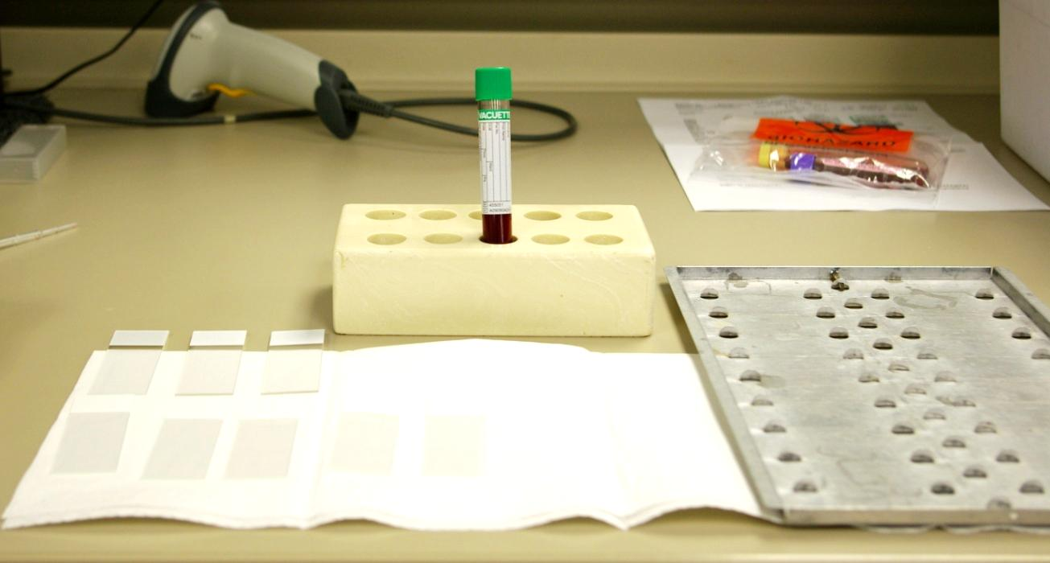
supplies
Green Sodium Heparin Tube, Blood Slides & Tray for Holding Blood Smears

Slide 28
procedure
Mix Blood in Sodium Heparin Tube Well
Make 7-8 thin, long blood smears that stretch across ¾ of the slide length.
Label slides with patient information in pencil on the frosted end of each slide.
If possible, make 4 thin, long blood smears from a known female patient on the postpartum floor of the hospital. Label slides as LAP control.
Place both patient slides and control slides on a slide tray; allow slides to dry
Place in designated drawer in the bone marrow room. Leave note on board so first shift will know that a LAP needs to be performed. There is NO negative control.

Slide 29
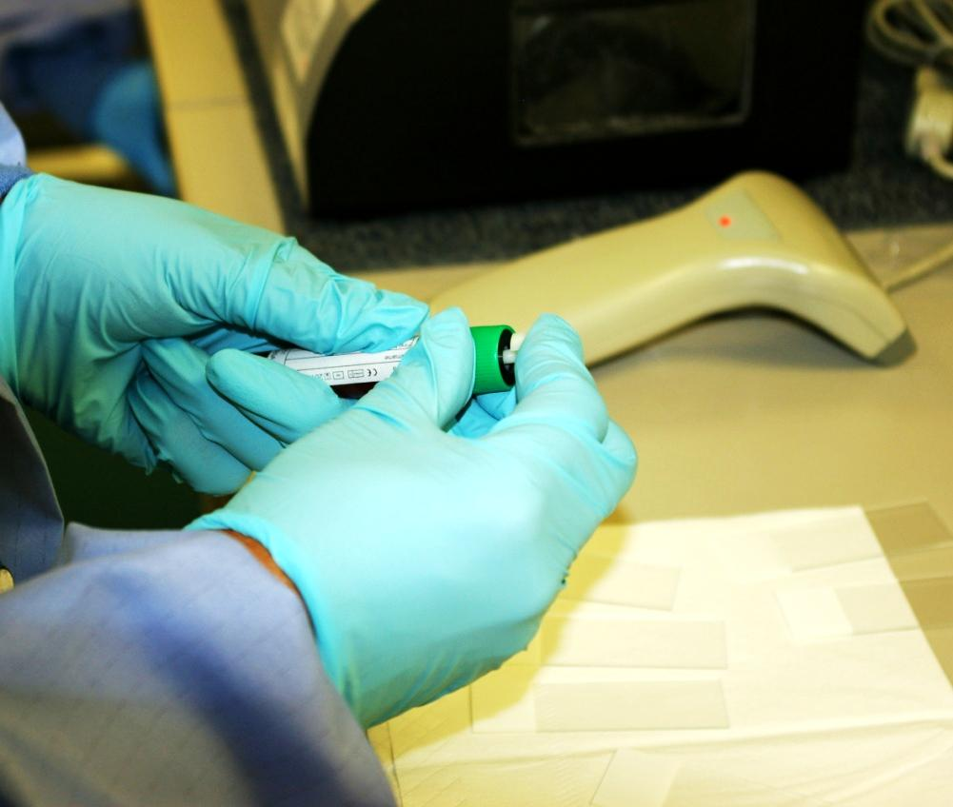
Leukocyte Alakaline Phosphatase
(LAP)
Mix Green Sodium Heparin Tube Well

Slide 30
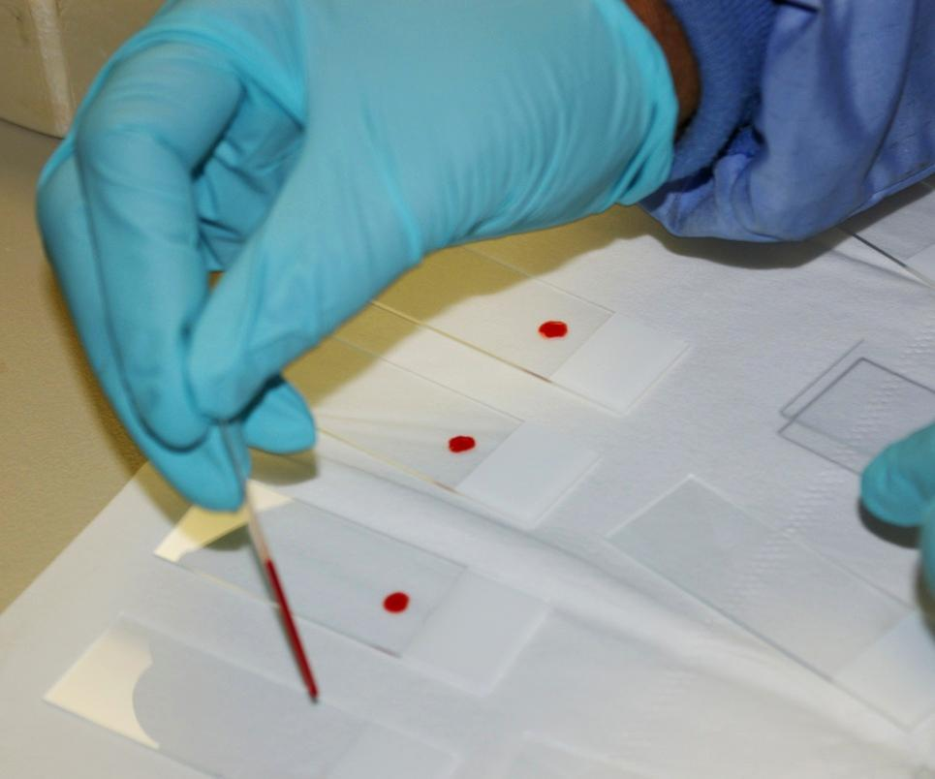
Leukocyte Alakaline Phosphatase
(LAP)
Place Drop of Blood on 7-8 slides

Slide 31
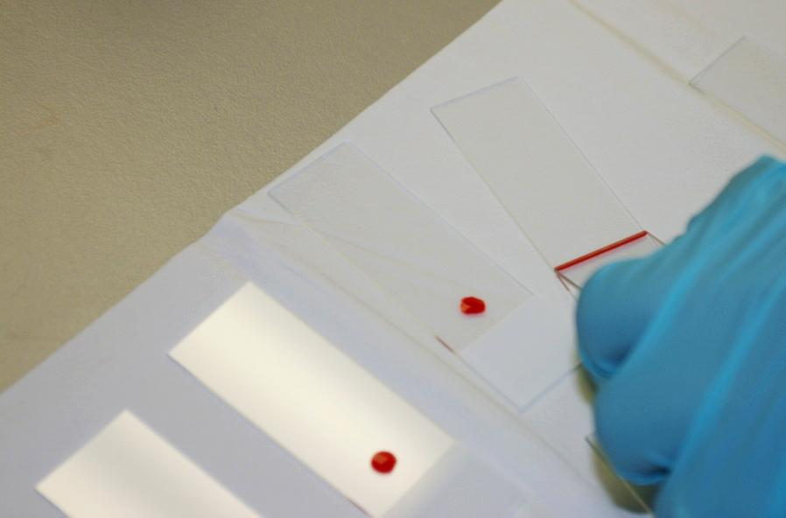
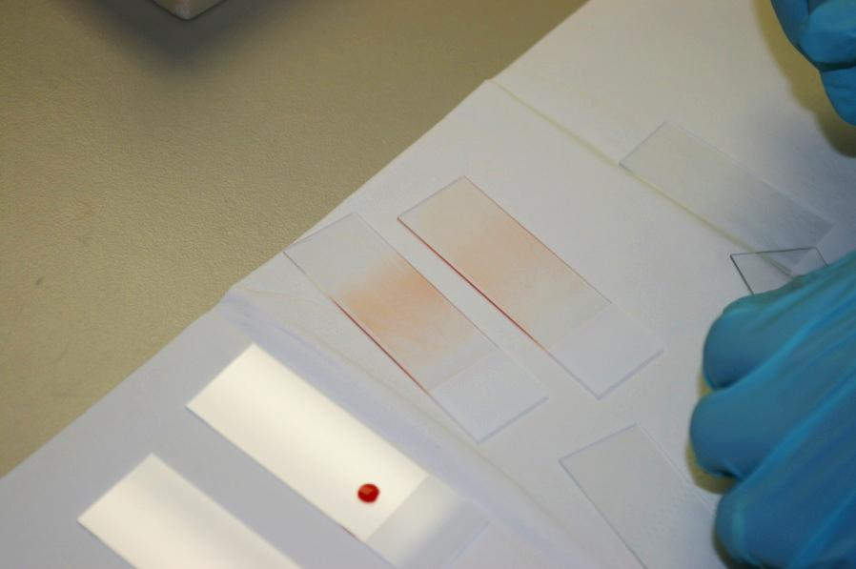
Leukocyte Alakaline Phosphatase
(LAP)
Use Pusher Slide to Make 7-8 Blood Smears for Patient & 4 Blood Smears for a Control
Make Both Patient & Control Slides Thin and Long

Slide 32
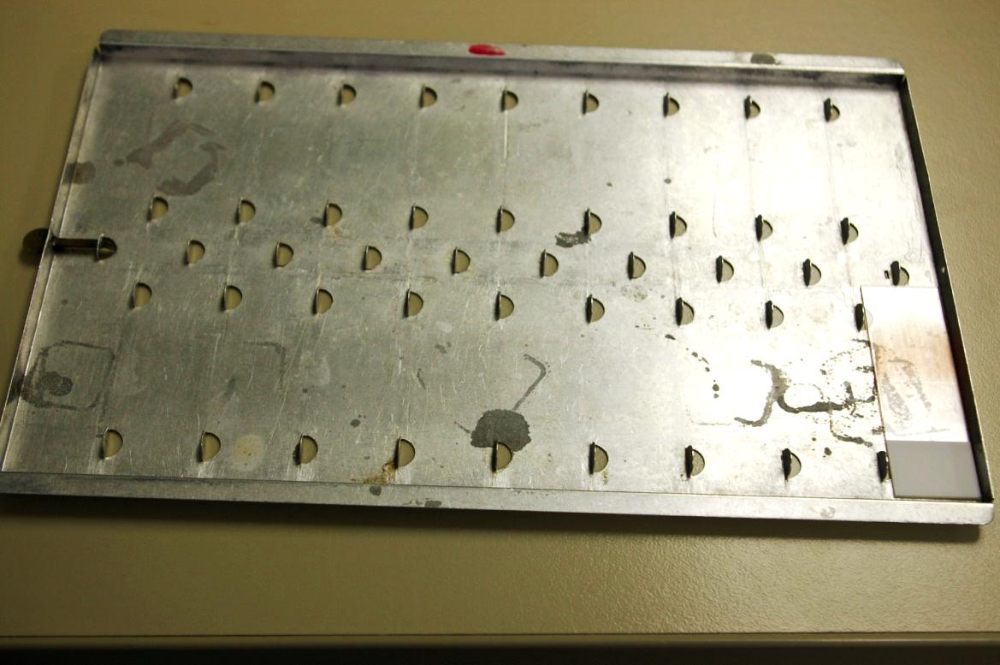
Leukocyte Alakaline Phosphatase
(LAP)
Place Both Patient & Control Blood Slide in Tray, protect from the light, place in designated area of Bone Marrow Room

Slide 33
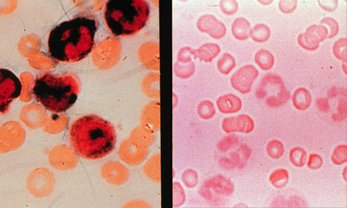
Leukocyte Alakaline Phosphatase
(LAP)
The LAP procedure is completed by counting 100 stained band or segmented neutrophils on a slide and scored on a 1-4 rating scale. The LAP score is the sum of the cell rating and represents a relative percentage of cytoplasmic volume describing the amount of LAP activity.

Slide 34
~The End~
☺

