Slide 1
H. Pylori Breath Test
Collection instructions

Slide 2
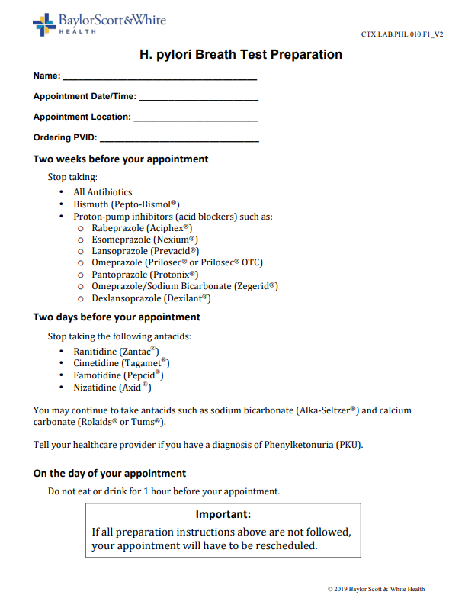
H. pylori Breath Test Preparation
Form is provided to the patient prior to making the appointment for collection

Slide 3
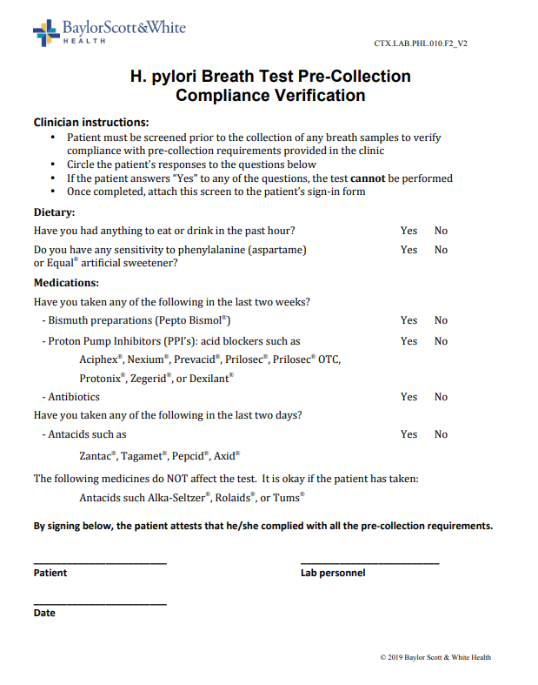
Step 1: Pre-Collection Verification
Review the questions with the patient at check-in collection instructions
If the patients answers “Yes” to the sensitivity question or any of the medication questions, then the H. pylori Breath Test cannot be collected.

Slide 4
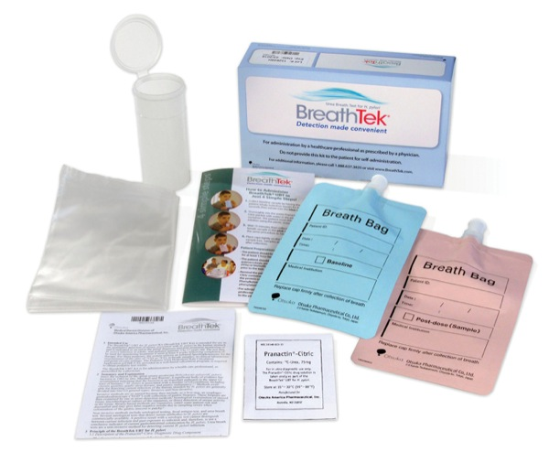
Step 2: Confirmation of Supplies
Open kit and confirm all supplies are present
Package insert
Collection instructions
Pediatric collection card
Pranactin® Citric packet
Bar-codes
Breath collection bags
Plastic container
Straw
Transport bag

Slide 5
Pediatric Patients 3 – 17 Years of Age
The pediatric patient card included in the kit must be completed and sent with the specimens when the patient is between 3 – 17 years of age

Slide 6
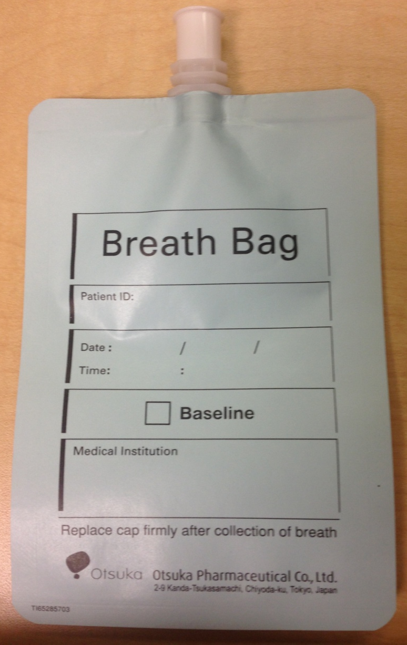
Step 3: Baseline Specimen Collection
The patient must breath normal
Have them take a deep breath in and hold for 4-5 seconds and exhale into the baseline bag
Replace cap firmly until it clicks
Document collector initials and time on the LIS label
Place LIS label on baseline collection bag

Slide 7
Step 4: Solution Preparation
Important: Prepare solution no more than 60 minutes before drinking
Fill water to line
First, add Promactin-Citric (powder)
Add water to fill line
Shake for 2 minutes

Slide 8
Step 5: Consuming the Prepared Solution
Have patient drink prepared solution.
The patient cannot swish around liquid in mouth
The patient must drink through straw without stopping

Slide 9
Step 6: Wait Time Between Specimen Collections
After patient finishes their drink start timer for 15 minutes.
Patient needs to sit quietly
No food or drink during wait time

Slide 10
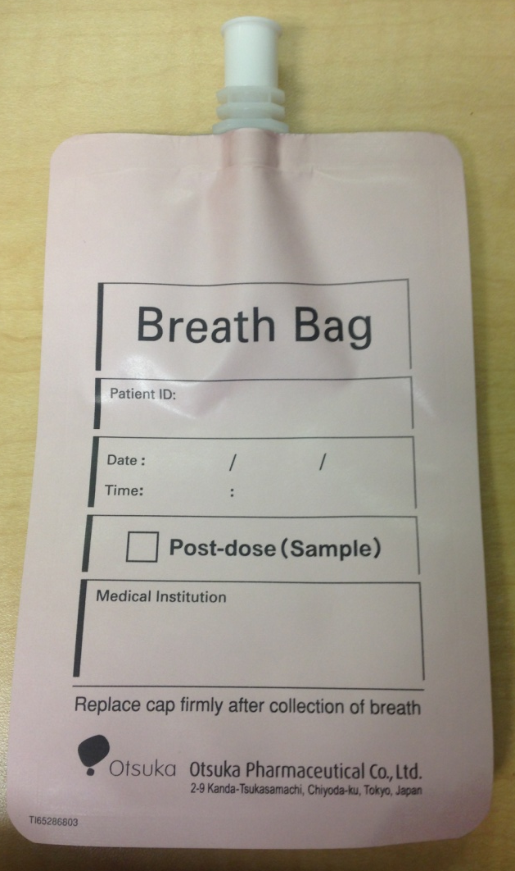
Step 7: Post-Dose Specimen Collection
Collect 2nd Breath specimen
The post-dose specimen cannot be collected before the 15 minutes are up
The patient must breath normal
Have them take a deep breath in and hold for 4-5 seconds and exhale into the baseline bag
Replace cap firmly until it clicks
Document collector initials and time on the LIS label
Place LIS label on baseline collection bag

Slide 11
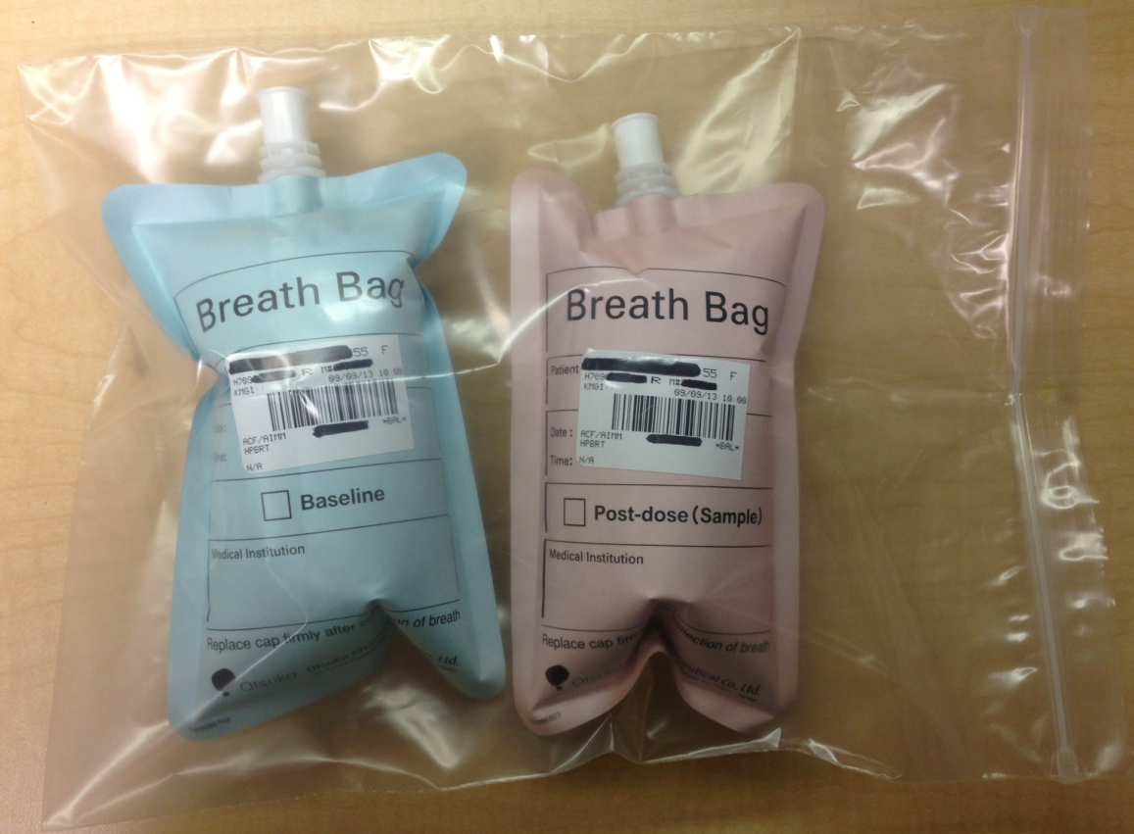
Step 8: Specimen Processing and Transport
Place labeled specimen bags together in the clear plastic ziploc bag
Follow specimen processing policy/procedure
Track and send with courier for testing

Slide 12
Collection Code
Laboratory staff:
Home clinic provider collection code
Add a HPBTB in LIS
Laboratory staff:
Courtesy provider collection
Add a HPBTB(clinic performing location) in LIS
Example: If performed at Killeen Clinic, then HPBTBG would be entered

