Slide 1
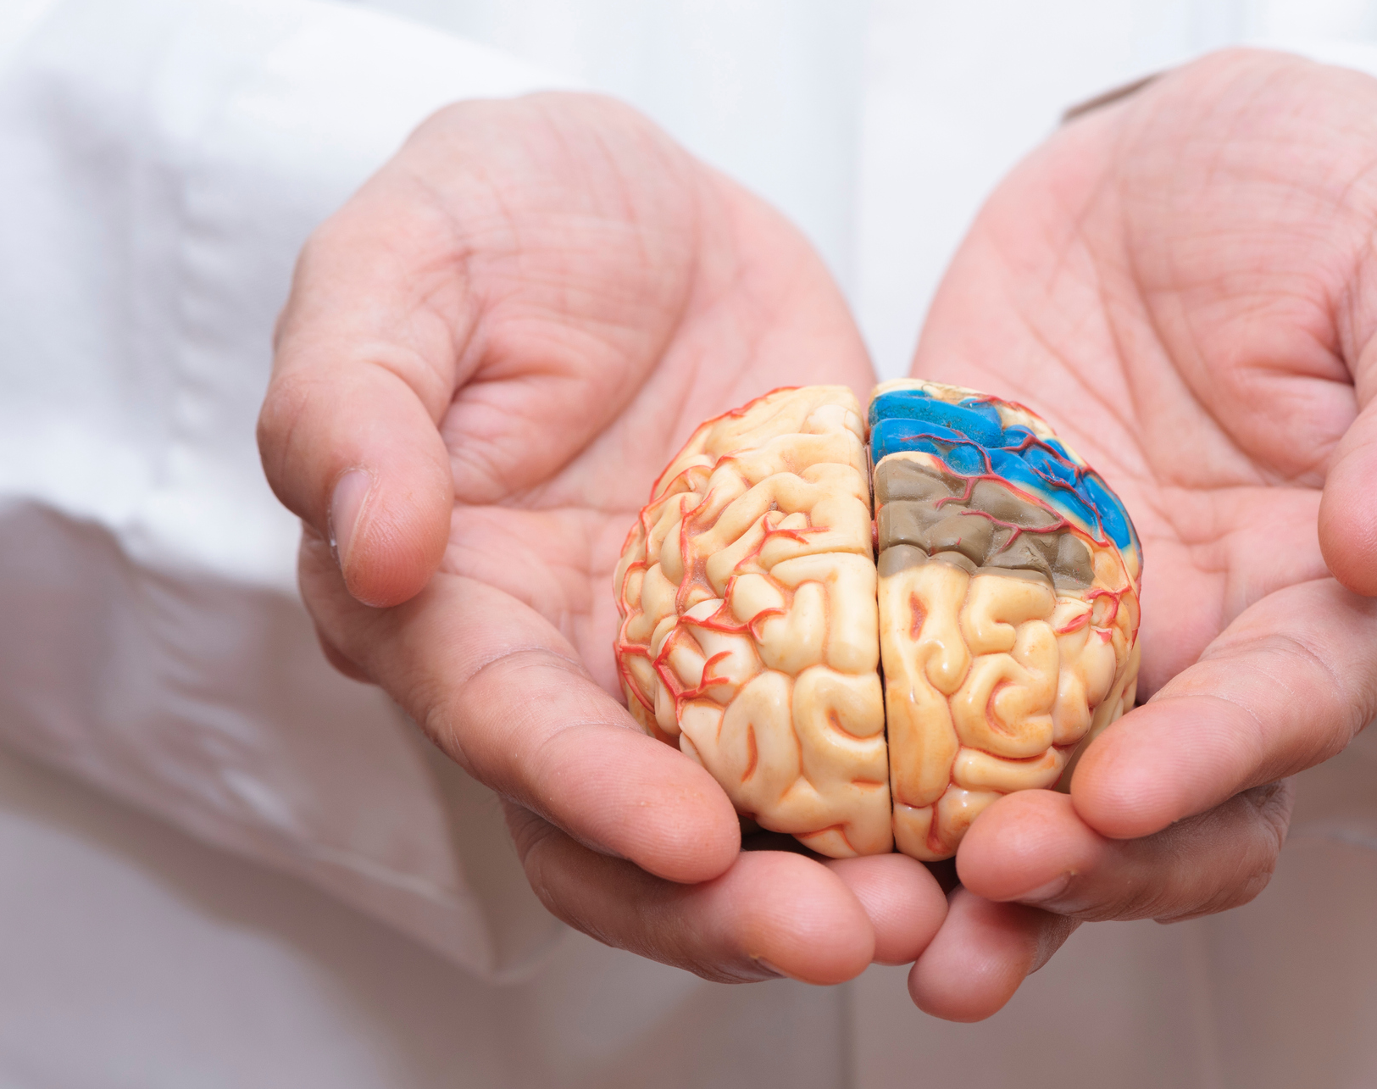
Introduction into Prion Diseases
Creutzfeldt-Jakob Disease (CJD)

Slide 2
Prion Diseases
Transmissible spongiform encephalopathies (TSEs) are a family of rare progressive neurodegenerative disorders that affect both humans and animals.
The causative agents of TSEs are believed to be prions (PrP).
What is a prion:
  A misfolded protein with the ability to transmit their misfolded (mutated) shape onto normal variants of the same protein.
Who is at risk?
  Family history of prion disease
  Eating contaminated meat
  Infection from receiving contaminated corneas or from contaminated medical equipment

Slide 3
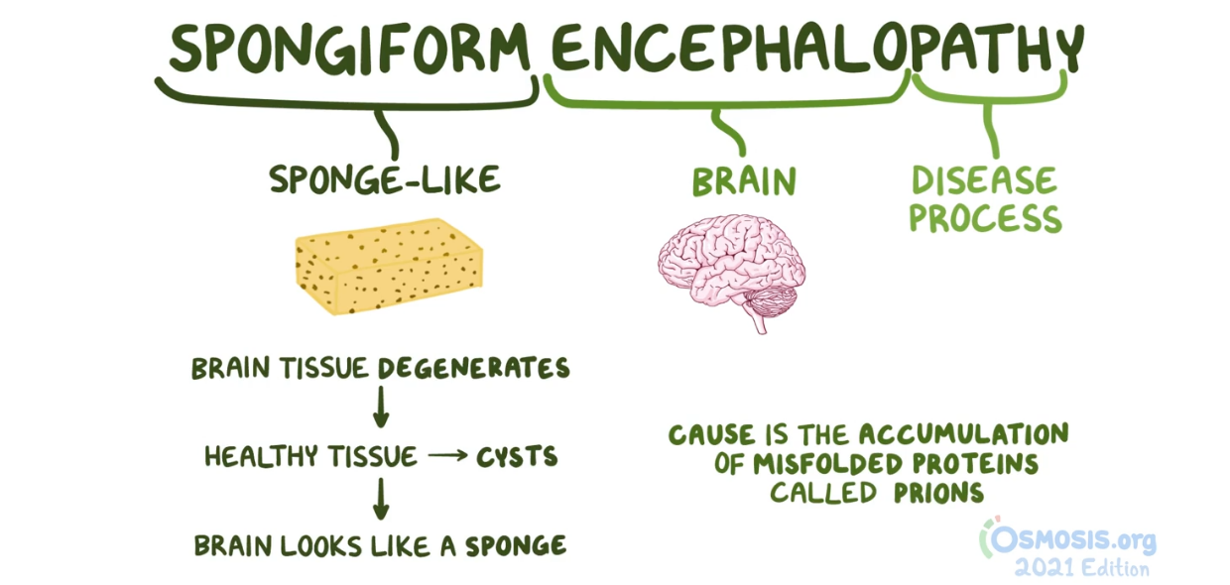

Slide 4
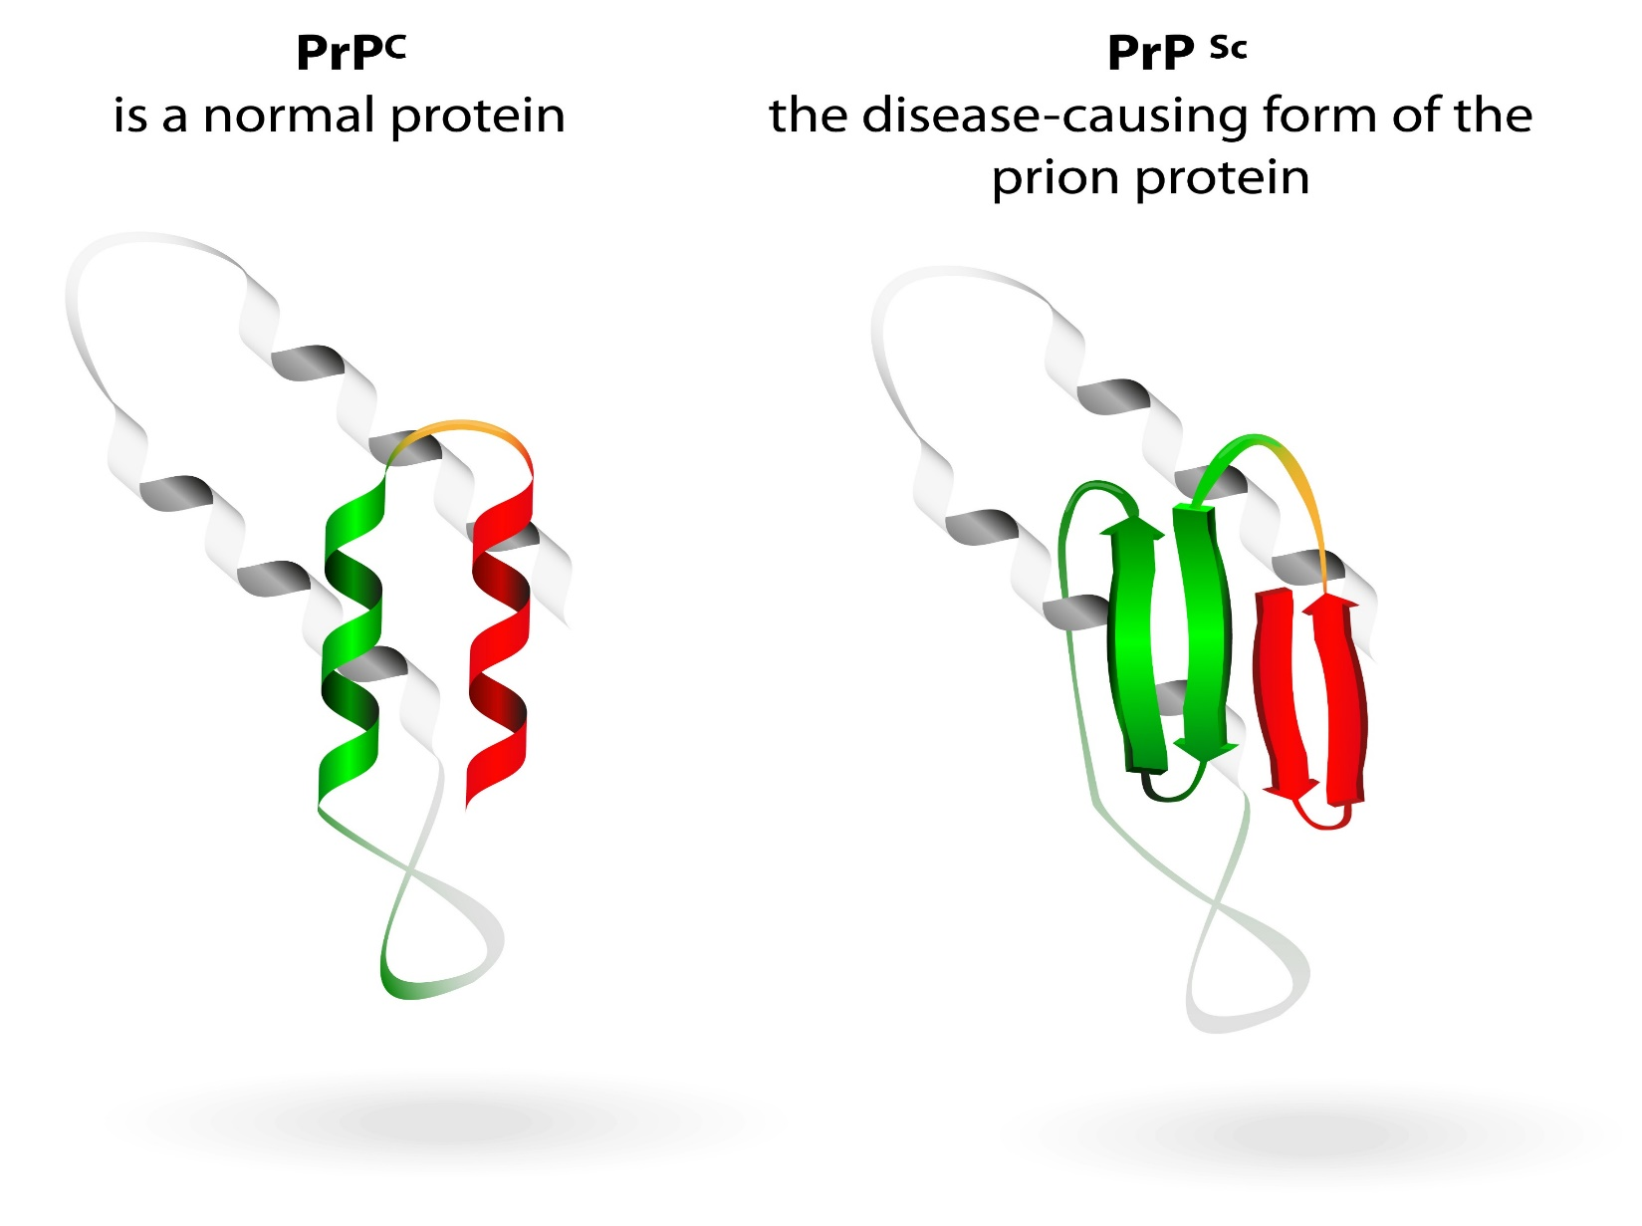

Slide 5
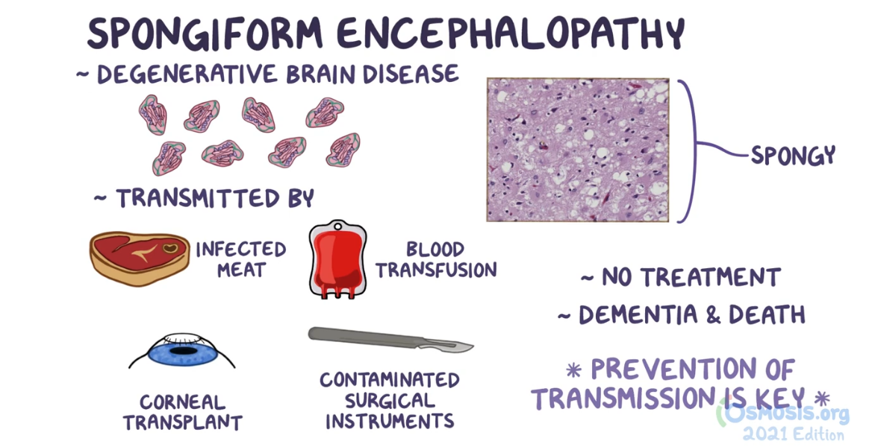

Slide 6
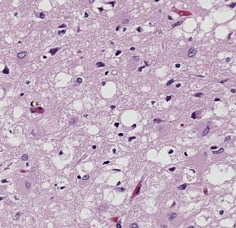
CJD
CJD is a human prion disease, with characteristic clinical and diagnostic features.
CJD is a rapidly progressive disease.
Symptoms:
  Weakness and pain in legs, which leads to stiffness and changes in gait; patients can lose their ability to walk
  clumsiness
  Muscle twitching and shaking
  Disturbances of general motor skills and sensation
  Dementia and other psychiatric and behavioral problems.
    mental changes include: mood swings, depression, anxiety, memory lapses, social withdrawal, disorientation, hallucinations, and extreme dementia

Slide 7
CDC 3 Categories of Contaminated Specimens
High Infectivity: Brain, Spinal Cord, Eye
Low Infectivity: CSF, Kidney, Liver, Lung, Lymph Nodes/Spleen, Placenta
No Detectable Infectivity: Adipose tissue, adrenal gland, gingival tissue, heart tissue, intestine, peripheral nerve prostate, skeletal muscle, testis, thyroid gland, tears, nasal mucous, saliva, sweat, serous exudate, milk, semen, urine, feces, blood, and body fluids (other than CSF) will be processed and disposed of by standard methods.

Slide 8
Orders and Notification
Primary care giver will notify lab that suspected sample is being sent.
Prion or CJD should be suspected when any of the following are ordered:
  14-3-3 Protein (1433P) on CSF
  Neuron Specific Enolase on CSF
  S100 Protein on CSF
  Tau Protein on CSF
  Thymosin on CSF
  RT-QuiC on CSF, blood, olfactory epithelium
Technologist should call manager or CLIA on call if any other tests are ordered with this test.

Slide 9
Handling CJD Sample
Further testing requires CLIA approval
Use disposable supplies
Manipulate Sample under hood
All waste placed in a secure, leak-proof container such as sharps container.
All extra CSF will be returned to Microbiology where it will be frozen for 30 days and then discarded.
All waste and sample will be discarded by “Incineration Only”

Slide 10
CJD Work Practices
Only after CLIA approval
  Use Disposable Equipment
  Work over plastic backed counter sheets
  Segregate supplies and disinfection materials used in handling specimen into a zip-top plastic bag for proper disposal.
  Disinfect surfaces:
    Low Infectivity Specimens with 1:1 sodium hypochlorite.
    High Infectivity Specimens with 2N NaOH (flood surface, allow 1 hour contact time, rinse 3X with water.

Slide 11
Preparation of 2N NaOH from 12N NaOH
1. Fill 500 mL bottle about halfway with DI or Type 1
water
2. Add 83 mL of 12N NaOH (Sodium hydroxide)
3. Add more DI or Type 1 water until the solution
reaches the 500 mL mark on the bottle
4. Cap tightly and gently invert to mix
5. Label the bottle with:
  a. Contents: 2N NaOH
  b. Quantity: 500mL
  c. Date Prepared: today’s date
  d. Expiration Date: one year from today

Slide 12
Transporting Materials for Disinfection
Contact Enviroment of Care for pickup and distribution of 2N NaOH

Slide 13
Policies to Reference
CJD Decontamination BSWH.LAB.SAF.0628.P
Creutzfeldt-Jakob Disease (“CJD”) and Other Transmissible Spongiform Encephalopathies (“TSEs”) Precautions
BSWH.IPC.013.P

