Slide 1
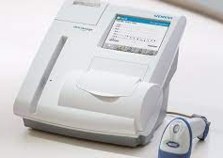
Siemens DCA Vantage
HgbA1c Testing

Slide 2
Specimen/Reagent/Supplies

Slide 3
Specimen
Collect whole blood in the provided glass capillary (within plastic capillary holder).
The glass capillary holds 1 μL of whole blood.
The blood sample may be obtained by fingerstick or venipuncture.
Acceptable anticoagulants are EDTA, heparin, fluoride/oxalate, and citrate.

Slide 4
Specimen Storage and Stability
Preserved whole blood may be stored at
Refrigerated (2°-8°C/35.6°-46.4°F) for two weeks
Room temperature up to 25°C (77°F) for one week
Allow blood sample to reach room temperature prior to testing
Mix blood sample thoroughly before use

Slide 5
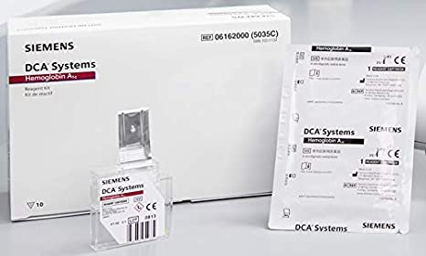
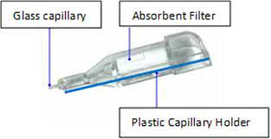
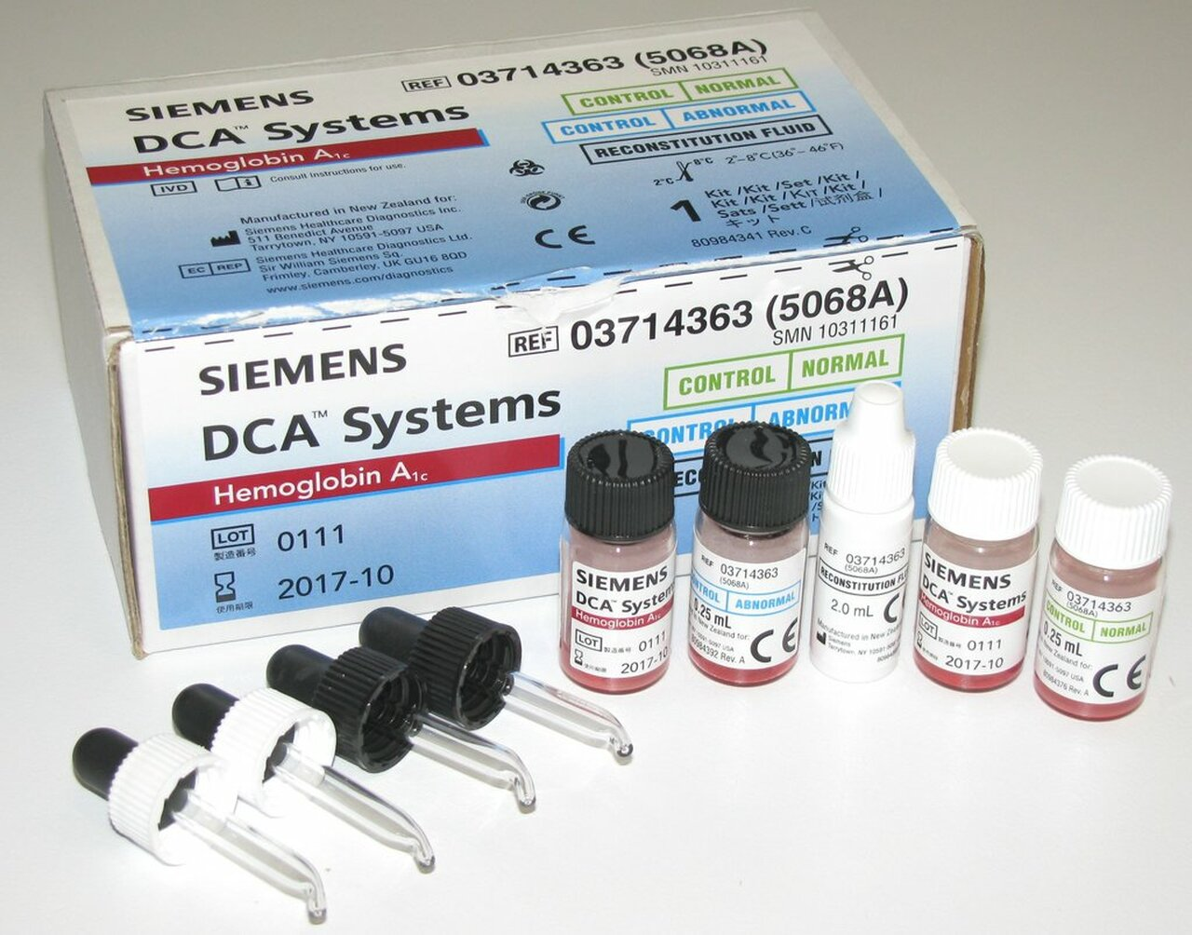
Reagents and Supplies
DCA Reagent Kit
Reagent Cartridges
Ready to use and are stable until expiration date on the kit when stored refrigerated (2°-8°C/35.6°-46.4°F).
Upon receipt of the kit, check temperature indicator located on the front of the carton. If the indicator has turned red, do not use the reagent cartridges.
Leave cartridges in foil package until needed for testing.
Upon removal from refrigerated storage, allow the reagent cartridge to warm up to room temperature for 10 minutes (in unopened foil pouch) or 5 minutes (if removed from the foil pouch).
Once brought to room temperature(15°-25°C/59°-77°F), the kit is stable for 3 months. The new expiration date must be indicated on the kit.
Glass Capillary Holders
Save unused capillary holders and use with any lot of DCA Hemoglobin A1c reagent cartridges.
Ready to use; may be stored refrigerated (2°-8°C/35.6°-46.4°F) or room temperature (15°-25°C/59°-77°F)
DCA Calibration Card
DCA Normal and Abnormal Control Kit
The lyophilized control is stable until the expiration date on the box.
Once control material has been reconstituted the control is stable for 3 months when stored refrigerated (2°-8°C/35.6°-46.4°F).
A DCA Normal and Abnormal Control Card are included with each lot number of control.
Color Coded Eyedroppers Cap Assemblies are included.
Additional Supplies
Cleaning Sponge Swabs.
Air Filter Replacement Kit
Printer Paper or Self Adhesive Printer Paper
Canned Air
Lint free wipes or cloth
Optical Cartridge

Slide 6
Calibration

Slide 7
Calibration
The DCA Vantage analyzer is calibrated by the manufacturer. Thereafter, the instrument automatically self-adjusts during the first-time power-up and during each assay. In the event the system is unable to make appropriate internal adjustments, an error message is displayed.
The values for the calibration parameters are encoded onto the calibration card provided with each lot of reagent cartridges. Before using a new lot of reagent cartridges, scan the calibration card into the analyzer. This accesses the appropriate calibration parameter values (calibration curve) for the particular lot number of reagent cartridges in use. If no calibration curve is in the instrument for the particular lot number of cartridges in use, the instrument prompts the user to scan the calibration card. The instrument can store 16 calibrations for the DCA HbA1c Assay.
When reagent cartridges are stored and used properly, acceptable performance up to the expiration date is ensured.

Slide 8
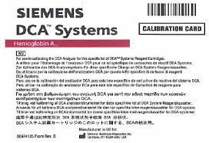
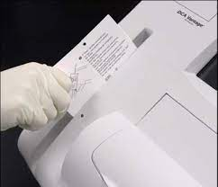
Calibration Procedure
Scan the calibration card for the lot of HbA1c cartridges before using a new lot number on the DCA Vantage system.
Locate the barcode on the calibration card.
Hold the card so that the barcode faces to the right.
Insert the calibration card into the top of the barcode track.
Hold the calibration card gently against the right side of the track and smoothly slide the card down.
A beep sounds to signal a successful scan.
If no beep sounds, repeat the scanning procedure.
If no beep is heard, refer to the Troubleshooting Section in the DCA Vantage Operator’s Guide.
Return to the home screen, select “OK”.

Slide 9
Quality Control

Slide 10
Quality Control
QC testing provides confidence that the reagent cartridges are reacting and being read correctly. It can also detect errors resulting from user techniques. Run quality control specimens under the following conditions:
Each new shipment of reagents,
New lot number,
Each time a calibration card is scanned,
For supplies that have been on the shelf for 30 days,
To train and confirm performance acceptability for new users,
When results do not match the patient’s clinical condition or symptoms,
Following maintenance or repair procedures.
If control results are out-of-range it will be necessary to repeat the control.
DO NOT run patient samples if controls are out of range.

Slide 11
Preparation of Controls
The following directions for reconstitution are recommended to minimize variation resulting from different reconstitution methods.
Remove the appropriate control bottle from the refrigerator just prior to reconstitution.
Gently tap the bottom of the control bottle on the counter to collect as much material as possible on the bottom of the bottle.
Carefully remove the cap from the control bottle.
Holding the reconstitution fluid dropper bottle vertically, discard the first drop, then add 6 (six) drops of fluid to the control bottle.
Carefully replace the color coded cap to the correct control bottle, not the eyedropper and swirl the control bottle several times.
Let stand at room temperature for 15 minutes.
After 15 minutes, coat all surfaces of the control bottle by rotating and inverting the bottle. Continue mixing until the solution is homogeneous and all lyophilized material is reconstituted.
Remove and discard cap and replace with color coded eye-dropper cap assembly.

Slide 12
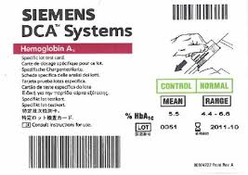
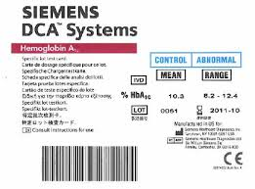
Quality Control Testing
Patient testing is disabled until the required controls are performed and pass.
Performing Controls
Remove controls from refrigerator and let stand for 15 minutes before testing.
Locate the control card and use the barcode for the appropriate control being tested.
One side of the control card is for a normal control and the other side is for an abnormal control.
Hold the control card so that the barcode faces to the right.
Insert the control card into the top of the barcode track.
Hold the control card gently against the right side of the track and quickly slide the card down.
A beep sounds to signal a successful scan.
If no beep sounds, repeat the scanning procedure.
If no beep is heard on repeat, refer to the troubleshooting section in the DCA Vantage Operator’s Guide.
Open the foil cartridge package.
Remove the glass capillary holder from the blister package.
Mix the control bottle well (by inversion or use of a tube mixer).
Allow a very small amount of the control solution to fill the eyedropper.
Hold the glass capillary tube to the eyedropper and completely fill the 1uL tube.
Only touch the tip of the tube to the control solution.
If an air bubble(s) is present in the filled tube, discard the glass capillary holder and fill a new one.

Slide 13
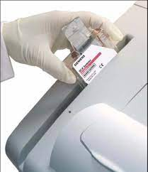
Quality Control Testing
Carefully insert the glass capillary holder into the reagent cartridge until the holder gently snaps into place.
Do not allow the control solution to come into contact with any part of the glass capillary holder. Contamination of the capillary holder may cause an invalid HbA1c control result or error message.
If control solution comes in contact with the plastic of the capillary holder, discard the capillary holder.
Avoid harsh insertion of the glass capillary holder. Do not dislodge the sample from the glass capillary holder or erroneous results may occur.
Scanning the Reagent Cartridge.
Locate the barcode on the reagent cartridge.
Hold the reagent cartridge so that the barcode faces to the right.
Insert the reagent cartridge at the top of the barcode track.
Quickly and smoothly, slide the reagent cartridge down.
A beep sounds to signal a successful scan.
If no beep sounds, repeat procedure.
If a beep repeatedly fails to sound, refer to the Troubleshooting section in the DCA Vantage Operator’s Guide.
Inserting the Reagent Cartridge into the System.
Open the cartridge compartment door.
Hold the reagent cartridge so that the barcode faces to the right.
Insert the reagent cartridge into the cartridge compartment until a gentle snap is heard or felt.
The cartridge is designed to fit only one way into the system, do not force the cartridge into system.
Place a finger on the top of the cartridge while using the other hand to, in one smooth and continuous motion, pull the silver flexible pull-tab completely out of the reagent cartridge.
Close the door and dispose of the silver flexible pull-tab. Five seconds after the door is closed, a beep sounds and the assay begins.
If the door is accidently closed before the silver flexible pull-tab is removed, there is a 5 second delay when the door can be re-opened for tab removal..

Slide 14
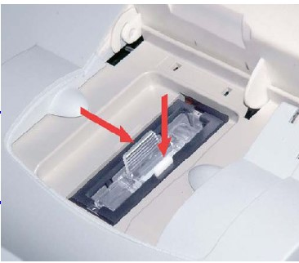
Quality Control Testing
Ensure that the control results are in range. The display screen will indicate PASS or FAIL.
If the controls FAIL, follow the Quality Control Troubleshooting.
If the first Control passes, repeat steps 1b-5a using the other control.
Removing the Reagent Cartridge
Open the cartridge compartment door.
Locate the white button on the right side of the cartridge compartment.
Push and hold it down with one hand.
With other hand, gently push the tab on the cartridge to the right. This action releases (unlocks) the cartridge.
Pull the reagent cartridge out of the compartment.
Close the system door.
Discard the cartridge in a proper container per laboratory procedures.

Slide 15
Quality Control Troubleshooting
Verify that the materials are not expired.
Repeat Quality Control:
Using a new cartridge, (stored at room temperature) or
Using a new box of reagent cartridges (stored in the refrigerator), or a new lot or
Using a newly reconstituted control solution.
Review procedure to ensure that the test was performed correctly.
Verify that required maintenance was performed.
Refer to the troubleshooting section in the DCA Vantage Operator’s Guide.

Slide 16
Patient Testing

Slide 17
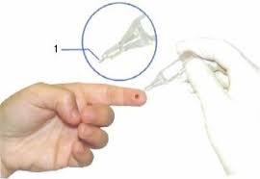
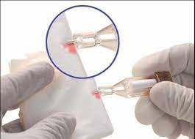
Patient Testing
When the glass capillary holder is filled with the sample, analysis must begin within 5 minutes.
Fingerstick Specimens
Hold the glass capillary holder at an angle.
Touch only the tip of the glass capillary holder to a small drop of blood on the finger until the glass capillary holder tip fills.
Using a lint-free tissue, carefully wipe the outside of the glass capillary holder.
Do not allow the tissue to touch the open end of the glass capillary holder.
Contact with the open end of the glass capillary holder could result in loss of sample (by wicking into the tissue.)
If sample loss is obvious, discard the glass capillary holder and repeat the procedure using a new glass capillary holder.
Inspect the glass capillary holder for the presence of bubbles.
If bubbles are obvious, discard the glass capillary holder and repeat the procedure using a new glass capillary holder.

Slide 18
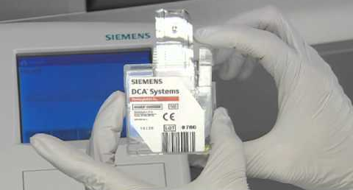
Patient Testing
Inserting Capillary Holder into Reagent Cartridge
Carefully insert the glass capillary holder into the reagent cartridge until the holder gently snaps into place.
Avoid harsh insertion of the glass capillary holder.
Do not dislodge the sample from the glass capillary holder or erroneous results may occur.
Scanning the Reagent Cartridge
Locate the barcode on the reagent cartridge.
Hold the reagent cartridge so that the barcode faces to the right.
Insert the reagent cartridge at the top of the barcode track.
Quickly and smoothly, slide the reagent cartridge down.
A beep sounds to signal a successful scan.
If no beep sounds, repeat procedure.
If a beep repeatedly fails to sound, refer to the Troubleshooting Section in the DCA Vantage Operator’s Guide.
A test can be cancelled anytime by selecting Cancel and cartridge must be removed and discarded.

Slide 19
Patient Testing
Entering Sample Data
Touch Sample ID
Scan or manually enter the Sample ID (EPIC requisition).
Touch User ID.
Scan or manually enter employee ID.
Touch OK.
Inserting the Reagent Cartridge into the System
Open the cartridge compartment door.
Hold the reagent cartridge so that the barcode faces to the right.
Insert the reagent cartridge into the cartridge compartment until a gentle snap is heard or felt.
The cartridge is designed to fit only one way into the system. Do not force the cartridge into system.
Place a finger on the top of the cartridge while using the other hand to, in one smooth and continuous motion, pull the silver flexible pull-tab completely out of the reagent cartridge.
Close the door and dispose of the silver flexible pull-tab. Five seconds after the door is closed, a beep sounds and the assay begins.
If the door is accidently closed before the silver flexible plastic tab is removed, there is a 5 second delay when the door can be re-opened for tab removal.
A test can be cancelled anytime by selecting Cancel and cartridge must be removed and discarded.
Removing the Reagent Cartridge once testing is complete.
Open the cartridge compartment door.
Locate the button on the right side of the cartridge compartment.
Push and hold it down with one hand.
With other hand, gently push the tab on the cartridge to the left. This action releases (unlocks) the cartridge.
Pull the reagent cartridge out of the compartment.
Close the system door.
Discard the cartridge in a proper container per laboratory procedures

Slide 20
Reporting Results
Reportable Range
HbA1c concentrations are reported between 2.5% to 14.0%.
Result preceded by a less than sign (<) indicates a concentration below 2.5%.
Result preceded by a greater than sign (>) indicates a concentration above 14.0%
Do not dilute samples.

Slide 21
Reference Ranges
American Diabetes Association Guidelines:
Nondiabetic: < 5.6%
Pre-diabetic: 5.7% - 6.4%
Diabetic: > 6.5%

Slide 22
Instrument Maintenance

Slide 23
Weekly Maintenance
Clean Barcode Window:
Clean the barcode window with a lint-free cloth dampened with water.
Clean Exterior of Instrument:
Clean the exterior with a lint-free cloth dampened with water.
Do not allow liquid to drip into system.
To disinfect the exterior of the system, remove any visible blood on the system using an approved type of wipe (ie: Sani-wipe).
Do not use any other type of solvent, oil, grease, or silicone spray on any part of the system.

Slide 24
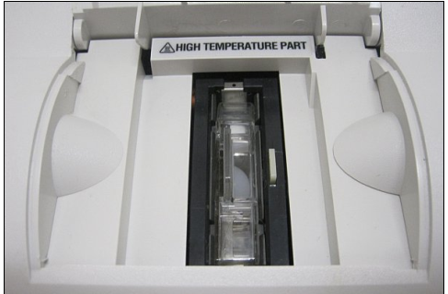
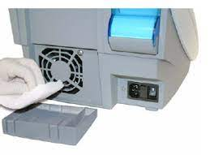
Quarterly Maintenance
Clean Cartridge Spring area:
Ensure the power is off.
Open the cartridge compartment door as far as possible.
Wipe the inside surface of the door and both sides of the compartment using a lint- free cloth dampened with water.
Dry all surfaces using a clean, dry, lint-free cloth.
Use canned air to clean out the area with the spring.
Use a clean, dry, sponge swab (provided in the Cleaning Kit), to remove any spilled liquid from the cartridge holder.
CAUTION: Do not use a cotton swab. Cotton fibers left on the surface can interfere with optics.
Power on instrument.
If instrument will not power up, contact Point of Care/Laboratory.
Change Air Filter:
Remove the filter holder from the back of the system by pulling from top.
Dispose of the old air filter.
Place the new air filter into the filter holder.
Place the filter holder back on the system.
Perform Optical Test
Locate the barcode on the optical test cartridge.
Hold the cartridge so that the barcode faces right.
Insert the cartridge into the barcode track and smoothly slide the cartridge down the track.
A beep sounds to signal a successful scan.
Open the cartridge compartment door.
Hold the optical test cartridge so that the barcode faces to the right.
Insert the optical test cartridge into the cartridge compartment until a gentle snap is heard or felt. Do not force the cartridge into system.
Close the door.
The test is completed in 6 minutes.
The result should display “pass” or “fail” on the screen.
If “pass” is displayed, document on maintenance sheet.
If “fail” is displayed, repeat optical test.
If it still fails, call Point of Care/Laboratory for assistance.
Remove the cartridge by opening the cartridge compartment door and locating the button on the right side of the compartment.
Push and hold down the white button with one hand and gently push the plastic tab on the cartridge to the right with other hand.
Pull the cartridge out of the compartment.

Slide 25
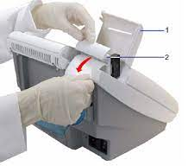
As Needed
Calibrate the touchscreen:
At the System Test menu, select “Calibrate Touchscreen”.
When the Touchscreen Calibration screen displays, select the “X” target at the center of the screen.
Repeat when prompted at each corner.
The Touchscreen Calibration Complete screen displays.
If touchscreen will not calibrate, contact Point of Care/Laboratory for assistance.
Replace Printer Paper:
Ensure the system is at the Home screen.
Turn the system so that you are looking at the back.
Use the tab to lift the cover off.
Lift the gray paper release lever up.
Push the plastic paper cover down.
Remove any leftover paper.
Replace with new roll.
Feed through paper guide with the paper unrolling from underneath.
Pull the paper feeder down and push down on the gray paper release lever to hold the paper in place.
Close the cover

Slide 26
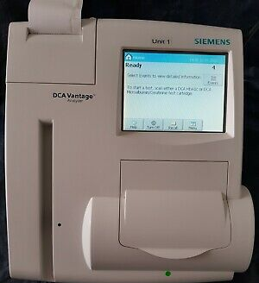
Event Notification
An Event Notification is displayed when controls need to be run, a maintenance task is due or an error event occurs.
At the Home screen, select “Events”.
Use the up and down arrows to scroll through the notifications.
Update the screen when a maintenance task event is performed.
The screen will then display “Not Due”.
To return to the Home screen, select “Back”.

Slide 27
