Slide 1
Pneumatic Tube System
Updated 8/19/22

Slide 2
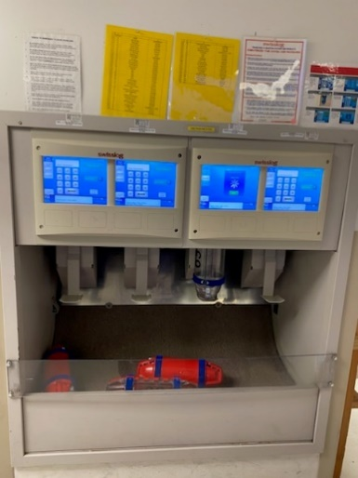
Pneumatic Tube System
What is the purpose of the pneumatic tube system?
Delivery system utilized to propel items placed in cylindrical containers through networks of tubes by compressed air or by partial vacuum
Each station is assigned a unique number
Each station is also assigned a certain number of cylinder tubes (footballs)

Slide 3
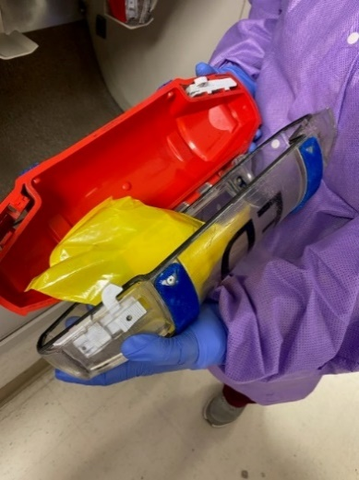
Receiving Specimens in the Pneumatic Tube System
NEVER FOOTBALL CSF!!!
Some specimens arrive via pneumatic tube system
Retrieve tube from station
Open tube
Remove specimens

Slide 4
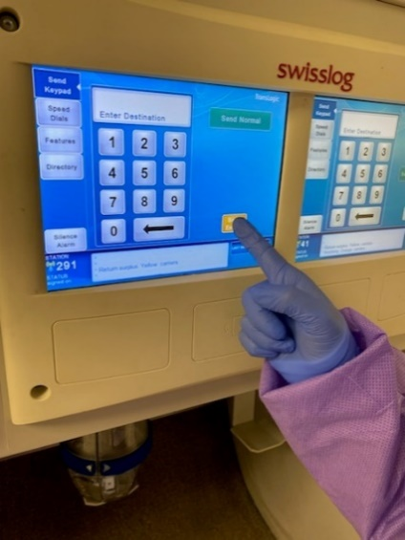
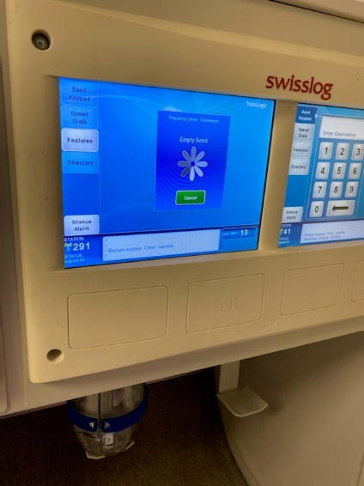
Returning/Sending Cylinder Tube (Football)
Close tube and place back in tube system sendoff slot
Returning
Return football to home station by pressing [empty send]
Do not return dirty tubes in tube system
If tube is dirty, take one of the following actions
Ice spills in bag
wipe out inside of cylinder tube
let the cylinder tube dry before returning it
Sample spills out into cylinder tube
place in a biohazard bag
call 24-2216 to report the issue
Important Notes:

Slide 5
Sending Cylinder Tube (Football)
Sending the cylinder tube (football) to selected stations
Find assigned station number for desired floor
Enter floor number using keypad
Press [Send Normal]
Do not return dirty tubes in tube system
If tube is dirty, take one of the following actions
Ice spills in bag
wipe out inside of cylinder tube
let the cylinder tube dry before returning it
Sample spills out into cylinder tube
place in a biohazard bag
call 24-2216 to report the issue
Important Notes:

Slide 6
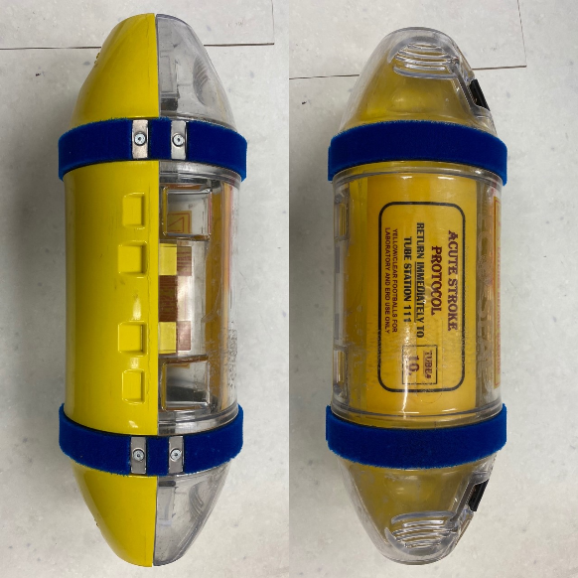
Pneumatic Tube System
Yellow Cylinder Tube (Football)
TOP PRIORITY!!!!!!!!!!
Used for stroke specimens
All specimens received in yellow football will be hand delivered to affected departments
If [carrier at home] message appears, keep cylinder tube in designated area

Slide 7
Pneumatic Tube System Problem Log Troubleshooting
All issues are documented on the Pneumatic Tube System Problem Log
Call 24-2216 to report if system is down
Tech reporting the issue will receive an email with the work request number
Forward email to processors@BSWHealth.org
This will notify all team members of the issue
Print email
Post on tube station

Slide 8
