Slide 1
Malignant Cells in Body Fluids
Feature of Malignancy as seen from low, medium, and high power.
Low power: Increased to higher the normal cellularity
Medium power: Two cell populations +/- Architecture often clustered
High power: Individual cells are Ugly (enlarged nucleus, irregular chromatin, abnormal cytoplasmic vacuoles).

Slide 2
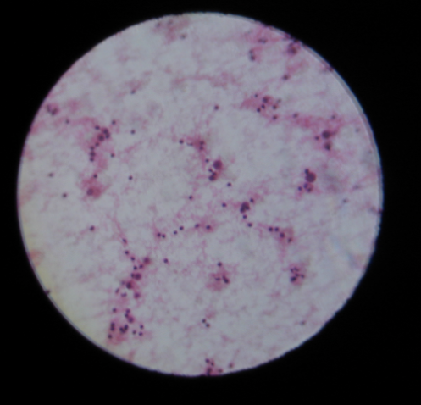
Approach to cytology specimen:
Start at Low power.
At low power #1 EVALUATE CELLULARITY
A benign, normal fluid has very few cells.
Fewer blood cells than a PBS and not very much blood from the procedure.

Slide 3
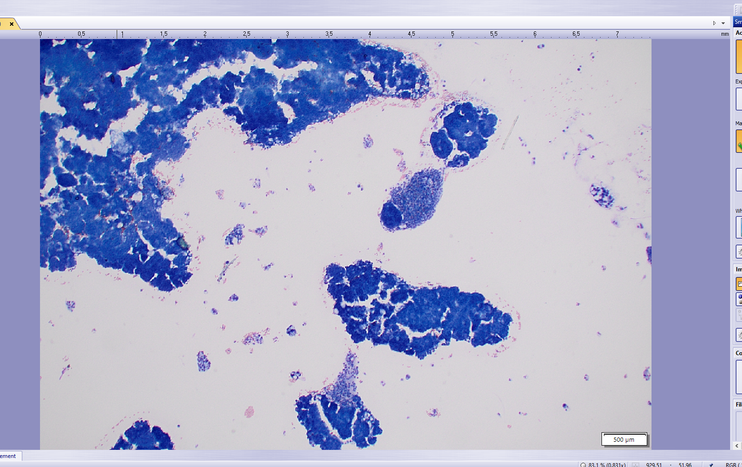
LOW POWER ASSESSMENT: Malignant fluid sample has too many cells

Slide 4
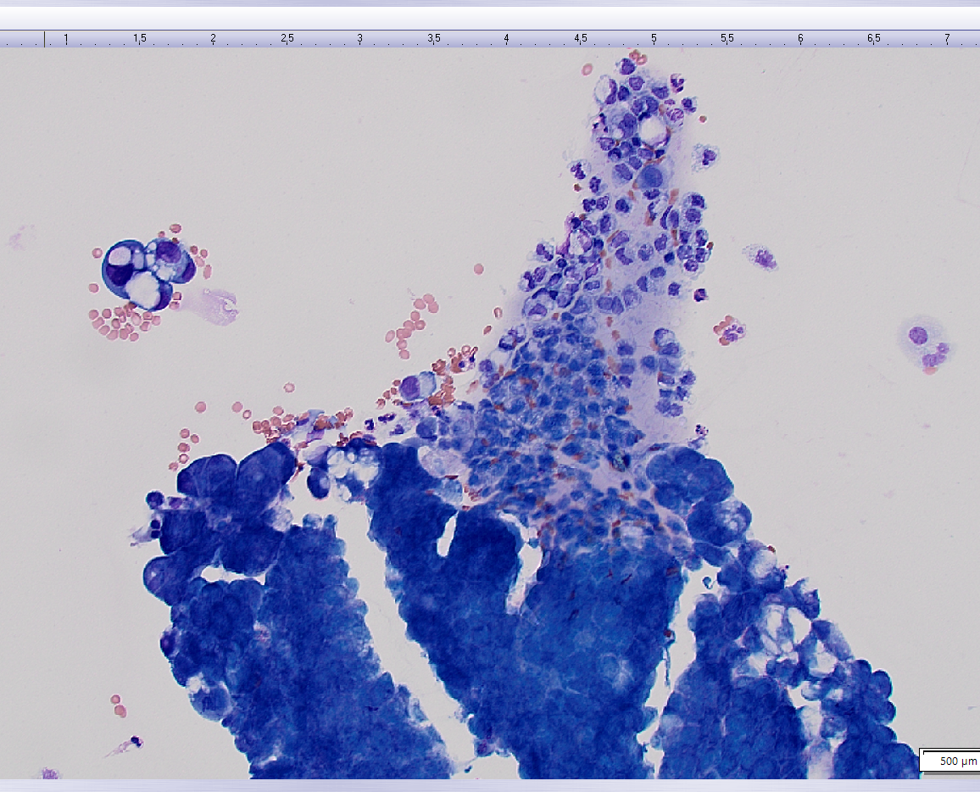
Next at medium power: Are there “two cell populations”?
Two populations is sort of conceptual.
Imagine one population being the normal inflammation, perhaps a few bland mesothelial cells. Mesos are NORMAL cells that the body cavities (pleura, pericardium, and abdomen).

Slide 5
First population here → Inflammation here, Benign
Second population here : Malignant →

Slide 6
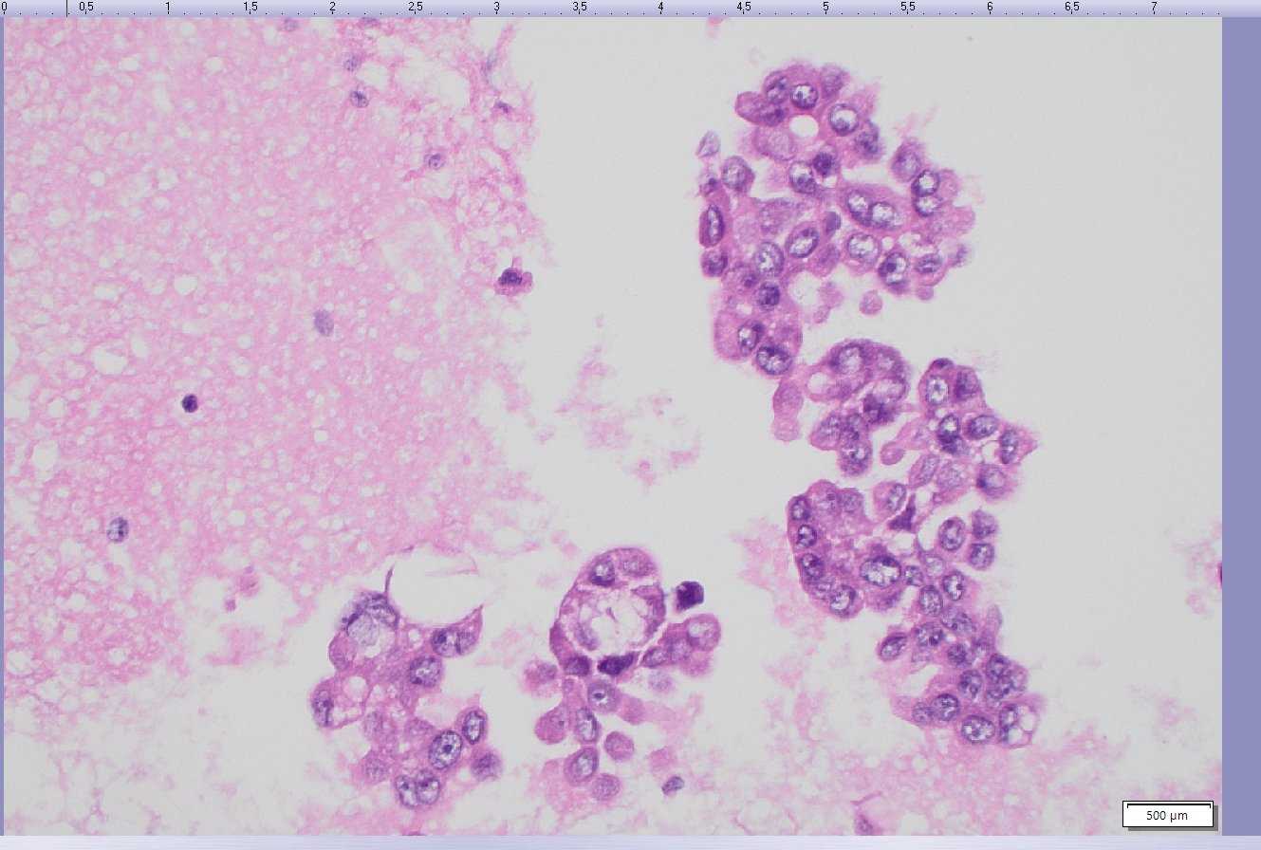
Medium power: A secondary feature of malignant cells could be the architecture.
Architecture of Malignancy is often (but not always) clustered.
Benign lymphocyte
Benign histiocyte
Benign cells in the background are often single cells, just hanging out by themselves.

Slide 7
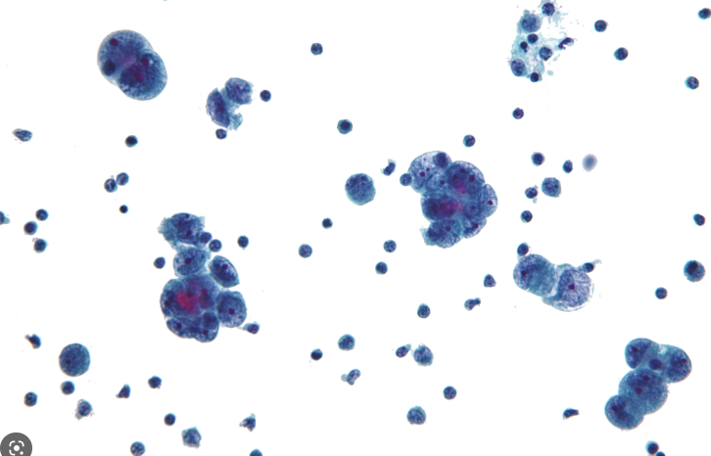
Lastly, at high power, Malignant cells look UGLY.
Larger overall cell size compared to normal body cells.
Comparison as is a key TOOL (skill) when evaluating cytology slides
In the left pic, compare Malignant cells to the RBCs (!).
Darker b/c high N:C ratio.
Eccentric (off-center) nucleus.
Complex clusters, not flat sheet of cells.

Slide 8
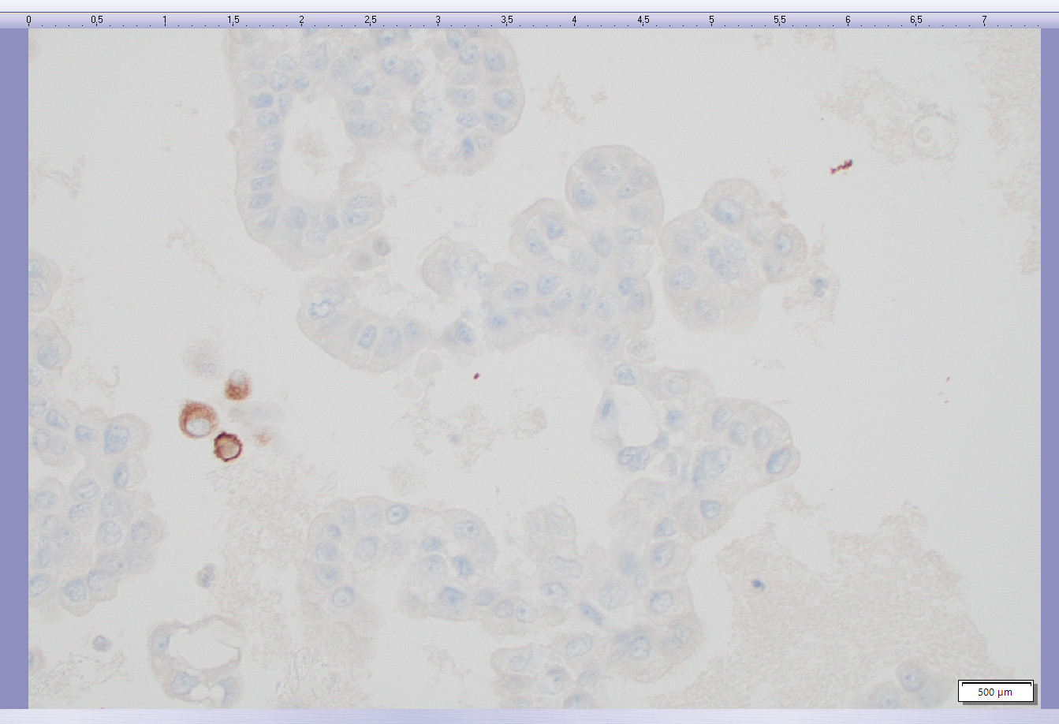
Are the Brown cells, benign or malignant?
Benign = Background mesothelial cells.

Slide 9
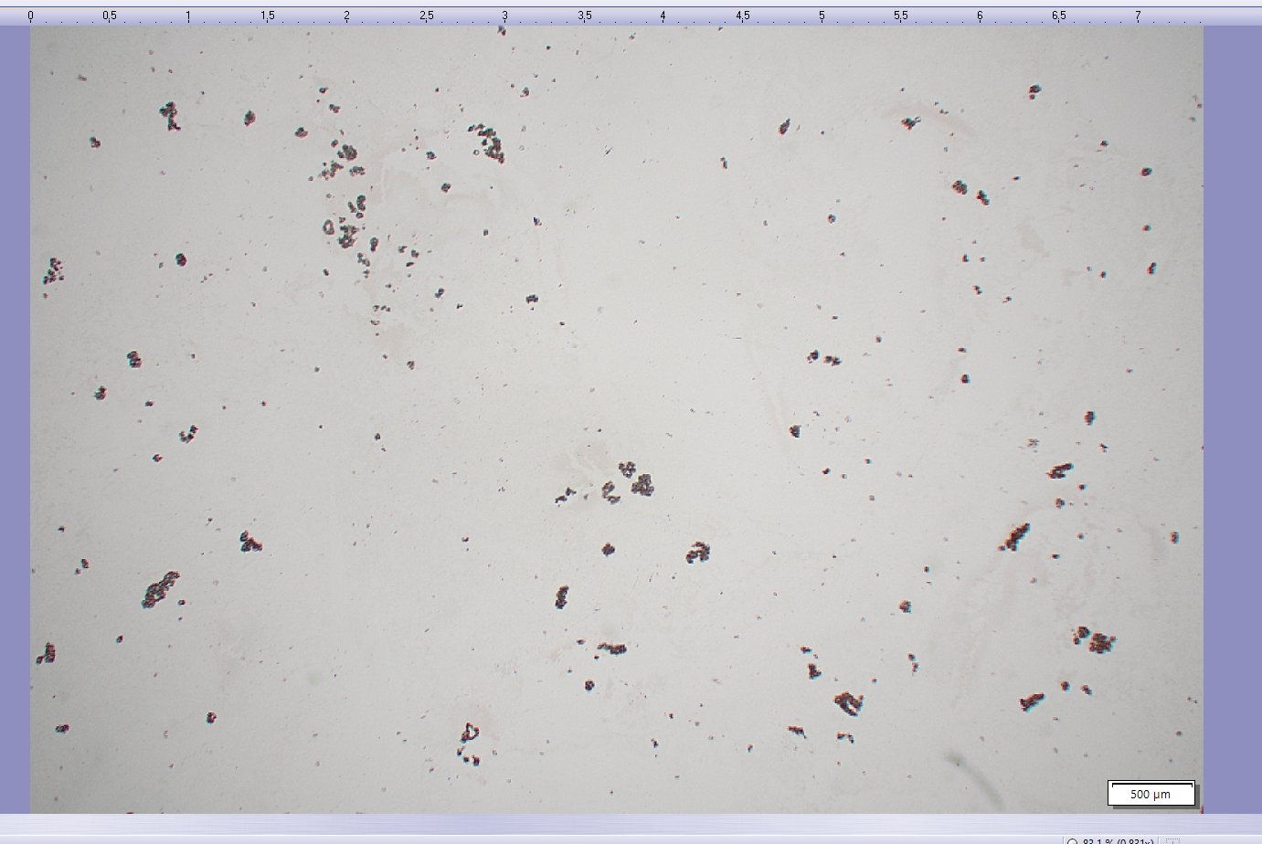
Are the Brown cells, benign or malignant?
Malignant
Feature, Low Power: Too many brown cells (see next)
The stain itself is not important but FYI it is an antibody-type stain (immunostain), has an attached generic brown fluorochrome.

Slide 10
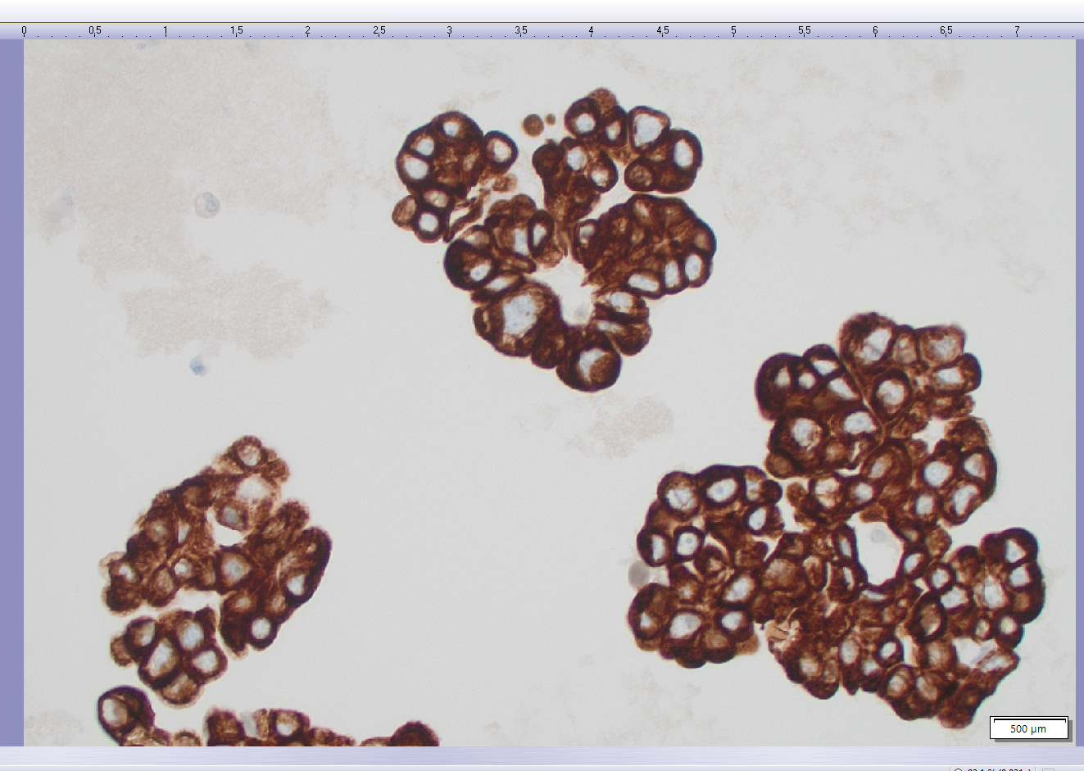
Are the Brown cells, benign or malignant?
Malignant
Feature, Medium power : Complex clustered architecture

Slide 11
InMalignant Cells in Body Fluids
Feature of Malignancy as seen from low, medium, and high power.
Low power: Increased to higher the normal cellularity
Medium power: Two cell populations +/- Architecture often clustered
High power: Individual cells are Ugly (enlarged nucleus, irregular chromatin, abnormal cytoplasmic vacuoles).

