Slide 1
Urorisk/Stone Risk Processing
7/20/21

Slide 2
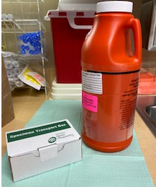
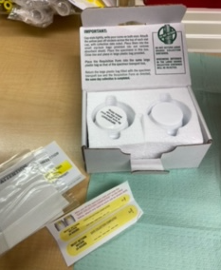
Urorisk/Stone Risk Collection Kit
Consists of:
Collection container
Specimen Transport Box
Two specimen jars
Two sealable bags to place specimen jars
Two collection labels

Slide 3
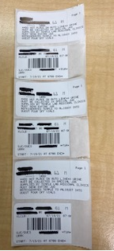
Pulling Orders from LIS
When pulling orders from LIS, print two extra specimen labels.
One for the specimen transport box
Other two for the specimen jars

Slide 4
Step 1
Receive completed 24 hour Urorisk/Stone Risk collection
Get Specimen Transport Box
Remove contents

Slide 5
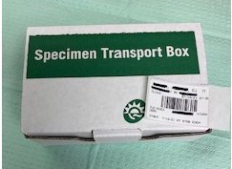
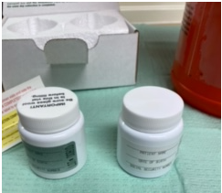
Step 2
Place one of the specimen labels on the top lid of the Specimen Transport Box
Invert the 24 hour collection container to mix the specimen
Take specimen jars out of the transport box

Slide 6
Step 3
Carefully pour well mixed specimen from 24 hour container into the jars
Place lid on each jar and tightly secure
IMPORTANT: Do NOT mix the lids. Each lid is specific to the specimen jar

Slide 7
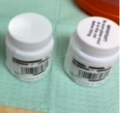
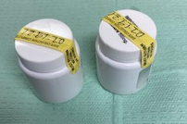
Step 4
Label the side of each specimen jar with the LIS specimen label
Place completed kit date label on across the top of the labeled specimen jars

Slide 8
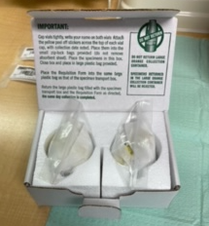
Step 5
Place labels specimen jars in resealable bags
Do not remove filter pad
Place sealed specimen jars into Specimen Transport Box

Slide 9
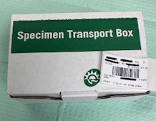
Step 6
Close the labeled Specimen Transport Box
Track to destination

