Slide 1

Laboratory Quality Assurance and Quality Control
2014

Slide 2
What is Quality Assurance?
Quality Assurance is a planned, ongoing review process that observes and evaluates the quality of all laboratory-related processes and activities.
An effective Quality Assurance process increases the quality of the laboratory’s performance and services by identifying, evaluating, correcting and preventing test system problems.
Quality Assurance in managed by the Laboratory Technical Consultants and Laboratory Administration.

Slide 3
HealthPartners/GHI
Laboratory Quality Assurance Plan
The HealthPartners QA Plan is designed to monitor and evaluate the ongoing and overall quality of the pre-analytic, analytic and post-analytic testing process at Central Lab and the HPMG and affiliated clinics.
One of several goals of the HP QA Plan is to;
  Assess the level of performance of laboratory functions;
  To identify barriers to consistent high performance
  To systematically eliminate those barriers; thus continuously improving patient care and service.

Slide 4
Ownership & Responsibilities
In HealthPartners Clinic laboratory’s Quality Assurance is every staff member’s responsibility to manage and participate in to ensure quality testing and accurate result reporting.
Maintaining Quality Assurance in a laboratory requires all staff to follow established policies and procedures as written. Including;
  Documentation of daily maintenance (temperatures, start-up, shut-down)
  Documentation of daily Quality Control (hematology, urinalysis, glucose)
  Monthly maintenance
  Monthly Quality Control for Kit Tests (performed on the first day of the month the clinic is open)
Documentation of all required information,
  Date, time, lot number, expiration dates, open dates, acceptable ranges, etc.

Slide 5
Quality Assurance vs.
Quality Control
Quality Assurance makes sure you are doing the right things, the right way.
Quality Control makes sure the results of what you've done are what you expected.

Slide 6
What is Quality Control?
Quality control in the medical laboratory is a statistical process used to monitor and evaluate the analytical process that produces patient results.

Slide 7
A Quality Control Program must specify the following
• Type of controls for each test.
• Number of controls to run and at what frequency.
• Expected range of the control material.
• Corrective actions to take in response to out of
  control situations.
• Process of proper documentation and periodic
  review by the laboratory director.

Slide 8
Quality Control = Statistical Process
Quality Control results are used to validate whether the instrument or test kit are operating within pre-defined specifications, inferring that patient test results are reliable. Once the test system is validated, patient results can then be used for diagnosis, prognosis, or treatment planning. Required processes for Quality Control are;
Regular testing of quality control products along with patient samples.
Comparison of quality control results to specific statistical limits (ranges).

Slide 9
The Three Phases of Testing
Pre-analytic Phase
Analytic Phase
Post-analytic Phase
Pre-analytic Phase
The pre-analytic phase of testing refers to all processes from the test order until the sample arrives at the bench for testing. It includes the test order, patient preparation, sample collection, handling, transportation, storage, and login. The highest fraction of errors tend to happen in the pre-analytic phase. This is because there are more manual, error-prone steps in the pre-analytic process.

Slide 10
Analytic Phase
The analytic phase of testing refers to all processes that occur once the sample arrives at the testing bench. This phase deals directly with the testing of samples. QA in the analytical phase of testing involves monitoring the quality of instruments and reagents. This continual monitoring helps detect problems with instruments and reagents. It is the most regulated phase of the testing process.
Aspects of analytic Quality Assurance include:
Instrument selection
Method validation
Quality control
Test performance
Result verification
Proficiency testing

Slide 11
Post-analytic Phase
The post-analytic phase of testing refers to all processes that occur after the test is performed. Mistakes in the post-analytic phase can cause erroneous or delayed reporting. QA in the post-analytic phase helps ensure clear, reliable, and timely result reporting.
Aspects of post-analytic Quality Assurance include:
Results reporting
Calling of critical and priority results
Result recommendations
Recording and archiving results and communications
Specimen storage
Monitoring of result distribution statistics

Slide 12
Laboratory Technical Consultant’s
Role in Quality Assurance
Technical and scientific oversight of HealthPartners’ Clinic Laboratories to ensure quality test performance.
Selects test methodologies and instrumentation appropriate for clinical use.
Verifies test procedures performed and establishes the laboratory’s performance criteria, including the accuracy and precision of each test and test system.
Enrolls laboratory in an approved proficiency testing (PT) program commensurate with services offered. Documents, reviews and monitors PT results.
Ensures instrument performance to include calibration, maintenance records, quality control and troubleshooting.
Monitors, reviews, and documents quality control records. Resolves technical problems and ensures remedial actions are taken whenever test systems deviate from the laboratory’s established performance specifications.
Identifies training needs and ensures testing personnel receive regular in-service training.
Evaluates the competency of all testing personnel on an ongoing basis.
Reviews patient test results on a daily basis.
Establishes and monitors Quality Assurance protocols to improve laboratory processes.
Implements and monitors “Point of Care” testing within the clinic.
Works in collaboration with the laboratory computer team on day to day operations and facilitates system enhancements and upgrades.
Establishes and implements laboratory policies and procedures.
Provides Quality Assurance and productivity reports to Laboratory Director as requested.
Ensures compliance with applicable regulatory agencies including COLA/CLIA, OSHA and prepares for inspections as required.

Slide 13
Why do laboratory errors occur?
Inadequate
Attention
To Detail
Understaffed
Poor
Sample Control
Poor
Quality
Management
Poor
Workload
Management
Poor Results
Verification
Time
Pressures
Quality
Control &
Assessment
Non-validated
Tests

Slide 14
Regular Testing
Good laboratory practice requires testing normal and abnormal controls for each non-waived test at least daily to monitor the analytical process. If the test is stable for less than 24 hours or some change has occurred which could potentially affect the test stability, controls should be assayed more frequently.
Regular testing of quality control products creates a QC database that the laboratory uses to validate the test system. Validation occurs by comparing daily QC results to a laboratory-defined range of QC values. The lab-defined range is calculated from QC data collected from testing of normal and abnormal controls.
(ex. ABX pre-assay control values)

Slide 15
How to Evaluate Quality Control
Run the quality control product/s following the established procedure.
Compare the result obtained with the quality control product/s “acceptable range”. The “acceptable range” has been determined either by the manufacturer or by the laboratory performing the test.
If the result/s fall with-in the “acceptable range” for each parameter, the QC is “in-control”.
Once QC is “in-control” patient test results may be reported out.
If any of the measured parameters for a test do not fall within the established Quality Control acceptable range, QC is “no- in-control”.
No patient test results may be reported out until all parameters are “in-control”.

Slide 16
QC Results “Out-of-Control”
The simplest rule to follow when no other rules are specified is: For control results outside the range on 2 consecutive runs or more than 3 times per month, action must be taken to look for problems with the instrument, reagents, or both.
NOTE: Repeating the control until it is within range is not the correct response to an "out-of-control" QC result.

Slide 17
Quality Control Corrective Actions
Repeating the control or trying a new control when a result is out-of-control is conventional wisdom, but may be ignoring the problem.
The best way to resolve the QC problem is to follow these simple steps:
Inspect data and/or Levey-Jennings control charts from previous days or weeks
Review for QC rule violations
Review maintenance records
Determine type or cause of error and plausible causes
Fix the problem
Verify the solution to the problem
Document the troubleshooting steps
  Above all, do not report the patient results until the problem is remedied and the QC results are "in-control".

Slide 18
QC Corrective Actions & Critical Thinking
Several steps in evaluating, “out-of-control”, QC require critical thinking. Ask yourself, “What should I do next?”. “What other steps should I explore?”
  Determine type or cause of error and plausible causes.
  Review maintenance records
Example: To evaluate more than one ABX Quality Control “out-of-control”.
  What is the open date of the control?
    Is it expired?
    Has it been open greater than 2 weeks?
    Has it been compromised in some way?
  Options
    If it is expired, or compromised, open new control. If the control comes in proceed with patient testing.
    If it new control is “not-in-control” the cause is the analyzer not the control material.

Slide 19
Troubleshoot the analyzer
What parameters were “out of control”?
  It will help to identify and isolate the area of the analyzer requiring troubleshooting.
  Review reagent stability associated with these parameters.
What maintenance procedures I can perform to troubleshoot the analyzer?
  Concentrated cleaning
  RBC and WBC flow cell cleaning.
Where do I find the directions if I don’t know how to clean the counting chambers?
  Use on-board troubleshooting manual.
What else can I try?
  Contact Horiba Services.
  Contact another HP lab for advice.
  You have to document something.

Slide 20
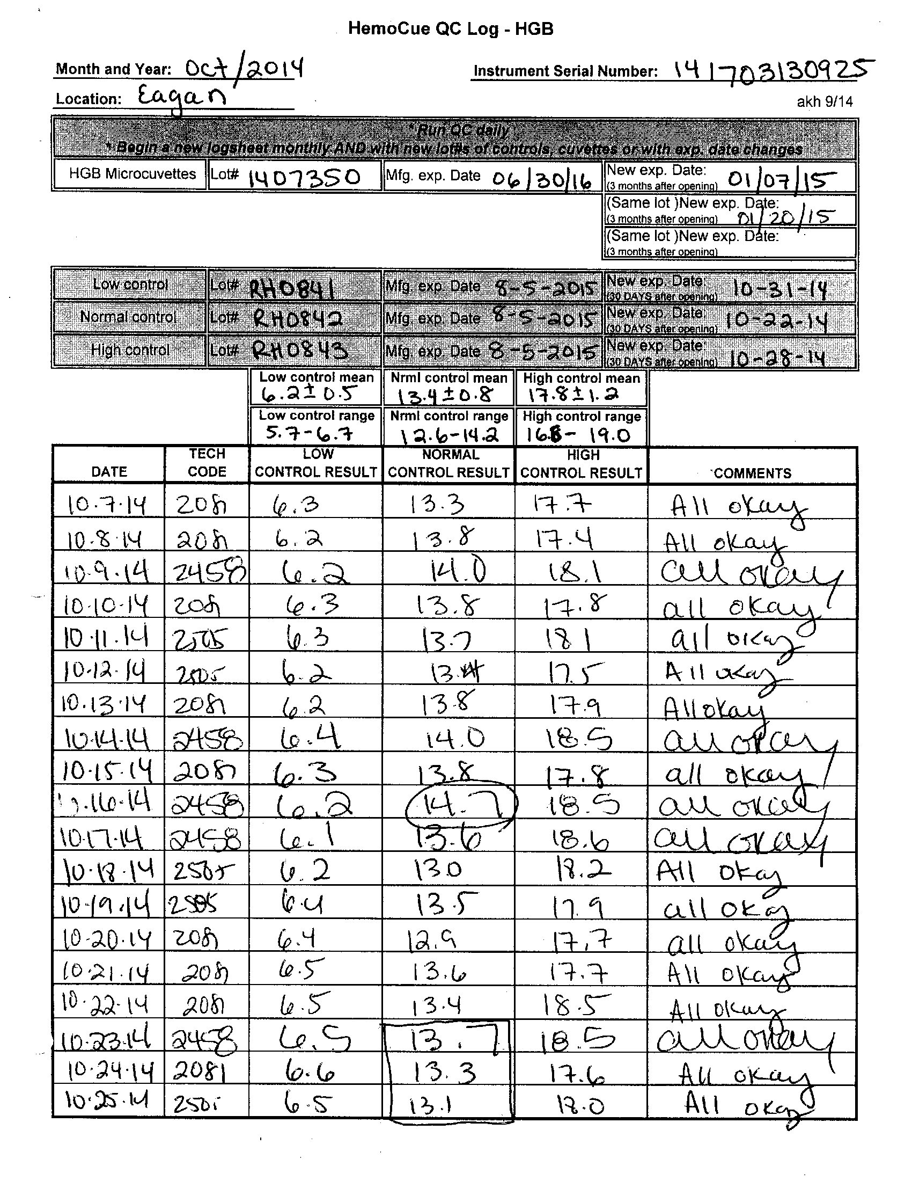
HemoCue QC Errors
Compare the result listed to the acceptable Normal QC range. The high end of the range is 14.2 mg/dL. This 14.7 mg/dL result is out-of-control and should not have been accepted. The control should have been repeated. If “in”, accepted or if still “out of control” a new vial opened, with all documentation recorded. In addition, no patient’s test result should have been reported until the control was “in-control”.
The Normal Control has a “New Exp. Date” of 10-22-14 (30 days after opening). Normal Controls ran on 10/23-10/25 were used after their “open expiration date”. None of these results should have been accepted. A new normal control should have been opened on 10/23/14, labeled with the new “open expiration date of 11/23/14.

Slide 21
Urine Quality Control
Please review the Urine QC Log on the following slide. Note the required information contained on the top of the worksheet.
Clinic name and location
Date/year
Control name, lot #, expiration date
Multi-stix SG lot # and expiration date

Slide 22
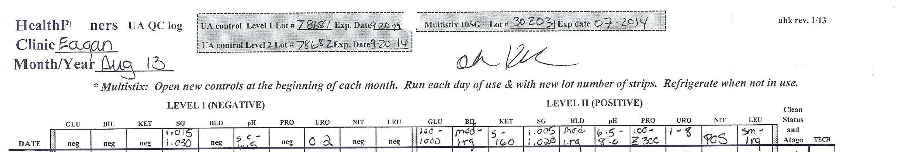
Manufacturer’s Acceptable Range
In addition to the control and test strip information, notice the listed acceptable limits for the controls. The QC ranges for the urine controls listed above is specific for the MultiStix SG reagent strip assayed on the Clinitek analyzer. These ranges are listed in the Bio-Rad urine control’s product insert. With each new urine control lot number the analyte’s range vary so be sure to verify and record new ranges for each new lot number of controls off the product insert.

Slide 23
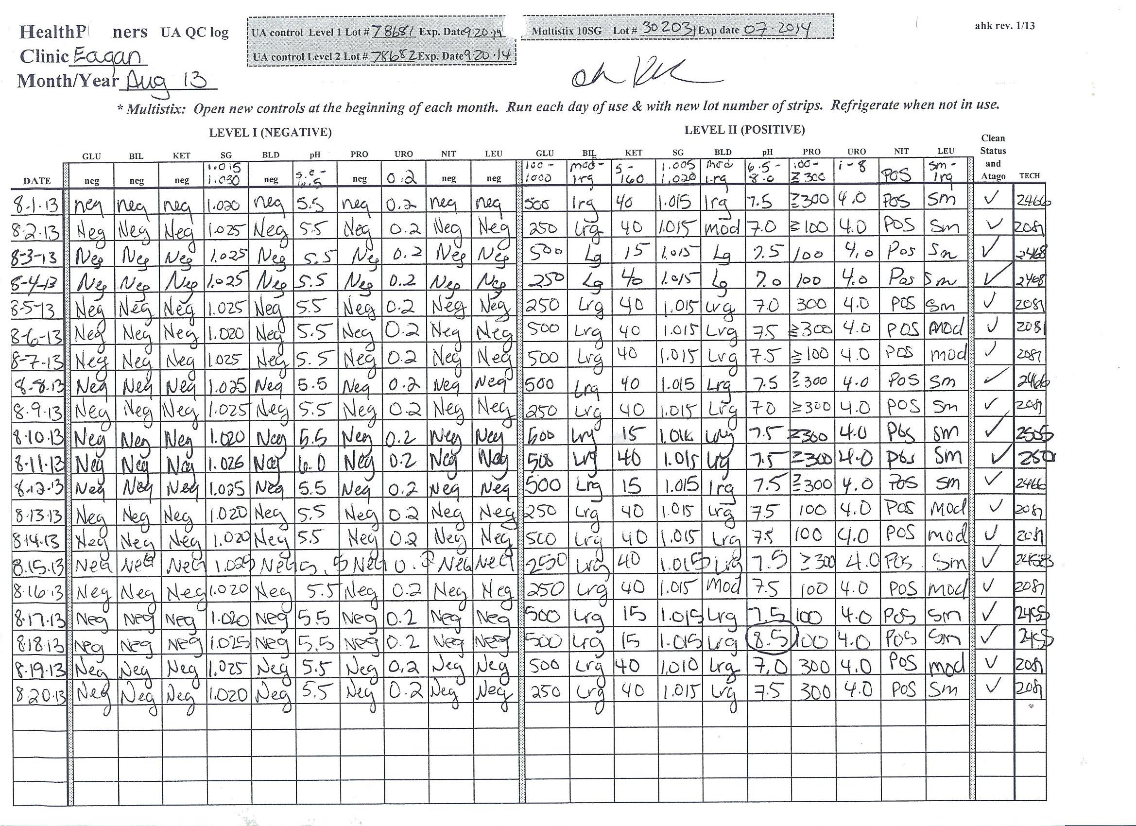

Slide 24
Out-of-Control
Note that the pH is not within the acceptable range of 6.5 – 8.0. The tech recorded 8.5 as the abnormal control’s pH result. pH is out-of-control and patient test results should not be reported out until all control results are within the acceptable limit.
The corrective action for this pH result would have been to,
Recognize that the pH is out-of-control and document it on the worksheet as out-of-control along with all corrective actions.
Verify that the quality control products in use are acceptable (current lot #, not expired, not past open expiration date, not compromised, etc.).
Be sure the urine controls have come to room temperature before testing. Urine pH and specific gravity are the two analytes most affect by temperature.
If QC product is acceptable, repeat the test using the same quality control product. If the control is now acceptable record result and proceed with patient testing.
If the pH is still out-of-control, verify that the reagent strip lot #, expiration date, are acceptable. Consider storage conditions, etc.
If the pH is still out of control, replace either the control or test strips. One at a time so you know the impact of each.

Slide 25
Analyzer Troubleshooting –
Critical Thinking
Why don’t I think it is an analyzer problem?
Only 1 of ten results is out of control. If it was an analyzer problem more results would be affected.
Knowing and understanding what methodology the Clinitek is using. The Clinitek is using a light source to measure the color developed on the test strip. If the light was out or damaged it couldn’t read any of the test strip results.
If the calibration strip or test strip holder was damaged or misaligned, more than one parameter would be affected and the Clinitek would not work correctly and give you an error message.

Slide 26
Temperature
On the following slide the acceptable temperature range for each piece of equipment is listed across the top of the temperature log.
Notice there are two dates when the incubator temperature is out-of-control.
Note that no corrective action was documented for either instance.

Slide 27
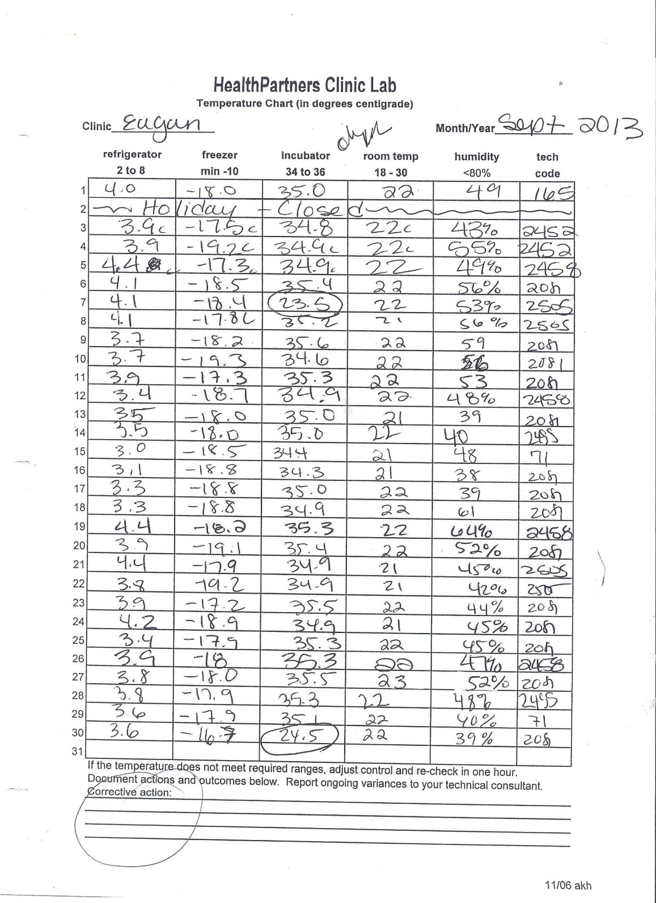

Slide 28

Temperature Corrective Action
Record the out-of-control temperature measured on the temperature log.
If there is no apparent reason why the temperature is not in range, adjust the temperature appropriately and re-check in one hour.
If you know the reason why the temperature is not in range, (door found open, recently added cold reroute packs to incubator, etc.) record the out-of-range temperature along with the reason why. Do not adjust the temperature, allow the appliance to reach the established temperature normally.
Recheck in one hour and document the temperature.
Repeat this process until the appliance has reached an acceptable range.
If the appliance does not reach an acceptable range within a few hours, move its contents to another location.
Contact Biomedical Engineering for additional suggestions or service.
Notify your Technical Consultant.

Slide 29
Patient Test Result Documentation
Patient identification and test results must be documented on the test worksheet. This is a regulatory requirement that verifies;
Who was tested.
The test was performed with valid quality controls.
What testing materials and reagents lot numbers were used.
What the patient’s test result was.
Person performing the test tech code.
Worksheet is used as resource to enter patient test results in Sunquest.
Technical Consultant review.
Documentation for follow-up.

Slide 30
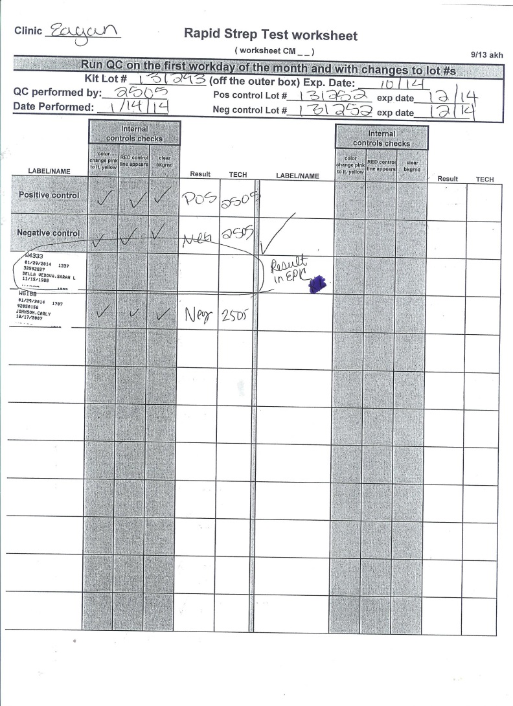
Missing Patient Test Result
No QC, patient result or tech ID documented. Only patient label applied. Audit shows result was entered in Epic.

Slide 31
Summary
This presentation was a review of a few basic laboratory, “Best Practices”. Please make sure that you have a clear understanding of each.
This review may include analyzers that are not used at your clinic. Regardless, the principals are the same and can be used to evaluate any analyzer’s performance.
These tips by no means cover the entire scope of Quality Assurance and Quality Control.
Please use Compliance 360 for additional HealthPartners policies and procedures.
The following list of resources are made available if you have further questions on CLIA ’88, regulatory agencies, newsletters or professional organizations.

Slide 32
Regulatory Information - Both state and federal regulators provide information about the Clinical Laboratory Improvement Amendments (CLIA) and related state laws. The Centers for Medicare and Medicaid Services (CMS) and individual State Health Departments are free sources for information on regulations and inspections.
Centers for Medicare and Medicaid Services (CMS)
www.cms.gov
877-267-2323
CLIA Program
www.cms.hhs.gov/clia
Occupational Safety & Health Administration (OSHA)
www.osha.gov
202-693-2100
Centers for Disease Control and Prevention (CDC)
www.cdc.gov
800-311-3435
College of American Pathologists (CAP)
www.cap.org
800-323-4040
COLA
www.cola.org
800-981-9883
The Joint Commission
www.jointcommission.org
630-792-5000

Slide 33
Newsletters-There are several clinical laboratory magazines that cover topics in laboratory medicine.
Advance for Administrators of the Laboratory
www.advanceforal.com
800-355-5627
Advance for Medical Laboratory Professionals
www.advanceformlp.com
800-355-5627
American Association of Physician Offices and Laboratories
www.aapol.com
800-470-9605
Clinical Laboratory News
www.aacc.org
800-892-1400
Clinical Laboratory Strategies
www.aacc.org
800-892-1400
COLA Insights
www.cola.org
800-981-9883
Medical Laboratory Observer (MLO)
www.mlo-online.com
941-966-9521
Phlebotomy Newsletter (Center for Phlebotomy Education, Inc.)
www.phlebotomy.com
812-633-4636
Physician Office Lab News
www.decisionhealth.com
877-397-1496

Slide 34
Professional Management Organizations
There are several organizations that focus on management of a clinical laboratory.
Medical Group Management Association (MGMA)
www.mgma.org
877-275-6462
Clinical Laboratory Management Association (CLMA)
www.clma.org
610-995-9580
Other Education and Information Sources
There are many other publications and internet websites that focus on clinical laboratory topics. Here is a sampling of a few.
CodeMap (MCF Compliance)
www.codemap.com
847-381-5465
LabTestsOnline.com (American Association for Clinical Chemistry)
www.labtestsonline.com
LabUniversity® (COLA)
www.labuniversity.org
800-981-9883
OSHA Watch (Quality America)
www.quality-america.com
800-946-9956

