Slide 1
QC Material Review
How to enter lot information in Beaker

Slide 2
Follow Visio Instructions for Entering Comments

Slide 3
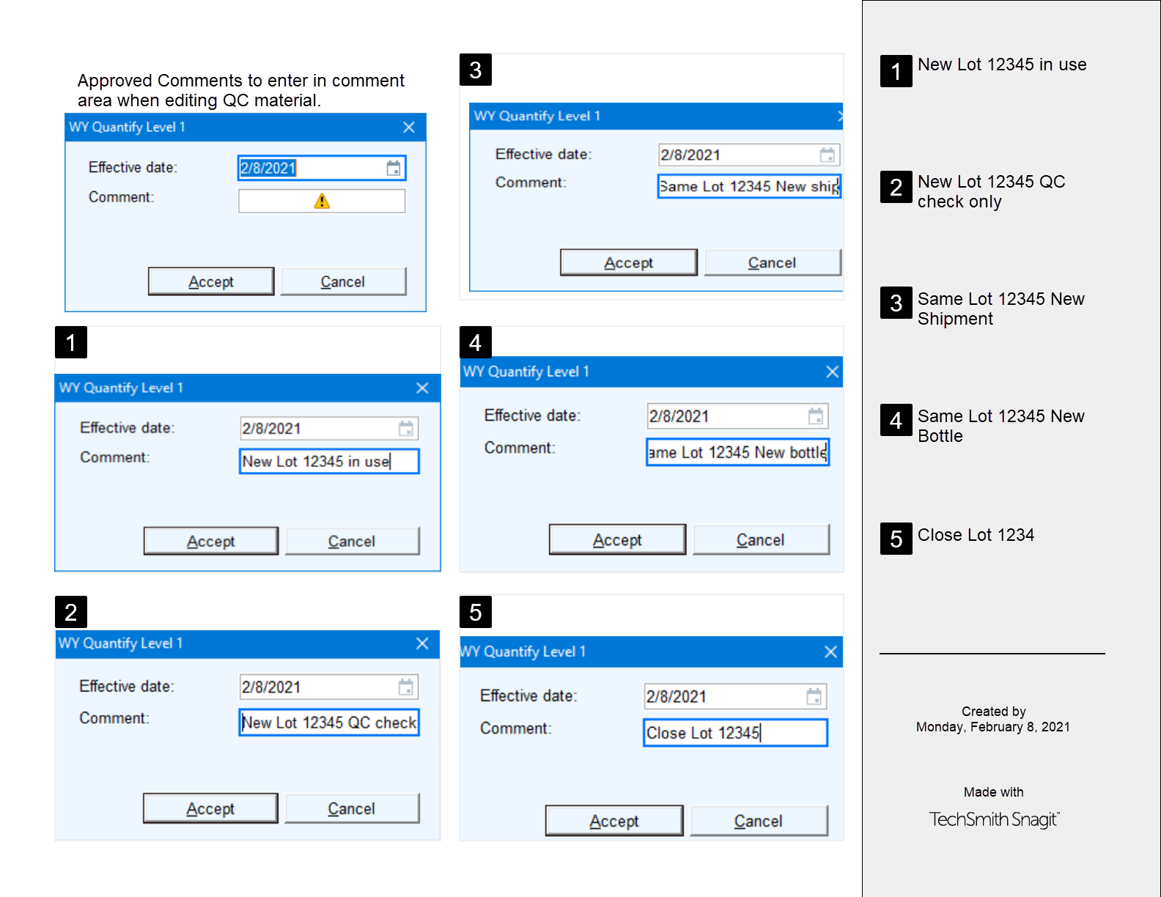
Notes:
Examples of entering comments

Slide 4
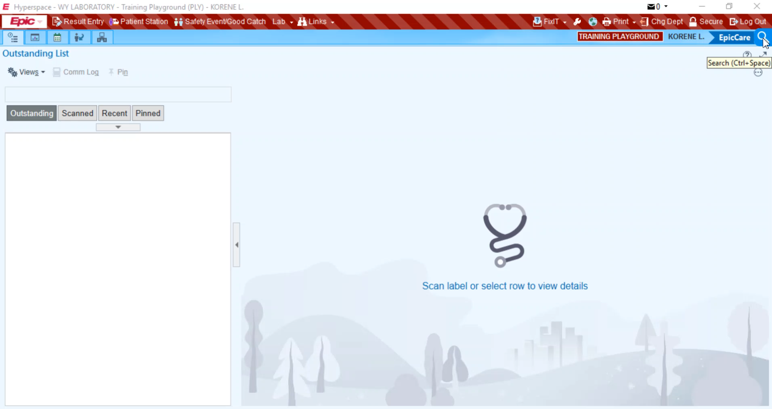
Notes:
Click to Watch the movie

Slide 5
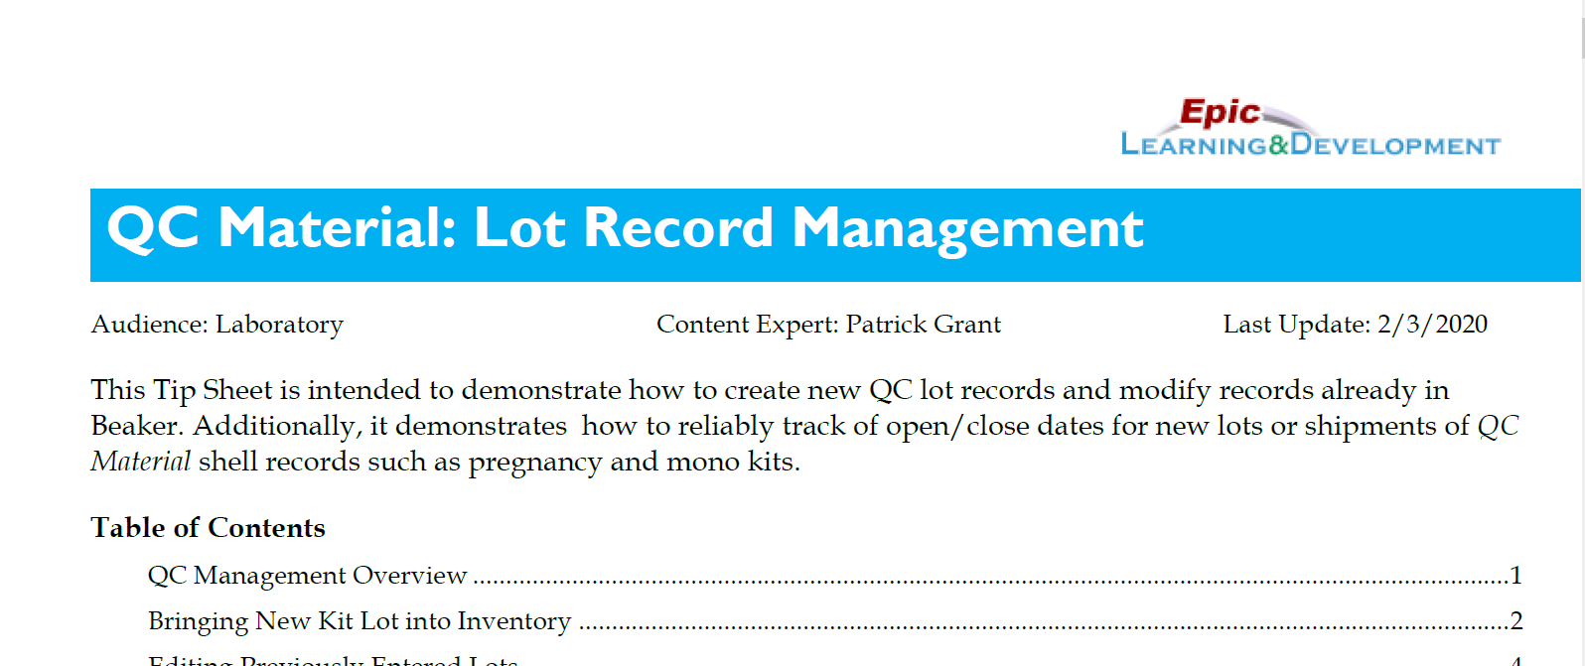

More information is available on the tipsheet

