Slide 1
QC Material Review
How to enter lot information in Beaker

Slide 2
Follow Visio Instructions for Entering Comments. Each site should have at least one copy

Slide 3
Notes:
Click on the screen to watch the movie for examples of entering QC lot information

Slide 4
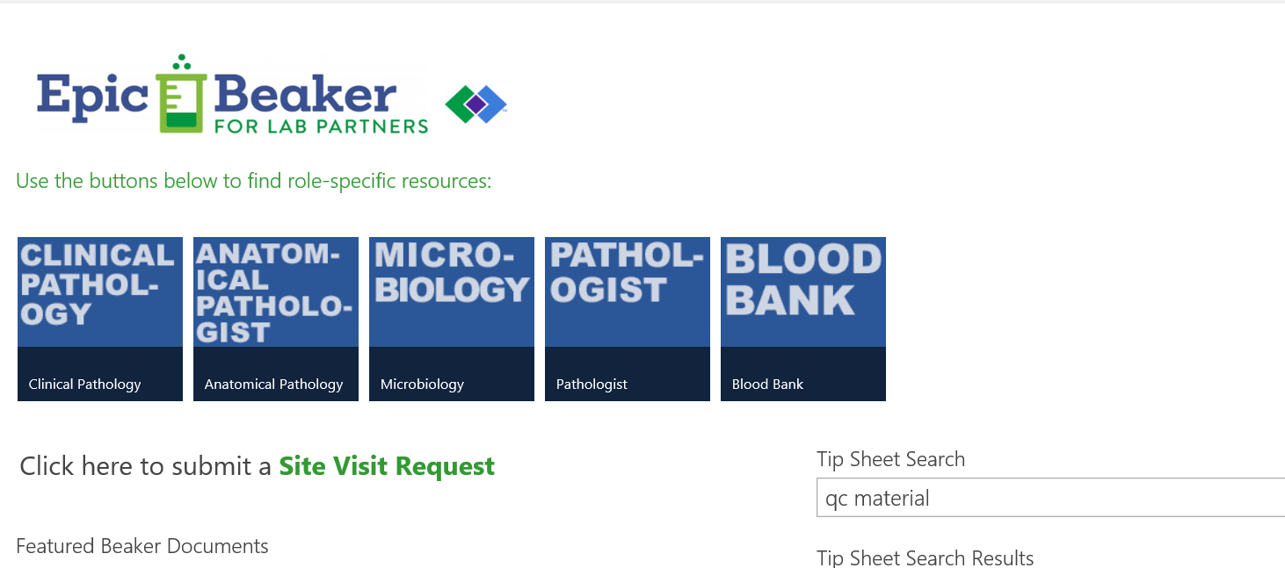
More information is available on the tipsheet

