Slide 1
Sexual Orientation and Gender Identity (SOGI)
Objectives:
Available organization-wide trainings focused on sexual orientation and gender identity.
Overview of the Sexual Orientation and Gender Identity (SOGI) SmartForm in Epic and related functionality.
Overview of the SOGI Resource Guide for more details on functionality and information for Laboratory staff.
Sexual orientation: A person’s physical, romantic, and/or emotional attraction to others. Every person has a sexual orientation. It is comprised of how a person identifies, their physical and emotional attractions to other gender(s), and their sexual behaviors.
Gender identity: A person’s deeply held internal sense of being a woman, man, both, neither, or another gender. Gender identity can be the same or different from one’s sex assigned at birth.
Cisgender, transgender, nonbinary, gender diverse

Slide 2
Creating Awareness of LGBTQ Inclusion Training
Builds a strong foundation of education and awareness of the lesbian, gay, bisexual, transgender and queer/questioning (LGBTQ) communities through an interactive presentation
Organization-wide training is available as:
30 min myLearning Module “Creating Awareness for LGBTQ Inclusion”
Objectives:
Explain the relationship between sex, gender and sexual orientation
Increase your awareness of the barriers to inclusion that LGBTQ people face
Practice culturally sensitive strategies for interacting with LGBTQ patients, members and colleagues

Slide 3
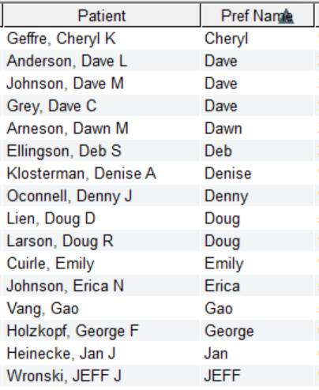
Laboratory Workflows
Lab Front Desk View
The “Patient” column shows patients first and last name. This column already shows the patient’s preferred name.
Patients can check-in using their preferred name as an identifier.
You should address and communicate with patients using their preferred name.
This snippet of the Front Desk view shows that the Patient column is displaying the patient’s preferred name (when compared to the “Pref Name” column displaying preferred name).

Slide 4
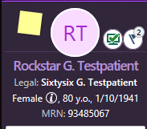
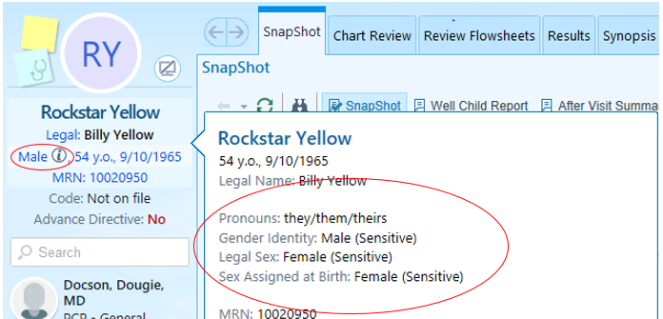
Laboratory Workflow
Lab Order Inquiry View
Be informed of Storyboard view showing patient’s legal name, preferred name, and gender field.
The gender field will show legal sex unless a gender identity is entered in the SOGI SmartForm.
A “i” information icon will show if there is information entered in the SOGI SmartForm. Hover over the gender field to see the entered content.
Lab staff will not be entering/changing information into the SOGI SmartForm, nor changing a patient’s legal name or legal sex in the demographic field in Epic.
Frontdesk staff can change the legal name or legal sex.
Clinicians/Clinical team can enter information into the SOGI SmartForm.

Slide 5
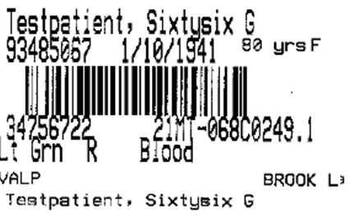
Laboratory Workflow
Call patient to room using their preferred name. Be aware and informed that the Beaker specimen labels will show patient’s legal name.
At time of specimen collection, you will need to verify patient’s legal name and date of birth as it is shown on the Beaker specimen labels.
Suggested scripting for confirming patient’s legal name: “To ensure I have the correct patient and labels, I ask this for all patients. Please confirm your legal name and date of birth”.
After name verification, continue to communicate with patient using their preferred name.
Use terminology of “legal name”. Do not use terms such as “real name”, “birth name”, or “new name”.
Also, when addressing patients, avoid using terms like “sir” or “ma’am”.
When talking to fellow staff about a patient, avoid using gendered pronouns to refer to the patient. Use “they/them” or “this patient”.

Slide 6
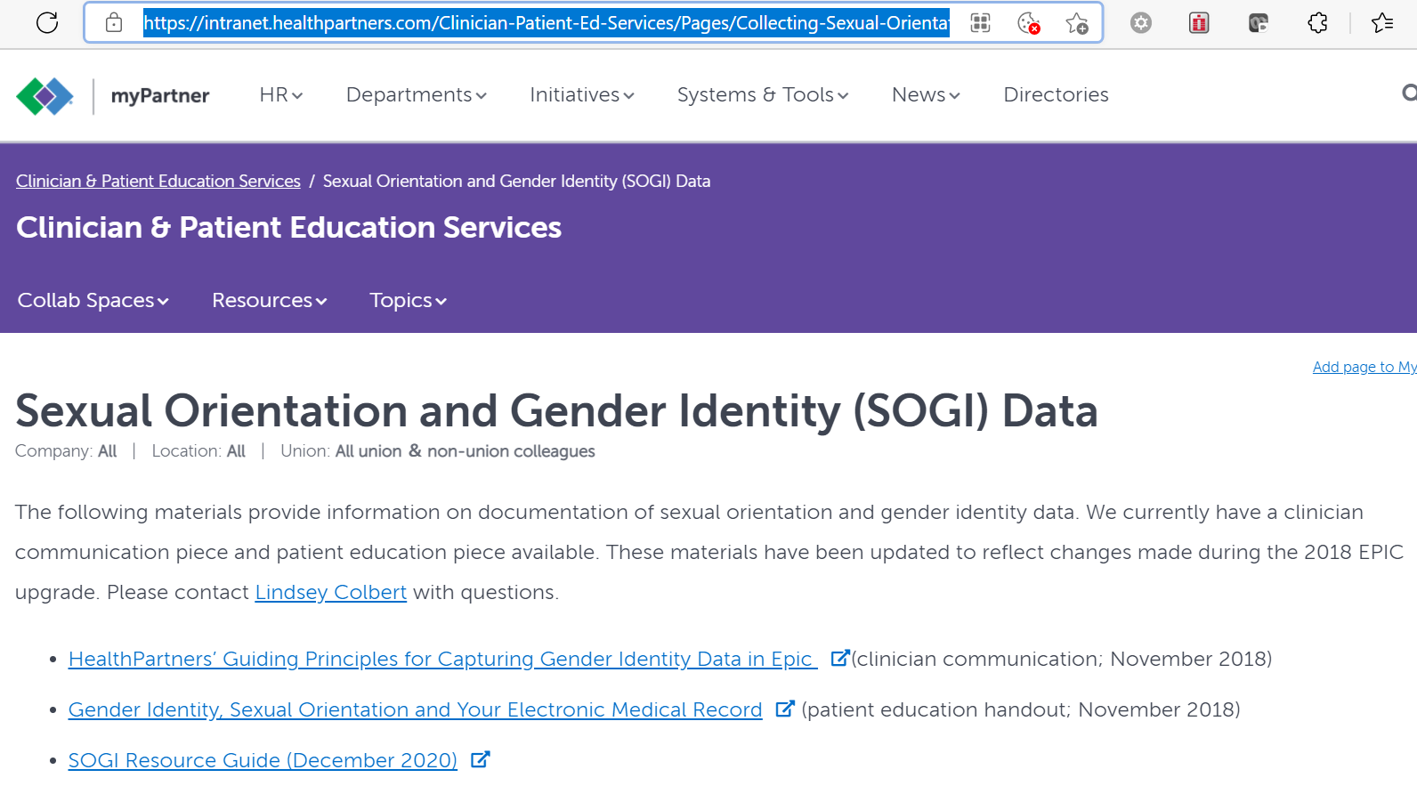
SOGI Resource Guide
Available on myPartner on the Sexual Orientation and Gender Identity (SOGI) Data page: Sexual Orientation and Gender Identity (SOGI) Data (healthpartners.com)
Updated SOGI Resource Guide will include October 2021 Epic Upgrade information.

Slide 7
Lab Staff: Talking Name and Gender with Patients
When checking in a patient, verify the patient’s name and identifiers.
The preferred name is an acceptable patient identifier and the patient does not need to state their legal first name. The preferred name will display as the first name on the Front Desk view.
Example of name in “Patient” column:
If a patient requests an update to their legal name or legal sex, please refer them to the frontline team to make the requested update.
Please use the terminology “legal name”, “preferred name”. Do not use terms such as “real name”, “birth name”, or “new name”. Also, avoid using terms like “sir” or “ma’am”.
When taking a patient to a room:
Verify the patient’s name in Epic before calling them to a room. Use the patient’s preferred name and chosen pronouns as information is available. Enter patient’s preferred name if given by the patient.
Before blood draw/specimen collection:
Confirm patient’s name and DOB as it appears on the Beaker label to confirm patient identity.
Be aware Beaker labels do not contain patients’ preferred names.
Suggested scripting “To ensure I have the correct patient and labels, I ask this for every patient. Please confirm your legal name and date of birth.”
Example of patient’s preferred name in Epic Storyboard view and legal name on Beaker labels:
Other considerations:
Do not assume a patient’s gender based upon their appearance, name, or voice.
Do not refuse an appointment or service/test for someone based upon perceived gender.
The SOGI SmartForm content is viewable for Lab Staff from the Lab Order Inquiry activity, by hovering over the “Gender” field in the patient header. Gender will populate with legal sex UNLESS the gender identity differs from the legal sex.
If the gender identity or legal sex differs from the sex assigned at birth, an “i” icon will be visible next to the Gender header.
Hover over the gender field in Storyboard view to see SOGI SmartForm content

Slide 8
Legal Sex of “X” Option
Effective October 2018, the Minnesota Driver & Vehicle Services (DVS) no longer requires documentation of gender identity or gender transition in order to change a legal sex on a Minnesota driver’s license or state-issued ID.
The Minnesota DVS also allows an individual to select the option of nonbinary for their legal sex. Individuals who mark the nonbinary designation will have a driver’s license or state-issued ID that reads “X” for sex.
Effective with the October 2021 Epic Upgrade (go-live on 10/13/21), the option of “X” can now be entered in the legal sex field in Epic for patients who present with “X” sex on their license.
Note: The option of a nonbinary gender marker on a state ID varies from state to state. For example, Wisconsin does not have the nonbinary gender marker. Federal IDs, like passports or real ID licenses, do not include this option.

